Slide 1
“Blow the horn in Zion; give a shout on my holy mountain! ... Change your hearts. Yet even now, says the Lord, return to me with all your hearts, with fasting, with weeping, and with sorrow; tear your hearts and not your clothing. ... call a fast; call a special assembly. Gather the people.” - Joel 2:1-16 (various)
Walking the Jerusalem Parade

Slide 2
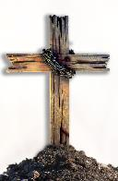
Jesus’ 3½ Years of Public Ministry
(perhaps AD 30-33)
Jesus begins Public Ministry (Beginning months)
Baptism, temptation, calling the first disciples
Year of Inauguration (First Year)
Moves to Capernaum, selects 12 apostles, travels throughout Galilee
Year of Popularity (Second Year)
Large crowds follow Jesus around Galilee
Year of Opposition (Third Year)
Begins in Galilee, then in Judea; people
desert Him, leaders oppose Him

Slide 4
THE STORY OF SALVATION IN DIRT
Advent Series: God’s Dirty Hands - Jesus’ pre-existence and birth
New Year’s Series: God’s Dirty Feet - Jesus’ public ministry on earth
Lenten Series: Dirty Faith - Jesus’ Passion (Jesus’ last week in Jerusalem)
Easter Series (Coming in April): Dirty Heaven - Jesus in Paradise and Return

Slide 5
John 12:9-11 (CEB)
⁹ Many Jews learned that he was there [in Bethany]. They came not only because of Jesus but also to see Lazarus, whom He had raised from the dead. ¹⁰ The chief priests decided that they would kill Lazarus too. ¹¹ It was because of Lazarus that many of the Jews had
deserted them and come to believe
in Jesus.

Slide 6
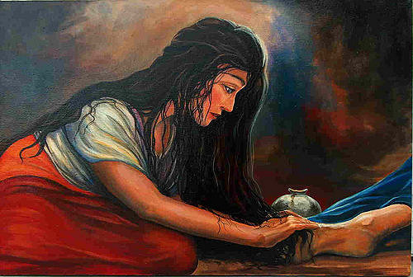

Slide 8
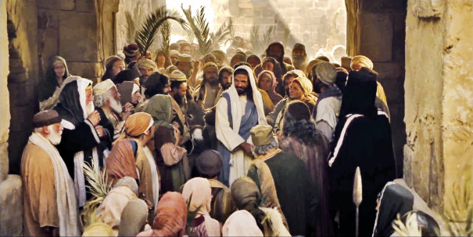

Slide 9
Luke 19:28-40
²⁸ After Jesus said this, He
continued on ahead, going up to Jerusalem.
²⁹ As Jesus came to Bethphage and Bethany on the Mount of Olives, He gave two disciples a task. ³⁰ He said, “Go into the village over there. When you enter it, you will find tied up there a colt that no one has ever ridden. Untie it and bring it here. ³¹ If someone asks, ‘Why are you untying it?’ just say, ‘Its master needs it.’”

Slide 10
Luke 19:28-40
³² Those who had been sent found it
exactly as He had said.
³³ As they were untying the colt, its owners said to them, “Why are you untying the colt?”
³⁴ They replied, “Its master needs it.” ³⁵ They brought it to Jesus, threw their clothes on the colt, and lifted Jesus onto it. ³⁶ As Jesus rode along, they spread their clothes on the road.

Slide 11
Luke 19:28-40
³⁷ As Jesus approached the road leading down from the Mount of Olives, the whole throng of His disciples began rejoicing. They praised God with a loud voice because of all the mighty things they had seen. ³⁸ They said, “Blessings on the king who comes in the name of the Lord. Peace in heaven and glory in the highest heavens.”
³⁹ Some of the Pharisees from the crowd
Said to Jesus, “Teacher, scold your disciples!
Tell them to stop!”
⁴⁰ He answered, “I tell you, if they were silent,
the stones would shout.”

Slide 12
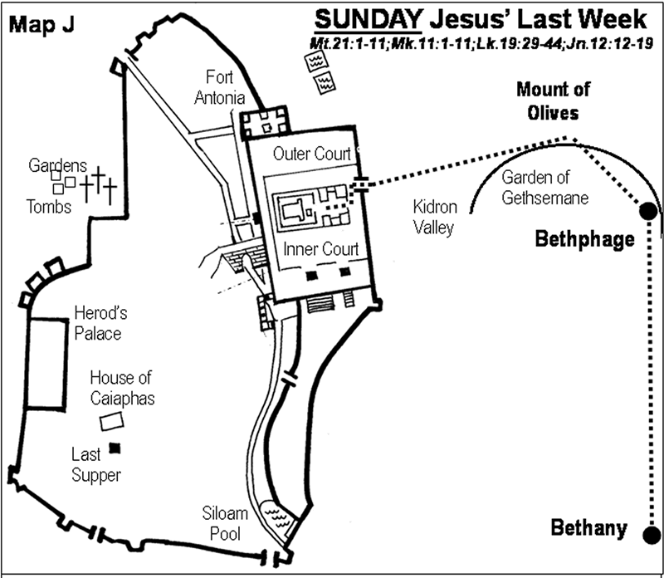

Slide 13
Luke 19 (CEB)
⁴¹ As Jesus came to the city and observed it, He wept over it. ⁴² He said, “If only you knew on this of all days the things that lead to peace. But now they are hidden from your eyes. ⁴³ The time will come when your enemies will build fortifications around you, encircle you, and attack you from all sides.
⁴⁴ They will crush you completely, you and the people within you. They won’t leave one
stone on top of another within you, because
you didn’t recognize the time of your
gracious visit from God.”

Slide 14
Matthew 23 (CEB)
³⁷ “Jerusalem, Jerusalem! You who kill the prophets and stone those who were sent to you. How often I longed to gather your people together, just as a hen gathers her chicks under her wings. But you didn’t want that. ³⁸ Look, your house is left to you deserted. ³⁹ I tell
you, you won’t see me until you say,
Blessings on the one who comes in the
Lord’s name.”

Slide 16
Luke 19 (CEB)
⁴⁵ When Jesus entered the temple, He threw out those who were selling things there. ⁴⁶ He said to them, “It’s written, My house will be a house of prayer, but you have made it a hideout for crooks.”
⁴⁷ Jesus was teaching daily in the temple. The chief priests, the legal experts, and the foremost leaders among the people were seeking to kill Him.
⁴⁸ However, they couldn’t find a way to do it
because all the people were enthralled with
what they heard.

Slide 17
Walking the Jerusalem Parade
We walk with a Jesus of mixed emotions

Slide 18
Walking the Jerusalem Parade
We walk with a Jesus of mixed emotions
We walk with a Jesus who weeps at sin

Slide 19
Walking the Jerusalem Parade
We walk with a Jesus of mixed emotions
We walk with a Jesus who weeps at sin
We walk with a Jesus who wants God’s House to be a House of Prayer

Slide 20
Joel 2 (CEB)
¹ Blow the horn in Zion; give a shout on my holy mountain! Let all the people of the land tremble, for the day of the Lord is coming. It is near! ... Change your hearts. ¹² Yet even now, says the Lord, return to me with all your hearts, with fasting, with weeping, and with sorrow; ¹³ tear your hearts and not your clothing. Return to the Lord your God, for He is merciful and compassionate, very patient, full of faithful love, and ready to forgive. ...
¹⁵ Blow the horn in Zion; demand a fast; call
a special assembly. ¹⁶ Gather the people;
prepare a holy meeting; assemble the elders.”

