Slide 1
“Then Pilate said to the chief priests and the crowds, ‘I find no legal basis for action against this man.’”
~Luke 23:4
Friday: Uphill Walk
Jesus’ Passion

Slide 2
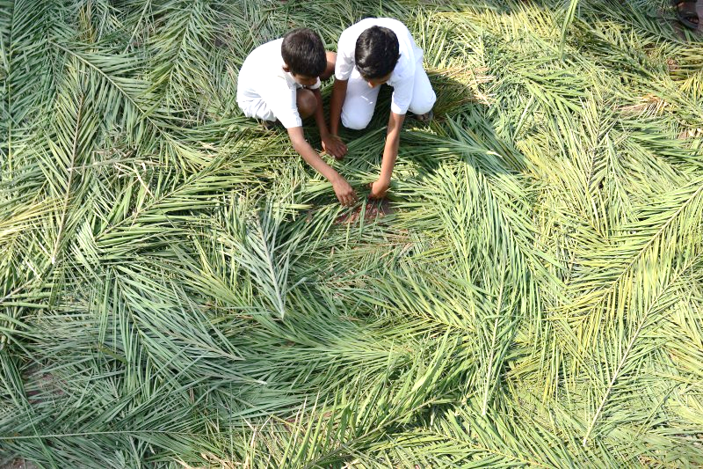

Slide 3
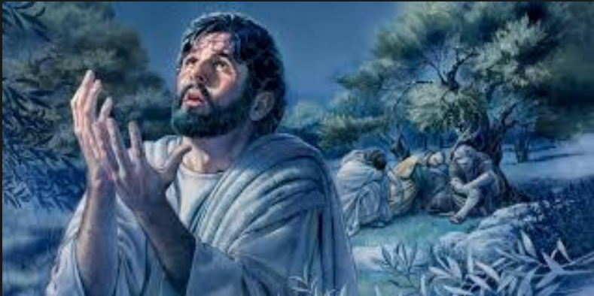

Slide 4
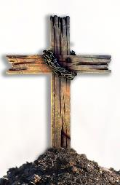
Mark 14:43-45 (CEV)
⁴³ Suddenly, while Jesus was still speaking, Judas, one of the Twelve, came with a mob carrying swords and clubs. They had been sent by the chief priests, legal experts, and elders. ⁴⁴ His betrayer had given them a sign: “Arrest the man I kiss, and take Him away under guard.” ⁴⁵ As soon as he got there, Judas said to Jesus, “Rabbi!” Then he kissed
Him.

Slide 5
Mark 14:46-50 (CEV)
⁴⁶ Then they came and grabbed Jesus and arrested Him. ⁴⁷ One of the bystanders drew a sword and struck the high priest’s slave and cut off his ear. ⁴⁸ Jesus responded, “Have you come with swords and clubs to arrest me, like an outlaw? ⁴⁹ Day after day, I was with you, teaching in the temple, but you didn’t arrest me. But let the scriptures be fulfilled.”
⁵⁰ And all His disciples left Him and ran
away.

Slide 6
John 19:12-21 (CEV)
¹² Then the company of soldiers, the commander, and the guards from the Jewish
leaders took Jesus into custody. They bound
Him ¹³ and led Him first to Annas. He was the father in law of Caiaphas, the high priest that year. ... [Peter denies Jesus the first time.] ... ¹⁹ Meanwhile, the chief priest questioned Jesus about His disciples and His teaching. ²⁰ Jesus answered, “I’ve spoken openly to the world. I’ve always taught in synagogues and in the temple, where all the Jews gather. I’ve said nothing in private. ²¹ Why ask me? Ask those who heard what I told them. They know what I said.”

Slide 7
John 19:21-24 (CEV)
²² After Jesus spoke, one of the guards standing there slapped Jesus in the face. “Is that how you would answer the high priest?” he asked. ²³ Jesus replied, “If I speak wrongly, testify about what was wrong. But if I speak correctly, why do you strike me?” ²⁴ Then Annas sent Him, bound, to Caiaphas the high priest.

Slide 8
Mark 14:53-59 (CEV)
⁵³ They led Jesus away to the high
priest, and all the chief priests, elders, and
legal experts gathered. ... ⁵⁵ The chief priests
and the whole Sanhedrin were looking for testimony against Jesus in order to put Him to death, but they couldn’t find any. ⁵⁶ Many brought false testimony against Him, but they contradicted each other. ⁵⁷ Some stood to offer false witness against Him, saying, ⁵⁸ “We heard Him saying, ‘I will destroy this temple, constructed by humans, and within three days I will build another, one not made by humans.’” ⁵⁹ But their testimonies didn’t agree even on this point.

Slide 9
Mark 14:60-65 (CEV)
⁶⁰ Then the high priest stood up in
the middle of the gathering and examined
Jesus. “Aren’t you going to respond to the testimony these people have brought against you?” ⁶¹ But Jesus was silent and didn’t answer. Again, the high priest asked, “Are you the Christ, the Son of the blessed one?”
⁶² Jesus said, “I am. And you will see the Human One sitting on the right side of the Almighty and coming on the heavenly clouds.”

Slide 10
Mark 14:60-65 (CEV)
⁶³ Then the high priest tore his clothes and said, “Why do we need any more witnesses? ⁶⁴ You’ve heard His insult against God. What do you think?”
They all condemned Him. “He
deserves to die!”
⁶⁵ Some began to spit on Him. Some
covered His face and hit Him, saying, “Prophesy!” Then the guards took Him
and beat Him.

Slide 11
Mark 15:1 (CEV)
At daybreak, the chief priests–with the elders, legal experts, and the whole Sanhedrin–formed a plan. They bound Jesus, led Him away, and turned Him
over to Pilate.

Slide 12
Luke 23:1-4 (CEV)
¹The whole assembly got up and led Jesus to Pilate and ² began to accuse Him. They said, “We have found this man misleading our people, opposing the payment of taxes to Caesar, and claiming that He is the Christ, a king.”
³ Pilate asked him, “Are you the king of
the Jews?”
Jesus replied, “That’s what you say.”
⁴ Then Pilate said to the chief priests and the crowds, “I find no legal basis for action against this man.”

Slide 13
Luke 23:5-12 (CEV)
⁵ But they objected strenuously, saying, “He agitates the people with His teaching throughout Judea–starting from Galilee all the way here.”
⁶ Hearing this, Pilate asked if the man was a
Galilean. ⁷ When he learned that Jesus was
from Herod’s district, Pilate sent Him to Herod, who was also in Jerusalem at that time. ⁸ Herod was
very glad to see Jesus, for he had heard about
Jesus and had wanted to see Him for quite
some time. He was hoping to see Jesus
perform some sign.

Slide 14
Luke 23:5-12 (CEV)
⁹ Herod questioned Jesus at length, but Jesus didn’t respond to him. ¹⁰ The chief priests and the legal experts were there, fiercely accusing Jesus. ¹¹ Herod and his soldiers treated Jesus with contempt. Herod mocked Him by dressing Jesus in elegant clothes and sent Him back to Pilate.
¹² Pilate and Herod became friends with
each other that day. Before this, they
had been enemies.

Slide 15
Luke 23:13-18 (CEV)
¹³ Then Pilate called together the chief
priests, the rulers, and the people. ¹⁴ He said to
them, “You brought this man before me as one who was misleading the people. I have questioned Him in your presence and found nothing in this man’s conduct that provides a legal basis for the charges you have brought against Him. ¹⁵ Neither did Herod, because Herod returned Him to us. He’s done nothing that deserves death. ¹⁶ Therefore, I’ll have Him whipped, then let him go.” ¹⁸ But with one voice they shouted, “Away with this man!”

Slide 16
John 18:38-39 (CEV)
After Pilate said this, he returned to the Jewish leaders and said, “I find no grounds for any charge against Him. ³⁹ You have a custom that I release one prisoner for you at Passover. Do you want me to release for you the king of the Jews?” ⁴⁰ They shouted, “Not this man! Give us Barabbas!” (Barabbas was an
outlaw.)

Slide 17
Mark 15:6-11 (CEV)
⁶ During the festival, Pilate released one
prisoner to them, whomever they requested.
⁷ A man named Barabbas was locked up with the rebels who had committed murder during an uprising. ⁸ The crowd pushed forward and asked Pilate to release someone, as he regularly did. ⁹ Pilate answered them, “Do you want me to release to you the king of the Jews?” ¹⁰ He knew that the chief priests had handed Him over because of jealousy.
¹¹ But the chief priests stirred up the crowd to have him release Barabbas to them instead.

Slide 18
Luke 23:20-24 (CEV)
²⁰ Pilate addressed them again because
he wanted to release Jesus.
²¹ They kept shouting out, “Crucify Him! Crucify Him!”
²² For the third time, Pilate said to them, “Why? What wrong has He done? I’ve found no legal basis for the death penalty in His case. Therefore, I will have Him whipped, then let him go.”
²³ But they were adamant, shouting their demand that Jesus be crucified. Their voices won out. ²⁴ Pilate issued his decision to grant their request.

Slide 19
Mark 15:16-20 (CEV)
¹⁶ The soldiers led Jesus away into the courtyard of the palace known as the governor’s headquarters, and they called together the whole company of soldiers. ¹⁷ They dressed Him up in a purple robe and twisted together a crown of thorns and put it on Him. ¹⁸ They saluted Him, “Hail! King of the Jews!” ¹⁹ Again and again, they struck His head with a stick. They spit on Him and knelt before Him to honor Him. ²⁰ When they finished
mocking Him, they stripped Him of the
purple robe and put His own clothes back on
Him. Then they led Him out to crucify Him.

Slide 20
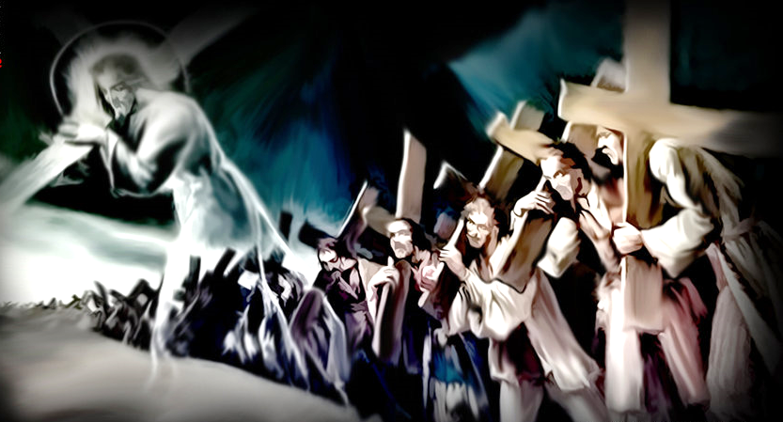

Slide 22
Write down a bitterness
or sin in your heart.
Come and nail it
to the cross.

