Slide 1
The Creator Created You to Connect!
Building a Unique Life with God
“Now to each one the manifestation of the Spirit is given for the common good.”
~1 Corinthians 12:7

Slide 3
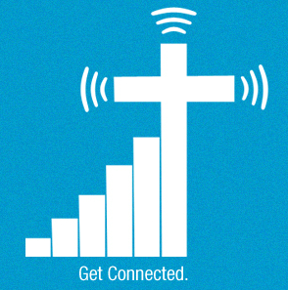
LEGO® Template
Template with bricks for PowerPoint
Notes:
© Copyright Showeet.com

Slide 4
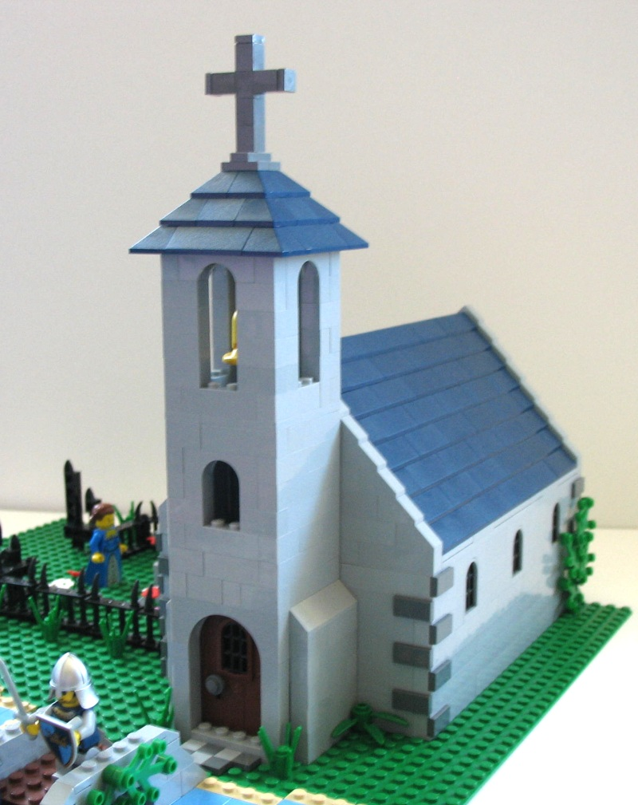
LEGO® Template
Template with bricks for PowerPoint
Notes:
© Copyright Showeet.com

Slide 5
Notes:
© Copyright Showeet.com

Slide 6
Notes:
© Copyright Showeet.com

