Slide 1
¹³ Then Jesus came from Galilee to the Jordan to be baptized by John.¹⁴ But John tried to deter him, saying, “I need to be baptized by you, and do you come to me?”
¹⁵ Jesus replied, “Let it be so now; it is proper for us to do this to fulfill all righteousness.” Then John consented. ¹⁶ As soon as Jesus was baptized, he went up out of the water. At that moment heaven was opened, and he saw the Spirit of God descending like a dove and alighting on him. ¹⁷ And a voice from heaven said, “This is my Son, whom I love; with him I am well pleased.”
Matthew 3:13-17

Slide 2
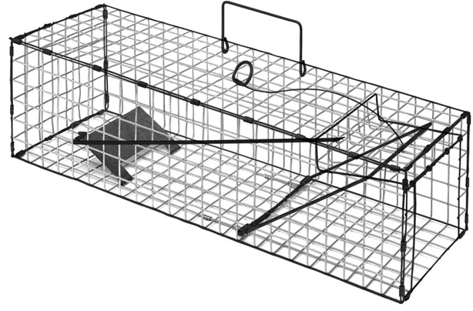

Slide 3
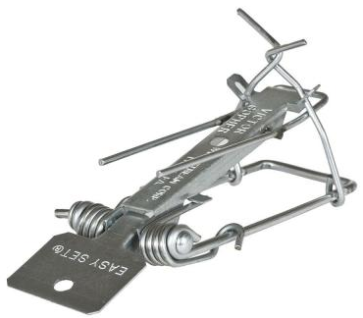

Slide 4
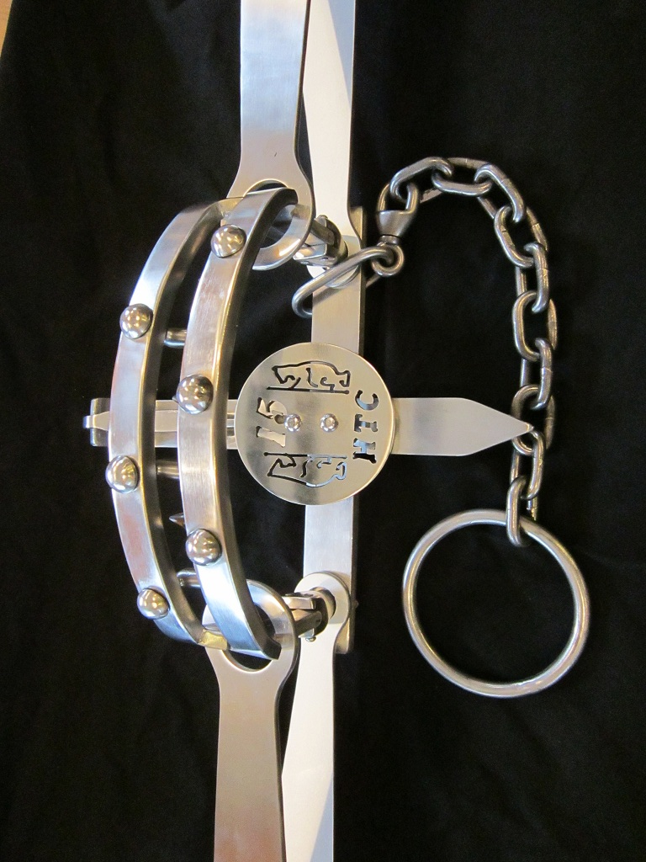

Slide 5
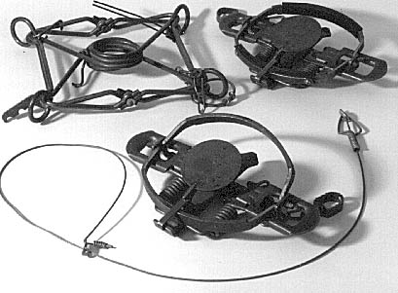
²⁶ “Among my people are the wicked
who lie in wait like men who snare birds
and like those who set traps to catch people.
Jeremiah 5:26

Slide 6
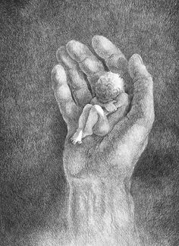
Fatherless homes:
60% of Rapists
72% of murderers
70% of long term prison inmates
~the Heritage Foundation

Slide 7
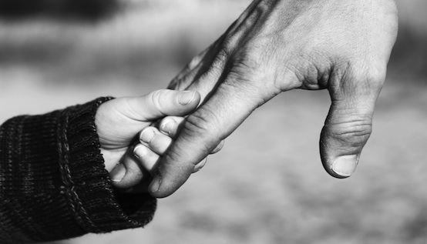
Psalm 68:5
⁵ A father to the fatherless, a defender of widows, is God in his holy dwelling.
Deuteronomy 10:18
¹⁸ He defends the cause of the fatherless and the widow, and loves the foreigner residing among you, giving them food and clothing.

Slide 8
We Can:
be present with them

Slide 9
We Can:
be present with them
provide for them
⁸ Anyone who does not provide for their relatives, and especially for their own household, has denied the faith and is worse than an unbeliever. 1 Timothy 5:8

Slide 10
We Can:
be present with them
provide for them
affirm them

Slide 11
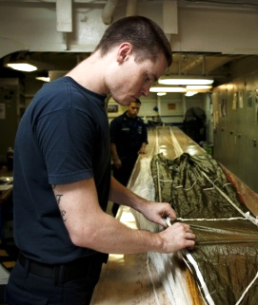

Slide 12
