Slide 1
“Our people should learn to spend their time doing something useful and worthwhile.” Titus 3:14
Productive Living
The Open Door

Slide 2
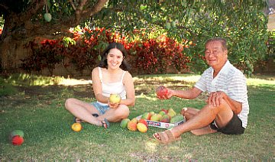

Slide 3
⁷ “But blessed is the one who trusts in the Lord, whose con-fidence is in Him.
⁸ They will be like a tree planted by the water that sends out its roots by the stream. It does not fear when heat comes its leaves are always green. It has no worries in a year of drought and never fails to bear fruit.”
Jeremiah 17:7-8

Slide 4
Titus:
Gospel believe + Gospel behavior
God’s Gospel goal is godliness
Productive living

Slide 5
Outline of Titus
Greeting (1:1-4)
Titus to organize the church of Crete (1:5-16)
Appoint elders (1:5-9)
Correct false teachers (1:10-16)
How Christians are to treat one another (internal)
Instructions for men, women & slaves (2:1-10)
God’s loving-kindness (2:11-15)
How Christians are to treat others (external) (3:1-11)
Closing (3:12-15)

Slide 6
¹ Remind your people to obey the rulers and authorities and not to be rebellious. They must always be ready to do something helpful ² and not say cruel things or argue. They should be gentle and kind to everyone. ³ We used to be stupid, disobedient, and foolish, as well as slaves of all sorts of desires and pleasures. We were evil and jealous. Everyone hated us, and we hated everyone.
Titus 3 (CEV)

Slide 7
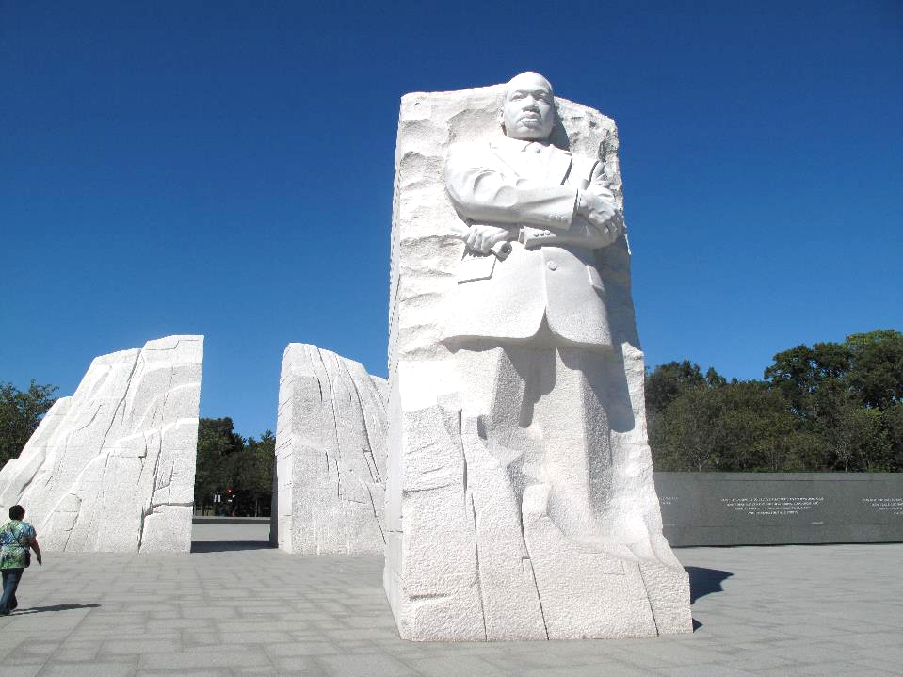

Slide 8
Live a Changed Life
Titus 3:1-3
“They should be gentle and kind to everyone.” Titus 3:2
Productive Living

Slide 9
¹ Remind your people to obey the rulers and authorities and not to be rebellious. They must always be ready to do something helpful ² and not say cruel things or argue. They should be gentle and kind to everyone. ³ We used to be stupid, disobedient, and foolish, as well as slaves of all sorts of desires and pleasures. We were evil and jealous. Everyone hated us, and we hated everyone.
Titus 3 (CEV)

Slide 10
⁴ God our Savior showed us how good and kind He is. ⁵ He saved us because of His mercy, and not because of any good things that we have done. God washed us by the power of the Holy Spirit. He gave us new birth and a fresh beginning.
⁶ God sent Jesus Christ our Savior to give us His Spirit. ⁷ Jesus treated us much better than we deserve. He made us acceptable to God and gave us the hope of eternal life. ⁸ This message is certainly true.
Titus 3 (CEV)

Slide 11
Live a Changed Life
Titus 3:1-3
How Change Happens
Titus 3:4-7
“Jesus...made us acceptable to God and gave us the hope of eternal life.” Titus 3:7
Productive Living

Slide 12
⁸ This message is certainly true. These teachings are useful and helpful for everyone. I want you to insist that the people follow them, so that all who have faith in God will be sure to do good deeds. ⁹ But don’t have anything to do with stupid arguments about ancestors. And stay away from disagreements and quarrels about the Law of Moses. Such arguments are useless and senseless. ¹⁰ Warn troublemakers once or twice. Then don’t have anything else to do with them. ¹¹ You know that their minds are twisted, and their own sins show how guilty they are.
Titus 3 (CEV)

Slide 13
Live a Changed Life
Foster a Changed Life
Titus 3:1-3
How Change Happens
Titus 3:4-7
Titus 3:8-13
“All who have faith in God will be sure to do good deeds.” Titus 3:8b
Productive Living

Slide 14
⁸ This message is certainly true. These teachings are useful and helpful for everyone. I want you to insist that the people follow them, so that all who have faith in God will be sure to do good deeds. ⁹ But don’t have anything to do with stupid arguments about ancestors. And stay away from disagreements and quarrels about the Law of Moses. Such arguments are useless and senseless. ¹⁰ Warn troublemakers once or twice. Then don’t have anything else to do with them. ¹¹ You know that their minds are twisted, and their own sins show how guilty they are.
Titus 3 (CEV)

Slide 15
¹² I plan to send Artemas or Tychicus to you. After he arrives, please try your best to meet me at Nicopolis. I have decided to spend the winter there.
¹³ When Zenas the lawyer and Apollos get ready to leave, help them as much as you can, so they won’t have need of anything.
¹⁴ Our people should learn to spend their time doing something useful and worthwhile.
¹⁵ Greetings to you from everyone here. Greet all of our friends who share in our faith. I pray that the Lord will be kind to all of you!
Titus 3 (CEV)

Slide 16
Live a Changed Life
Foster a Changed Life
Titus 3:1-3
How Change Happens
Titus 3:4-7
Titus 3:8-13
Productive Living

Slide 17
¹² I plan to send Artemas or Tychicus to you. After he arrives, please try your best to meet me at Nicopolis. I have decided to spend the winter there.
¹³ When Zenas the lawyer and Apollos get ready to leave, help them as much as you can, so they won’t have need of anything.
¹⁴ Our people should learn to spend their time doing something useful and worthwhile.
¹⁵ Greetings to you from everyone here. Greet all of our friends who share in our faith. I pray that the Lord will be kind to all of you!
Titus 3 (CEV)

