Slide 1
“Free to Be Slaves”
“You have been set free from sin and have become slaves to righteousness.” Romans 6:18

Slide 4
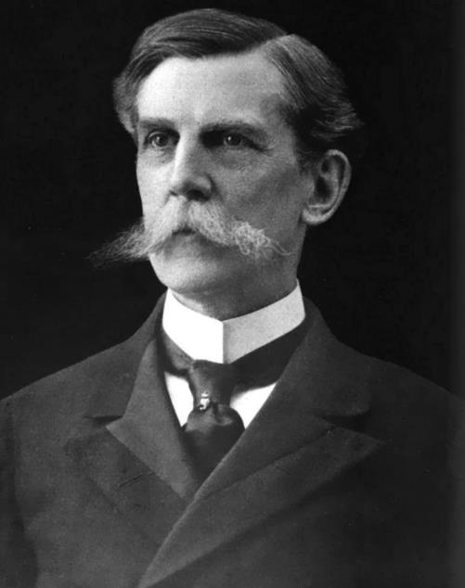

Slide 5
Christian Freedom
Freedom from:
Freedom for:

Slide 6
Christian Freedom
Freedom from:
1. Sin!

Slide 7
Romans 6:15-18
What then? Shall we sin because we are not under law but under grace? By no means! Don't you know that when you offer yourselves to someone to obey him as slaves, you are slaves to the one whom you obey–whether you are slaves to sin, which leads to death, or to obedience, which leads to righteousness? But thanks be to God that, though you used to be slaves to sin, you whole-heartedly obeyed the form of teaching to which you were entrusted. You have been set free from sin and have become slaves to righteousness.

Slide 8
Christian Freedom
Freedom from:
1. Sin!
2. Death!

Slide 9
Christian Freedom
Freedom from:
1. Sin!
2. Death!
3. The Law!

Slide 10
Christian Freedom
Freedom from:
1. Sin!
2. Death!
3. The Law!
4. Earning salvation!
Spiritual Slavery!

Slide 11
Christian Freedom
Freedom from:
1. Sin!
2. Death!
3. The Law!
4. Earning salvation!
Spiritual Slavery!
“If the Son sets you free, you are free indeed!” John 8:36

Slide 12
Christian Freedom
Freedom from:
Freedom for:
1. Life with God!
2. Life abundant!
3. Life eternal!

Slide 13
Christian Freedom
Freedom from:
Freedom for:
1. Life with God!
2. Life abundant!
3. Life eternal!
4. Slavery!

Slide 14
The lie of the autonomous self!

Slide 15
Free to Be Slaves
The Lie of the Autonomous Self

Slide 16
Romans 6:15-18
What then? Shall we sin because we are not under law but under grace? By no means! Don't you know that when you offer yourselves to someone to obey him as slaves, you are slaves to the one whom you obey–whether you are slaves to sin, which leads to death, or to obedience, which leads to righteousness? But thanks be to God that, though you used to be slaves to sin, you whole-heartedly obeyed the form of teaching to which you were entrusted. You have been set free from sin and have become slaves to righteousness.

Slide 17
Free to Be Slaves
The Lie of the Autonomous Self
Slaves to Righteousness
Romans 6:18, “You have been set free from sin and have become slaves to righteousness.”

Slide 18
Galatians 5:13-14
For you were called to freedom, brothers and sisters; only do not use your freedom as an opportunity for self indulgence, but through love become slaves to one another. For the whole law is summed up in a single commandment, “You shall love your neighbor as yourself.”

Slide 19
Free to Be Slaves
The Lie of the Autonomous Self
Slaves to Righteousness
Slaves to One Another

Slide 20
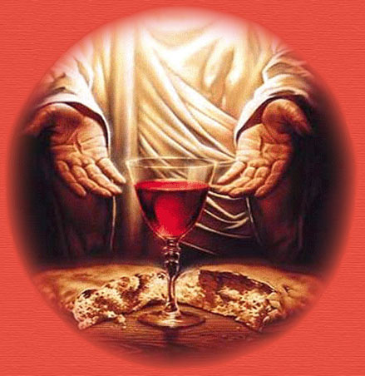
“Free to Be Slaves”

