Slide 1
“We walk by faith, not by sight.”
2 Corinthians 5:7
Jesus’ Ascension
Walking in Vanishing Footsteps

Slide 2
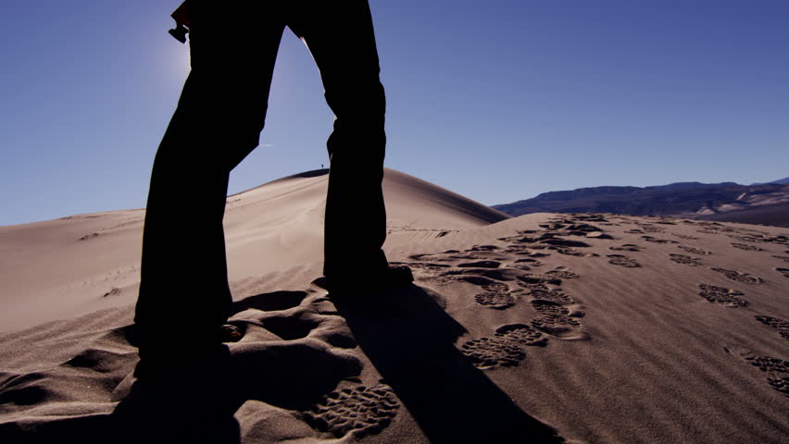

Slide 4
Acts 1:6-12 (CEB)
⁶ While the apostles were still with Jesus, they asked Him, “Lord, are you now going to give Israel its own king again?”
⁷ Jesus said to them, “You don’t need to know the time of those events that only the Father controls. ⁸ But the Holy Spirit will come upon you and give you power. Then you will tell everyone about me in Jerusalem, in all Judea, in Samaria, and everywhere in the world.”

Slide 5
Walking in Vanishing Footsteps
It might not be the path you expect

Slide 6
Acts 1:6-12 (CEB)
⁶ While the apostles were still with Jesus, they asked Him, “Lord, are you now going to give Israel its own king again?”
⁷ Jesus said to them, “You don’t need to know the time of those events that only the Father controls. ⁸ But the Holy Spirit will come upon you and give you power. Then you will tell everyone about me in Jerusalem, in all Judea, in Samaria, and everywhere in the world.”

Slide 7
Walking in Vanishing Footsteps
It might not be the path you expect
You don’t need the roadmap

Slide 8
Acts 1:6-12 (CEB)
⁶ While the apostles were still with Jesus, they asked Him, “Lord, are you now going to give Israel its own king again?”
⁷ Jesus said to them, “You don’t need to know the time of those events that only the Father controls. ⁸ But the Holy Spirit will come upon you and give you power. Then you will tell everyone about me in Jerusalem, in all Judea, in Samaria, and everywhere in the world.”

Slide 9
Walking in Vanishing Footsteps
It might not be the path you expect
You don’t need the roadmap
You don’t have the how, but you do have the what, the who, and the where

Slide 10
Acts 1:6-12 (CEB)
⁹ After Jesus had said this and while they were watching, He was taken up into a cloud. They could not see Him, ¹⁰ but as He went up, they kept looking up into the sky. Suddenly two men dressed in white clothes were standing there beside them. ¹¹ They said, “Why are you men from Galilee standing here and looking up into the sky? Jesus has been taken to heaven. But He will come back in the same way that you have seen Him go.”

Slide 11
Walking in Vanishing Footsteps
It might not be the path you expect
You don’t need the roadmap
You don’t have the how, but you do have the what, the who, and the where
Stop sky gazing!

Slide 12
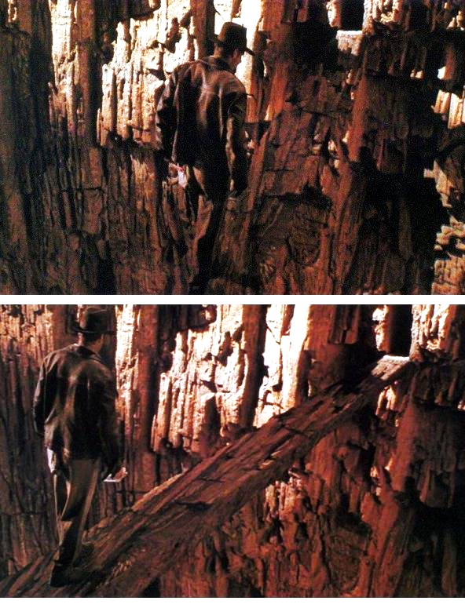
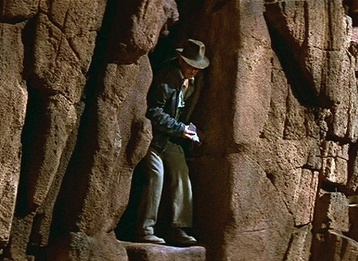
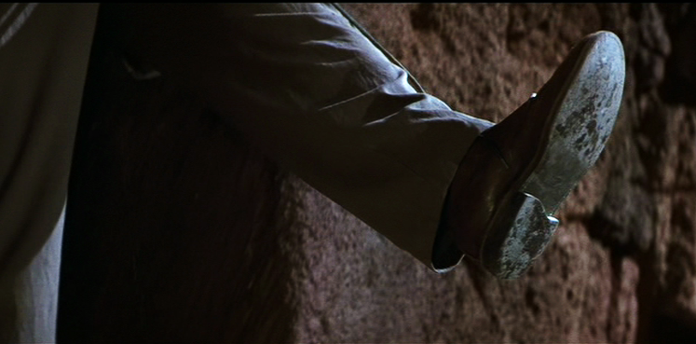

Slide 13
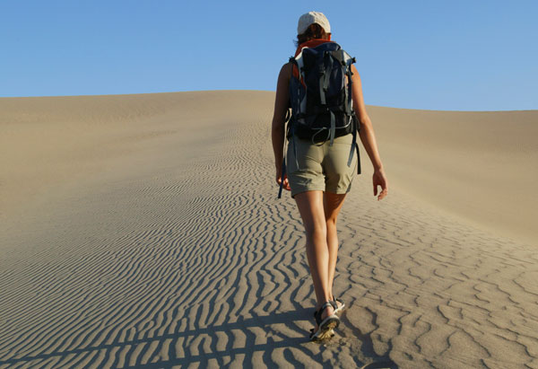

Slide 14
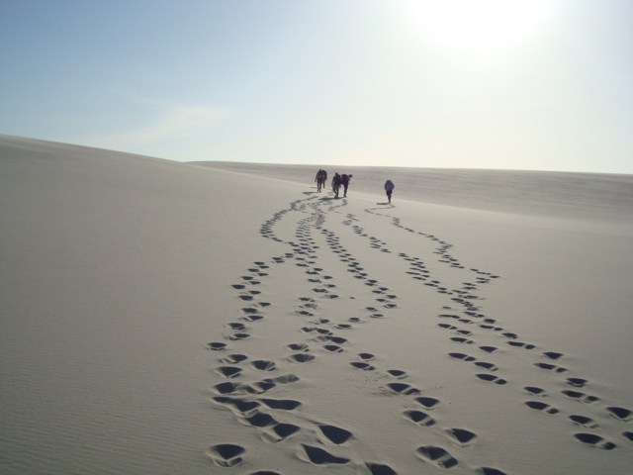

Slide 15
The Napkin Challenge
“Holy Spirit, help me see one thing you want to show me.”

