Slide 1
If It Is You, I Will Come!
“‘Lord, if it’s you,’ Peter replied, ‘tell me to come to you on the water.’” ~Matthew 14:28

Slide 2
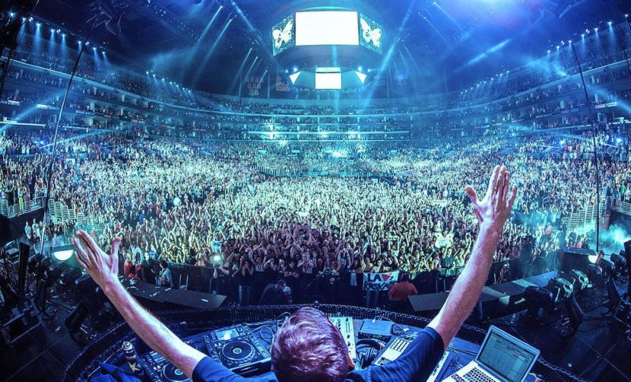

Slide 3
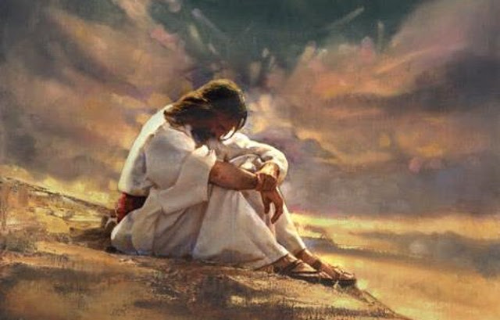

Slide 4
Matthew 14:22-33 (CEB)
²² Right then, Jesus made the disciples get into the boat and go ahead to the other side of the lake while He dismissed the crowds. ²³ When He sent them away, He went up onto a mountain by Himself to pray. Evening came and He was alone.

Slide 5
Matthew 14:22-33 (CEB)
²⁴ Meanwhile, the boat, fighting a strong headwind, was being battered by the waves and was already far away from land. ²⁵ Very early in the morning He came to His disciples, walking on the lake. ²⁶ When the disciples saw Him walking on the lake, they were terrified and said, “It’s a ghost!” They were so frightened they screamed.

Slide 6
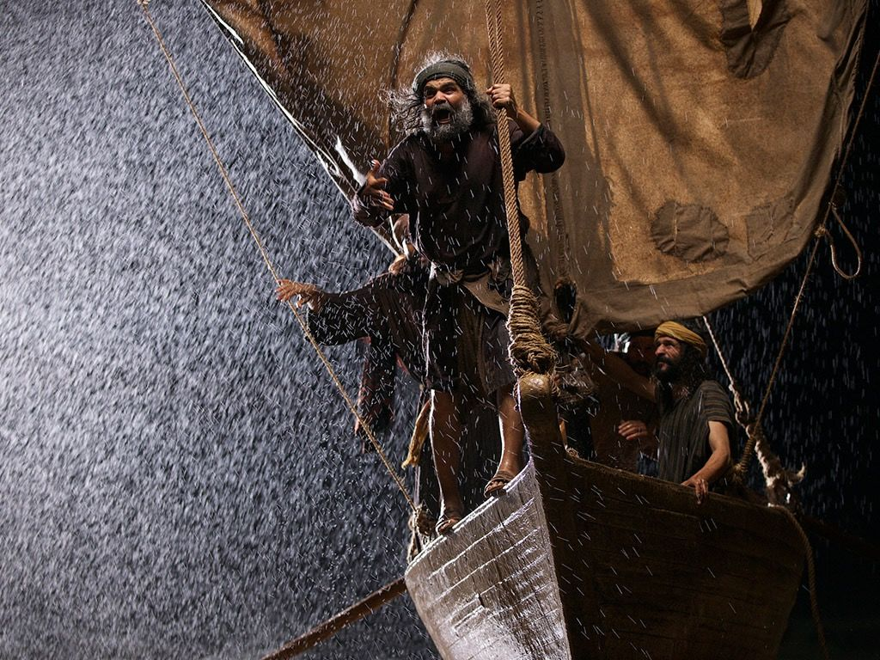

Slide 7
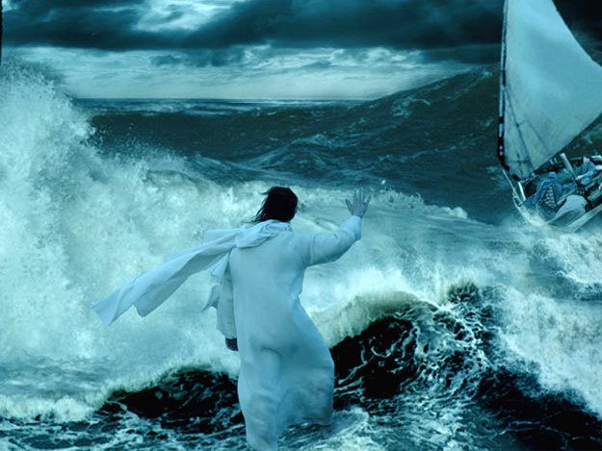

Slide 8
Matthew 14:22-33 (CEB)
²⁷ Just then Jesus spoke to them, “Be encouraged! It’s me. Don’t be afraid.”
²⁸ Peter replied, “Lord, if it’s you, call me to come to you on the water.”
²⁹ And Jesus said, “Come.”
Then Peter got out of the boat and was walking on the water toward Jesus.

Slide 9
Matthew 14:22-33 (CEB)
³⁰ But when Peter saw the strong wind, he became frightened. As he began to sink, he shouted, “Lord, rescue me!”
³¹ Jesus immediately reached out and grabbed him, saying, “You man of weak faith! Why did you begin to have doubts?”
³² When they got into the boat, the wind settled down.
³³ Then those in the boat worshipped Jesus and said, “You must be God’s Son!”

Slide 10
