Slide 1
Where Else Can We Go?
“Samuel said, ‘Speak, Lord. Your servant is listening.’”
~1 Samuel 3:10b

Slide 5
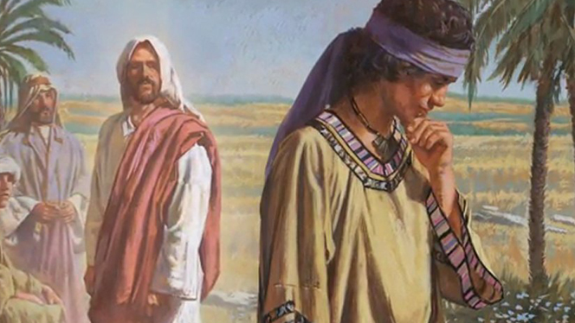
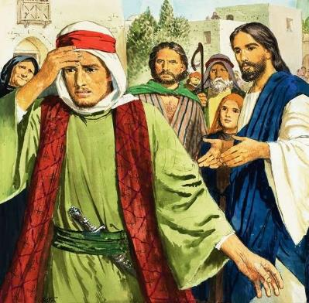
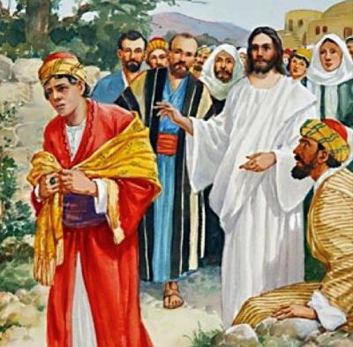

Slide 6
John 6:60-69 (CEB)
⁶⁰ Many of His disciples who heard this said, “This message is harsh. Who can hear it?”
⁶¹ Jesus knew that the disciples were grumbling about this and He said to them, “Does this offend you?

Slide 7
Where Can We Go?
You have the words of eternal life!
The words of life can be offensive

Slide 8
John 6:60-69 (CEB)
⁶² What if you were to see the Human One going up where He was before? ⁶³The Spirit is the one who gives life and the flesh doesn’t help at all. The words I have spoken to you are spirit and life. ⁶⁴ Yet some of you don’t believe.” Jesus knew from the begin-ning who wouldn’t believe and the one who would betray Him. ⁶⁵ He said, “For this reason I said to you that none can come to me unless the Father enables them to do so.” ⁶⁶ At this, many of His disciples turned away and no longer accompanied Him.

Slide 9
Where Can We Go?
You have the words of eternal life!
The words of life can be offensive
Jesus speaks words of life

Slide 10
John 6:60-69 (CEB)
⁶⁷ Jesus asked the Twelve, “Do you also want to leave?”

Slide 11
1 Samuel 3:8-10
⁸ A third time the Lord called Samuel. He got up, went to Eli, and said, “I’m here. You called me?”
Then Eli realized that it was the Lord who was calling the boy. ⁹ So Eli said to Samuel, “Go and lie down. If He calls you, say, ‘Speak, Lord. Your servant is listening.’” So Samuel went and lay down where he’d been. ¹⁰ Then the Lord came and stood there, calling just as before, “Samuel, Samuel!”
Samuel said, “Speak, Lord. Your servant is listening.”

Slide 12
Where Can We Go?
You have the words of eternal life!
The words of life can be offensive
Jesus speaks words of life
Will you listen?

Slide 13
John 6:60-69 (CEB)
⁶⁷ Jesus asked the Twelve, “Do you also want to leave?”
⁶⁸ Simon Peter answered, “Lord, where would we go? You have the words of eternal life. ⁶⁹ We believe and know that you are God’s holy one.”

Slide 14
