Slide 1
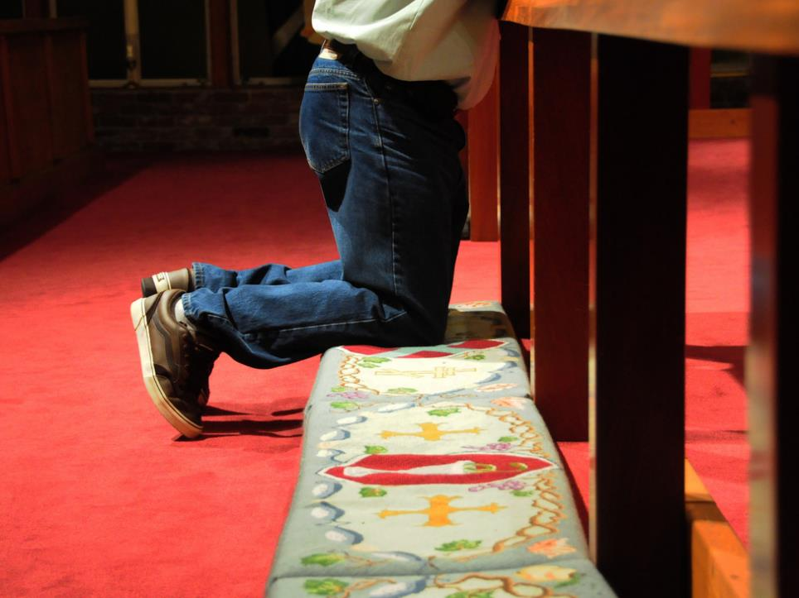

UMW Sunday

Slide 2
“All In!”
“Then, Lord,” Simon Peter replied, “not just my feet but my hands and my head as well!” ~John 13:9

Slide 3

“Mr. All In”
Fishing Nets
Walking on Water
No Retreat, No Surrender

Slide 4
Matthew 16:13-18
¹³ When Jesus came to the region of Caesarea Philippi, he asked his disciples, “Who do people say the Son of Man is?”
¹⁴ They replied, “Some say John the Baptist; others say Elijah; and still others, Jeremiah or one of the prophets.”
¹⁵ “But what about you?” he asked. “Who do you say I am?”
¹⁶ Simon Peter answered, “You are the Messiah, the Son of the living God.”

Slide 5
Matthew 16:13-18
¹⁷ Jesus replied, “Blessed are you, Simon, son of Jonah, for this was not revealed to you by flesh and blood, but by my Father in heaven. ¹⁸ And I tell you that you are Peter, and on this rock I will build my church, and the gates of Hades will not overcome it.”

Slide 6
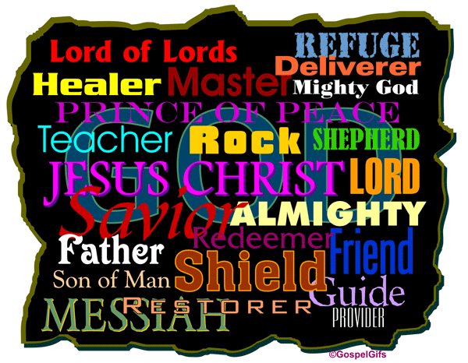

Slide 7
John 13:4-9
⁴ [Jesus] got up from the meal, took off his outer clothing, and wrapped a towel around his waist. ⁵ After that, he poured water into a basin and began to wash his disciples’ feet, drying them with the towel that was wrapped around him.
⁶ He came to Simon Peter, who said to him, “Lord, are you going to wash my feet?”
⁷ Jesus replied, “You do not realize now what I am doing, but later you will understand.”

Slide 8
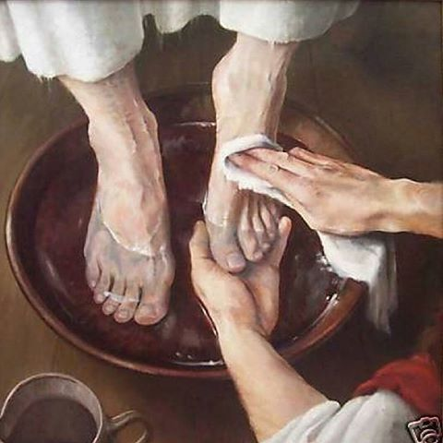
John 13:4-9
⁸ “No,” said Peter, “you shall never wash my feet.”
Jesus answered, “Unless
I wash you, you have no
part with me.”
⁹ “Then, Lord,” Simon
Peter replied, “not just my
feet but my hands and my
head as well!”

Slide 9

“All In”
What won’t I let Jesus do for me?

Slide 10
“All In”
What won’t I let Jesus do for me?
What will my response be?

Slide 11
“Mr. All In”
Fishing Nets: Obedience
Walking on Water: Faith
No Retreat, No Surrender: Future
“You are the Messiah”: Truth
Feet, Head and Hands: ALL IN

Slide 12
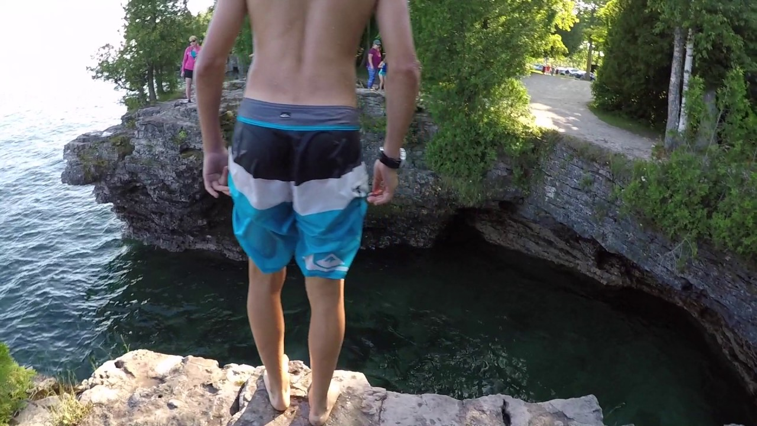
Cave Point County Park, Door County, WI

