Slide 1
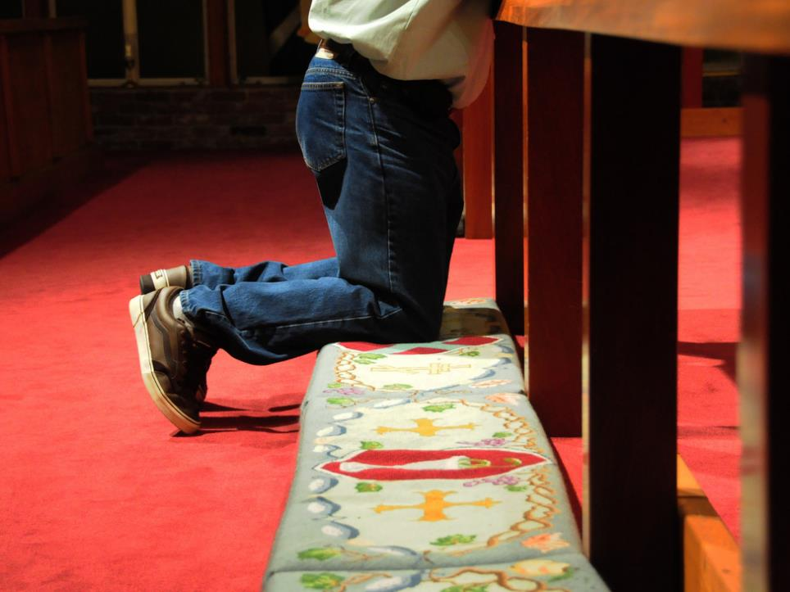

If You Say So,
I Will!
“Simon replied, ‘Master, we’ve worked hard all night and caught nothing. But because you say so, I’ll drop the nets.’” ~Luke 5:5

Slide 2

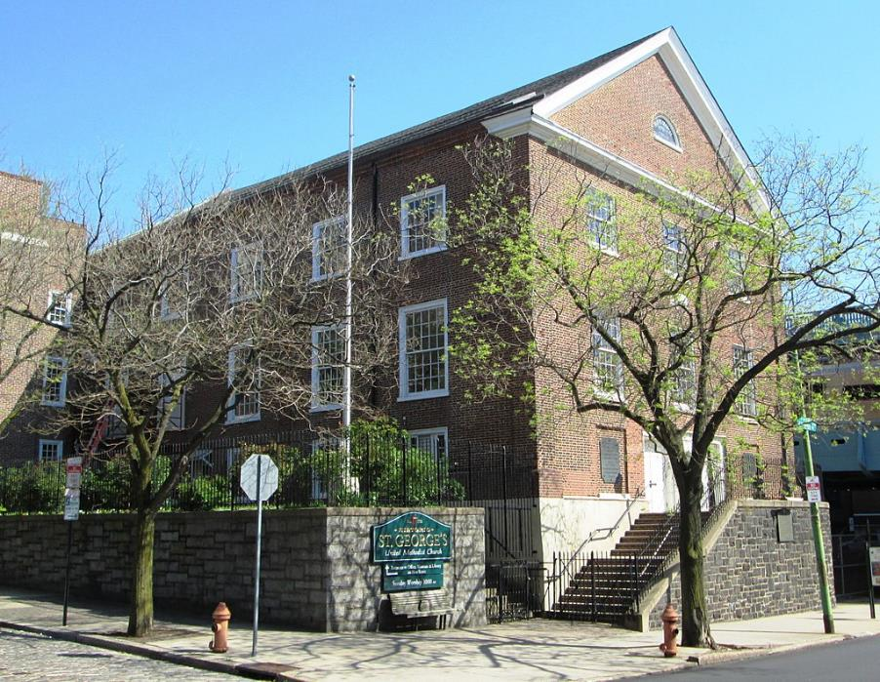

Slide 3
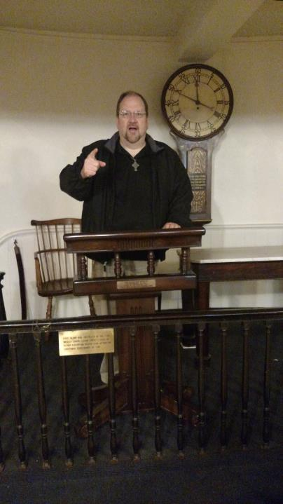

Slide 4
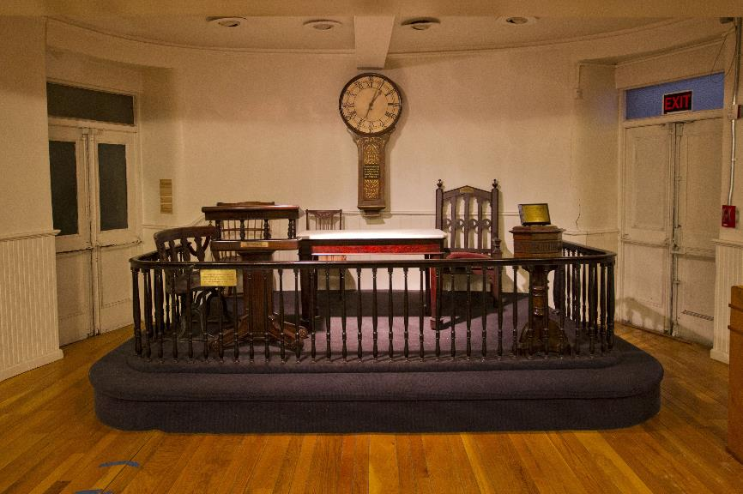

Slide 5
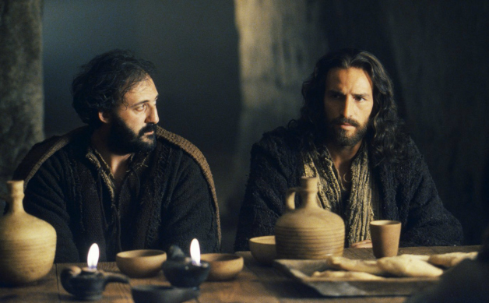

Slide 6
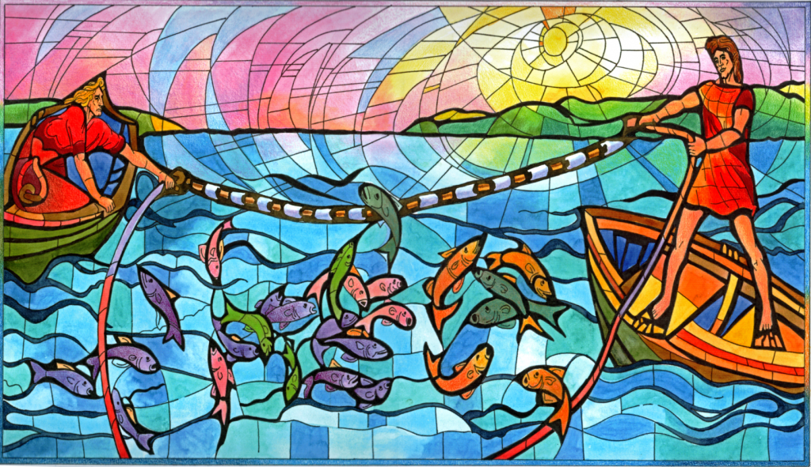

Slide 7
Luke 5:1-11 (CEB)
¹ One day Jesus was standing beside Lake Gennesaret when the crowd pressed in around Him to hear God’s word. ² Jesus saw two boats sitting by the lake. The fishermen had gone ashore and were washing their nets. ³ Jesus boarded one of the boats, the one that belonged to Simon, then asked him to row out a little distance from the shore. Jesus sat down and taught the crowds from the boat.

Slide 8
Luke 5:1-11 (CEB)
⁴ When Jesus finished speaking to the crowds, He said to Simon, “Row out farther, into the deep water, and drop your nets for a catch.”
⁵ Simon replied, “Master, we’ve worked hard all night and caught nothing. But because you say so, I’ll drop the nets.”
⁶ So they dropped the nets and their catch was so huge that their nets were splitting. ⁷ They signaled for their partners in the other boat to come and help them. They filled both boats so full that they were about to sink.

Slide 9
Luke 5:1-11 (CEB)
⁸ When Simon Peter saw the catch, he fell at Jesus’ knees and said, “Leave me, Lord, for I’m a sinner!” ⁹ Peter and those with him were overcome with amazement because of the number of fish they caught. ¹⁰ James and John, Zebedee’s sons, were Simon’s partners and they were amazed too.
Jesus said to Simon, “Don’t be afraid. From now on, you will be fishing for people.” ¹¹ As soon as they brought the boats to the shore, they left everything and followed Jesus.

Slide 10
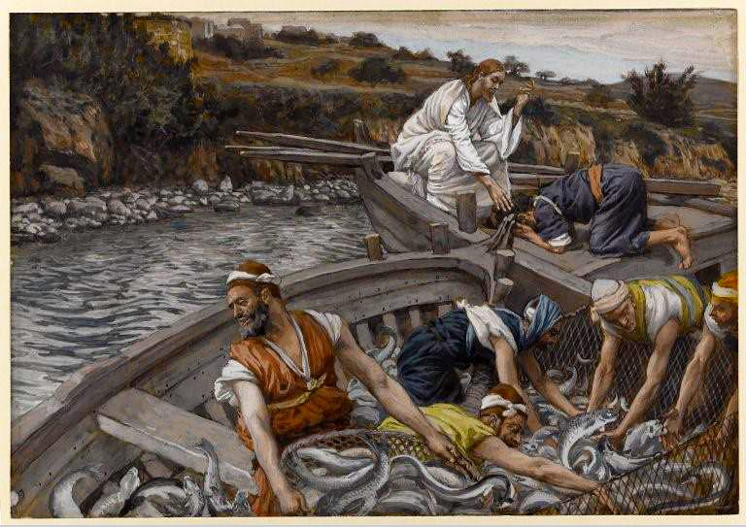

Slide 11
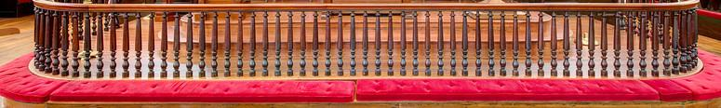
At the Rail: “But if you say so, I will!”
We are frustrated and defeated
We are empty and tired

Slide 12
At the Rail: “But if you say so, I will!”
We are frustrated and defeated
We are empty and tired
But Jesus speaks words of life
And our hope begins again

Slide 13
At the Rail: “But if you say so, I will!”
We are frustrated and defeated
We are empty and tired
But Jesus speaks words of life
And our hope begins again
We open our hearts to Jesus!

Slide 14
