Slide 1
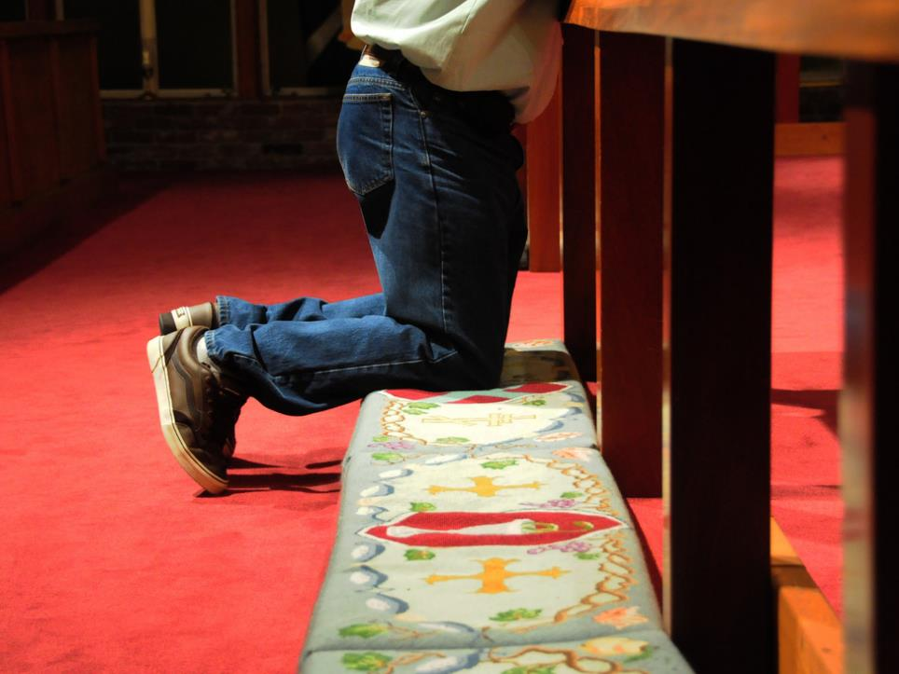

“You Know I Do!”
“‘Yes Lord,’ Peter said, ‘you know that I love you.’”
~John 21:15b, 16b, & 17b

Slide 2



Slide 3
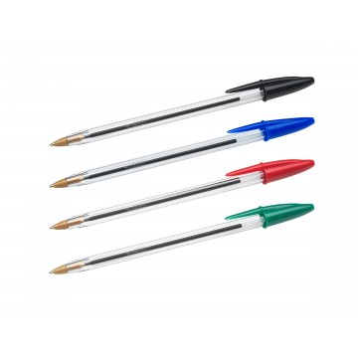

Slide 4
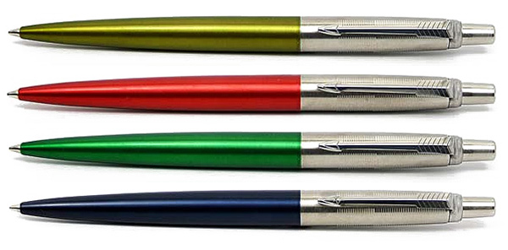

Slide 5
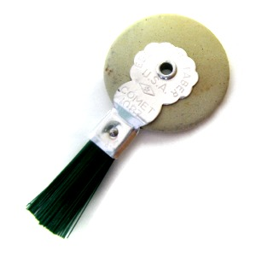

Slide 6
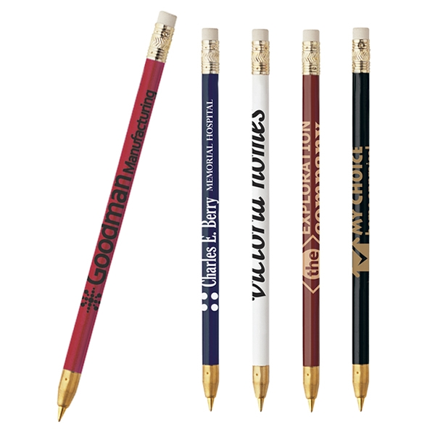

Slide 7
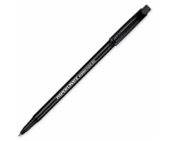

Slide 8
“Let your yes mean yes, and your no mean no. Anything more than this comes from the evil one.” ~Matt. 5:37

Slide 9
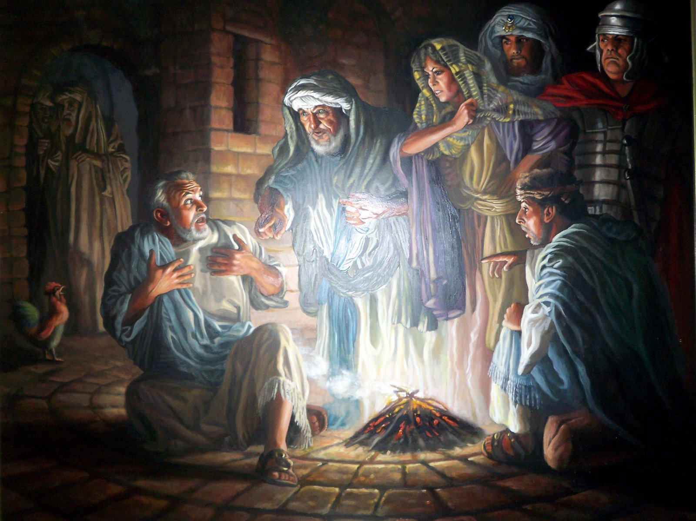

Slide 10
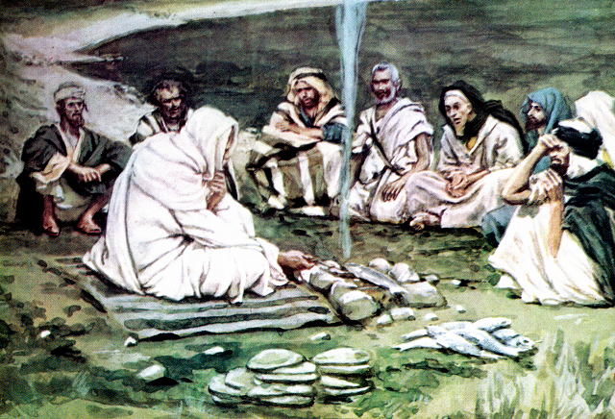

Slide 11
John 21:15-19 (CEB)
¹⁵ When they finished eating, Jesus asked Simon Peter, “Simon son of John, do you love me more than these?”
Simon replied, “Yes, Lord, you know I love you.”
Jesus said to him, “Feed my lambs.” ¹⁶ Jesus asked a second time, “Simon son of John, do you love me?”
Simon replied, “Yes, Lord, you know I love you.”
Jesus said to him, “Take care of my sheep.” ¹⁷ He asked a third time, “Simon son of John, do you love me?”

Slide 12
John 21:15-19 (CEB)
Peter was sad that Jesus asked him a third time, “Do you love me?” He replied, “Lord, you know everything; you know I love you.”
Jesus said to him, “Feed my sheep. ¹⁸ I assure you that when you were younger you tied your own belt and walked around wherever you wanted. When you grow old, you will stretch out your hands and another will tie your belt and lead you where you don’t want to go.” ¹⁹ He said this to show the kind of death by which Peter would glorify God. After saying this, Jesus said to Peter, “Follow me.”

Slide 13
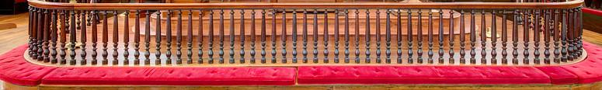
“You Know I Do” - Forgiveness!
Jesus seeks
Peter out

Slide 14
“You Know I Do” - Forgiveness!
Jesus seeks
Peter out
Jesus gives Peter a second chance

Slide 15

I am
committed
to
Jesus

Slide 16
I am
committed
to
Jesus

