Slide 1

I am
committed
to
Jesus

Slide 2
REINSTATED
I am
committed
to
Jesus

Slide 3
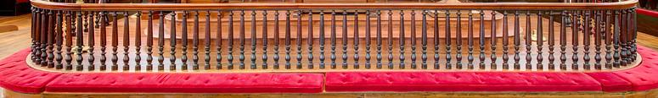
“You Know I Do” - Forgiveness!
Jesus
seeks
Peter out
Jesus gives Peter a second chance
Jesus gives Peter more work to do

Slide 4
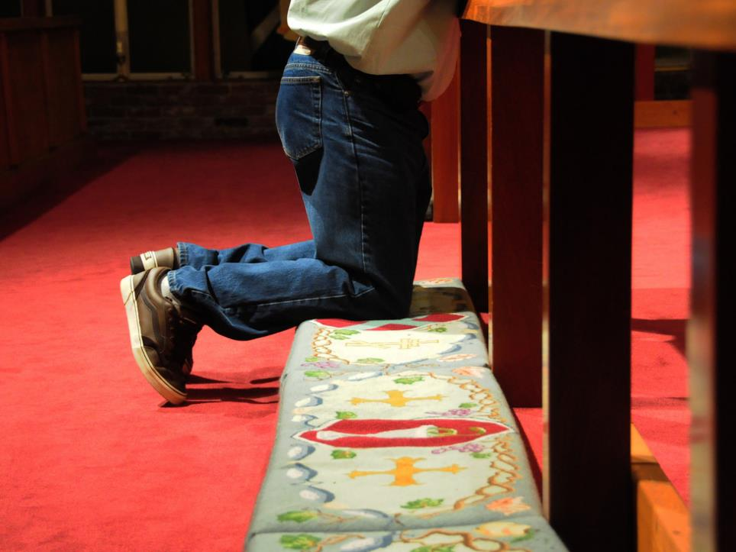

What work is Jesus calling you to?

