Slide 1
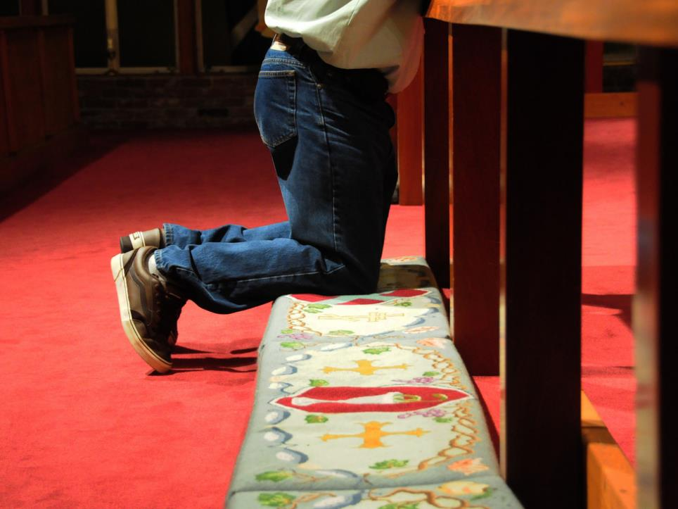

“I Never Will!”
“Peter replied, ‘Even if all fall away on account
of you, I never will.’” ~Matthew 26:33

Slide 2

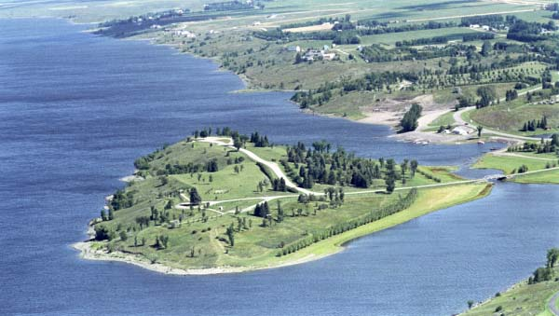

Slide 3
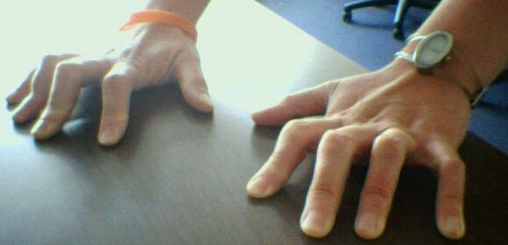

Slide 4
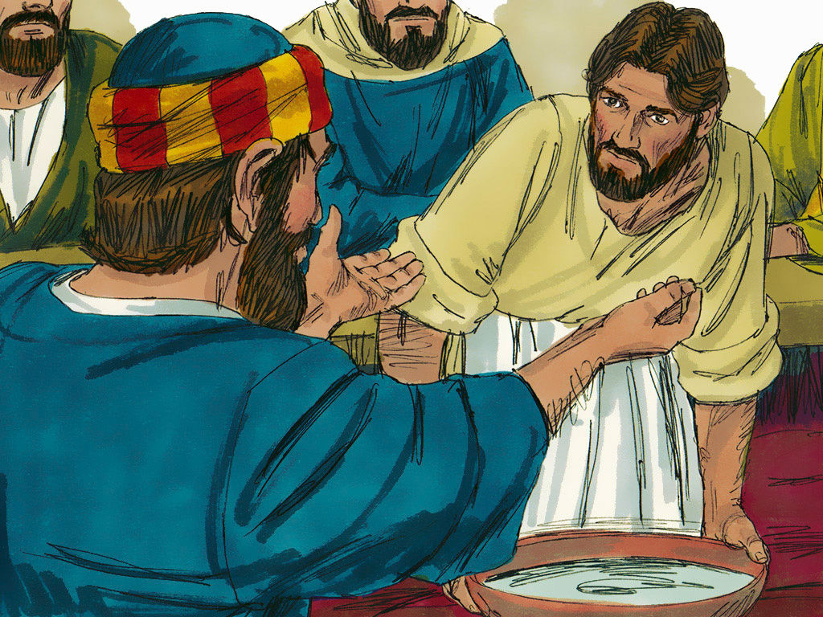

Slide 5
Matthew 26:31-35 (CEB)
³¹ Then Jesus said to His disciples, “Tonight you will all fall away because of me. This is because it is written, ‘I will hit the shepherd, and the sheep of the flock will go off in all directions.’ [Zech 13:7] ³² But after I’m raised up, I’ll go before you to Galilee.”
³³ Peter replied, “If everyone else stumbles because of you, I’ll never stumble.”

Slide 6
Matthew 26:31-35 (CEB)
³⁴ Jesus said to Peter, “I assure you that, before the rooster crows, tonight you will deny me three times.”
³⁵ Peter said, “Even if I must die alongside you, I won’t deny you.” All the disciples said the same thing.

Slide 7
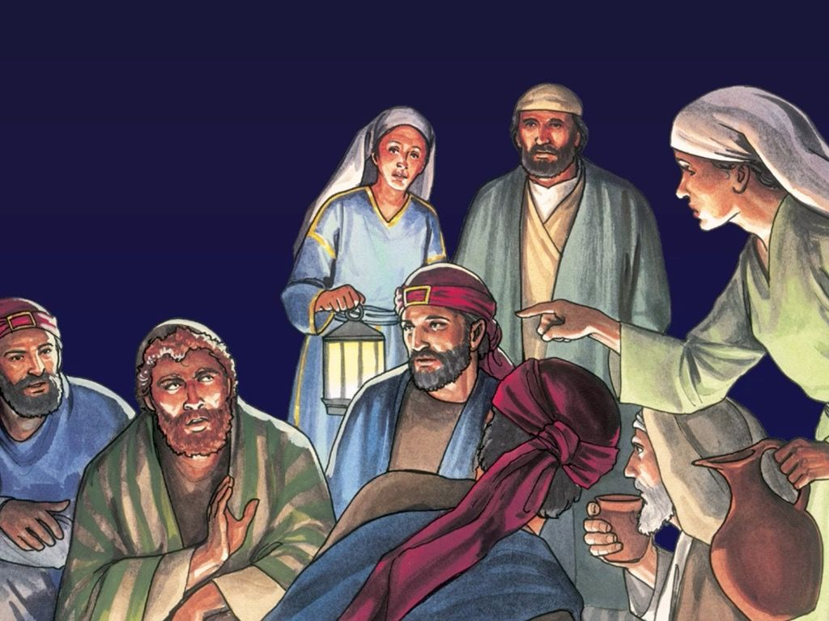

Slide 8
I am
committed
to
Jesus

Slide 9

I am
committed
to
Jesus

