Slide 1
Mark 12:13-17 (CEB)
¹³ [The Jewish leaders] sent some of the Pharisees and Herodians to Jesus to catch Him in His words. ¹⁴ They came to Him and said, “Teacher, we know that you are a man of integrity. You aren’t swayed by others, because you pay no attention to who they are;
but you teach the way of God in
accordance with the truth. Is it right to
pay the imperial tax to Caesar or not?
¹⁵ Should we pay or shouldn’t we?”

Slide 2
Mark 12:13-17 (CEB)
¹⁵ But Jesus knew their hypocrisy. “Why are you trying to trap me?” He asked. “Bring me a denarius and let me look at it.” ¹⁶ They brought the coin, and He asked them, “Whose image is this? And whose inscription?”
“Caesar’s,” they replied.
¹⁷ Then Jesus said to them, “Give back to Caesar what is Caesar’s and to God what is God’s.” And they were amazed at him.

Slide 3
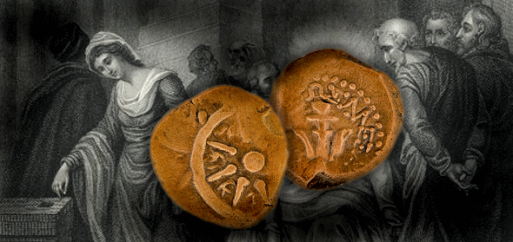

Slide 4
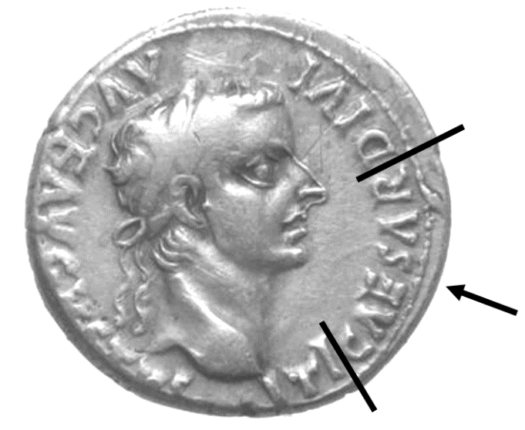

Slide 5
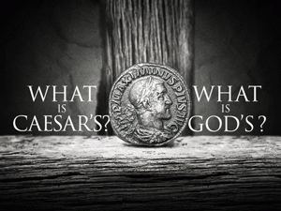

Slide 6
Genesis 1:26-28 (NIV)
“Then God said, “Let us make mankind in our image, in our likeness ... So God created mankind in his own image, in the image of God he created them; male and female he created them. God blessed them ....”

Slide 7
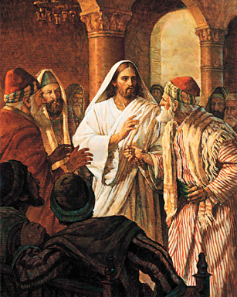

Slide 9
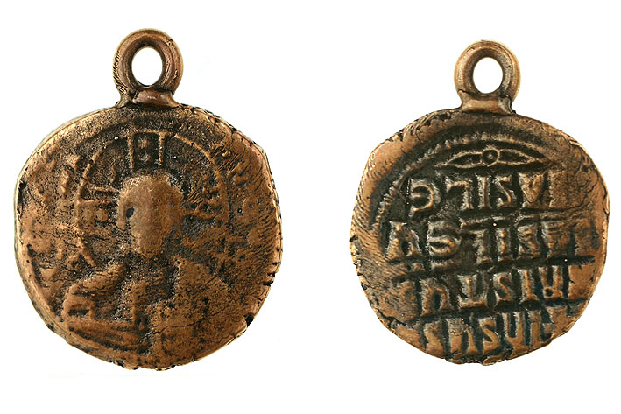
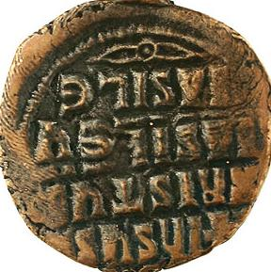

Slide 10
➔ Maxibillion Craig Thompson
Baptism: At Red Rock Camp later this summer
Confirmation Mentor: Jim Letourneau
Favorite Bible Verses: Romans 12:21 (Also Deuteronomy 31:6 and Isaiah 43:2)
“Do not be overcome by evil, but
overcome evil with good.”
Favorite Christian Songs: The Battle Hymn of the Republic, The Lord Is My Light, and God and God Alone by Steve Green

Slide 11
➔ Ian Hunter Bautch
Baptized: May 25, 2003 at First Lutheran Church, Hibbing
Confirmation Mentor: Chuck Yetter
Favorite Bible Passage: Psalm 23
“The Lord is my shepherd,
I shall not want. ...”
Favorite Christian Song: The Lion and the Lamb

Slide 12
➔ Conner Philip Keintz
Baptized: August 24, 2003 at FHUMC
Confirmation Mentor: Randy Coley
Favorite Bible Verse: Romans 12:2
“Do not conform to the pattern of this world, but be transformed by the renewing of your mind. Then you will be able to test and approve what God’s will is - His good, pleasing and perfect will.”
Favorite Christian Song: God’s Not Dead by the Newsboys

Slide 13
➔ James Allen Richter
Baptized: Oct. 13, 2002 at First UMC, Lindstrom
Confirmation Mentor: Ray Rought
Favorite Bible Verse: 2 Timothy 3:16
“All Scripture is God breathed and is useful for teaching, rebuking, correcting and training in righteousness.”
Favorite Christian Song: The Old Rugged Cross

Slide 14
The Apostle’s Creed
as understood by Nathan Werner
I believe that there is a God almighty, who made absolutely everything in the universe, besides what people made and dark powers.
I also believe that God’s one and only Son, Jesus, was conceived by the Holy Spirit, the third person of the Trinity (which is God, Jesus, and the Holy Spirit), and was born to Mary, His mother, who was a virgin.

Slide 15
The Apostle’s Creed
as understood by Nathan Werner
He suffered under the Roman governor, Pontius Pilate; then was crucified, then He died, and was buried, and He then descended down to hell. On the third day of being “dead” He was raised from the “dead,” and then He ascended into heaven. Now He sits at the right hand of God the Father Almighty. From there He will come down during the rapture and will judge between those who will live forever those who won’t.

Slide 16
The Apostle’s Creed
as understood by Nathan Werner
I also believe in the Holy Spirit, the Holy Christian Church, that people who have died being a Christian are still alive, that Jesus forgives our sins (us doing wrong against God, Jesus, and the Holy Spirit), that if we are Christians our souls continue to live and our bodies will be resurrected after we die, and that in heaven we will not die.
Amen.

Slide 17
& Prayer

Slide 18
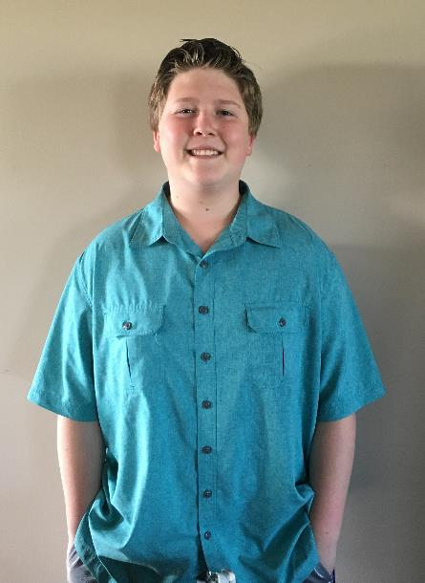

Slide 19
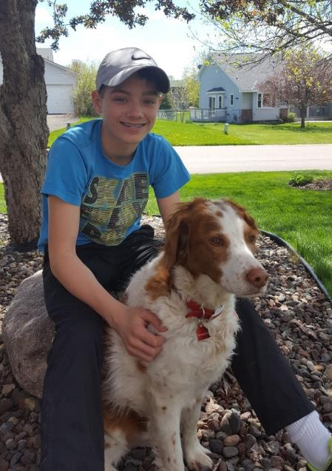

Slide 20
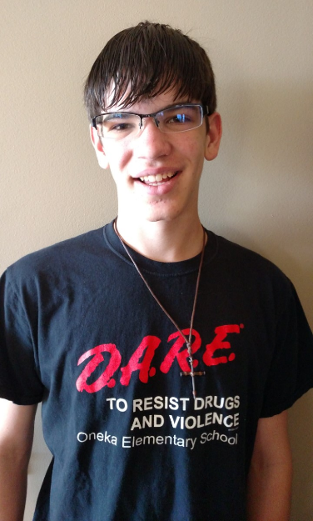

Slide 21
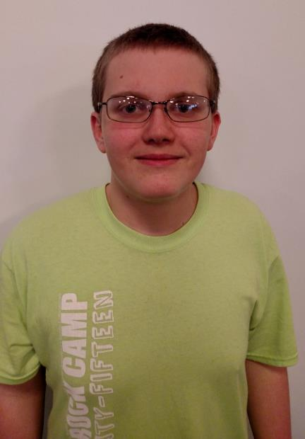

Slide 22
Presentation of the Confirmation Bibles
by the United Methodist Women

Slide 23
Confirmation Verse: Ephesians 4:23-24
“Let the Spirit renew your mind and make you into a new person, for you were created in God’s image in true righteousness and holiness.”

