Slide 3
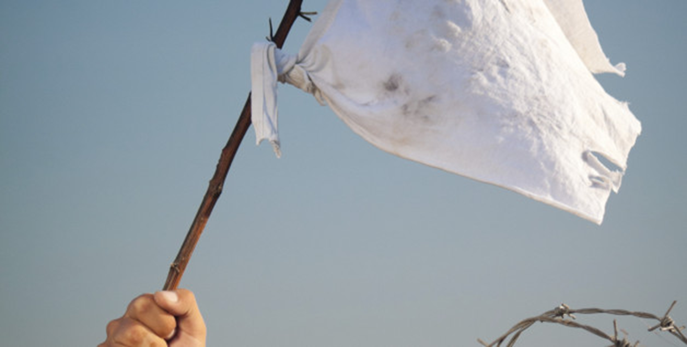
Excuses:
Self-imposed, false barriers
Is the goal
worthwhile?

Slide 6
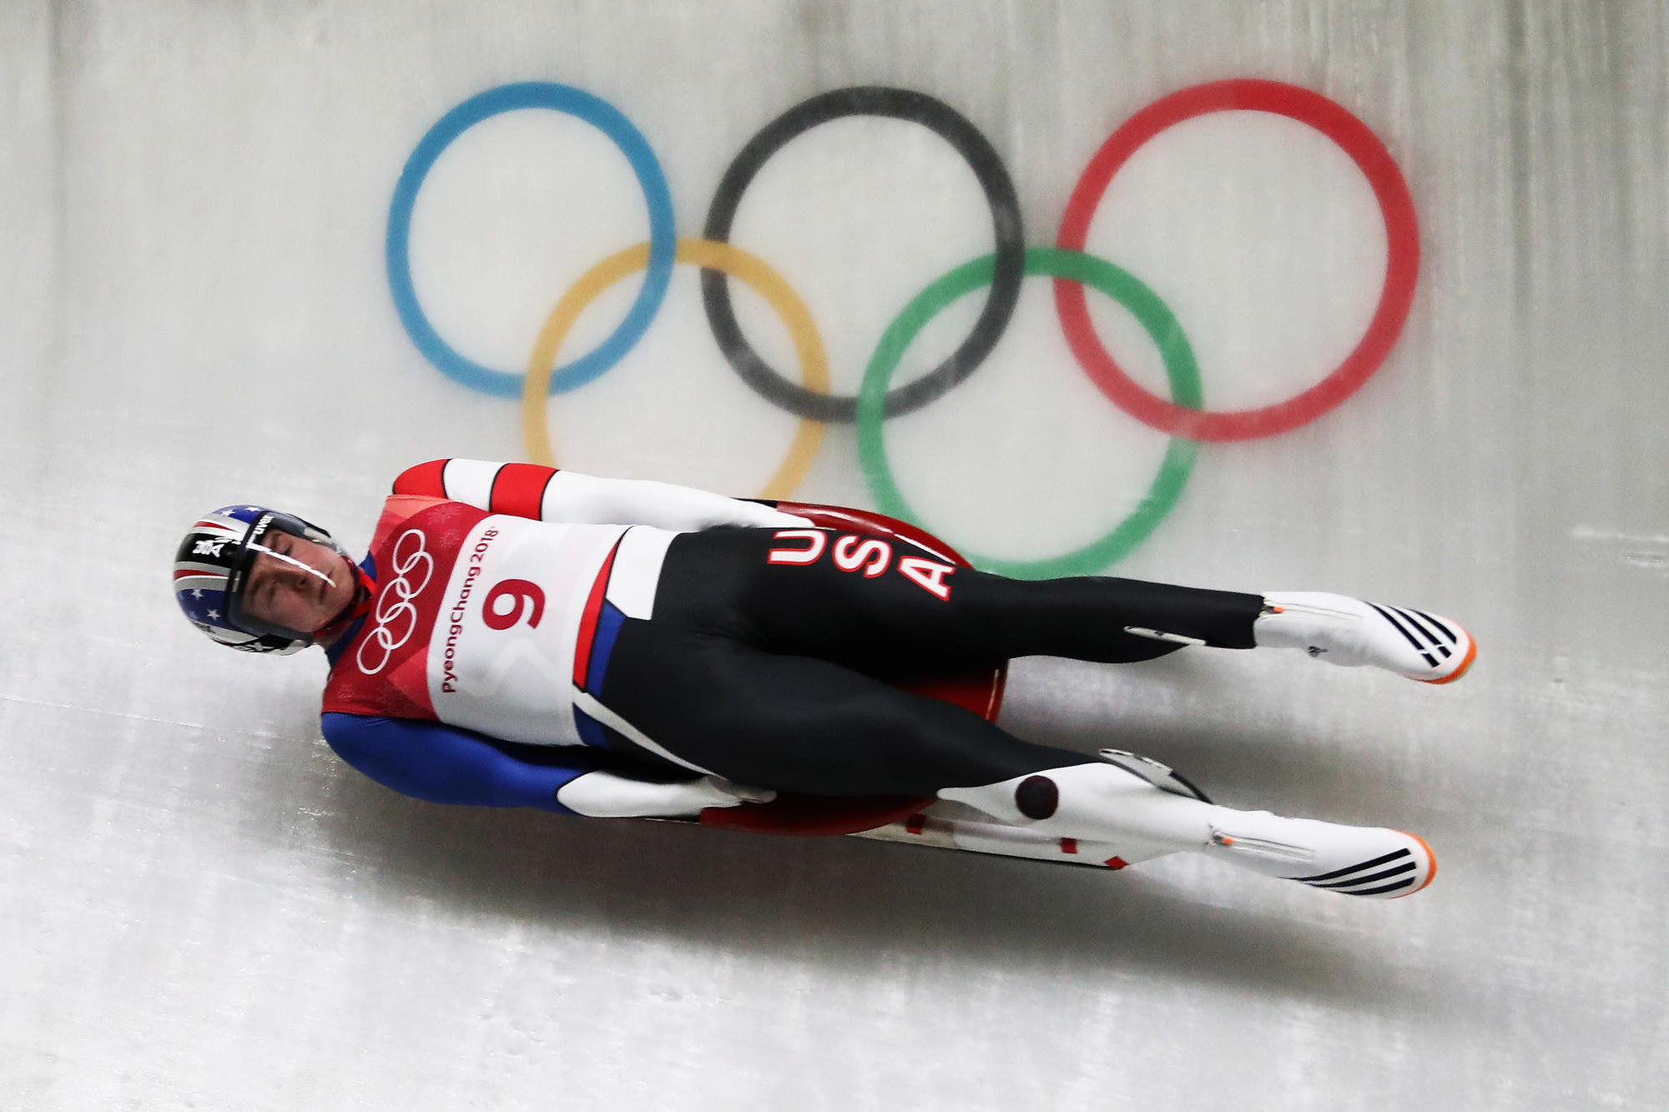

Slide 7
Exodus 3
⁴ When the Lord saw that he had gone over to look, God called to him from within the bush, “Moses! Moses!”
And Moses said, “Here I am.”
⁵ “Do not come any closer,” God said. “Take off your sandals, for the place where you are standing is holy ground.” ⁶ Then he said, “I am the God of your father,^{[a]}the God of Abraham, the God of Isaac and the God of Jacob.” At this, Moses hid his face, because he was afraid to look at God.

Slide 8
¹¹ But Moses said to God, “Who am I that I should go to Pharaoh and bring the Israelites out of Egypt?”
¹² And God said, “I will be with you. And this will be the sign to you that it is I who have sent you: When you have brought the people out of Egypt, you^{[b]} will worship God on this mountain.”
¹³ Moses said to God, “Suppose I go to the Israelites and say to them, ‘The God of your fathers has sent me to you,’ and they ask me, ‘What is his name?’ Then what shall I tell them?”
¹⁴ God said to Moses, “I am who I am.^{[c]} This is what you are to say to the Israelites: ‘I am has sent me to you.’”

Slide 9
Exodus 4
Moses answered, “What if they do not believe me or listen to me and say, ‘The Lord did not appear to you’?”
² Then the Lord said to him, “What is that in your hand?”
“A staff,” he replied.
³ The Lord said, “Throw it on the ground.”

Slide 10
¹⁰ Moses said to the Lord, “Pardon your servant, Lord. I have never been eloquent, neither in the past nor since you have spoken to your servant. I am slow of speech and tongue.”
¹¹ The Lord said to him, “Who gave human beings their mouths? Who makes them deaf or mute? Who gives them sight or makes them blind? Is it not I, the Lord?¹² Now go; I will help you speak and will teach you what to say.”

Slide 11
¹³ But Moses said, “Pardon your servant, Lord. Please send someone else.”
¹⁴ Then the Lord’s anger burned against Moses and he said, “What about your brother, Aaron the Levite? I know he can speak well. He is already on his way to meet you, and he will be glad to see you.

Slide 12
What is the goal?
Is it worthwhile?

Slide 13
Moses’ goal is the same as ours:
Right relationship with God

Slide 14
John 14:16,26
I will ask the Father, and he will give you another advocate to help you and be with you forever— the Spirit of truth…the Advocate, the Holy Spirit, whom the Father will send in my name, will teach you all things and will remind you of everything I have said to you.

