Slide 1
“The LORD Himself goes before you and will be with you; He will never leave you nor forsake you. Do not be afraid; do not be discouraged.” Deut. 31:8
Putting the Pieces Together

Slide 3
Jeremiah 29:11
“For I know the plans I have for you,” declares the Lord, “plans to prosper you and not to harm you, plans to give you hope and a future.”

Slide 4
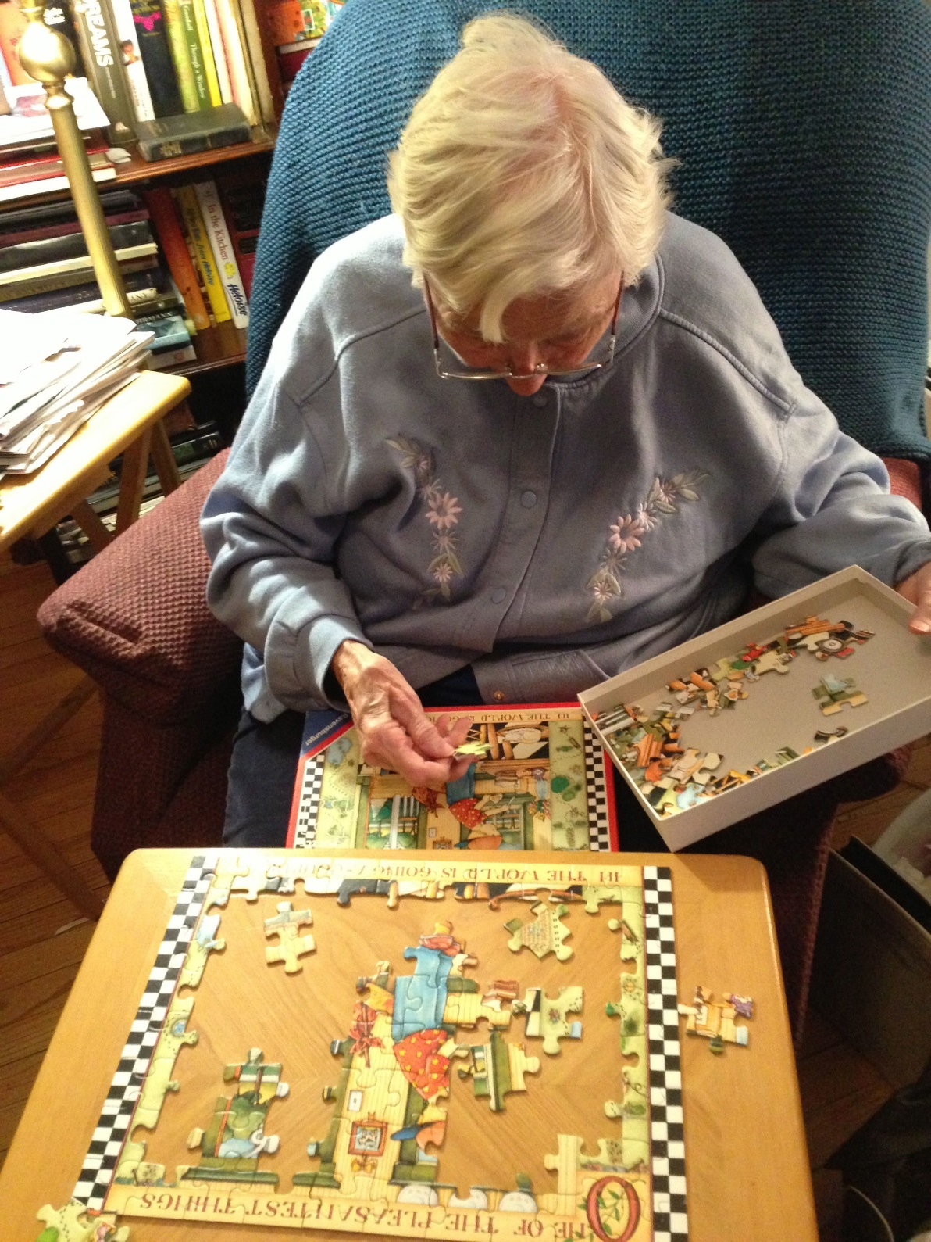

Slide 5
You can go forward
boldly when you can’t
see clearly if you hang
on to Jesus tightly.

Slide 6
Philippians 1:2-11 (NIV)
² Grace and peace to you from God our Father and the Lord Jesus Christ. ³ I thank my God every time I remember you. ⁴ In all my prayers for all of you, I always pray with joy ⁵ because of your partnership in the gospel from the first day until now, ⁶ being confident of this, that He who began a good work in you will carry it on to completion until the day of Christ Jesus.

Slide 7
Philippians 1:2-11 (NIV)
⁹ And this is my prayer: that your love may abound more and more in knowledge and depth of insight, ¹⁰ so that you may be able to discern what is best and may be pure and blameless for the day of Christ, ¹¹ filled with the fruit of righteousness that comes through Jesus Christ—to the glory and praise of God.

Slide 9
Putting the Pieces Together
Jeremiah 29:11 “For I know the plans I have for you,” declares the Lord, “plans to prosper you and not to harm you, plans to give you hope and a future.”
Philippians 1:6 “Be confident in this: that He who began a good work in you will carry it on to completion until the day of Christ Jesus.”
Deuteronomy 31:8 “The LORD Himself goes before you and will be with you; He will never leave you nor forsake you. Do not be afraid; do not be discouraged.”

