Slide 1
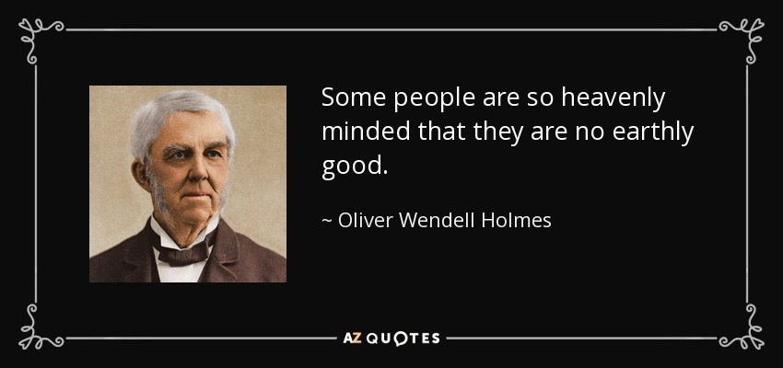

Slide 2
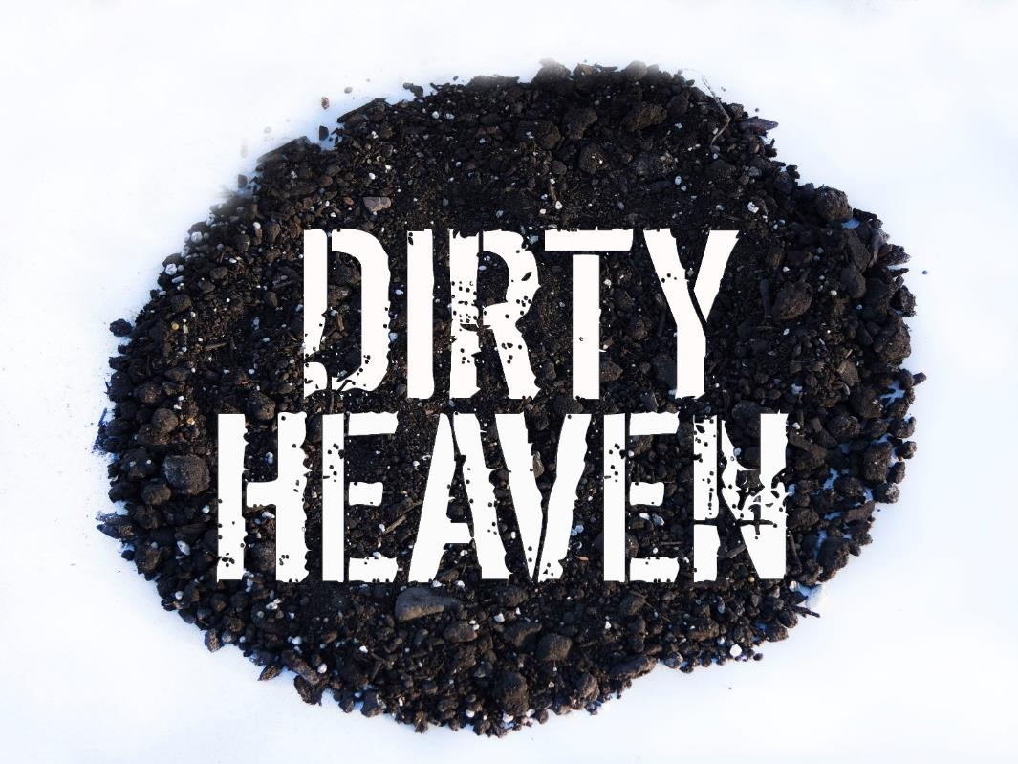
“God has made everything beautiful in its time. He has also set eternity in the human heart; yet no one can fathom what God has done from beginning to end.”
-Ecclesiastes 3:11
Jesus in Paradise & Return
Heaven on Earth

Slide 3
THE STORY OF SALVATION IN DIRT
Advent Series: God’s Dirty Hands - Jesus’ pre-existence and birth
New Year’s Series: God’s Dirty Feet - Jesus’ public ministry on earth
Lenten Series: Dirty Faith - Jesus’ Passion (Jesus’ last week in Jerusalem)
Easter Series: Dirty Heaven - Jesus in Paradise and Return

Slide 4
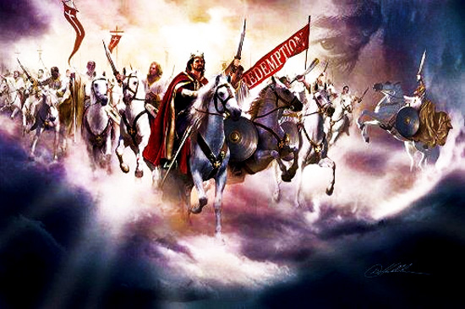

Slide 5
The Rapture (the word does not appear in the Bible)
“¹⁶ For the Lord himself will come down from heaven, with a loud command, with the voice of the archangel and with the trumpet call of God, and the dead in Christ will rise first. ¹⁷ After that, we who are still alive and are left will be caught up together with them in the clouds to meet the Lord in the air. And so we will be with the Lord forever. ¹⁸ Therefore encourage one another with these words.”
1 Thessalonians 4:16-17 (NIV)
(See also Matthew 24:30-31 and
1 Corinthians 15:50-53)

Slide 6
Revelation 21:1-7 (NIV)
¹ Then I saw “a new heaven and a new earth,” for the first heaven and the first earth had passed away, and there was no longer any sea. ² I saw the Holy City, the new Jerusalem, coming down out of heaven from God, prepared as a bride beautifully dressed for her husband.
³ And I heard a loud voice from the throne saying, “Look! God’s dwelling place is now among the people, and He will dwell with them. They will be His people, and God Himself will be with them and be their God.
⁴ ‘He will wipe every tear from their eyes. There will be no more death’ or mourning or crying or pain, for the old order of things has passed away.”

Slide 7
Revelation 21:1-7 (NIV)
⁵ He who was seated on the throne said, “I am making everything new!” Then He said, “Write this down, for these words are trustworthy and true.”
⁶ He said to me: “It is done. I am the Alpha and the Omega, the Beginning and the End. To the thirsty I will give water without cost from the spring of the water of life. ⁷ Those who are victorious will inherit all this, and I will be their God and they will be my children.

Slide 8
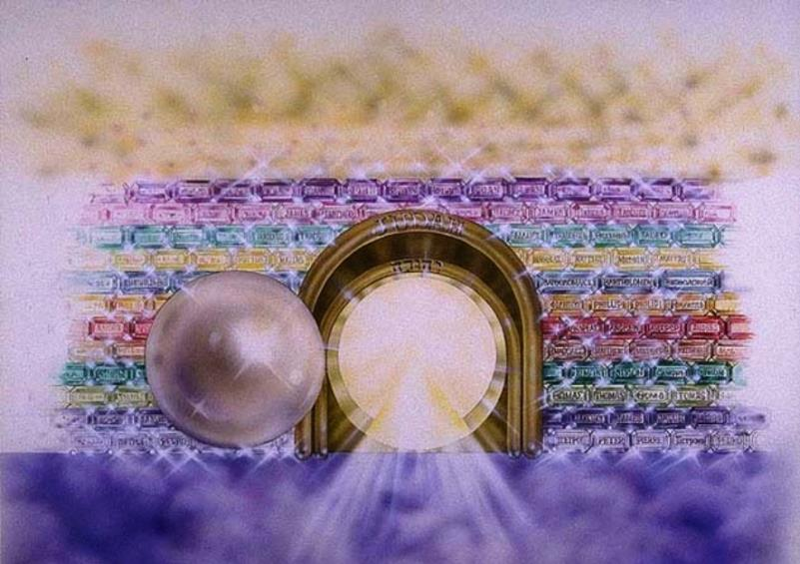
Heaven in Revelation 21
“The twelve gates were twelve pearls, each gate made of a single pearl. The great street of the city was of gold, as pure as transparent glass.”

Slide 9
Heaven in Revelation 21
Earth and heaven will be new - the old will passed away (21:1, 4-5)
Heaven is the Holy City Jerusalem - Where God dwells (21:2)
Heaven is a bride for God, an intimate relationship with God (21:2)
God dwells directly with people - the covenant fulfilled (21:3, 7)
No more sorrow, death, crying or pain (21:4)
Jesus is the Beginning and the End (21:6)
Heaven is living water (21:6)
Heaven is for God’s children (21:7)

Slide 10
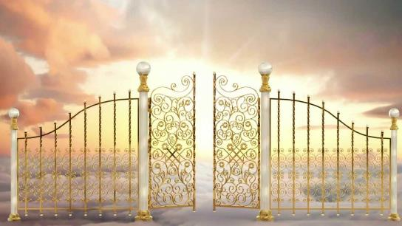
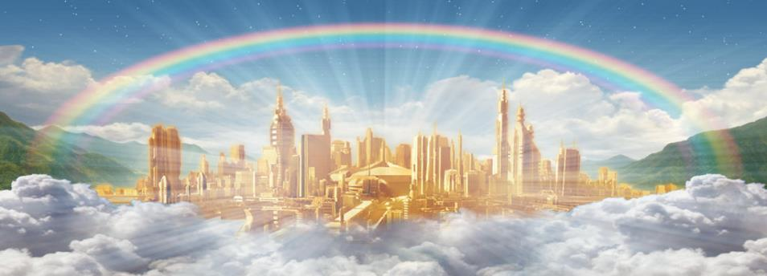
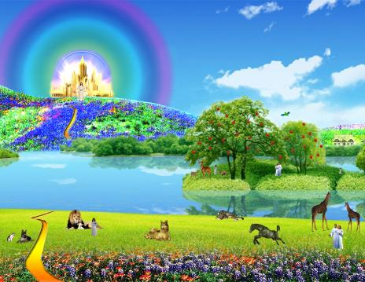
“I can only
imagine!”

Slide 11
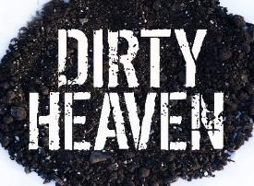
Heaven on Earth
Now in part, then fully
1 Corinthians 13:12 “For now we see only a reflection as in a mirror; then we shall see face to face. Now I know in part; then I shall know
fully, even as I am fully known.”

Slide 12
Heaven on Earth
2 Peter 3:9-12 “The Lord is not slow in keeping His promise, as some understand slowness. Instead He is patient with you, not wanting anyone to perish,
but everyone to come to repentance....
You look forward to the day
of God and speed
its coming.”
Now in part, then fully
Share our joy with others

Slide 13
Heaven on Earth
Now in part, then fully
Share our joy with others
Fully live this life, lightly
1 Thessalonians 4:13 “We do not grieve like the rest of mankind, who have no hope.”

Slide 14
“God has made everything beautiful in its time. He has also set eternity in the human heart; yet no one can fathom what God has done from beginning to end.”
-Ecclesiastes 3:11

