Slide 1
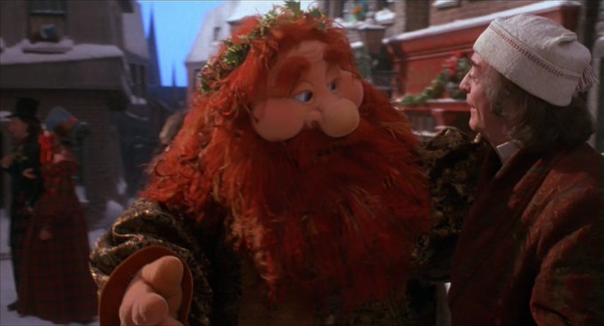

Slide 2
“Come in, and know me better, man!”
Celebrating 50 Years with a Year of Jubilee Sabbath
“Therefore, the Lord God, the holy one of Israel, says: In return and rest you will be saved; quietness and trust will be your strength ... the Lord is waiting to be merciful to you, and will rise up to show you compassion. The Lord is a God of justice; happy are all who wait for Him.”
~Isaiah 30:15-17

Slide 3
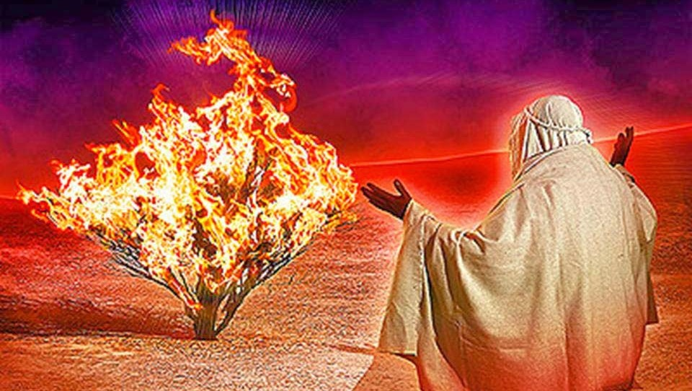
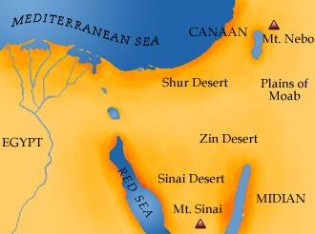

Slide 4
Exodus 3:1-12 (CEB)
¹ Moses was taking care of the flock for his father in law Jethro, Midian’s priest. He led his flock out to the edge of the desert, and he came to God’s mountain called Horeb [or Sinai]. ² The Lord’s messenger appeared to him in a flame of fire in the middle of a bush. Moses saw that the bush was in flames, but it didn’t burn up. ³ Then Moses said to himself, Let me check out this amazing sight and find out why the bush isn’t burning up.

Slide 5
Exodus 3:1-12 (CEB)
⁴ When the Lord saw that he was coming to look, God called to him out of the bush, “Moses, Moses!”
Moses said, “I’m here.”
⁵ Then the Lord said, “Don’t come any closer! Take off your sandals, because you are standing on holy ground.” ⁶ He continued, “I am the God of your father, Abraham’s God, Isaac’s God, and Jacob’s God.” Moses hid his face because he was afraid to look at God.

Slide 6
Exodus 3:1-12 (CEB)
⁷ Then the Lord said, “I’ve clearly seen my people oppressed in Egypt. I’ve heard their cry of injustice because of their slave masters. I know about their pain. ⁸ I’ve come down to rescue them from the Egyptians in order to take them out of that land and bring them to a good and broad land, a land that’s full of milk and honey ... . ⁹ Now the Israelites’ cries of injustice have reached me. I’ve seen just how much the Egyptians have oppressed them. 10 So, I’m sending you to Pharaoh to bring my people, the Israelites, out of Egypt.”

Slide 7
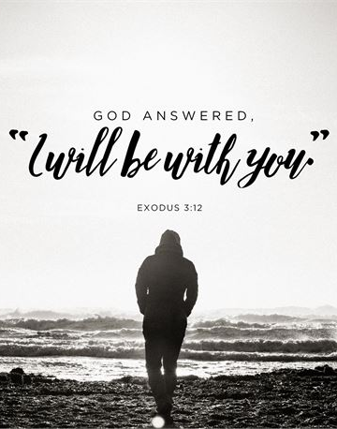
Exodus 3:1-12 (CEB)
¹¹ But Moses said to God, “Who am I to go to Pharaoh and to bring the Israelites out of Egypt?”
¹² God said, “I’ll be with you. And
this will show you that I’m the one
who sent you. After you bring the
people out of Egypt, you will come
back here and worship God on this
mountain.”

Slide 8
“Come in, and know me better, man!”
God called Moses to a time away with Him

Slide 9
“Come in, and know me better, man!”
God called Moses to a time away with Him
God shapes and equips Moses for his calling

Slide 10
“Come in, and know me better, man!”
God called Moses to a time away with Him
God shapes and equips Moses for his calling
God tells Moses to bring others to that place

Slide 11
Our Year of Jubilee
Answering God’s invitation to
“Come in, and Know Me Better!”

Slide 12
Our Year of Jubilee
1. Pause from our regular business
Pastor: Church, is this the calling of God?
Church: We believe this to be God’s calling for us right now!

Slide 13
Our Year of Jubilee
1. Pause from our regular business
2. Simple, Soulful Sunday Worship
Pastor: Church, is this the calling of God?
Church: We believe this to be God’s calling for us right now!

Slide 14
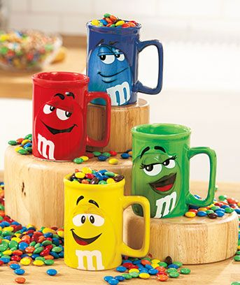
Our Year of Jubilee
3. Fellowship Wednesdays: M&M (Meals & More!)
Pastor: Church, is this the calling of God?
Church: We believe this
to be God’s calling for us
right now!

Slide 15
Our Year of Jubilee
3. Fellowship Wednesdays: M&M (Meals & More!)
4. Small groups
Pastor: Church, is this the calling of God?
Church: We believe this to be God’s calling for us right now!

Slide 16
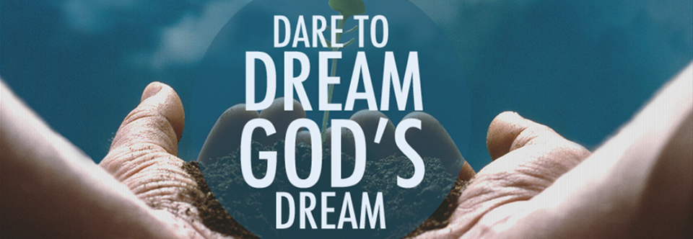
Our Year of Jubilee
5. Dream a new future
Pastor: Church, is this the calling of God?
Church: We believe this to be God’s calling for us right now!

