Slide 1

“For the wages of sin is death, but the gift of God is eternal life in Christ Jesus our Lord.” ~Romans 6:23

Slide 2

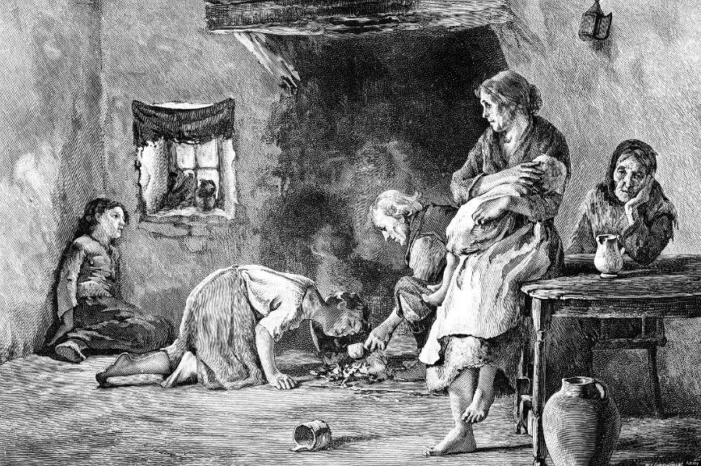

Slide 3


Slide 4
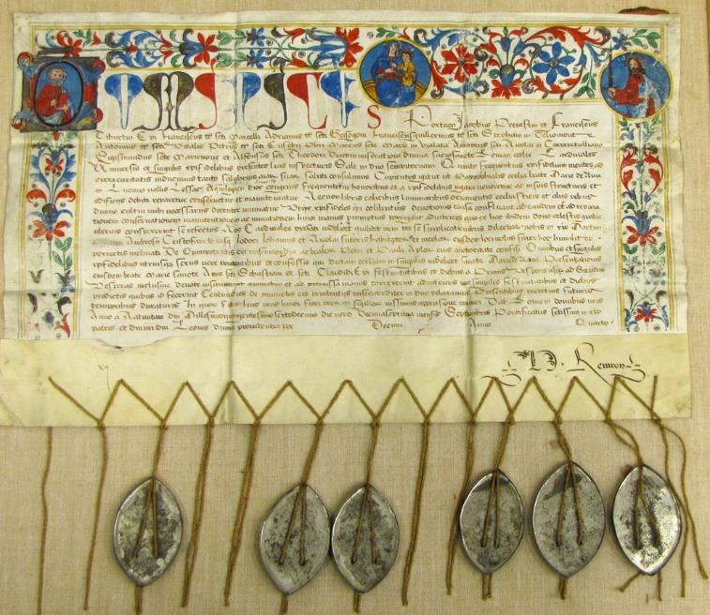

Slide 5
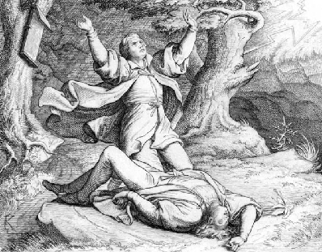

Slide 6
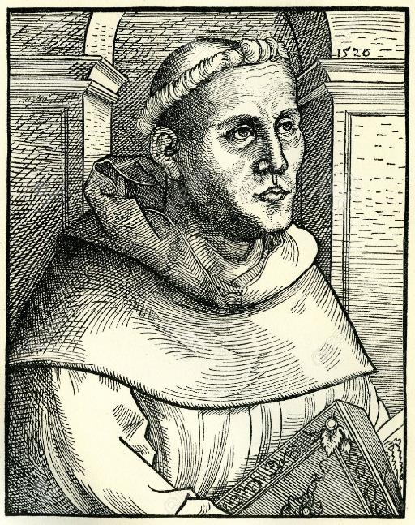

Slide 7
Romans 6:23 “For the wages of sin is death, but the gift of God is eternal life in Christ Jesus our Lord.”
Romans 10:9 “If you declare with your mouth, “Jesus is Lord,” and believe in your heart that God raised him from the dead, you will be saved.”

Slide 8
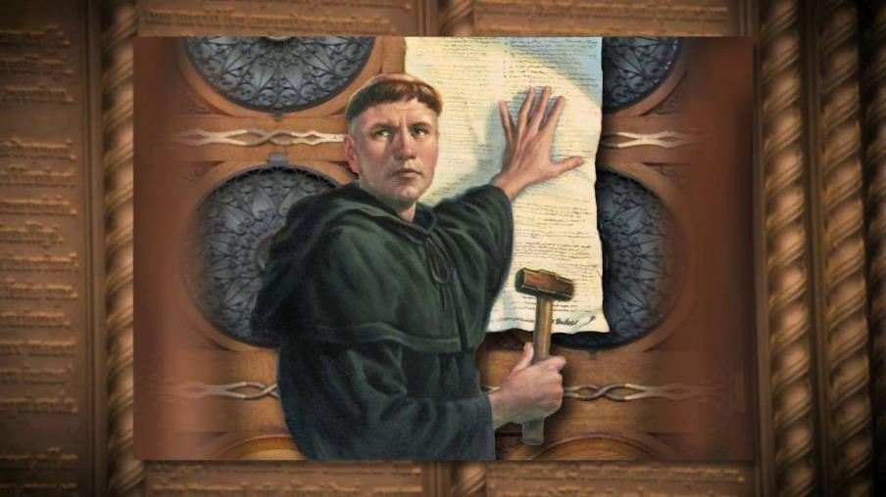

Slide 9
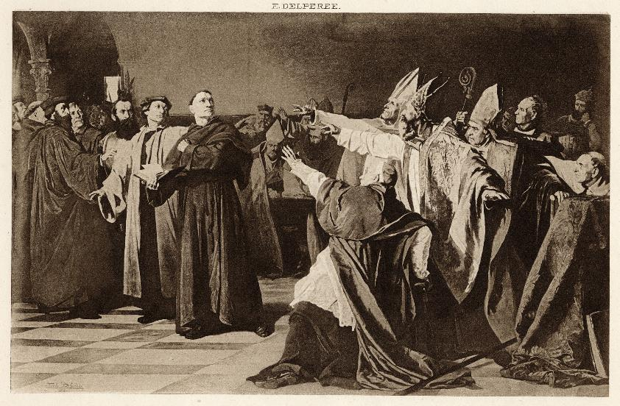

Slide 10
The 5 solas (alones) of the
Protestant Reformation
1) Sola fide: Salvation comes through faith alone
2) Sola gratia: Favor from God comes through His grace alone
3) Sola Christus: Salvation is accomplished by Christ alone
4) Sola Scriptura: Scripture alone is the one true authority on all things spiritual
5) Soli Deo gloria: “Glory be to God alone”

Slide 11
Ephesians 2:4-10 (NKJV)
⁴ But God, who is rich in mercy, because of His great love with which He loved us, ⁵ even when we were dead in trespasses, made us alive together with Christ (by grace you have been saved), ⁶ and raised us up together, and made us sit together in the heavenly places in Christ Jesus, ⁷ that in the ages to come He might show the exceeding riches of His grace in His kindness toward us in Christ Jesus. ⁸ For by grace you have been saved through faith, and that not of yourselves; it is the gift of God, ⁹ not of works, lest anyone should boast. ¹⁰ For we are His workmanship, created in Christ Jesus for good works, which God prepared beforehand that we should walk in them.

Slide 12


Slide 13
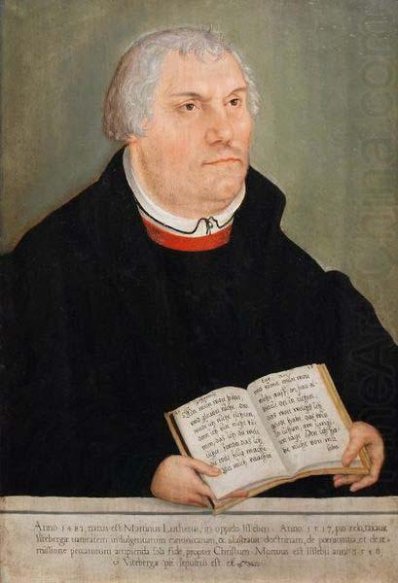

Slide 14


