Slide 1
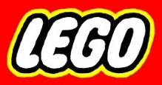
Building Beauty with Broken Bricks
Building a Unique Life with God
“To the weak I became weak, to win the weak.
I have become all things to all people so that by all possible means I might save some.” ~1 Corinthians 9:22

Slide 2

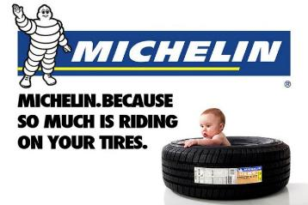
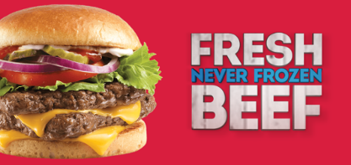


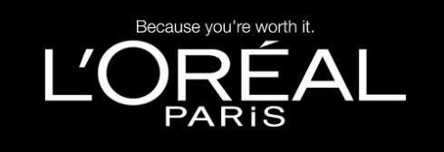

Slide 3
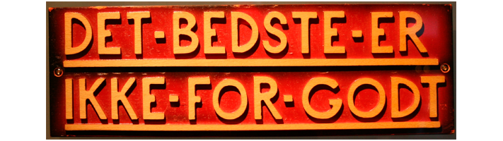
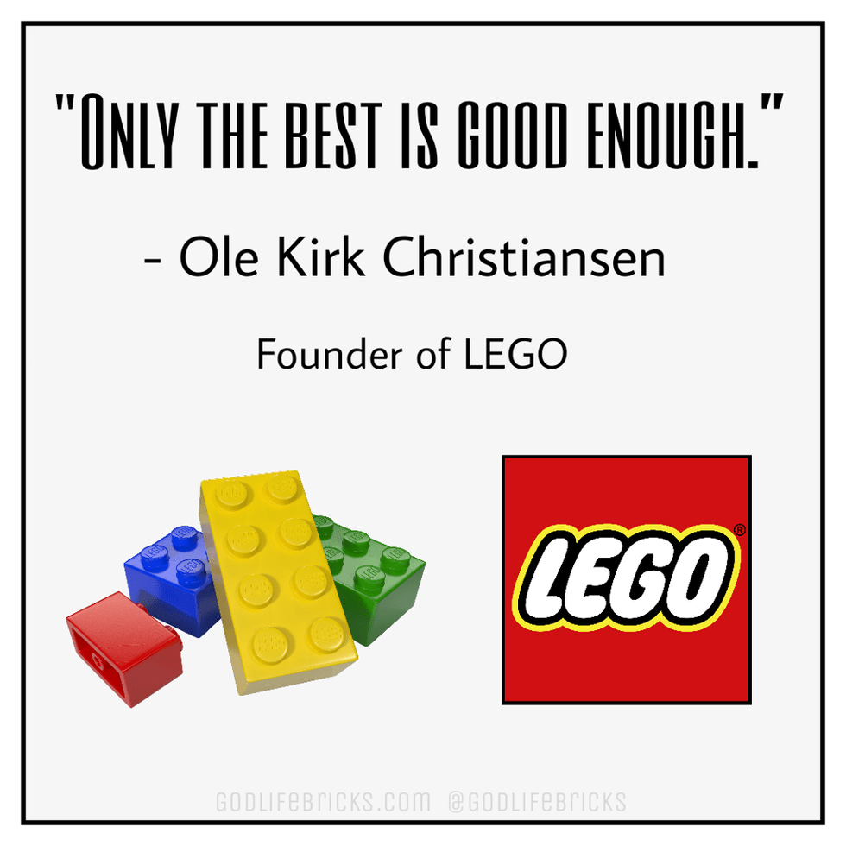

Slide 4
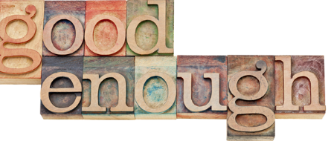
Building Beauty with Broken Bricks
Jesus’ motto:
  “Less-than-the-best is
“”
Notes:
© Copyright Showeet.com

Slide 5
Building Beauty with Broken Bricks
Jesus’ motto:
  “Less-than-the-best is good enough!”
1. I’m not all that good. I can be pretty rotten!
2. God is perfect in every way, and making all things perfect.
3. God chooses to work with broken people.
Notes:
© Copyright Showeet.com

Slide 6
“You also, like living stones, are being built into a spiritual house to be a holy priesthood, offering spiritual sacrifices acceptable to God through Jesus Christ.”
~ 1 Peter 2:5
Notes:
© Copyright Showeet.com

Slide 7
Building Beauty with Broken Bricks
You are broken
“All have sinned and fall short of the glory of God”
~ Romans 3:23
Notes:
© Copyright Showeet.com

Slide 8
Building Beauty with Broken Bricks
You are broken
God loves and chooses broken people
Notes:
© Copyright Showeet.com

Slide 9
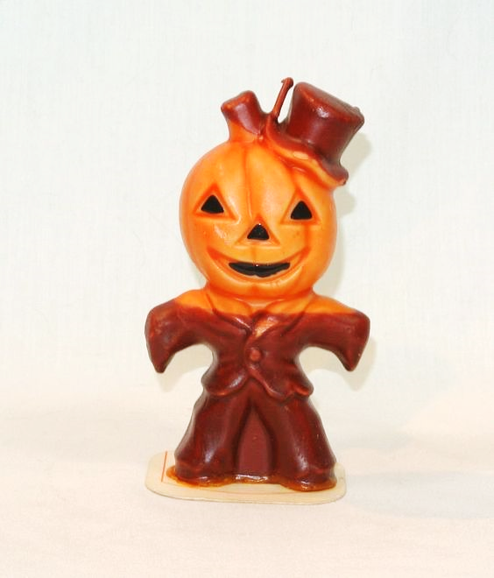

Slide 10
Share with a neighbor:
Something you own that has no monetary value but is priceless to you.
Notes:
© Copyright Showeet.com

Slide 11
Building Beauty with Broken Bricks
You are broken
God loves and chooses broken people
“But God demonstrates His own love for us in this: While we were still sinners, Christ died for us.”
~ Romans 5:8
Notes:
© Copyright Showeet.com

Slide 12
Building Beauty with Broken Bricks
You are broken
God loves and chooses broken people
God builds with broken people
“My grace is sufficient for you, for My power is
made perfect in weakness.” ~ 2 Corinthians 12:9
Notes:
© Copyright Showeet.com

Slide 13
1 Corinthians 1:27 29 (CEB)
²⁷ But God chose what the world considers foolish to shame the wise. God chose what the world considers weak to shame the strong. ²⁸ And God chose what the world considers low class and low life—what is considered to be nothing—to reduce what is considered to be something to nothing. ²⁹ So no human being can brag in God’s presence.

Slide 14
Building Beauty with Broken Bricks
You are broken
God loves and chooses broken people
God builds with broken people
We are called to build with broken people
“To the weak I became weak, to win the weak. I have
become all things to all people so that by all
possible means I might save some.” ~ 1 Cor. 9:22
Notes:
© Copyright Showeet.com

Slide 15
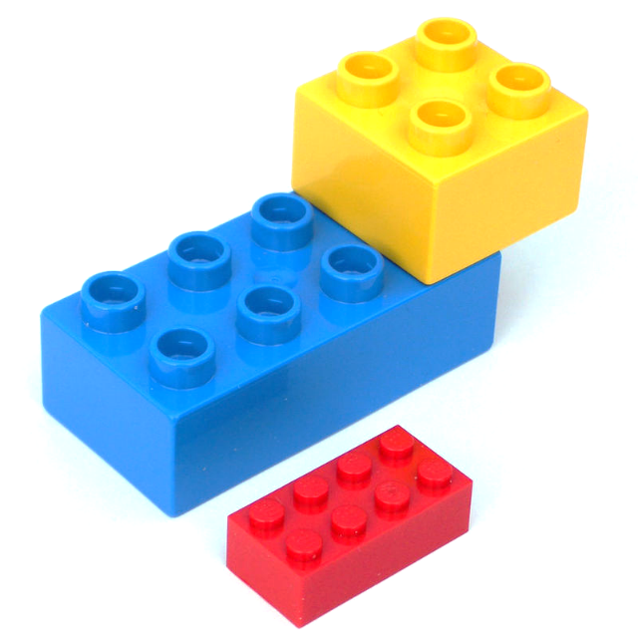

Slide 16
Building Beauty with Broken Bricks
You are broken
God loves and chooses broken people
God builds with broken people
We are called to build with broken people
Notes:
© Copyright Showeet.com

