Slide 1

The Creative Creator Created You to Create Creatively!
Building a Unique Life with God
“Do you see a man skilled in his work? He will serve before kings; he will not serve before obscure men.” ~Proverbs 22:29

Slide 2

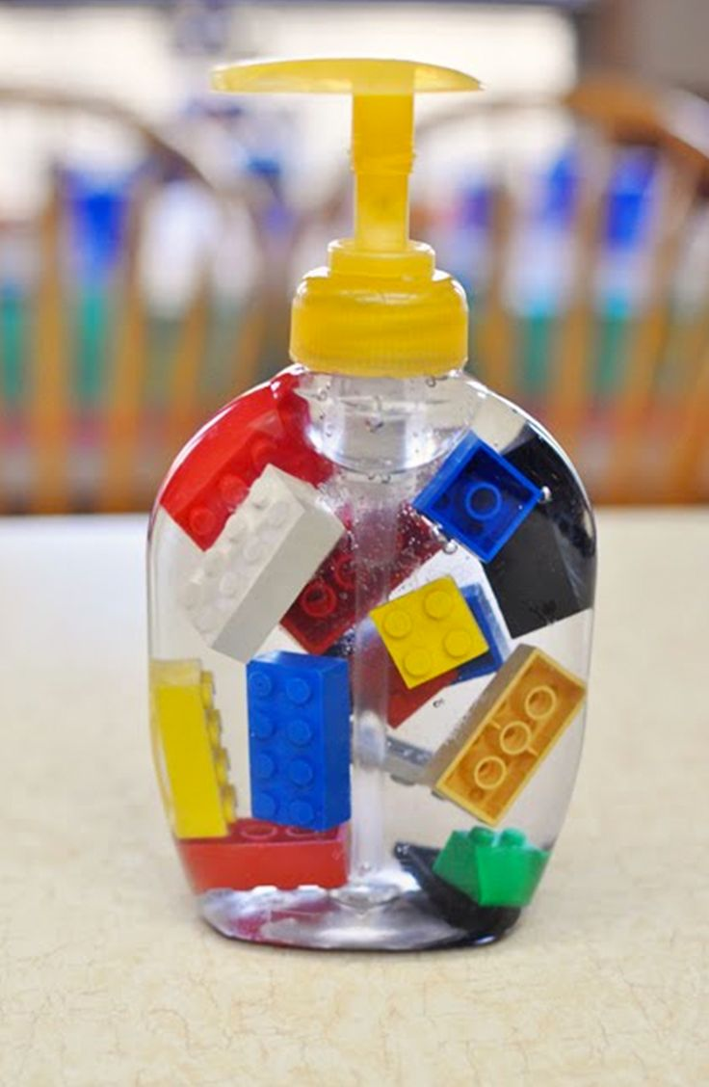
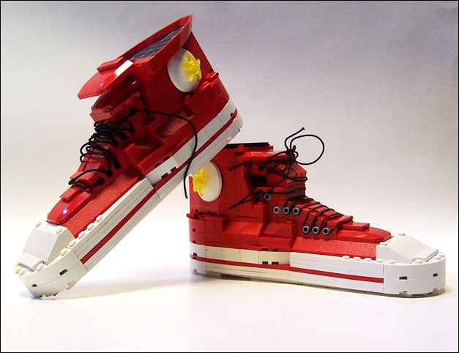
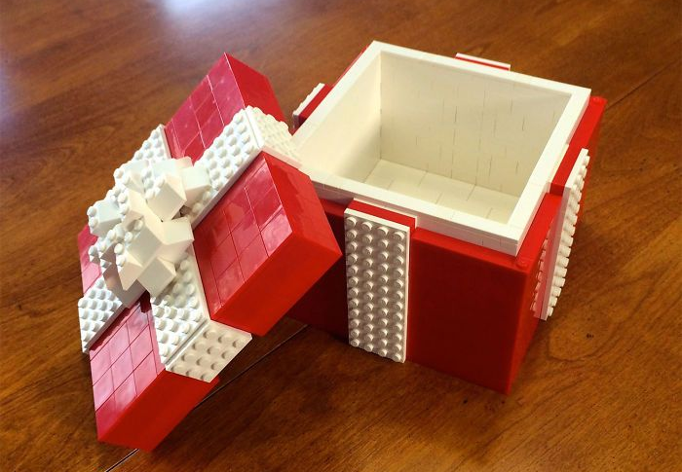
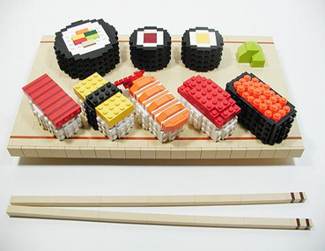

Slide 3

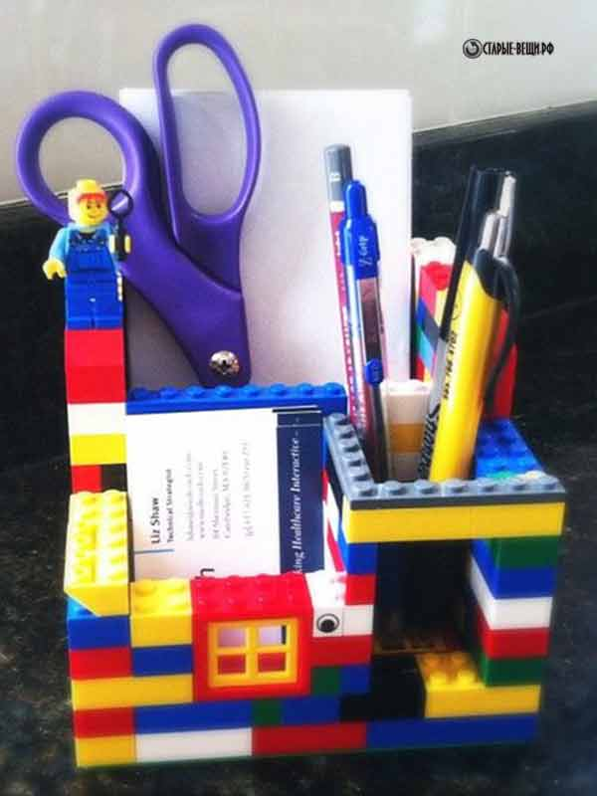
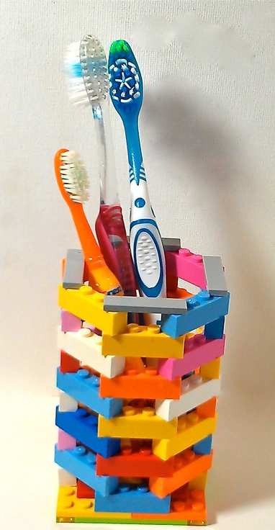
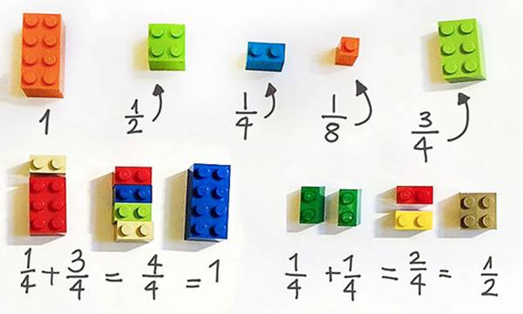

Slide 4


Slide 5
The Creative Creator created you to create creatively!
God made you creative!
Notes:
© Copyright Showeet.com

