Slide 1

I’ll be home for Christmas
You can plan on me
Please have snow and mistletoe
And presents on the tree
Christmas Eve will find me
Where the lovelight gleams
I’ll be home for Christmas
If only in my dreams

Slide 2



Slide 3
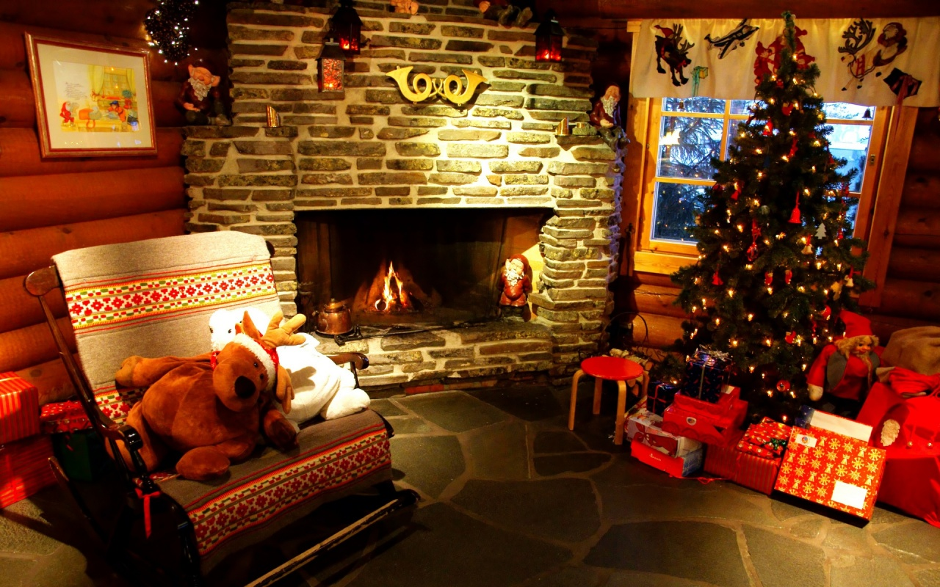

Slide 4
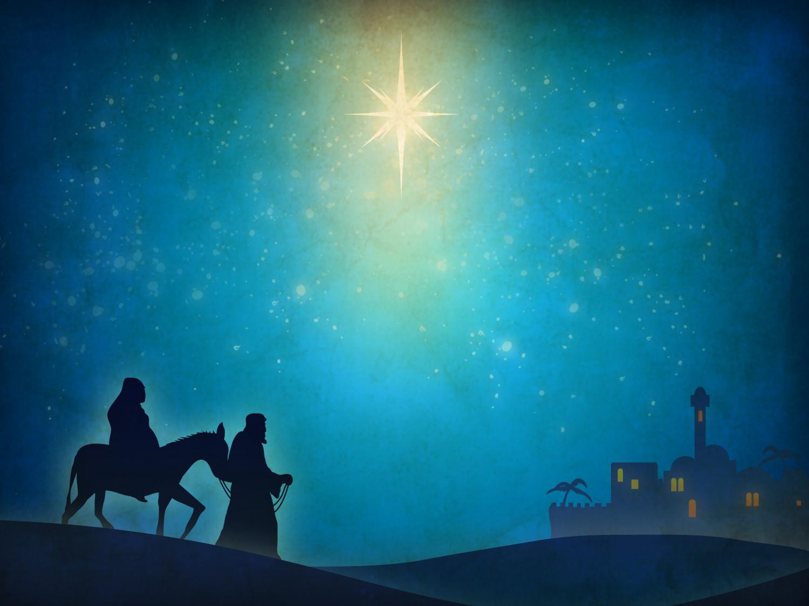
Leaving Home for Christmas
“Where is the one who has been born king of the Jews? We have seen His star in the east, and we have come to worship Him.” ~Matt. 2:2
Journey to Bethlehem

Slide 5


Slide 6
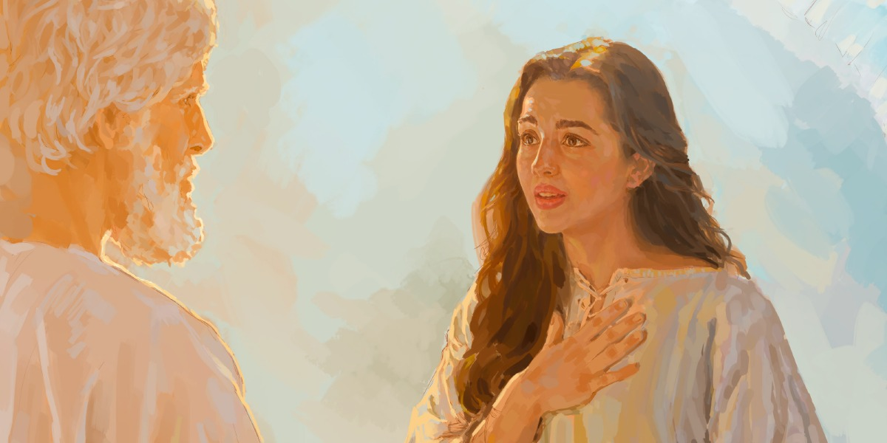

Slide 7

Luke 2 (The Christmas Story)
¹ In those days Caesar Augustus declared that everyone throughout the empire should be enrolled in the tax lists. ² This first enrollment occurred when Quirinius governed Syria. ³ Everyone went to their own cities to be enrolled. ⁴ Since Joseph belonged to David’s house and family line, he went up from the city of Nazareth in Galilee to David’s city, called Bethlehem, in Judea. ⁵ He went to be enrolled together with Mary, who was promised to him in marriage and who was pregnant.

Slide 8
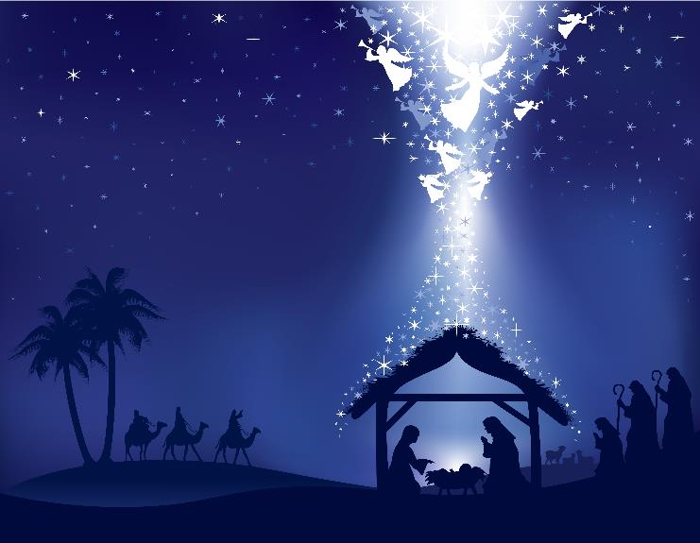
Luke 2 (The Christmas Story)
⁶ While they were there, the time came for Mary to have her baby. ⁷ She gave birth to her firstborn child, a son, wrapped him snugly, and laid him in a manger, because there was no place for them in the guestroom.

Slide 9
Leaving Home for Christmas
Journey to Bethlehem

Slide 10
Leave behind comfort in order to have capacity
Leaving Home for Christmas

Slide 11
Leave behind comfort in order to have capacity
Leaving Home for Christmas
Leave behind fun in order to have what’s important

Slide 12
Leave behind comfort in order to have capacity
Leaving Home for Christmas
Leave behind fun in order to have what’s important
Leave behind preferences in order to have purpose

