Slide 1
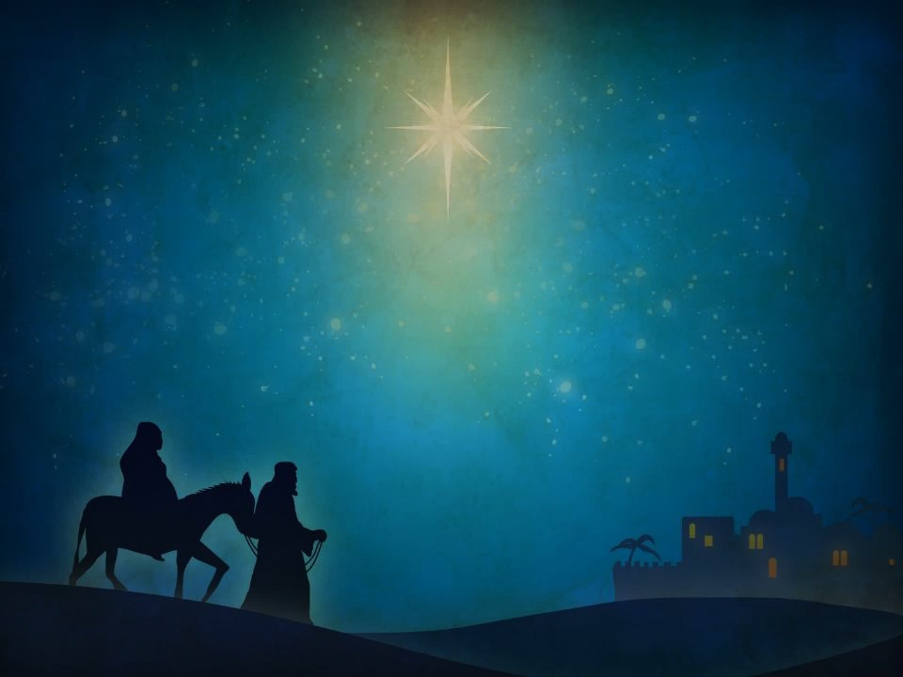
Going Straight There
“Let's go to Bethlehem and see this what God has revealed to us.” Luke 2:15b
Journey to Bethlehem

Slide 2

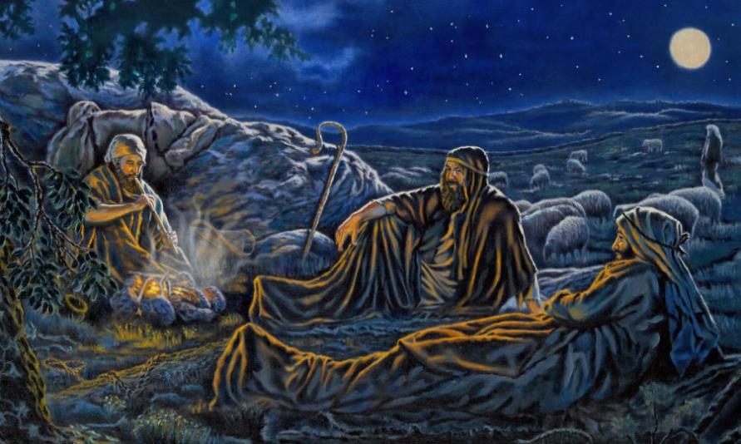

Slide 3
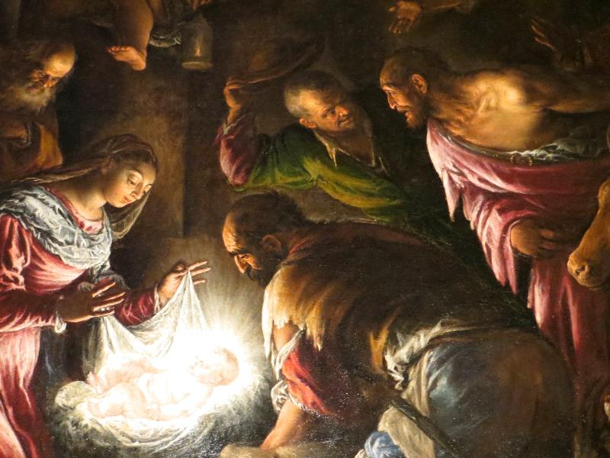

Slide 4
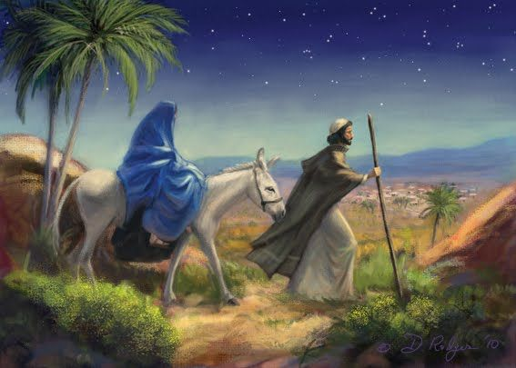

Slide 5

Luke 2:8-20 (CEB)
⁸ Nearby shepherds were living in the fields, guarding their sheep at night. ⁹ The Lord’s angel stood before them, the Lord’s glory shone around them, and they were terrified.
¹⁰ The angel said, “Don’t be afraid! Look! I bring good news to you—wonderful, joyous news for all people. ¹¹ Your savior is born today in David’s city. He is Christ the Lord. ¹² This is a sign for you: you will find a newborn baby wrapped snugly and lying in a manger.”
¹³ Suddenly a great assembly of the heavenly forces was with the angel praising God. They said, ¹⁴ “Glory to God in heaven, and on earth peace among those whom he favors.”

Slide 6
Luke 2:8-20 (CEB)
¹⁵ When the angels returned to heaven, the shepherds said to each other, “Let’s go right now to Bethlehem and see what’s happened. Let’s confirm what the Lord has revealed to us.”
¹⁶ They went quickly and found Mary and Joseph, and the baby lying in the manger. ¹⁷ When they saw this, they reported what they had been told about this child. ¹⁸ Everyone who heard it was amazed at what the shepherds told them.
¹⁹ Mary committed these things to memory and considered them carefully. ²⁰ The shepherds returned home, glorifying and praising God for all they had heard and seen. Everything happened just as they had been told.

Slide 7
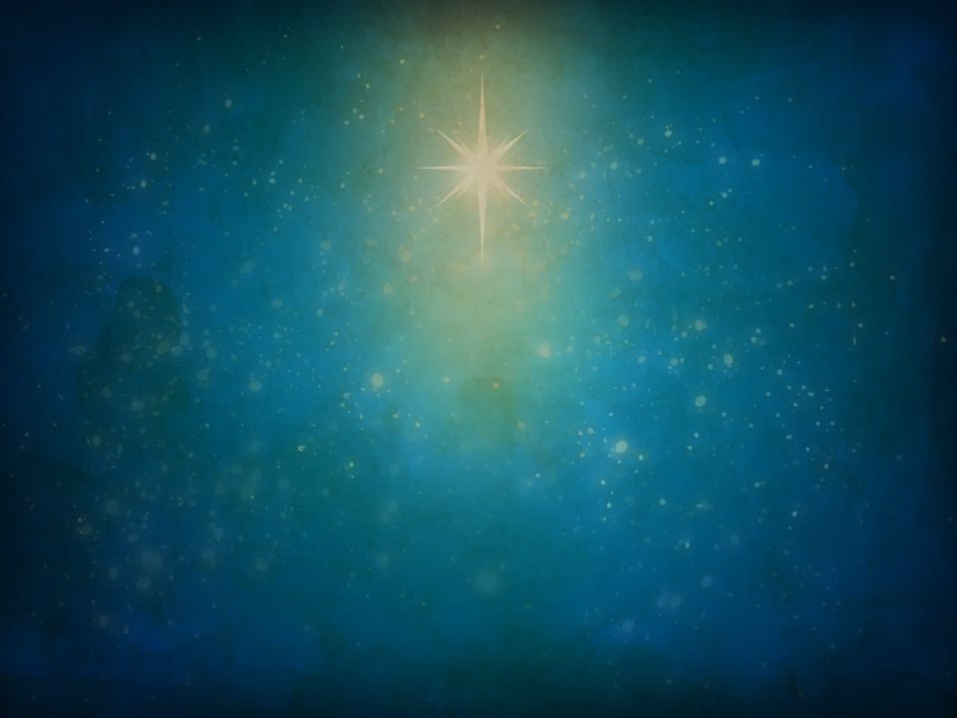
Going Straight There
Seek

Slide 8
Going Straight There
Seek
Focus

Slide 9
Going Straight There
Seek
Focus
Listen

Slide 10
Going Straight There
Seek
Focus
Listen
Devote

Slide 11
A Prayer Journey to Bethlehem
Seek
Focus
Listen
Devote

Slide 12

You are invited on a Prayer Journey to Bethlehem, to the manger!
Seek!
Pray a silent prayer committing to seek Jesus more in your life.
Then continue your journey of prayer by going to any of the Focus prayer stations in the back of the sanctuary.
(Take a pen or pencil from the pew with you!)

