Slide 1
Walking Daily with the Holy Spirit
Galatians 5:25 “If we live by the Spirit, let us also walk by the Spirit.”

Slide 2
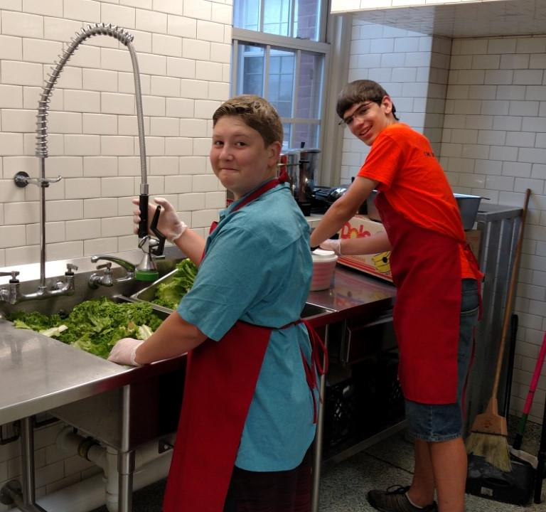
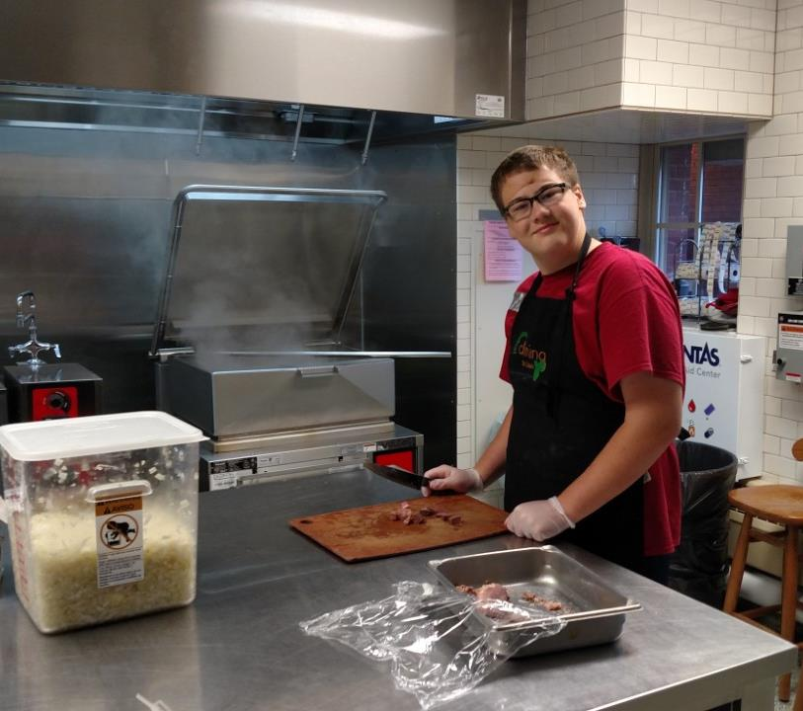

Slide 4
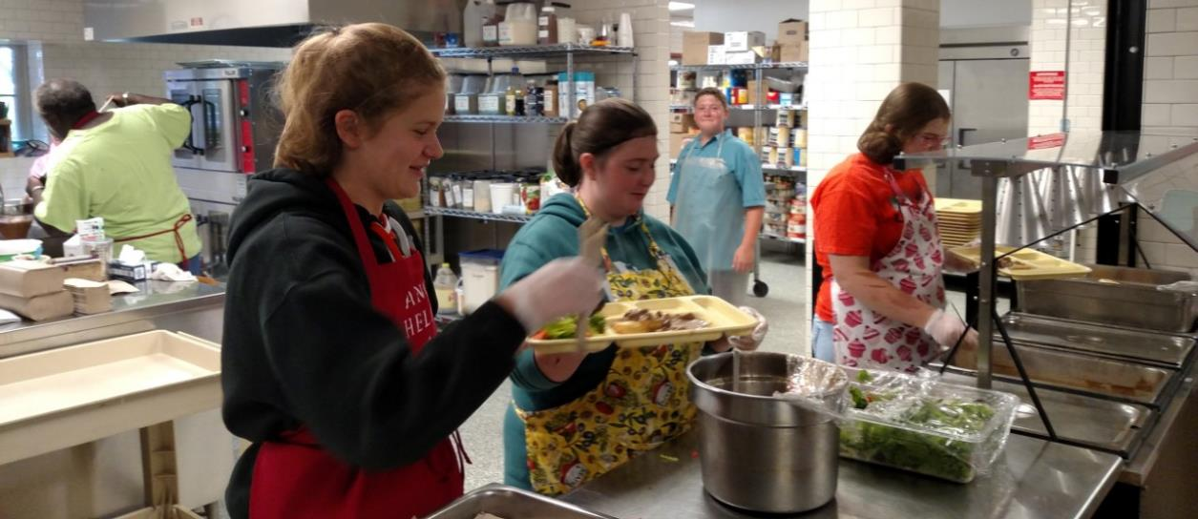
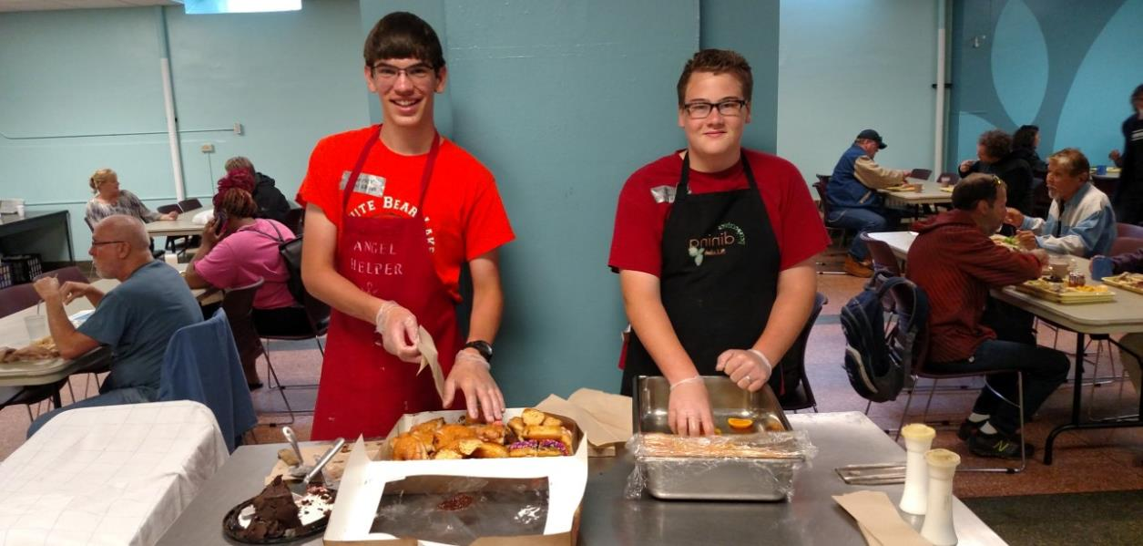

Slide 6
Entry Point
Vs.
The Main Point

Slide 7
“Jesus answered, ‘I assure you, unless someone is born anew, it’s not possible to see God’s kingdom.’” ~John 3:3
“Jesus answered, ‘I assure you, unless someone is born of water and the Spirit, it’s not possible to enter God’s kingdom.’” ~John 3:5
“A new heart I will give you and a new spirit I will put within you ... I will put my Spirit within you and cause you to walk in my statutes.” ~Ezekiel 36:26-27

Slide 8
Winning the Inner War
The Holy Spirit empowers you to do the right thing
Focus your mind on what is right
Align your will with the Spirit’s will
Mark the deaths of specific selfish desires
Rest in your identity as God’s child

Slide 9
Galatians 5 (CEB)
¹⁶ I say, walk by the Spirit and you won’t carry out your selfish desires. ¹⁷ A person’s selfish desires are set against the Spirit, and the Spirit is set against one’s selfish desires. They are opposed to each other, so you shouldn’t do what-
ever you want to do.

Slide 10
Walking Daily with the Spirit
Walk by the Spirit:
let the Spirit change your desires

Slide 11
Galatians 5 (CEB)
¹⁶ I say, walk by the Spirit and you won’t carry out your selfish desires. ¹⁷ A person’s selfish desires are set against the Spirit, and the Spirit is set against one’s selfish desires. They are opposed to each other, so you shouldn’t do what-
ever you want to do.

Slide 12
Walking Daily with the Spirit
Walk by the Spirit:
let the Spirit change your desires

Slide 13
Galatians 5 (CEB)
¹⁸ But if you are being led by the Spirit, you aren’t under the Law. ¹⁹ The actions that are produced by selfish motives are obvious, since they include sexual immorality, moral corruption, doing whatever feels good, ²⁰ idolatry, drug use and casting spells, hate, fighting, obsession, losing your temper, competitive opposition, conflict, selfishness, group rivalry, ²¹ jealousy, drunkenness, partying, and other things like that. I warn you as I have already warned you, that those who do these kinds of things won’t inherit God’s kingdom.

Slide 14
Walking Daily with the Spirit
Walk by the Spirit:
let the Spirit change your desires
Led by the Spirit:
let the Spirit direct your way

Slide 15
Galatians 5 (CEB)
²² But the fruit of the Spirit is love, joy, peace, patience, kindness, goodness, faithfulness, ²³ gentleness, and self control. There is no law against things like this. ²⁴ Those who belong to Christ Jesus have crucified the self with
its passions and its desires. ²⁵ If
we live by the Spirit, let’s walk
by the Spirit.

Slide 16
Walking Daily with the Spirit
Walk by the Spirit:
let the Spirit change your desires
Led by the Spirit:
let the Spirit direct your way
Bear fruit by the Spirit:
let the Spirit grow different behaviors

Slide 17
Galatians 5 (CEB)
²² But the fruit of the Spirit is love, joy, peace, patience, kindness, goodness, faithfulness, ²³ gentleness, and self control. There is no law against things like this. ²⁴ Those who belong to Christ Jesus have crucified the self with
its passions and its desires. ²⁵ If
we live by the Spirit, let’s walk
by the Spirit.

Slide 18
Galatians 5 (CEB)
¹³ You were called to freedom, brothers and sisters; only don’t let this freedom be an opportunity to indulge your selfish impulses, but serve each other through love. ¹⁴ All the Law has been fulfilled in a single statement: Love your neigh-
bor as yourself.

Slide 19
1 Thessalonians 3:12-13
¹² May the Lord cause you to increase and enrich your love for each other and for everyone. ¹³ May the love cause your hearts to be strengthened, to be blameless in holiness before our God and Father when our Lord Jesus comes with all His people.

