Slide 1


Breakfast with Jesus
“Jesus said to them, ‘Come and have breakfast.’” ~John 21:12

Slide 2

Healthy Church Initiative (HCI) Proposal
A Jubilee Sabbath
Break from our normal work
Rekindle our passionate spirituality
Simple, soulful, Sunday worship
Food and intergenerational fellowship Wednesday evenings
Streamlined small groups for everyone

Slide 3

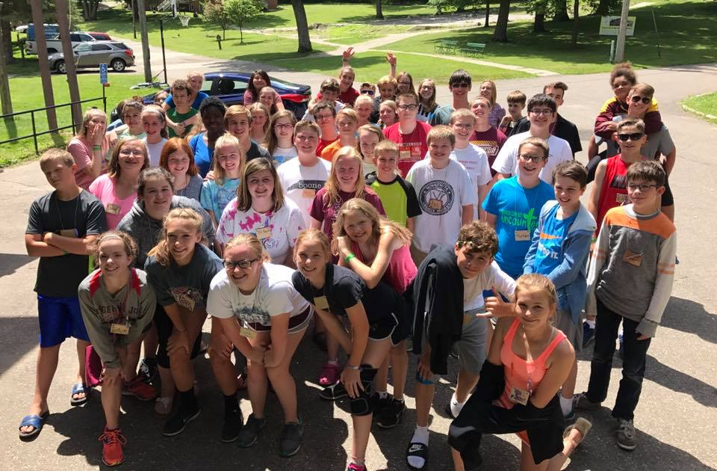
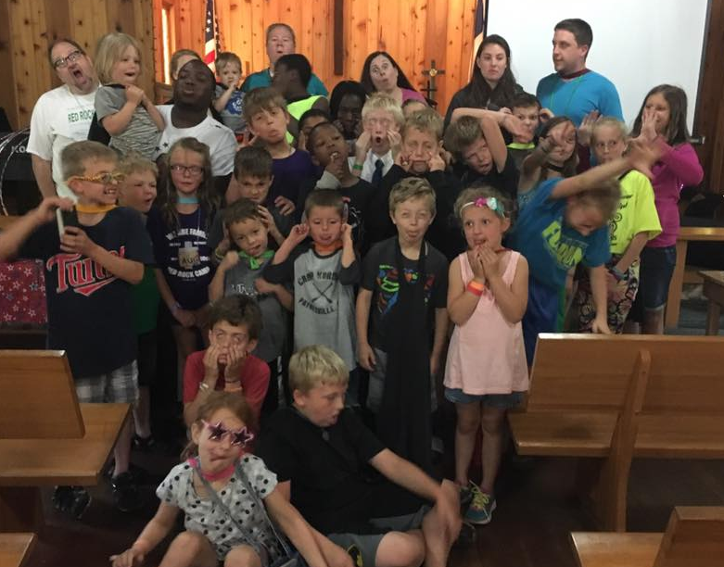

Pentecost Jubilee
Jesus said to them, “Look, I’m sending to you what my Father promised, but you are to stay in the city until you have been furnished with heavenly power.” ~Luke 24:49

Slide 4
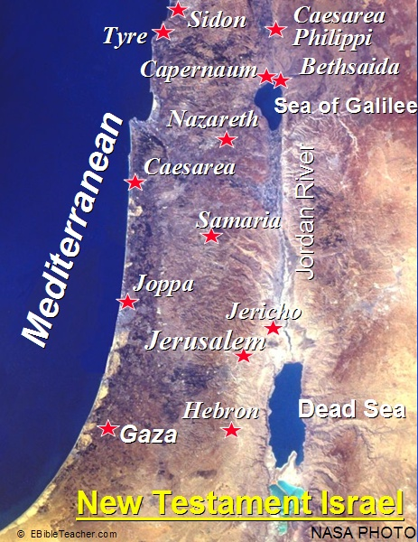

Slide 5
John 21 (CEB)
¹ Later, Jesus Himself appeared again to His disciples at the Sea of Tiberias. This is how it happened: ² Simon Peter, Thomas (called Didymus [or “The Twin”]), Nathanael from Cana in Galilee, Zebedee’s sons [James and John], and two other disciples were together. ³ Simon Peter told them, “I’m going fishing.”
They said, “We’ll go with you.” They set out in a boat, but throughout the night they caught nothing.

Slide 6
John 21 (CEB)
⁴ Early in the morning, Jesus stood on the shore, but the disciples didn’t realize it was Jesus.
⁵ Jesus called to them, “Children, have you caught anything to eat?”
They answered Him, “No.”

Slide 7
John 21 (CEB)
⁶ He said, “Cast your net on the right side of the boat and you will find some.”
So they did, and there were so many fish that they couldn’t haul in the net. ⁷ Then the disciple whom Jesus loved said to Peter, “It’s the Lord!” When Simon Peter heard it was the Lord, he wrapped his coat around himself (for he was naked) and jumped into the water. ⁸ The other disciples followed in the boat, dragging the net full of fish, for they weren’t far from shore, only about one hundred yards.

Slide 8
John 21 (CEB)
⁹ When they landed, they saw a fire there, with fish on it, and some bread. ¹⁰ Jesus said to them, “Bring some of the fish that you’ve just caught.” ¹¹ Simon Peter got up and pulled the net to shore. It was full of large fish, one hundred fifty three of them. Yet the net hadn’t torn, even with so many fish. ¹² Jesus said to them, “Come and have breakfast.” None of the disciples could bring themselves to ask Him, “Who are you?” They knew it was the Lord. ¹³ Jesus came, took the bread, and gave it to them. He did the same with the fish. ¹⁴ This was now the third time Jesus appeared to His disciples after He was raised from the dead.

Slide 9
Breakfast with Jesus
Take a break: Stop the work you are trying so hard to do, and let Jesus feed you.

Slide 10
Breakfast with Jesus
Take a break: Stop the work you are trying so hard to do, and let Jesus feed you.
Jesus feeds us by filling us with the Holy Spirit

Slide 11

John 21 (CEB)
¹⁵ When they finished eating, Jesus asked Simon Peter, “Simon son of John, do you love me more than these?”
Simon replied, “Yes, Lord, you know I love you.”
Jesus said to him,
“Feed my lambs.”

Slide 12
Breakfast with Jesus
Take a break: Stop the work you are trying so hard to do, and let Jesus feed you.
Jesus feeds us by filling us with the Holy Spirit
“Wasting time with Jesus” is preparation for new living

