Slide 1


Winning the Inner War
Galatians 5:17 (CEB) “A person’s selfish desires are set against the Spirit, and the Spirit is set against one’s selfish desires. They are opposed to each other, so you shouldn’t do whatever you want to do.”

Slide 2


Slide 3
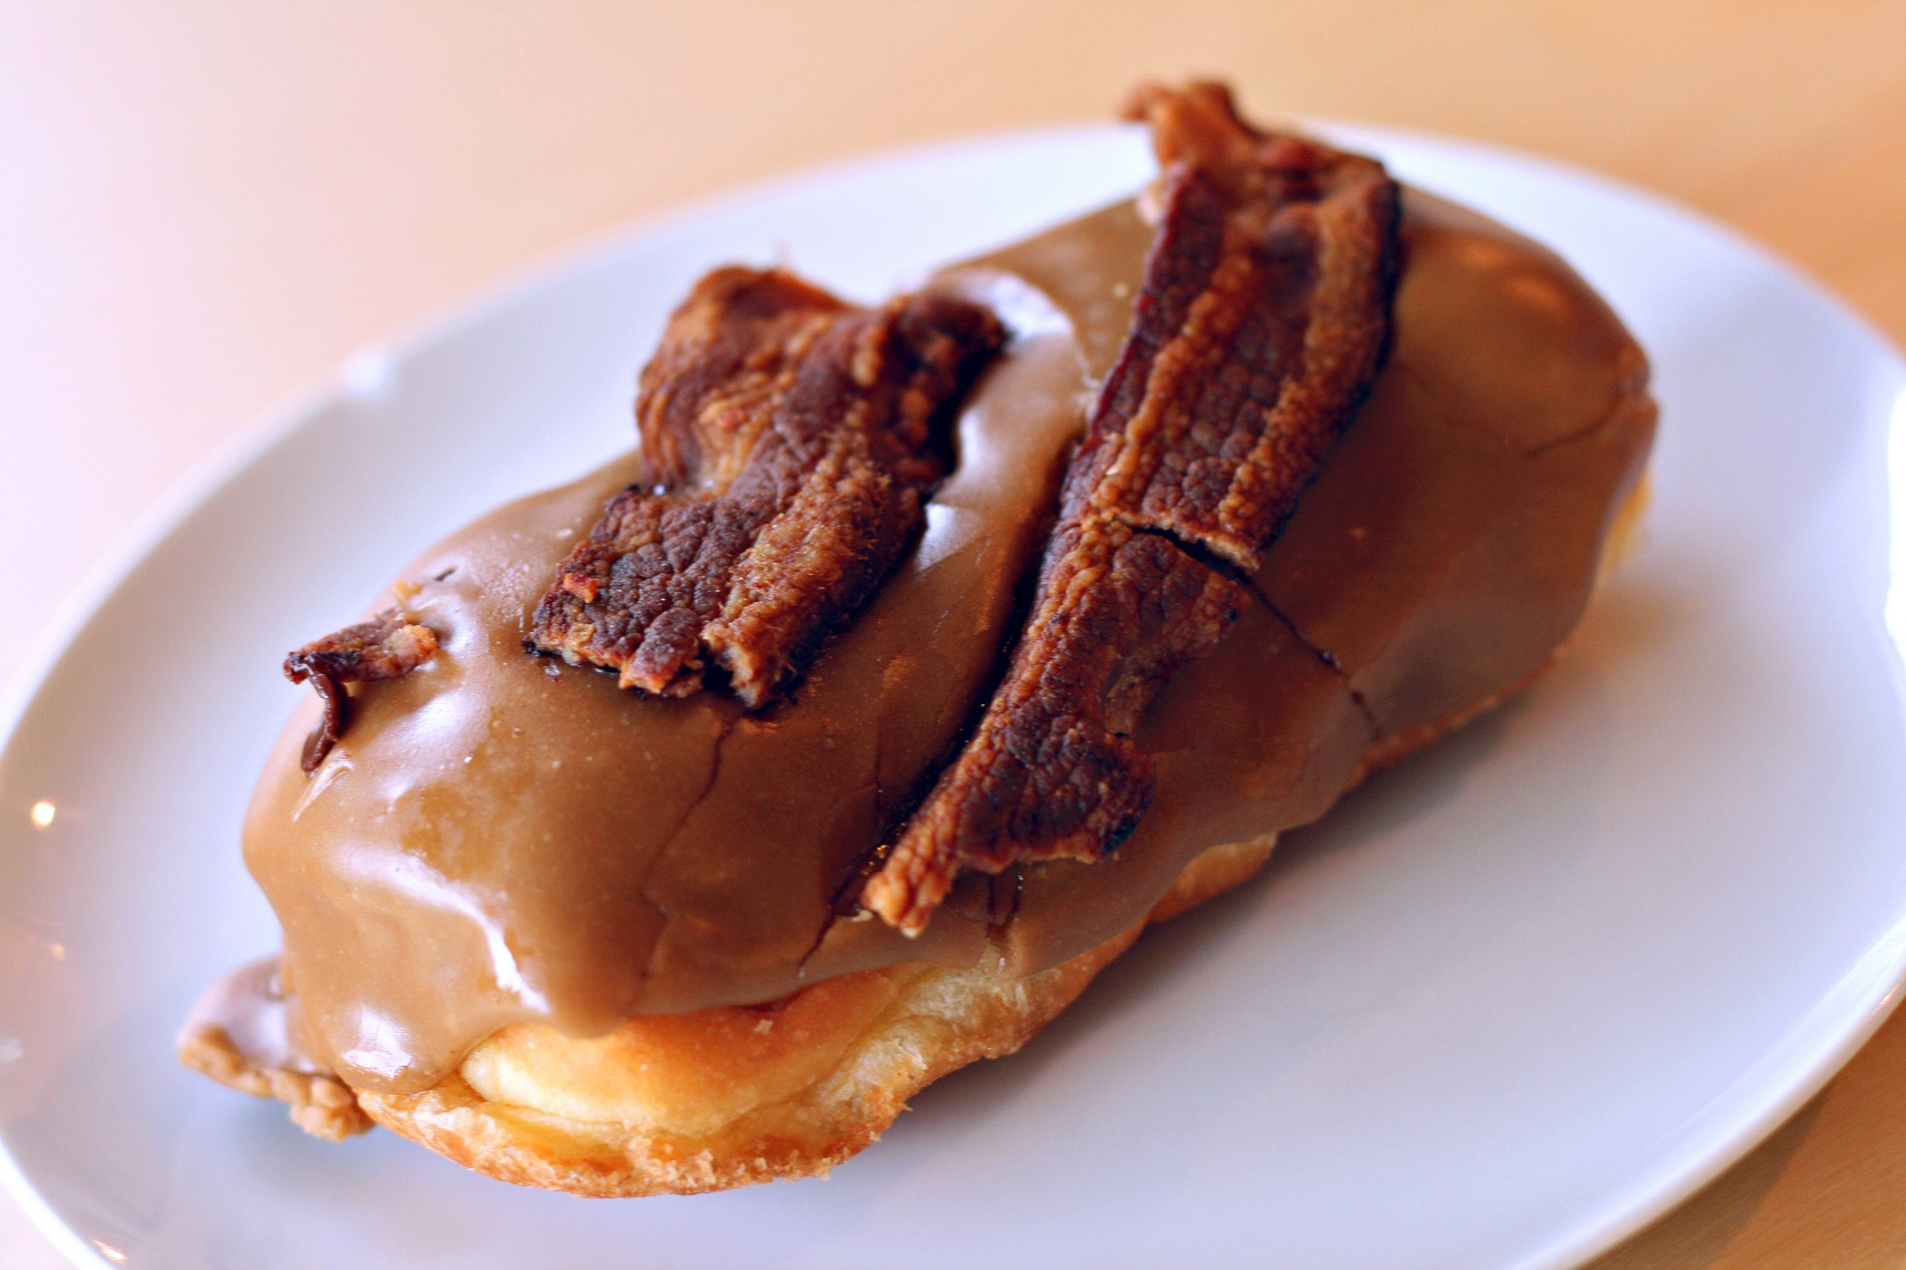

Slide 4
Romans 8:1-17 (CEB)
¹ So now there isn’t any condemnation for those who are in Christ Jesus. ² The law of the Spirit of life in Christ Jesus has set you free from the law of sin and death. ³ God has done what was impossible for the Law, since it was weak because of selfishness. God condemned sin in the body by sending His own Son to deal with sin in the same body as humans, who are controlled by sin. ⁴ He did this so that the righteous requirement of the Law might be fulfilled in us.

Slide 5
Romans 8:1-17 (CEB)
Now the way we live is based on the Spirit, not based on selfishness. ⁵ People whose lives are based on selfishness think about selfish things, but people whose lives are based on the Spirit think about things that are related to the Spirit. ⁶ The attitude that comes from selfishness leads to death, but the attitude that comes from the Spirit leads to life and peace. ⁷ So the attitude that comes from selfishness is hostile to God. It doesn’t submit to God’s Law, because it can’t. ⁸ People who are self centered aren’t able to please God.

Slide 6

Winning the Inner War
The Holy Spirit empowers you to do the right thing

Slide 7
Romans 8:1-17 (CEB)
Now the way we live is based on the Spirit, not based on selfishness. ⁵ People whose lives are based on selfishness think about selfish things, but people whose lives are based on the Spirit think about things that are related to the Spirit. ⁶ The attitude that comes from selfishness leads to death, but the attitude that comes from the Spirit leads to life and peace. ⁷ So the attitude that comes from selfishness is hostile to God. It doesn’t submit to God’s Law, because it can’t. ⁸ People who are self centered aren’t able to please God.

Slide 8
Winning the Inner War
The Holy Spirit empowers you to do the right thing
Focus your mind on what is right

Slide 9
Daily Bible Verse
Choose it in the morning
Reflect on it while going to work
Review it when you eat lunch
Share it with someone during the afternoon
Reflect on it while traveling home
Share it with someone when you get home.
Pray it when you go to bed

Slide 10
Romans 8:1-17 (CEB)
Now the way we live is based on the Spirit, not based on selfishness. ⁵ People whose lives are based on selfishness think about selfish things, but people whose lives are based on the Spirit think about things that are related to the Spirit. ⁶ The attitude that comes from selfishness leads to death, but the attitude that comes from the Spirit leads to life and peace. ⁷ So the attitude that comes from selfishness is hostile to God. It doesn’t submit to God’s Law, because it can’t. ⁸ People who are self centered aren’t able to please God.

Slide 11
Romans 8:1-17 (CEB)
⁹ But you aren’t self centered. Instead you are in the Spirit, if in fact God’s Spirit lives in you. If anyone doesn’t have the Spirit of Christ, they don’t belong to him. ¹⁰ If Christ is in you, the Spirit is your life because of God’s righteousness, but the body is dead because of sin. ¹¹ If the Spirit of the One who raised Jesus from the dead lives in you, the One who raised Christ from the dead will give life to your human bodies also, through His Spirit that lives in you.

Slide 12
Romans 8:1-17 (CEB)
¹² So then, brothers and sisters, we have an obligation, but it isn’t an obligation to ourselves to live our lives on the basis of selfishness. ¹³ If you live on the basis of selfishness, you are going to die. But if by the Spirit you put to death the actions of the body, you will live.

Slide 13
Winning the Inner War
The Holy Spirit empowers you to do the right thing
Focus your mind on what is right
Align your will with the Spirit’s will
Mark the deaths of specific selfish desires

Slide 14
Romans 8:1-17 (CEB)
¹⁴ All who are led by God’s Spirit are God’s sons and daughters. ¹⁵ You didn’t receive a spirit of slavery to lead you back again into fear, but you received a Spirit that shows you are adopted as His children. With this Spirit, we cry, “Abba, Father.” ¹⁶ The same Spirit agrees with our spirit, that we are God’s children. ¹⁷ But if we are children, we are also heirs. We are God’s heirs and fellow heirs with Christ, if we really suffer with Him so that we can also be glorified with Him.

Slide 15
Winning the Inner War
The Holy Spirit empowers you to do the right thing
Focus your mind on what is right
Align your will with the Spirit’s will
Mark the deaths of specific selfish desires
Rest in your identity as God’s child

