Slide 1


Living Filled with Joy
“Because of the abundant presence of the Holy Spirit in their lives, the disciples were
overflowing with joy.” ~Acts 13:52 (CEB)

Slide 2


Slide 3
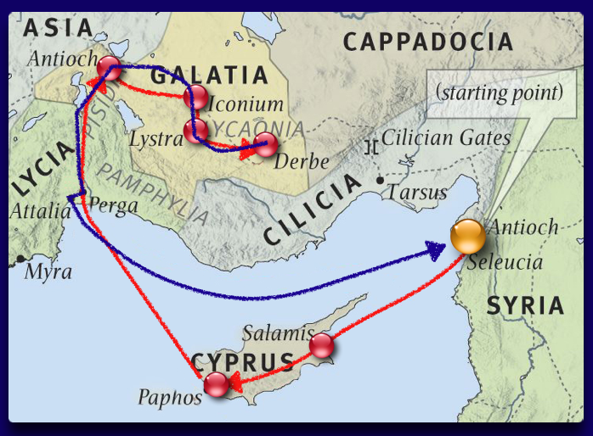

Slide 4
Acts 13:50-52 (CEB)
⁵⁰ However, the Jews provoked the prominent women among the Gentile God worshippers, as well as the city’s leaders. They instigated others to harass Paul and Barnabas, and threw them out of their district.

Slide 5
Acts 13:50-52 (CEB)
⁵⁰ However, the Jews provoked the prominent women among the Gentile God worshippers, as well as the city’s leaders. They instigated others to harass Paul and Barnabas, and threw them out of their district.
⁵¹ Paul and Barnabas shook the dust from their feet and went to Iconium.

Slide 6
Acts 13:50-52 (CEB)
⁵⁰ However, the Jews provoked the prominent women among the Gentile God worshippers, as well as the city’s leaders. They instigated others to harass Paul and Barnabas, and threw them out of their district.
⁵¹ Paul and Barnabas shook the dust from their feet and went to Iconium.
⁵² Because of the abundant presence of the Holy Spirit in their lives, the disciples were overflowing with happiness.

Slide 7

Living Filled with Joy
The Holy Spirit gives inner joy
Romans 14:17-18 “For the kingdom of God is ... righteousness, peace and joy in the Holy Spirit ....”

Slide 8
Living Filled with Joy
The Holy Spirit gives inner joy
The Holy Spirit guides you in all truth
John 16:13 Jesus said, “But when He, the Spirit of truth, comes, He will guide you into all the truth.”

Slide 9
Living Filled with Joy
The Holy Spirit gives inner joy
The Holy Spirit guides you in all truth
The Holy Spirit will bring to mind what you need to know
John 14:26 “But the Advocate, the Holy Spirit, whom the Father will send in my name, will teach you all things and will remind you of everything I have said to you.”

Slide 10
Living Filled with Joy
The Holy Spirit gives inner joy
The Holy Spirit guides you in all truth
The Holy Spirit will bring to mind what you need to know
The Holy Spirit grows good fruit out of us
Galatians 5:22-23 “But the fruit of the Spirit is love, joy, peace, patience, kindness, goodness, faithfulness, gentleness, and self control.”

Slide 11
Ephesians 1:11-14 (CEB)
¹¹ We have also received an inheritance in Christ. We were destined by the plan of God, who accomplishes everything according to His design. ... ¹³ You too heard the word of truth in Christ, which is the good news of your salvation. You were sealed with the promised Holy Spirit because you believed in Christ. ¹⁴ The Holy Spirit is the down payment on our inheritance, which is applied toward our redemption as God’s own people, resulting in the honor of God’s glory.

Slide 12


