Slide 1
PLUGGING In
“Our good news didn’t come to you just in words but also with power and the Holy Spirit and with deep conviction.”
~1 Thessalonians 1:5

Slide 2
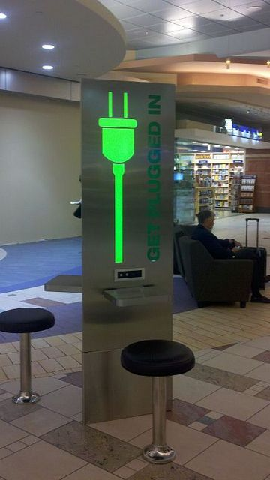
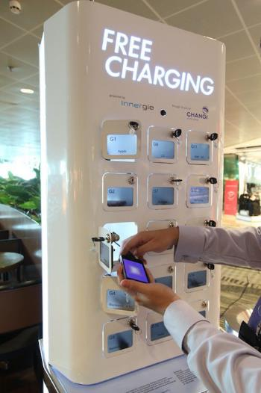

Slide 3
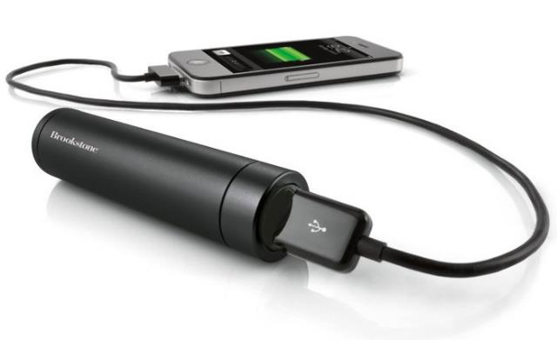

Slide 4
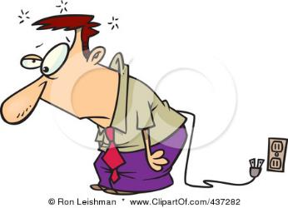
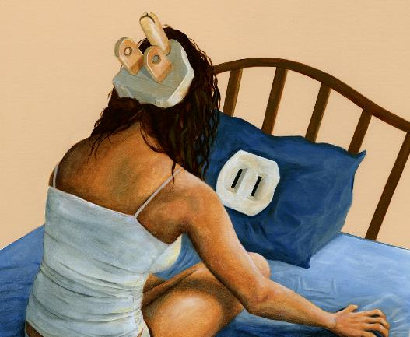

Slide 6
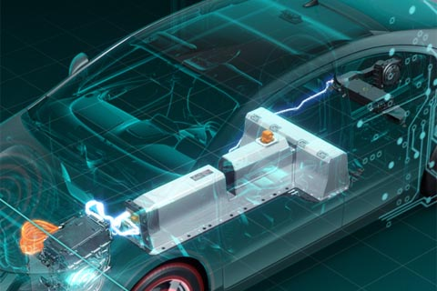
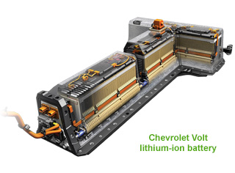

Slide 7
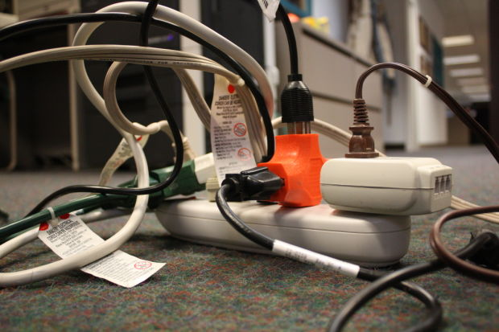

Slide 9
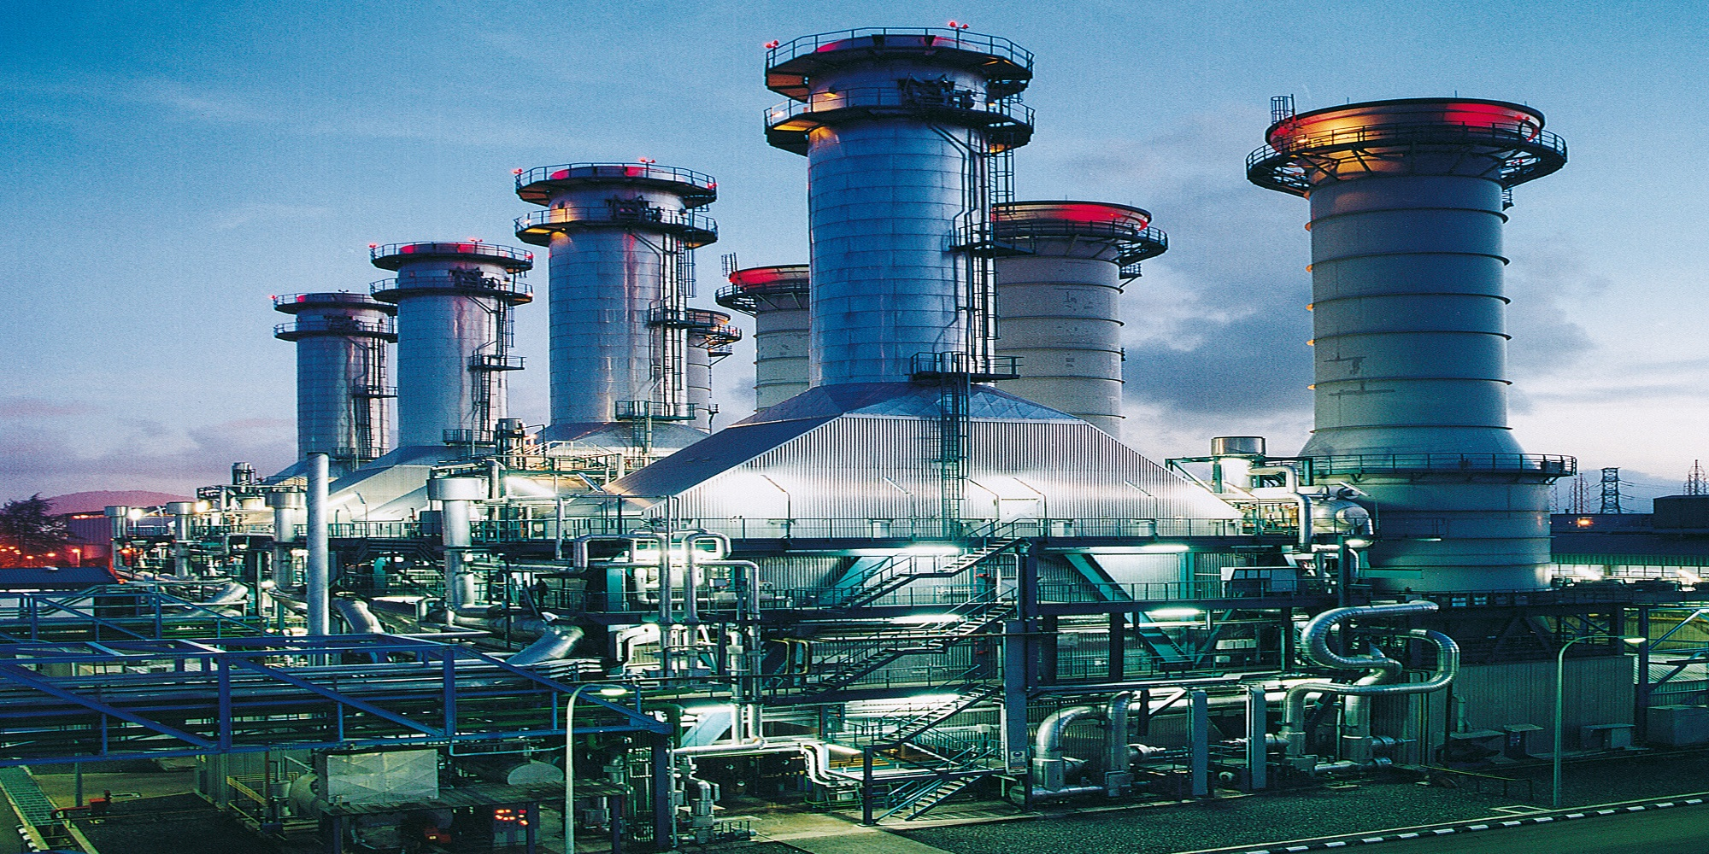

Slide 10
Ephesians 3:16-19 (NIV) …
¹⁶ I pray that out of His glorious riches the Father may strengthen you with power through His Spirit in your inner being, ¹⁷ so that Christ may dwell in your hearts through faith. And I pray that you, being rooted and established in love, ¹⁸ may have power, together with all the Lord’s holy people, to grasp how wide and long and high and deep is the love of Christ, ¹⁹ and to know this love that surpasses knowledge—that you may be filled to the measure of all the fullness of God.

Slide 11
Memory Verse:
“Glory to God, who is able to do immeasurably more than we could ask or imagine by His power at work within us.” ~Ephesians 3:20

