Slide 1
Heart Perfection
Matt. 5:48 Jesus said, “Be perfect, therefore, as your heavenly Father is perfect.”

Slide 2
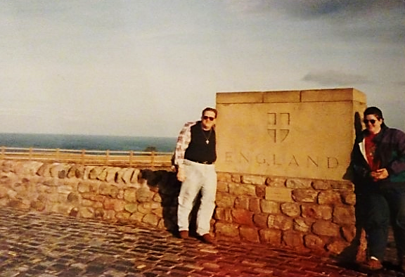

Slide 3
US: Cookie UK: Biscuit
US: Biscuit UK: Muffin
US: Muffin UK: American Muffin

Slide 6
1 John 1:7-9
⁷ But if we walk in the light, as He is in the light, we have fellowship with one another, and the blood of Jesus, His Son, purifies us from all sin. ⁸ If we claim to be without sin, we deceive ourselves and the truth is not in us. ⁹ If we confess our sins, He is faithful and just and will forgive us our sins and purify us from all unrighteousness.

Slide 7
Salvation: Put right with God
Justification: Past sins forgiven (Work of Jesus on the cross)
Regeneration: Made new and different, don’t have to sin (Work of the Holy Spirit within us)
Sanctification: Made more like Jesus, ungodliness removed (Work of the Holy Spirit within us)
Perfection: Made perfect in love in the heart (Work of the Holy Spirit within us)

Slide 8
Heart Perfection
Not sinning:
We can do the right thing

Slide 9
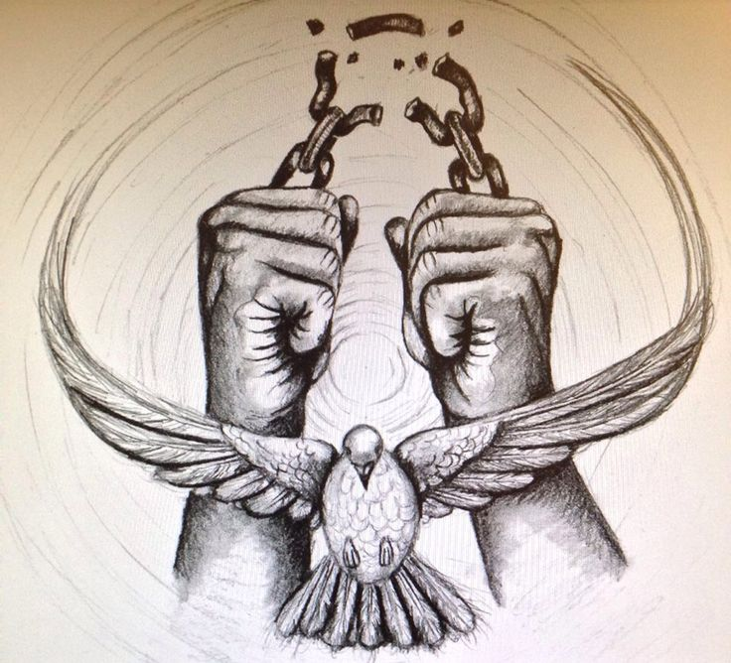
Heart Perfection
Not sinning:
We can do the right thing
Broken sinful nature:
We don’t have to follow it

Slide 10
Heart Perfection
Not sinning:
We can do the right thing
Broken sinful nature:
We don’t have to follow it
Heart filled with love:
God’s love fills up our hearts

Slide 11
1 John 4:7-18
“⁷ Dear friends, let us love one another, for love comes from God. Everyone who loves has been born of God and knows God. ... ¹² If we love one another, God lives in us and His love is made complete in us. ¹³ This is how we know that we live in Him and He in us: He has given us of His Spirit. ... ¹⁶ And so we know and rely on the love God has for us. God is love. Whoever lives in love lives in God, and God in them. ¹⁷ This is how love is made complete among us so that we will have confidence on the day of judgment: In this world we are like Jesus.”

Slide 12
Heart Perfection
Believers “purify their hearts by faith” [Acts 15:90] from:
1. Pride
2. Self-will (or self-desire)
3. Anger leading to sin
~John Wesley, “Christian Perfection,” Sermon #40 (1740) II.26

Slide 13
Philippians 3:12-16 (CEB)
¹² It’s not that I have already reached this goal or have already been perfected, but I pursue it, so that I may grab hold of it because Christ grabbed hold of me for just this purpose. ¹³ Brothers and sisters, I myself don’t think I’ve reached it, but I do this one thing: I forget about the things behind me and reach out for the things ahead of me. ¹⁴ The goal I pursue is the prize of God’s upward call in Christ Jesus. ¹⁵ So all of us who are spiritually mature should think this way, and if anyone thinks differently, God will reveal it to him or her. ¹⁶ Only let’s live in a way that is consistent with whatever level we have reached.

Slide 14
Heart Perfection
Believers “purify their hearts by faith” [Acts 15:90] from:
1. Pride
2. Self-will (or self-desire)
3. Anger leading to sin
~John Wesley, “Christian Perfection,” Sermon #40 (1740) II.26

