Slide 3
The Cat In the Hat Knows a Lot about That
Keep trying, and trying, and trying some more!
“Do not get tired of doing good, because in time we’ll have a harvest if we don’t give up.” Galatians 6:9

Slide 4
It’s a Seussical Life!
Living Seussically as God’s Kids
Psalm 103:12 “As far as east is from west–that’s how far God has removed our sin from us.”

Slide 5
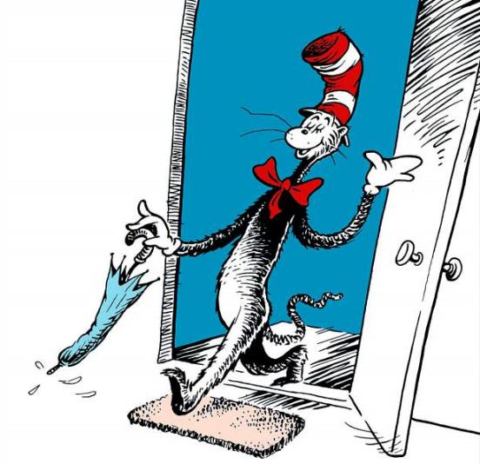

Slide 6
The Cat In the Hat Knows a Lot about That
Keep trying, and trying, and trying some more!
Living selfishly, even for innocent fun, brings great messes
“There is a way that may at first seem right, but in the end,
it leads to death.” Prov. 14:12

Slide 7
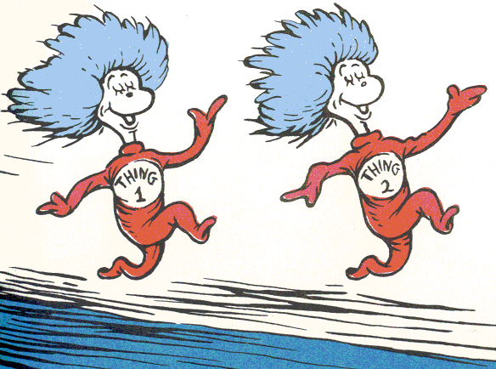

Slide 8
The Cat In the Hat Knows a Lot about That
Keep trying, and trying, and trying some more!
Living selfishly, even for innocent fun, brings great messes
Choose your friends by how they influence you
“Do not be deceived: ‘Bad company
corrupts good morals.’” 1 Cor. 15:33
“The one who walks with the wise will be wise, but the companion of fools will suffer harm.” Prov. 13:20

Slide 9
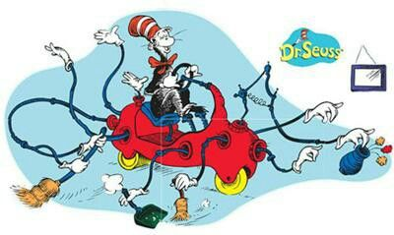

Slide 10
The Cat In the Hat Knows a Lot about That
Keep trying, and trying, and trying some more!
Living selfishly, even for innocent fun, brings great messes
Choose your friends by how they influence you
Let Jesus clean you from the inside out
“As far as east is from west–that’s how far God has removed our sin from us.” Psalm 103:12

Slide 11
Isaiah 1:16-18
¹⁶ Wash! Be clean! Remove your ugly deeds from my sight. Put an end to such evil; ¹⁷ learn to do good. Seek justice: help the oppressed; defend the orphan; plead for the widow. ¹⁸ Come now, and let’s settle this, says the Lord. Though your sins are like scarlet, they will be white as snow. If they are red as crimson, they will become like wool.

Slide 12
Psalm 103
¹ Let my whole being bless the Lord! Let everything inside me bless His holy name! ² Let my whole being bless the Lord and never forget all His good deeds: ³ how God forgives all your sins, heals all your sickness, ⁴ saves your life from the pit, crowns you with faithful love and compassion, ⁵ and satisfies you with plenty of good things so that your youth is made fresh like an eagle’s....

Slide 13
Psalm 103
⁸ The Lord is compassionate and merciful, very patient, and full of faithful love.... ¹⁰ He doesn’t deal with us according to our sin or repay us according to our wrongdoing, ¹¹ because as high as heaven is above the earth, that’s how large God’s faithful love is for those who honor Him.
¹² As far as east is from west–that’s how far God has removed our sin from us. ¹³ Like a parent feels compassion for their children–that’s how the Lord feels compassion for those who honor Him.

Slide 14
It’s a Seussical Life!
Living Seussically
as God’s Kids

