Slide 1
It’s a
Seussical Life!
Discovering Creative Ways to Live as God’s Kids
Yertle the Turtle:
Hanging Out in the Mud
Amos 5:11 “Truly, because you trample the weak,
and because you tax their grain, you have built houses of carved stone, but you won’t live in them....”

Slide 2
Matthew 7:24-27 (CEB)
²⁴ “Everybody who hears these words of mine and puts them into practice is like a wise builder who built a house on bedrock. ²⁵ The rain fell, the floods came, and the wind blew and beat against that house. It didn’t fall because it was firmly set on bedrock. ²⁶ But everybody who hears these words of mine and doesn’t put them into practice will be like a fool who built a house on sand. ²⁷ The rain fell, the floods came, and the wind blew and beat against that house. It fell and was completely destroyed.”

Slide 4
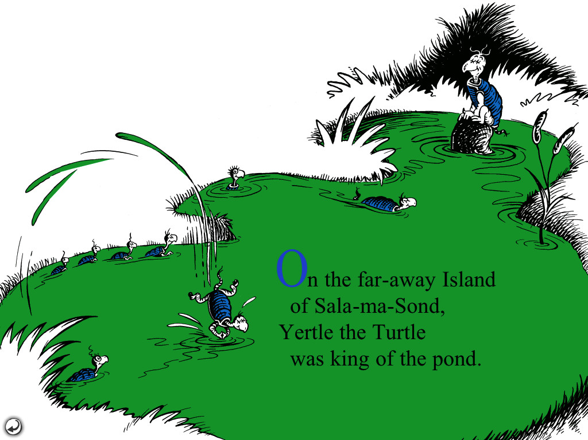

Slide 5
You tURTLE

Slide 6
You tURTLE
Solomon’s Pond = Sala-ma-Sond

Slide 7
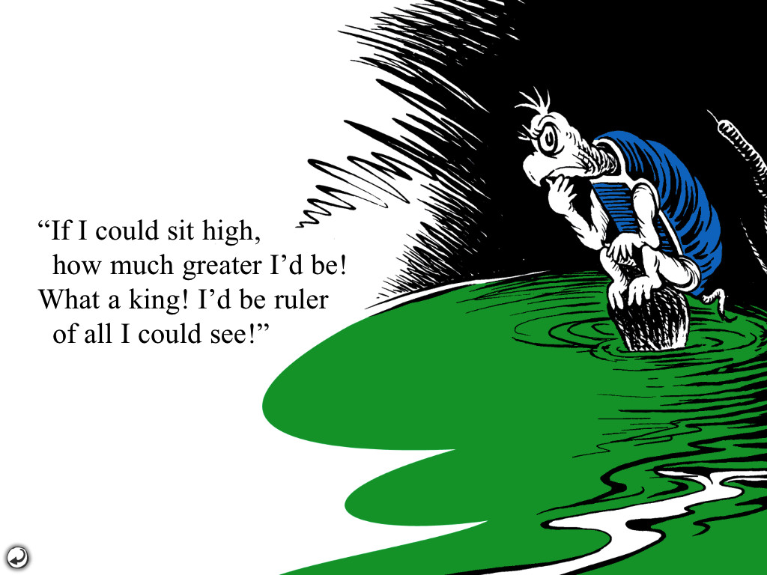

Slide 8
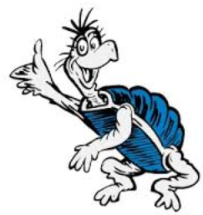
Hanging Out in the Mud
Run a contentment “check”
1 Thess. 5:18 “Give thanks in all circumstances because this is God’s will for you in Christ Jesus.”

Slide 9
Hanging Out in the Mud
Bulletin Insert: Sermon Notes
3 Things you really want: 3 Things that are so glad you have:
1. 1.
2. 2.
3. 3.

Slide 10
Hanging Out in the Mud
Run a contentment “check”
Be a blessing to others…..
Hebrews 10:24 “Let us consider others carefully for the purpose of sparking love and good deeds.”

Slide 11
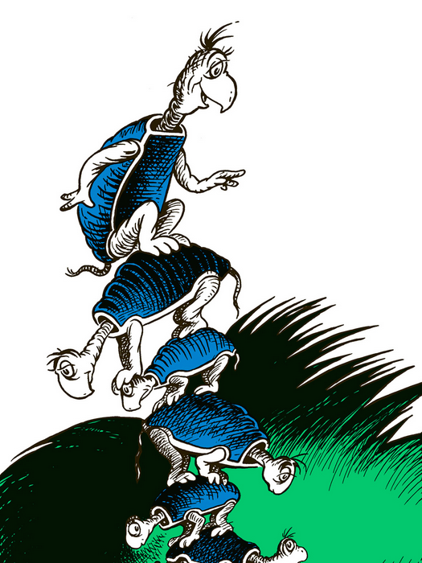

Slide 13
Hanging Out in the Mud
Run a contentment “check”
Be a blessing to others…..
Keep a firm footing on your Rock
Matt. 6:33 “Instead, desire first and foremost God’s kingdom and God’s righteousness, and all these things will be given to you as well.”

Slide 14
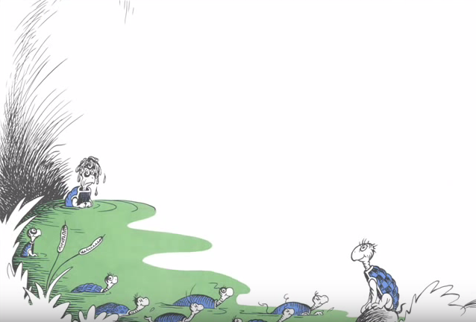

Slide 15
Amos 5:11 “Truly, because you trample the weak, and because you tax their grain, you have built houses of carved stone, but you won’t live in them.”
Proverbs 16:18 “Pride comes before disaster, and arrogance before a fall.”

Slide 16
Hanging Out in the Mud
Run a contentment “check”
Be a blessing to others…..
Keep a firm footing on your Rock
Stay missionaries in the mud…..
Proverbs 11:25 “The one who blesses others is abundantly blessed; those who help others are helped.”

Slide 17
Philippians 2:1-9 (CEB)
¹ Therefore, if there is any encourage-ment in Christ, any comfort in love, any sharing in the Spirit, any sympathy, ² complete my joy by thinking the same way, having the same love, being united, and agreeing with each other. ³ Don’t do anything for selfish purposes, but with humility think of others as better than yourselves. ⁴ Instead of each person watching out for their own good, watch out for what is better for others.

Slide 18
Philippians 2:1-9 (CEB)
⁵ Adopt the attitude that was in Christ Jesus: ⁶ Though He was in the form of God, He did not consider being equal with God something to exploit. ⁷ But He emptied Himself by taking the form of a slave and by becoming like human beings. When He found Himself in the form of a human, ⁸ He humbled Himself by becoming obedient to the point of death, even death on a cross.

Slide 19
Hanging Out in the Mud
Run a contentment “check”
Be a blessing to others…..
Keep a firm footing on your Rock
Stay missionaries in the mud…..

