Slide 1
It’s a
Seussical Life!
Discovering Creative Ways to Live as God’s Kids
You Are Enough,
Plain and Simple!”
Isaiah 43:1 “But now, this is what the LORD says–He who created you, Jacob, He who formed you, Israel: ‘Do not fear, for I have redeemed you; I have summoned you by name; you are mine.’”

Slide 2
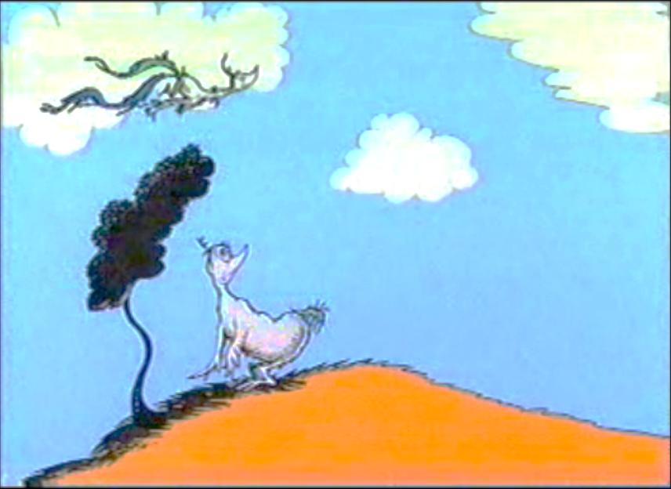

Slide 3
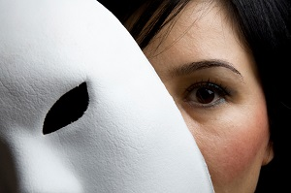

Slide 4
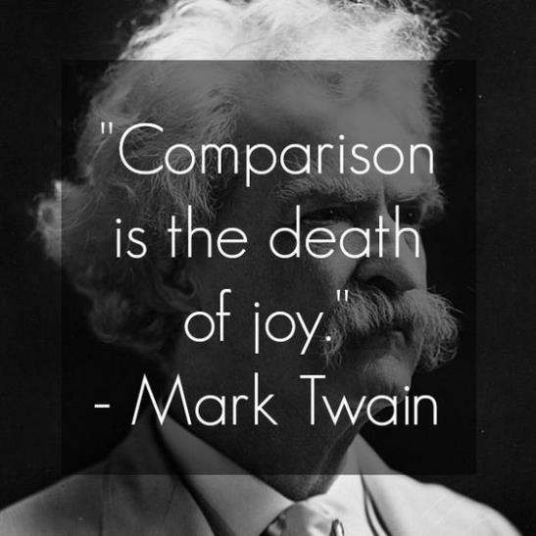

Slide 5
You are Enough, Plain and Simple
When you play the game of comparison, you will lose

Slide 8
You are Enough, Plain and Simple
When you play the game of comparison, you will lose
Your value comes from the One who made you: Just right!

Slide 9
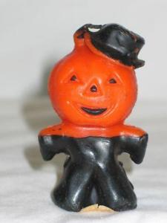

Slide 10
Psalm 139 (NIV)
¹³ For you created my inmost being; you knit me together in my mother’s womb. ¹⁴ I praise you because I am fearfully and wonderfully made; your works are wonderful, I know that full well. ¹⁵ My frame was not hidden from you when I was made in the secret place, when I was woven together in the depths of the earth. ¹⁶ Your eyes saw my unformed body; all the days ordained for me were written in your book before one of them came to be.

Slide 11
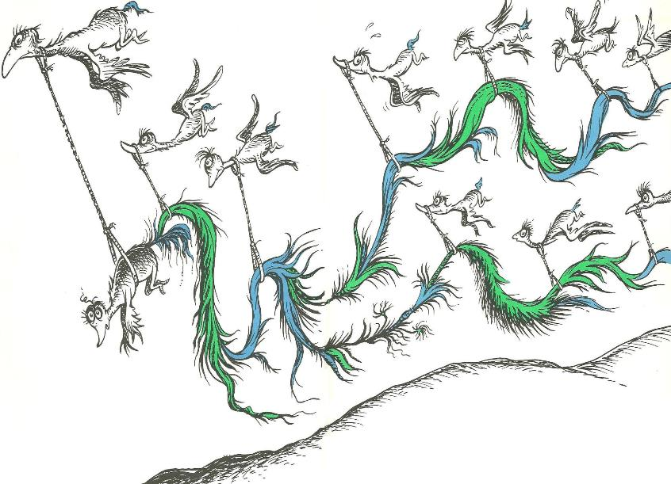

Slide 12
You are Enough, Plain and Simple
When you play the game of comparison, you will lose
Your value comes from the One who made you: Just right!
Others, who believe God’s value of us, lift us up

Slide 13
You are Enough, Plain and Simple
When you play the game of comparison, you will lose
Your value comes from the One who made you: Just right!
Others, who believe God’s value of us, lift us up
God can restore your intended luster

Slide 15
Matthew 6:25-34 (CEV)
²⁵ “Therefore, I say to you, don’t worry about your life, what you’ll eat or what you’ll drink, or about your body, what you’ll wear. Isn’t life more than food and the body more than clothes? ²⁶ Look at the birds in the sky. They don’t sow seed or harvest grain or gather crops into barns. Yet your heavenly Father feeds them. Aren’t you worth much more than they are?
²⁷ Who among you by worrying can add a single moment to your life? ²⁸ And why do you worry about clothes? Notice how the lilies in the field grow. They don’t wear themselves out with work, and they don’t spin cloth.

Slide 16
Matthew 6:25-34 (CEV)
²⁹ But I say to you that even Solomon in all of his splendor wasn’t dressed like one of these. ³⁰ If God dresses grass in the field so beautifully, even though it’s alive today and tomorrow it’s thrown into the furnace, won’t God do much more for you, you people of weak faith?
³¹ Therefore, don’t worry and say, ‘What are we going to eat?’ or ‘What are we going to drink?’ or ‘What are we going to wear?’ ³² Gentiles long for all these things. Your heavenly Father knows that you need them.

Slide 17
Matthew 6:25-34 (CEV)
³³ Instead, desire first and foremost God’s kingdom and God’s righteousness, and all these things will be given to you as well. ³⁴ Therefore, stop worrying about tomorrow, because tomorrow will worry about itself. Each day has enough trouble of its own.

Slide 18
