Slide 1


Habitat for Divinity
Rev. Peter Milloy

Slide 2
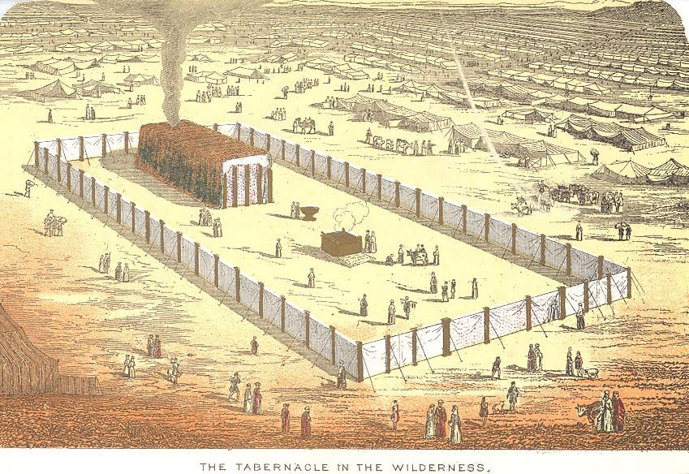

Slide 3
Exodus 35:30-36:1 (RSV)
³⁰ And Moses said to the people of Israel, “See, the Lord has called by name Bez′alel the son of Uri, son of Hur, of the tribe of Judah; ³¹ and he has filled him with the Spirit of God, with ability, with intelligence, with knowledge, and with all craftsmanship, ³² to devise artistic designs, to work in gold and silver and bronze, ³³ in cutting stones for setting, and in carving wood, for work in every skilled craft. ³⁴ And he has inspired him to teach, both him and Oho′liab the son of Ahis′amach of the tribe of Dan.

Slide 4
Exodus 35:30-36:1 (RSV)
³⁵ He has filled them with ability to do every sort of work done by a craftsman or by a designer or by an embroiderer in blue and purple and scarlet stuff and fine twined linen, or by a weaver—by any sort of workman or skilled designer.
^{36:1} Bez′alel and Oho′liab and every able man in whom the Lord has put ability and intelligence to know how to do any work in the construction of the sanctuary shall work in accordance with all that the Lord has commanded.”

Slide 5
Exodus 40:34-38 (RSV)
The Cloud and the Glory
³⁴ Then the cloud covered the tent of meeting, and the glory of the Lord filled the tabernacle. ³⁵ And Moses was not able to enter the tent of meeting, because the cloud abode upon it, and the glory of the Lord filled the tabernacle. ³⁶ Throughout all their journeys, whenever the cloud was taken up from over the tabernacle, the people of Israel would go onward; ³⁷ but if the cloud was not taken up, then they did not go onward till the day that it was taken up. ³⁸ For throughout all their journeys the cloud of the Lord was upon the tabernacle by day, and fire was in it by night, in the sight of all the house of Israel.

