Slide 1
Pentecost Jubilee
Jesus said to them, “Look, I’m sending to you what my Father promised, but you are to stay in the city until you have been furnished with heavenly power.” ~Luke 24:49

Slide 2
Romans 12:3b-8
“Think of yourself with sober judgment, in accordance with the faith God has distributed to each of you. For just as each of us has one body with many members, and these members do not all have the same function, so in Christ we, though many, form one body, and each member belongs to all the others. We have different gifts, according to the grace given to each of us. If your gift is prophesying, then prophesy in accordance with your faith; if it is serving, then serve; if it is teaching, then teach; if it is to encourage, then give encouragement; if it is giving, then give generously; if it is to lead, do it diligently; if it is to show mercy, do it cheerfully.”

Slide 3
You are gifted!
Spiritual Gifts Inventory: www.foresthillsumc.net ⇨ “Connect” tab

Slide 4
Prayers for discerning and using your spiritual gifts

Slide 5
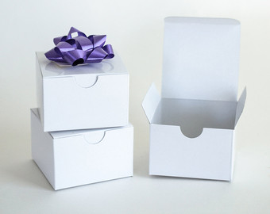
Gift boxes
Come get your gift box
during the offering.
Use it as a reminder every day to open your spiritual gifts that day!

Slide 6
Offering
&

Slide 7
Pouring from an Empty Pitcher
“They brought the jars to her and she
kept pouring.” ~2 Kings 4:5b

Slide 8
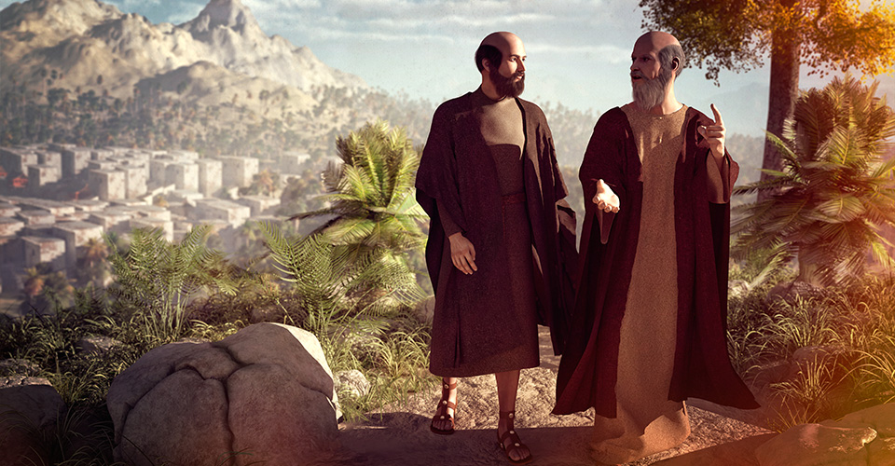

Slide 9
2 Kings 4:1-7 (CEB) The poor widow and the olive oil
¹ Now there was a woman who had been married to a member of a group of prophets. She appealed to Elisha, saying, “My husband, your servant, is dead. You know how he feared the Lord. But now someone he owed money to has come to take my two children away as slaves.”
² Elisha said to her, “What can I do for you? Tell me what you still have left in the house.”
She said, “Your servant has nothing at all in the house except a small jar of oil.”
³ He said, “Go out and borrow containers from all your neighbors. Get as many empty containers as
possible.

Slide 10
2 Kings 4:1-7 (CEB) The poor widow and the olive oil
⁴ Then go in and close the door behind you and your sons. Pour oil into all those containers. Set each one aside when it’s full.”
⁵ She left Elisha and closed the door behind her and her sons. They brought her containers as she kept on pouring. ⁶ When she had filled the containers, she said to her son, “Bring me another container.”
He said to her, “There aren’t any more.” Then the oil stopped flowing, ⁷ and she reported this to the man of God.
He said, “Go! Sell the oil and pay your debts. You and your sons can live on what remains.”

Slide 11
2 Kings 4:8-37 (CEB) Elisha raises the son of a rich woman
⁸ One day Elisha went to Shunem. A rich woman lived there. She urged him to eat something, so whenever he passed by, he would stop in to eat some food. ⁹ She said to her husband, “Look, I know that he is a holy man of God and he passes by regularly. ¹⁰ Let’s make a small room on the roof. We’ll set up a bed, a table, a chair, and a lamp for him there. Then when he comes to us, he can stay there.”

Slide 12
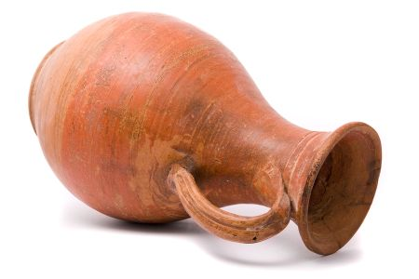
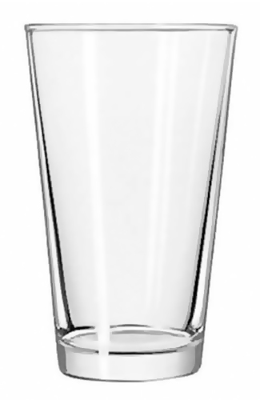
Pouring from an Empty Pitcher
Seek more of God

Slide 13
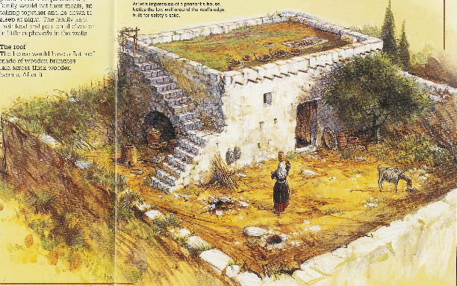

Slide 14
Pouring from an Empty Pitcher
Seek more of God
Create emptiness (capacity)

Slide 15
2 Kings 4:8-37 (CEB) Elisha raises the son of a rich woman
¹⁸ The child grew up. One day he ran to his father, who was with the harvest workers. ¹⁹ He said to his father, “Oh, my head! My head!”
The father said to a young man, “Carry him to his mother.” ²⁰ So he picked up the boy and brought him to his mother.
The boy sat on her lap until noon. Then he died.

Slide 16
2 Kings 4:8-37 (CEB) Elisha raises the son of a rich woman
²¹ She went up and laid him down on the bed for the man of God. Then she went out and closed the door. ²² She called her husband and said, “Send me one of the young men and one of the donkeys so that I can hurry to the man of God and come back.”
²³ Her husband said, “Why are you going to him today? It’s not a new moon or sabbath.” She said, “Don’t worry about it.”

Slide 17
2 Kings 4:8-37 (CEB) Elisha raises the son of a rich woman
²⁹ Elisha said to Gehazi, “Get ready, take my staff, and go! If you encounter anyone, don’t stop to greet them. If anyone greets you, don’t reply. Put my staff on the boy’s face.”
³⁰ But the boy’s mother said, “I swear by your life and by the Lord’s life, I won’t leave you!” So Elisha got up and followed her.
³¹ Gehazi went on ahead of them. He set the staff on the young boy’s face, but there was no sound or response. So he went back to meet Elisha and told him, “The boy didn’t wake up.”

Slide 18
Pouring from an Empty Pitcher
Seek more of God
Create emptiness (capacity)
Cling to God’s Presence

Slide 19
2 Kings 4:8-37 (CEB) Elisha raises the son of a rich woman
³² Elisha came into the house and saw the boy lying dead on his bed. ³³ He went in and closed the door behind the two of them. Then he prayed to the Lord. ³⁴ He got up on the bed and lay down on top of the child, putting his mouth on the boy’s mouth, his eyes on the boy’s eyes, his hands on the boy’s hands. And as he bent over him, the child’s skin grew warm.

Slide 20
2 Kings 4:8-37 (CEB) Elisha raises the son of a rich woman
³⁵ Then Elisha got down and paced back and forth in the house. Once again he got up on the bed and bent over the boy, at which point the boy sneezed seven times and opened his eyes. ³⁶ Elisha called for Gehazi and said, “Call the Shunammite woman.” Gehazi called her, and she came to Elisha. He told her, “Pick up your son.” ³⁷ She came and fell at his feet, facedown on the ground. Then she picked up her son and left.

Slide 21
Pouring from an Empty Pitcher
Seek more of God
Create emptiness (capacity)
Cling to God’s Presence
God brings new life

Slide 22
HCI Consult Report

Slide 23
Pouring from an Empty Pitcher
“They brought the jars to her and she
kept pouring.” ~2 Kings 4:5b

