Slide 1
A MAN OF PASSION & DESTINY
The Giant
“‘The Lord,’ David added, ‘who rescued me from the power of both lions and bears, will rescue me from the power of this Philistine.’” ~1 Samuel 17:37

Slide 2
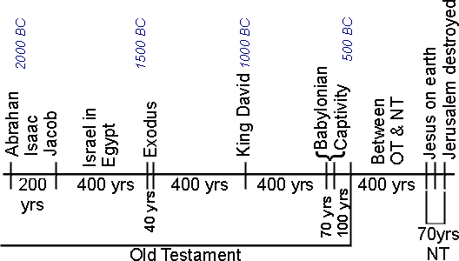

Slide 3
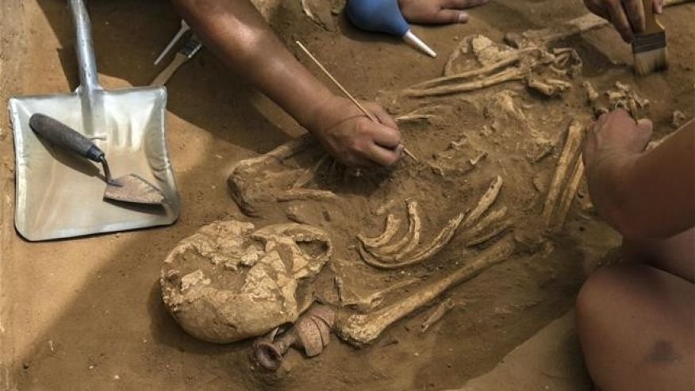
http://www.foxnews.com/science/2016/07/11/big-discovery-could-reveal-true-story-philistines.html

Slide 4
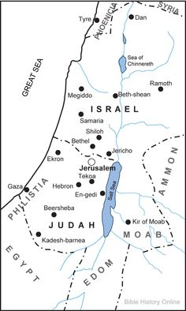

Slide 5
1 Samuel 17
¹ The Philistines assembled their troops for war at Socoh of Judah. They camped between Socoh and Azekah at Ephes dammim. ² Saul and the Israelite army assembled and camped in the Elah Valley, where they got organized to fight the Philistines. ³ The Philistines took positions on one hill while Israel took positions on the opposite hill. There was a valley between them. ⁴ A champion named Goliath from Gath came out from the Philistine camp. He was more than nine feet tall.

Slide 6
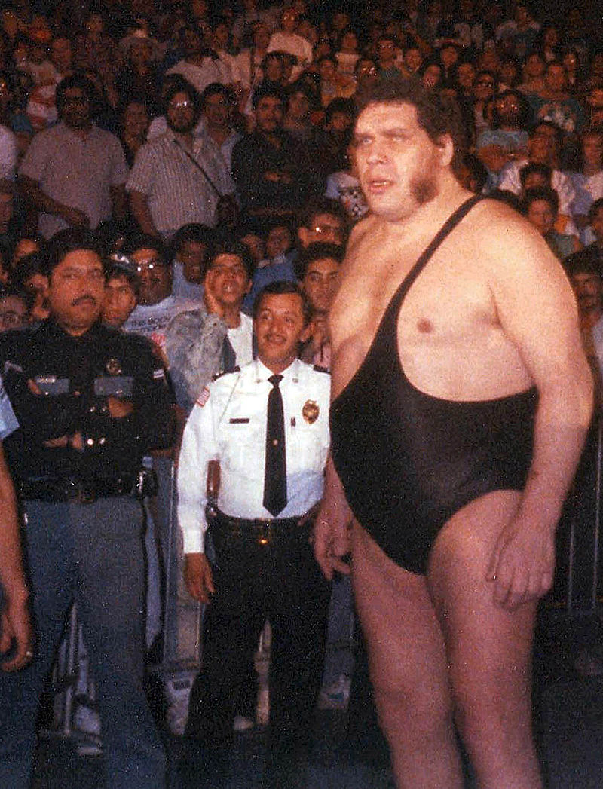

Slide 7
1 Samuel 17
⁸ Goliath stopped and shouted to the Israelite troops, “Why have you come and taken up battle formations? I am the Philistine champion, and you are Saul’s servants. Isn’t that right? Select one of your men, and let him come down against me. ⁹ If he is able to fight me and kill me, then we will become your slaves, but if I overcome him and kill him, then you will become our slaves and you will serve us.
¹⁰ I insult Israel’s troops today!” The Philistine continued, “Give me an opponent, and we’ll fight!” ¹¹ When Saul and all Israel heard what the Philistine said, they were distressed and terrified.

Slide 8
A MAN OF PASSION & DESTINY
The Giant
Giants loom (unexpectedly?) in your life

Slide 9
1 Samuel 17
¹² Now David ... ¹⁵ went back and forth from Saul’s side to shepherd his father’s flock in Bethlehem.
¹⁶ For forty days straight the Philistine came out and took his stand, both morning and evening.
¹⁷ Jesse said to his son David, “...Find out how your [three oldest] brothers are doing and bring back some sign that they are okay. ¹⁹ They are with Saul and all the Israelite troops fighting the Philistines in the Elah Valley.”

Slide 10
1 Samuel 17
²⁶ David asked the soldiers standing by him, “What will be done for the person who kills that Philistine over there and removes this insult from Israel? Who is that uncircumcised Philistine, anyway, that he can get away with insulting the army of the living God?” ... ²⁸ When David’s oldest brother Eliab heard him talking to the soldiers, he got very mad at David. “Why did you come down here?” he said. “Who is watching those few sheep for you in the wilderness? I know how arrogant you are and your devious plan: you came down just to see the battle!” ²⁹ “What did I do wrong this time?” David replied. “It was just a question!”

Slide 11
David 2: The Giant
Giants loom (unexpectedly?) in your life
Even those close to you will push you down

Slide 12
1 Samuel 17
³¹ The things David had said were overheard and reported to Saul, who sent for him.
³² “Don’t let anyone lose courage because of this Philistine!” David told Saul. “I, your servant, will go out and fight him!”
³³ “You can’t go out and fight this Philistine,” Saul answered David. “You are still a boy. But he’s been a warrior since he was a boy!”

Slide 13
1 Samuel 17
³⁴ “Your servant has kept his father’s sheep,” David replied to Saul, “and if ever a lion or a bear came and carried off one of the flock, ³⁵ I would go after it, strike it, and rescue the animal from its mouth. If it turned on me, I would grab it at its jaw, strike it, and kill it. ³⁶ Your servant has fought both lions and bears. This uncircumcised Philistine will be just like one of them because he has insulted the army of the living God.
³⁷ “The Lord,” David added, “who rescued me from the power of both lions and bears, will rescue me from the power of this Philistine.” “Go!” Saul replied to David. “And may the Lord be with you!”

Slide 14
David 2: The Giant
Giants loom (unexpectedly?) in your life
Even those close to you will push you down
Remember God’s faithfulness in the past

Slide 15
1 Samuel 17
³⁸ Then Saul dressed David in his own gear, putting a coat of armor on him and a bronze helmet on his head. ³⁹ David strapped his sword on over the armor, but he couldn’t walk around well because he’d never tried it before. “I can’t walk in this,” David told Saul, “because I’ve never tried it before.” So he took them off. ⁴⁰ He then grabbed his staff and chose five smooth stones from the streambed. He put them in the pocket of his shepherd’s bag and with sling in hand went out to the Philistine.

Slide 16
David 2: The Giant
Giants loom (unexpectedly?) in your life
Even those close to you will push you down
Remember God’s faithfulness in the past
Use your own strengths

Slide 17
1 Samuel 17
⁴³ The Philistine asked David, “Am I some sort of dog that you come at me with sticks?” And he cursed David by his gods. ⁴⁴ “Come here,” he said to David, “and I’ll feed your flesh to the wild birds and the wild animals!”
⁴⁵ But David told the Philistine, “You are coming against me with sword, spear, and scimitar, but I come against you in the name of the Lord of heavenly forces, the God of Israel’s army, the one you’ve insulted.

Slide 18
1 Samuel 17
⁴⁶ Today the Lord will hand you over to me. I will strike you down and cut off your head! Today I will feed your dead body and the dead bodies of the entire Philistine camp to the wild birds and the wild animals. Then the whole world will know that there is a God on Israel’s side. ⁴⁷ And all those gathered here will know that the Lord doesn’t save by means of sword and spear. The Lord owns this war, and he will hand all of you over to us.”

Slide 19
David 2: The Giant
Giants loom (unexpectedly?) in your life
Even those close to you will push you down
Remember God’s faithfulness in the past
Use your own strengths
It’s not your battle!

Slide 20
2 Corinthians
12:9-10
⁹ He said to me, “My grace is enough for you, because power is made perfect in weakness.” So I’ll gladly spend my time bragging about my weaknesses so that Christ’s power can rest on me. ¹⁰ Therefore, I’m all right with weaknesses, insults, disasters, harassments, and stressful situations for the sake of Christ, because when I’m weak, then I’m strong.

Slide 21
1 Samuel 17
⁴⁸ The Philistine got up and moved closer to attack David, and David ran quickly to the front line to face him.
⁴⁹ David put his hand in his bag and took out a stone. He slung it, and it hit the Philistine on his forehead. The stone penetrated his forehead, and he fell facedown on the ground. ⁵⁰ And that’s how David triumphed over the Philistine with just a sling and a stone, striking the Philistine down and killing him—and David didn’t even have a sword! ⁵¹ Then David ran and stood over the Philistine. He grabbed the Philistine’s sword, drew it from its sheath, and finished him off. Then David cut off the Philistine’s head with the sword.

Slide 22
David 2: The Giant
Giants loom (unexpectedly?) in your life
Even those close to you will push you down
Remember God’s faithfulness in the past
Use your own strengths
It’s not your battle!
God makes you way bigger than your giant

Slide 23
