Slide 1
A MAN OF PASSION & DESTINY
Only a Boy Named David
“Later, God removed Saul and let David rule in his place. God said about him, ‘I have found David son of Jesse, a man after my own heart; he will do everything I want him to do.’”
Acts 13:22

Slide 2
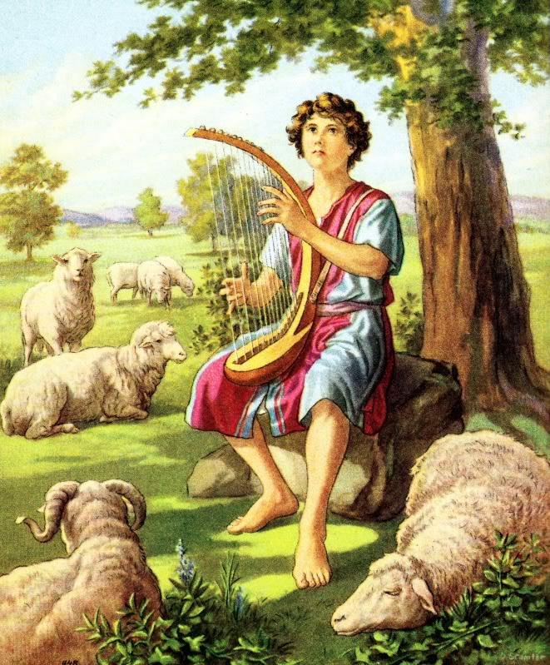
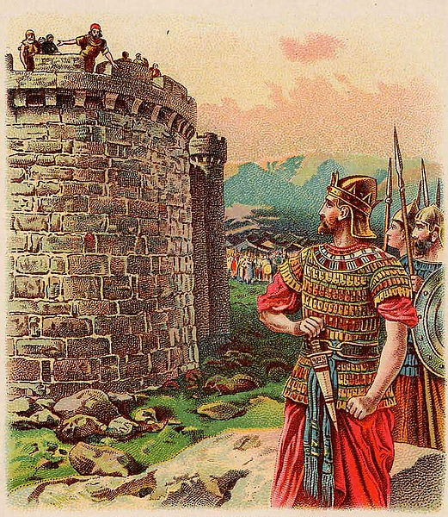
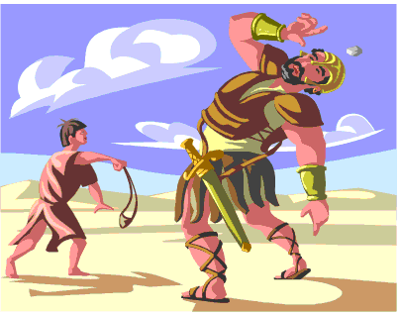
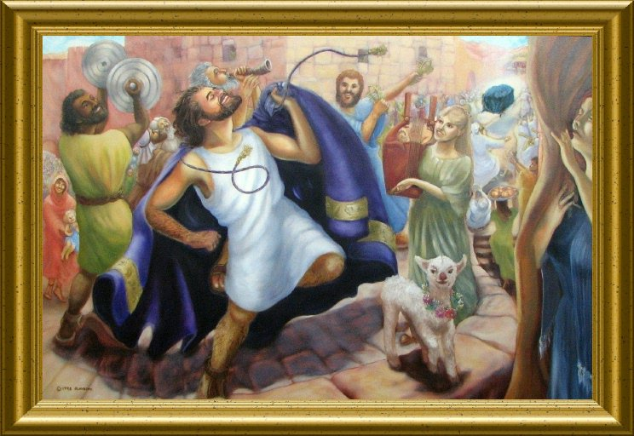
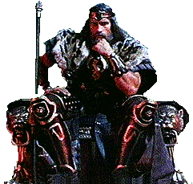

Slide 3
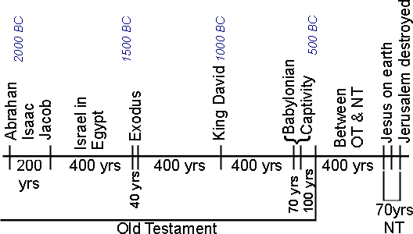

Slide 4
1 Samuel 15
⁹ Saul and the troops spared Agag along with the best sheep, cattle, fattened calves, lambs, and everything of value. They weren’t willing to put them under the ban; but anything that was despised or of no value they placed under the ban. ¹⁰ Then the Lord’s word came to Samuel: ¹¹ “I regret making Saul king because he has turned away from follow-ing me and hasn’t done what I said.” Samuel was upset at this, and he prayed to the Lord all night long.

Slide 5
1 Samuel 15
¹³ When Samuel reached Saul, Saul greeted him, “The Lord bless you! I have done what the Lord said.”
¹⁴ “Then what,” Samuel asked, “is this bleating of sheep in my ears and mooing of cattle I hear?”
¹⁵ “They were taken from the Amalekites,” Saul said, “because the troops spared the best sheep and cattle in order to sacrifice them to the Lord your God. The rest was placed under the ban.”

Slide 6
1 Samuel 15
²³ “Rebellion is as bad as the sin of divination; arrogance is like the evil of idolatry. Because you have rejected what the Lord said, He has rejected you as king.”

Slide 7
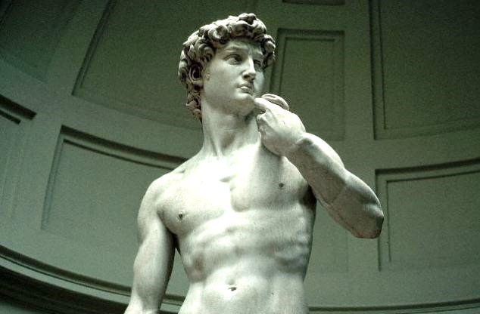

Slide 8
1 Samuel 16
¹ The Lord said to Samuel, “How long are you going to grieve over Saul? I have rejected him as king over Israel. Fill your horn with oil and get going. I’m sending you to Jesse of Bethlehem because I have found my next king among his sons.”
² “How can I do that?” Samuel asked. “When Saul hears of it he’ll kill me!”
“Take a heifer with you,” the Lord replied, “and say, ‘I have come to make a sacrifice to the Lord.’ ³ Invite Jesse to the sacrifice, and I will make clear to you what you should do. You will anoint for me the person I point out to you.”

Slide 9
1 Samuel 16
⁴ Samuel did what the Lord instructed. When he came to Bethlehem, the city elders came to meet him. They were shaking with fear. “Do you come in peace?” they asked.
⁵ “Yes,” Samuel answered. “I’ve come to make a sacrifice to the Lord. Now make yourselves holy, then come with me to the sacrifice.” Samuel made Jesse and his sons holy and invited them to the sacrifice as well.
⁶ When they arrived, Samuel looked at Eliab and thought, that must be the Lord’s anointed right in front.

Slide 10
1 Samuel 16
⁷ But the Lord said to Samuel, “Have no regard for his appearance or stature, because I haven’t selected him. God doesn’t look at things like humans do. Humans see only what is visible to the eyes, but the Lord sees into the heart.”

Slide 11
Only a Boy
Named David
God sees the heart

Slide 14
1 Samuel 16
⁸ Next Jesse called for Abinadab, who presented himself to Samuel, but he said, “The Lord hasn’t chosen this one either.” ⁹ So Jesse presented Shammah, but Samuel said, “No, the Lord hasn’t chosen this one.” ¹⁰ Jesse presented seven of his sons to Samuel, but Samuel said to Jesse, “The Lord hasn’t picked any of these.” ¹¹ Then Samuel asked Jesse, “Is that all of your boys?”
“There is still the youngest one,” Jesse answered, “but he’s out keeping the sheep.”

Slide 15
1 Samuel 16
¹¹ Then Samuel asked Jesse, “Is that all of your boys?”
“There is still the youngest one,” Jesse answered, “but he’s out keeping the sheep.”
“Send for him,” Samuel told Jesse, “because we can’t proceed until he gets here.”
¹² So Jesse sent and brought him in. He was reddish brown, had beautiful eyes, and was good looking. The Lord said, “That’s the one. Go anoint him.” ¹³ So Samuel took the horn of oil and anointed him right there in front of his brothers. The Lord’s spirit came over David from that point forward. Then Samuel left and went to Ramah.

Slide 16
Only a Boy
Named David
God sees the heart
God sees the overlooked

Slide 17
Only a Boy
Named David
God sees the heart
God sees the overlooked
God redeems “wasted” time as preparation

Slide 18
