Slide 1

A MAN OF PASSION & DESTINY
A Fast Friend
“Saul’s son Jonathan came to David at Horesh and encouraged him with God.” ~1 Samuel 23:16

Slide 2
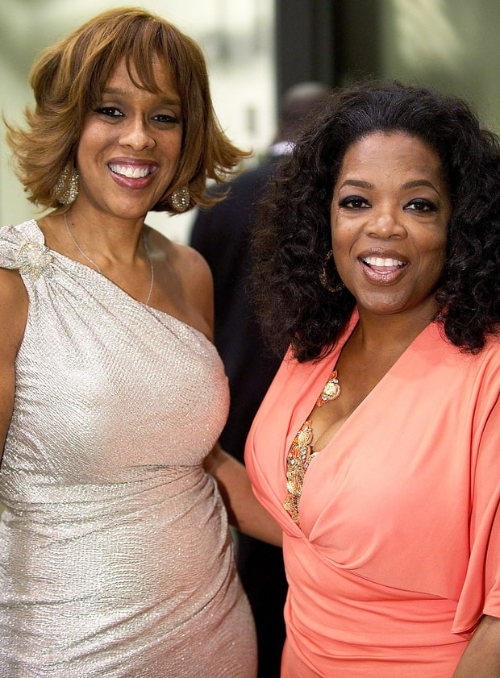

Slide 3
A MAN OF PASSION & DESTINY
Prayed for you in worship this morning. Thanks for being such a great friend!

Slide 4

Qualities of best friends:
1.
2.
3.

Slide 5
1 Samuel 18 (CEB)
¹ As soon as David had finished talking with Saul, Jonathan’s life became bound up with David’s life, and Jonathan loved David as much as himself.
² From that point forward, Saul kept David in his service and wouldn’t allow him to return to his father’s household. ³ And Jonathan and David made a covenant together because Jonathan loved David as much as himself. ⁴ Jonathan took off the robe he was wearing and gave it to David, along with his armor, as well as his sword, his bow, and his belt. ⁵ David went out and was successful in every mission Saul sent him to do. So Saul placed him in charge of the soldiers, and this pleased all the troops as well as Saul’s servants.

Slide 6
1 Samuel 18 (CEB)
⁹ “And Saul looked at David with suspicion from that day on.”
²⁸ When Saul knew for certain that the Lord was with David and that his daughter Michal loved him, ²⁹ then Saul was even more afraid of David. Saul was David’s enemy for the rest of his life.

Slide 7
Insights for growing spiritually:
Defeating your giants doesn’t necessarily bring respite

Slide 8
Insights for growing spiritually:
Defeating your giants doesn’t necessarily bring respite
Sometimes our trials are because of someone else’s mess

Slide 9
Insights for growing spiritually:
Defeating your giants doesn’t necessarily bring respite
Sometimes our trials are because of someone else’s mess
God still uses them to grow us, including spiritually

Slide 10
Insights for growing spiritually:
Defeating your giants doesn’t necessarily bring respite
Sometimes our trials are because of someone else’s mess
God still uses them to grow us, including spiritually
God provides friends to carry us through hardships

Slide 11
A Fast Friend - Biblical Characteristics
A willingness to sacrifice

Slide 12
1 Samuel 19
¹ Saul ordered his son Jonathan and all his servants to kill David, but Jonathan, Saul’s son, liked David very much. ² So Jonathan warned David, “My father Saul is trying to kill you. Be on guard tomorrow morning. Stay somewhere safe and hide. ³ I’ll go out and stand by my father in the field where you’ll be. I’ll talk to my father about you, and I’ll tell you whatever I find out.”
⁴ So Jonathan spoke highly about David to his father Saul, telling him, “The king shouldn’t do anything wrong to his servant David, because he hasn’t wronged you. In fact, his actions have helped you greatly.

Slide 13
1 Samuel 19
⁵ He risked his own life when he killed that Philistine, and the Lord won a great victory for all Israel. You saw it and were happy about it. Why then would you do something wrong to an innocent person by killing David for no reason?”
⁶ Saul listened to Jonathan and then swore, “As surely as the Lord lives, David won’t be executed.” ⁷ So Jonathan summoned David and told him everything they had talked about. Then Jonathan brought David back to Saul, and David served Saul as he had previously.

Slide 14
A Fast Friend - Biblical Characteristics
A willingness to sacrifice
A loyal defense

Slide 15
1 Samuel 20
¹ David fled from the camps at Ramah. He came to Jonathan and asked, “What have I done? What is my crime? How have I wronged your father that he wants me dead?...But I promise you—on the Lord’s life and yours!—that I am this close to death!” ...
⁹ “Enough!” Jonathan replied. “If I can determine for certain that my father intends to harm you, of course I’ll tell you!” ...
^{13b} May the Lord be with you as he once was with my father. ¹⁴ If I remain alive, be loyal to me. But if I die, ¹⁵ don’t ever stop being loyal to my household....

Slide 16
1 Samuel 20
¹⁷ So Jonathan again made a pledge to David because he loved David as much as himself. ...
³³ At that, Saul threw his spear at Jonathan to strike him, and Jonathan realized that his father intended to kill David. ³⁴ Jonathan got up from the table in a rage. He didn’t eat anything on the second day of the new moon because he was worried about David and because his father had humiliated him. ³⁵ In the morning, Jonathan went out to the field for the meeting with David.... David came out from behind the mound and fell down, face on the ground, bowing low three times.

Slide 17
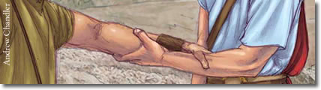
1 Samuel 20
The friends kissed each other, and cried with each other, but David cried hardest. ⁴² Then Jonathan said to David, “Go in peace because the two of us made a solemn pledge in the Lord’s name when we said, ‘The Lord is witness between us and between our descendants forever.’” Then David got up and left, but Jonathan went back to town.

Slide 18
A Fast Friend - Biblical Characteristics
A willingness to sacrifice
A loyal defense
An accepting heart

Slide 19
1 Samuel 23 (CEB)
¹⁵ While David was at Horesh in the Ziph wilderness he learned that Saul was looking to kill him. ¹⁶ Saul’s son Jonathan came to David at Horesh and encouraged him with God. ¹⁷ Jonathan said to him, “Don’t be afraid! My father Saul’s hand won’t touch you. You will be king over Israel, and I will be your second in command. Even my father Saul knows this.” ¹⁸ Then the two of them made a covenant before the Lord. David stayed at Horesh, but Jonathan went back home.

Slide 20
A Fast Friend - Biblical Characteristics
A willingness to sacrifice
A loyal defense
An accepting heart
A consistent encouragement

