Slide 1
A MAN OF PASSION & DESTINY
Cave Dwelling
“[Jesus said,] ‘But to you who are willing to listen,
I say, love your enemies! Do good to those
who hate you.’” ~ Luke 6:27

Slide 2
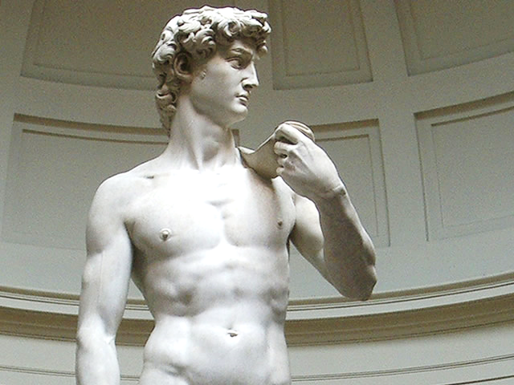

Slide 3
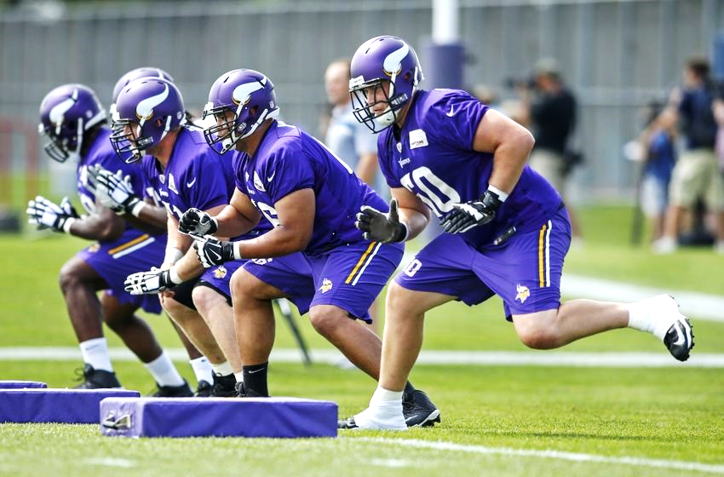

Slide 4
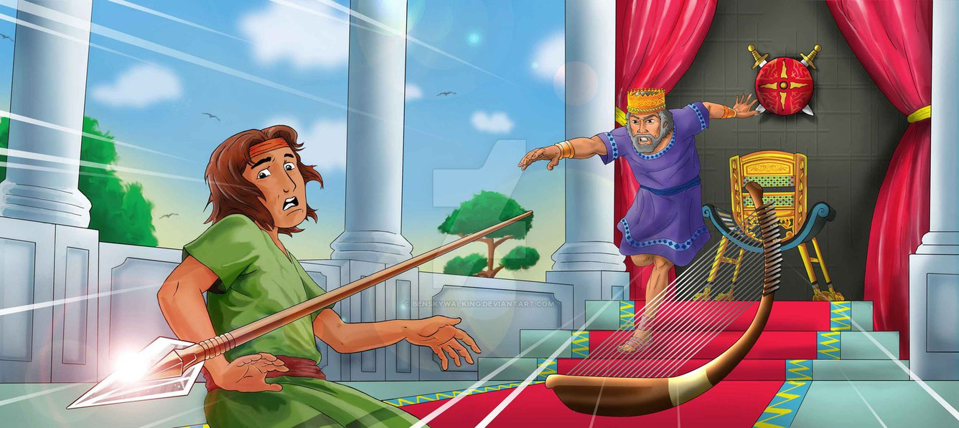

Slide 5
Cave Dwelling
Removing Your Crutches
“David took these words very seriously and became very frightened of Achish, Gath’s king. So he changed the way he acted with them, pretending to be insane while he was with them. He scratched marks on the doors of the city gates and let spit run down his chin.” 1 Samuel 21:12-13

Slide 6
Cave Dwelling
Removing Your Crutches
God shows up in the lonely darkness
“David left Gath and escaped to Adullam’s fortress. When David’s siblings and all his extended family learned of this, they went to join him there. Everyone who was in trouble, in debt, or in desperate circumstances gathered around David, and he became their leader. Approximately four hundred men joined him.” 1 Samuel 22:1-2

Slide 7
1 Samuel 24 (CEB)
¹ Even as Saul returned from pursuing the Philistines, he was informed that David was in the En gedi wilderness. ² So Saul took three thousand men selected from all Israel and went to look for David and his soldiers near the rocks of the wild goats. ³ He came to the sheep pens beside the road where there was a cave. Saul went into the cave to use the restroom. Meanwhile, David and his soldiers were sitting in the very back of the cave.

Slide 8
1 Samuel 24 (CEB)
⁴ David’s soldiers said to him, “This is the day the Lord spoke of when he promised you, ‘I will hand your enemy over to you, and you can do to him whatever you think best.’” So David snuck up and cut off a corner of Saul’s robe. ⁵ But immediately David felt horrible that he had cut off a corner of Saul’s robe. ⁶ “The Lord forbid,” he told his men, “that I should do something like that to my master, the Lord’s anointed, or lift my hand against him, because he’s the Lord’s anointed!” ⁷ So David held his soldiers in check by what he said, and he wouldn’t allow them to attack Saul. Saul then left the cave and went on his way.

Slide 9
1 Samuel 24 (CEB)
⁸ Then David also went out of the cave and yelled after Saul, “My master the king!” Saul looked back, and David bowed low out of respect, nose to the ground. ⁹ David said to Saul, “Why do you listen when people say, ‘David wants to ruin you’? ¹⁰ Look! Today your own eyes have seen that the Lord handed you over to me in the cave. But I refused to kill you. I spared you, saying, ‘I won’t lift a hand against my master because he is the Lord’s anointed.’ ¹¹ Look here, my protector! See the corner of your robe in my hand? I cut off the corner of your robe but didn’t kill you. So know now that I am not guilty of wrongdoing or rebellion. I haven’t wronged you, but you are hunting me down, trying to kill me.

Slide 10
1 Samuel 24 (CEB)
¹⁶ As soon as David finished saying all this to Saul, Saul said, “David, my son, is that your voice?” Then he broke down in tears, ¹⁷ telling David, “You are more righteous than I am because you have treated me generously, but I have treated you terribly. ... ²⁰ Now even I know that you will definitely become king, and Israel’s kingdom will flourish in your hands. ²¹ Because of that, make a solemn pledge to me by the Lord that you won’t kill off my descendants after I’m gone and that you won’t destroy my name from my family lineage.”
²² David made a solemn pledge to Saul. Then Saul went back home, but David and his soldiers went up to the fortress.

Slide 11
Cave Dwelling
Removing Your Crutches
God shows up in the lonely darkness
Resist lashing out
Luke 6:27 “[Jesus said,] ‘But to you who are willing to listen, I say, love your enemies! Do good to those who hate you.’”

