Slide 1
A MAN OF PASSION & DESTINY
The Open Window Shade
“The one whose wrongdoing is forgiven, whose sin is covered over, is truly happy! The one the Lord
doesn’t consider guilty–in whose spirit there is no dishonesty–that one is truly happy!” ~Psalm 32:1-2

Slide 2
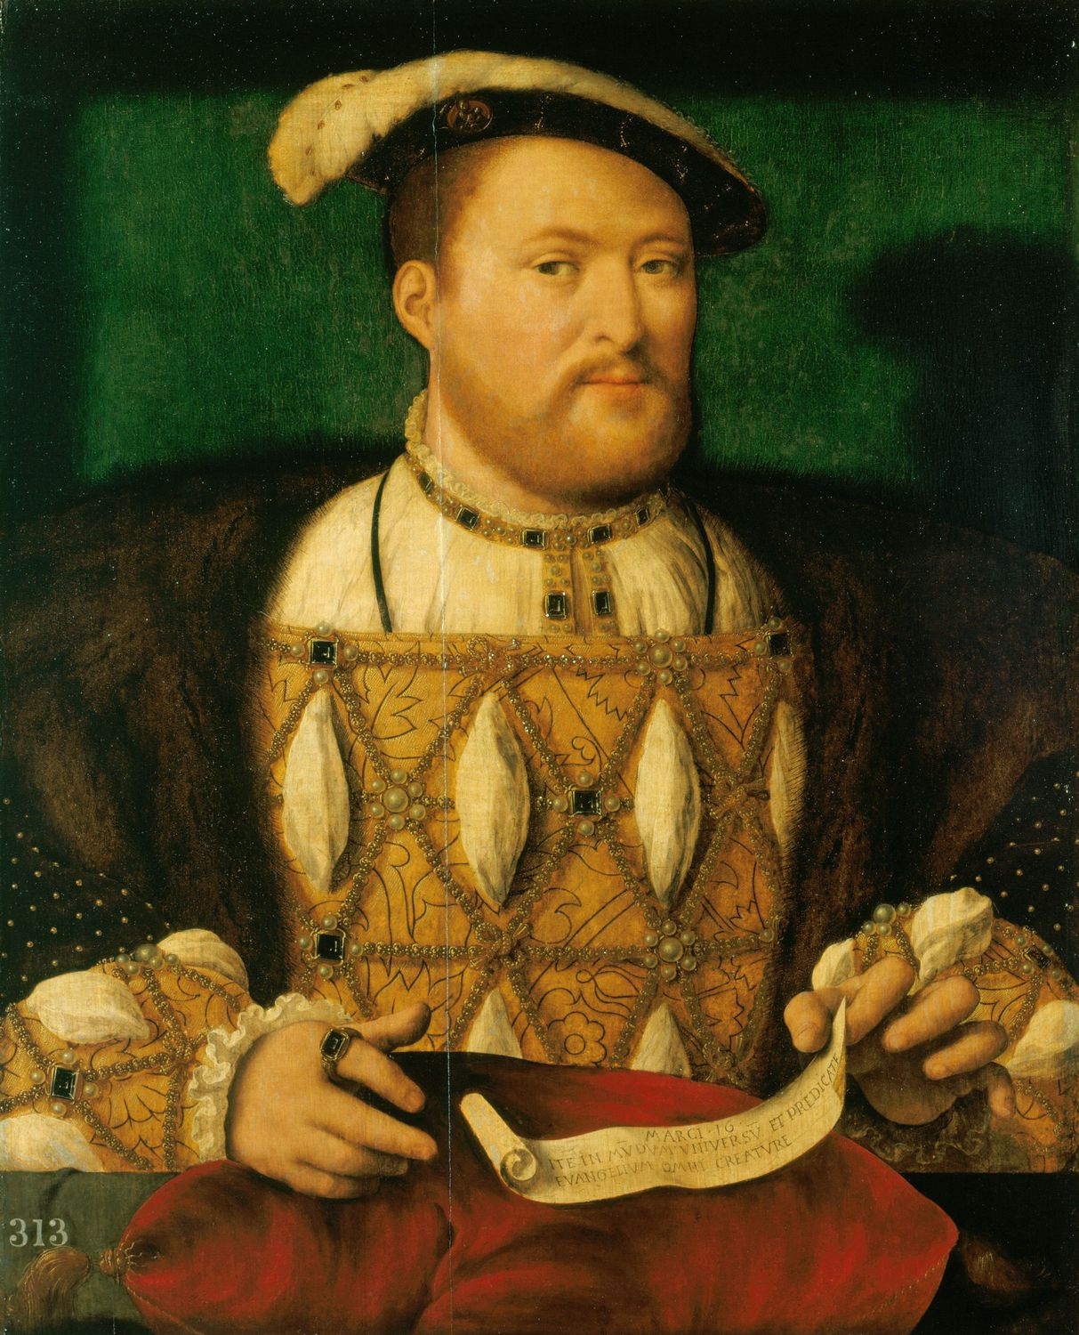

Slide 3
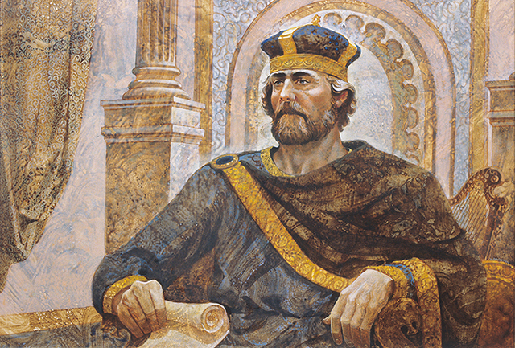

Slide 4
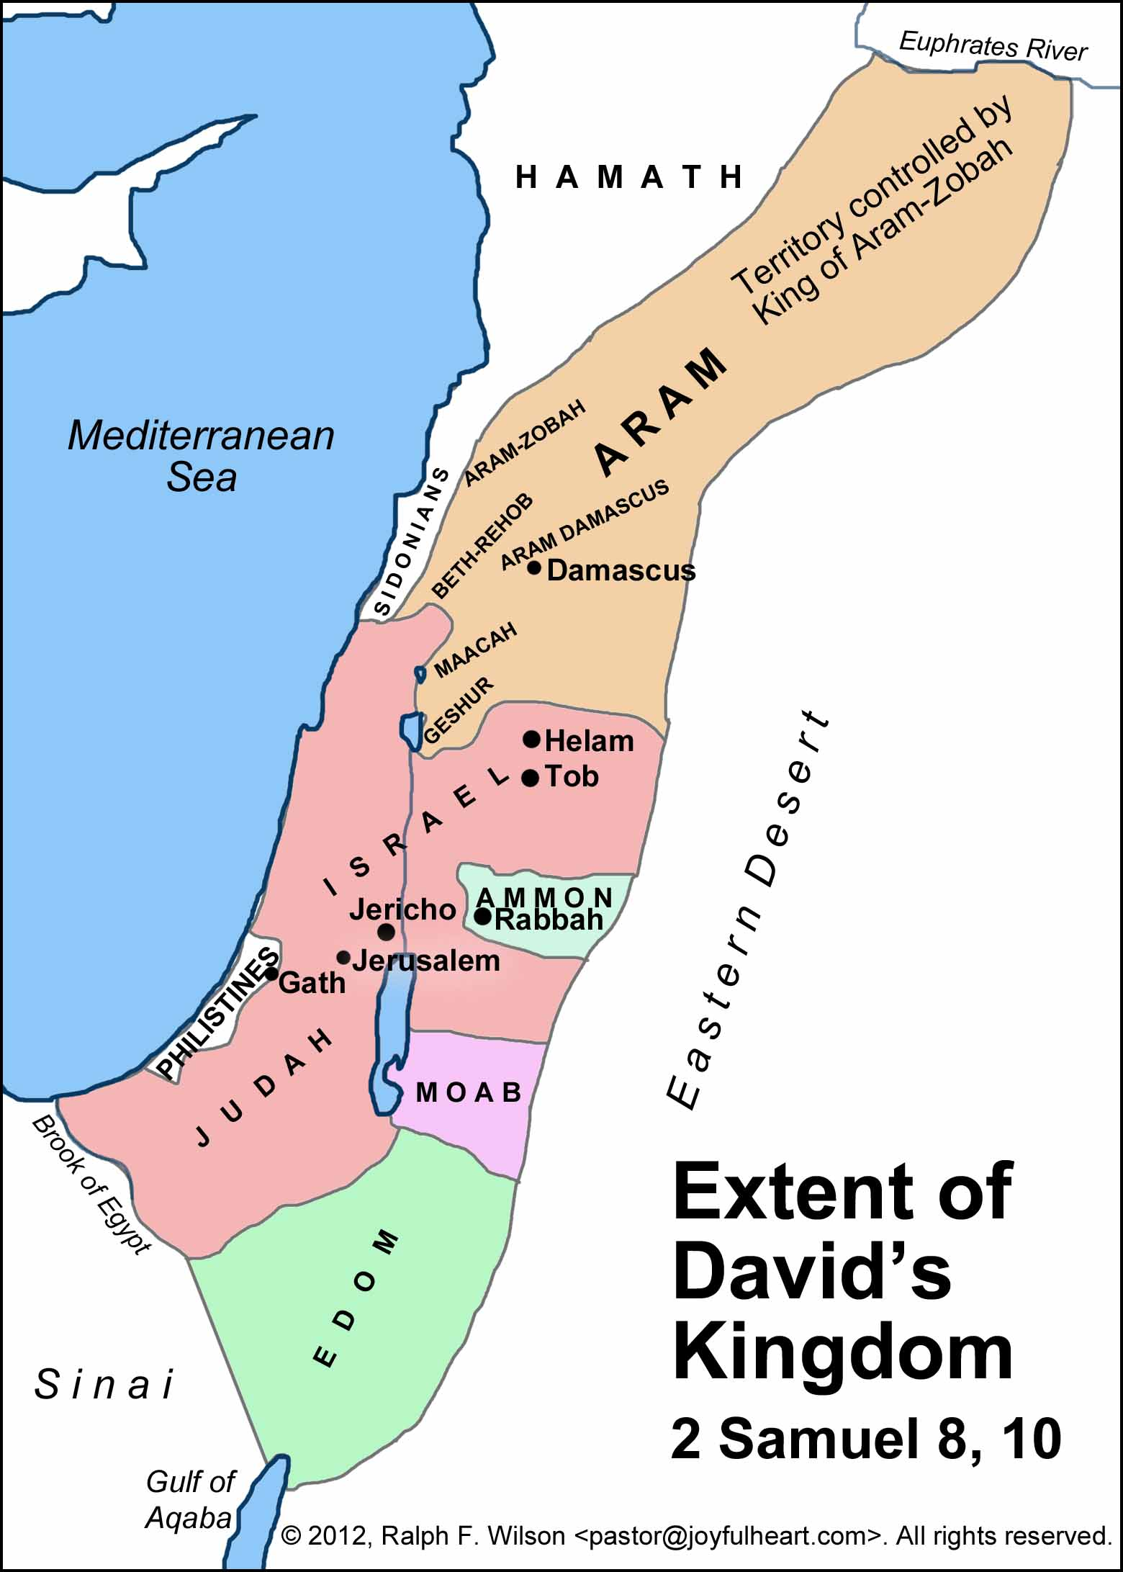

Slide 5
Deuteronomy 17:14-17
“When you enter the land the Lord your God is giving you... be sure to appoint over you a king the Lord your God chooses.... The king, moreover...must not take multiple wives, or his heart will be led astray. He must not accumulate large amounts of silver and gold.”

Slide 6
1 Samuel 11 (CEB)
¹ In the spring, when kings go off to war, David sent Joab, along with his servants and all the Israelites, and they destroyed the Ammonites, attacking the city of Rabbah. But David remained in Jerusalem.

Slide 7
1 Samuel 11 (CEB)
² One evening, David got up from his couch and was pacing back and forth on the roof of the palace. From the roof he saw a woman bathing; the woman was very beautiful. ³ David sent someone and inquired about the woman. The report came back: “Isn’t this Eliam’s daughter Bathsheba, the wife of Uriah the Hittite?” ⁴ So David sent messengers to get her. When she came to him, he had sex with her. (Now she had been purifying herself after her monthly period.) Then she returned home.

Slide 8
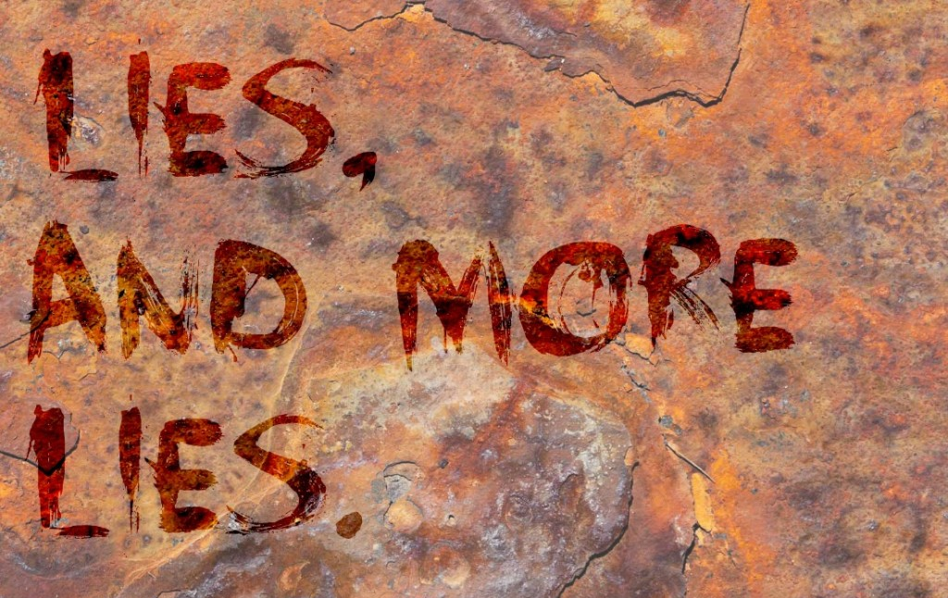
1 Samuel 11 (CEB)
⁵ The woman conceived and sent word to David. “I’m pregnant,” she said.

Slide 9
1 Samuel 11 (CEB)
⁶ Then David sent a message to Joab: “Send me Uriah the Hittite.” So Joab sent Uriah to David. ⁷ When Uriah came to him, David asked about the welfare of Joab and the army and how the battle was going. ⁸ Then David told Uriah, “Go down to your house and wash your feet.” Uriah left the palace, and a gift from the king was sent after him.

Slide 10
1 Samuel 11 (CEB)
⁹ However, Uriah slept at the palace entrance with all his master’s servants. He didn’t go down to his own house.
¹⁰ David was told, “Uriah didn’t go down to his own house,” so David asked Uriah, “Haven’t you just returned from a journey? Why didn’t you go home?”
¹¹ “The chest and Israel and Judah are all living in tents,” Uriah told David. “And my master Joab and my master’s troops are camping in the open field. How could I go home and eat, drink, and have sex with my wife? I swear on your very life, I will not do that!”

Slide 11
1 Samuel 11 (CEB)
¹² Then David told Uriah, “Stay here one more day. Tomorrow I’ll send you back.” So Uriah stayed in Jerusalem that day. The next day ¹³ David called for him, and he ate and drank, and David got him drunk. In the evening Uriah went out to sleep in the same place, alongside his master’s servants, but he did not go down to his own home.

Slide 12
1 Samuel 11 (CEB)
¹⁴ The next morning David wrote a letter to Joab and sent it with Uriah. ¹⁵ He wrote in the letter, “Place Uriah at the front of the fiercest battle, and then pull back from him so that he will be struck down and die.”

Slide 13
1 Samuel 11 (CEB)
²³ “The men overpowered us,” the messenger told David. “They came out against us in the open field, but we fought against them up to the entrance of the city gate. ²⁴ Archers shot down on your servants from the wall. Some of the king’s servants died. And your servant Uriah the Hittite is dead, too.”

Slide 14
1 Samuel 11 (CEB)
²⁶ When Uriah’s wife heard that her husband Uriah was dead, she mourned for her husband. ²⁷ After the time of mourning was over, David sent for her and brought her back to his house. She became his wife and bore him a son. But what David had done was evil in the Lord’s eyes.

Slide 15
The Open
Window Shade
How we can control our desires:
Establish boundaries before being tempted | Full disclosure to accountability partners
Cultivate healthy alternatives to keep from being idle | Cling to the Lord’s guidance

Slide 16
1 Samuel 11 (CEB)
³ When I kept quiet, my bones wore out; I was groaning all day long–every day, every night! ⁴ because your hand was heavy upon me. My energy was sapped as if in a summer drought.
⁵ So I admitted my sin to you; I didn’t conceal my guilt. “I’ll confess my sins to the Lord,” is what I said. Then you removed the guilt of my sin.

Slide 17
1 Samuel 12 (CEB)
¹ So the Lord sent Nathan to David. When Nathan arrived he said, “There were two men in the same city, one rich, one poor. ² The rich man had a lot of sheep and cattle, ³ but the poor man had nothing–just one small ewe lamb that he had bought. He raised that lamb, and it grew up with him and his children. It would eat from his food and drink from his cup—even sleep in his arms! It was like a daughter to him.

Slide 18
1 Samuel 12 (CEB)
⁴ “Now a traveler came to visit the rich man, but he wasn’t willing to take anything from his own flock or herd to prepare for the guest who had arrived. Instead, he took the poor man’s ewe lamb and prepared it for the visitor.”

Slide 19
1 Samuel 12 (CEB)
⁵ David got very angry at the man, and he said to Nathan, “As surely as the Lord lives, the one who did this is demonic! ⁶ He must restore the ewe lamb seven times over because he did this and because he had no compassion.”

Slide 20
1 Samuel 12 (CEB)
⁷ “You are that man!” Nathan told David.
“This is what the Lord God of Israel says: I anointed you king over Israel and delivered you from Saul’s power. ... I gave you the house of Israel and Judah. ... ⁹ Why have you despised the Lord’s word by doing what is evil in his eyes? You have struck down Uriah the Hittite with the sword and taken his wife as your own. You used the Ammonites to kill him. ¹⁰ ... You despised me and took the wife of Uriah the Hittite as your own....”

Slide 21
1 Samuel 12 (CEB)
¹³ “I’ve sinned against the Lord!” David said to Nathan.
“The Lord has removed your sin,” Nathan replied to David. “You won’t die.

Slide 22
The Open
Window Shade
God knows our sin,
but wants us restored.
We can seek forgiveness
through repentance!

Slide 23
The Open
Window Shade
Repentance:
Getting sin into the open: confessing to God and others
Asking for forgiveness
Restoring your relationship with others and God
Paying any possible restitution

Slide 24
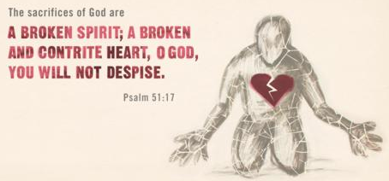
Psalm of Repentance:
Psalm 51 “For the music leader. A psalm of David, when the prophet Nathan came to him just after he had been with Bathsheba.”
(Red Hymnal in the pews, Page #785.)

