Slide 1
A MAN OF PASSION & DESTINY
The End of an Era
“The Lord lives! Bless God, my rock! Let my God, the rock of my salvation, be lifted high!”
~2 Samuel 22:47

Slide 2
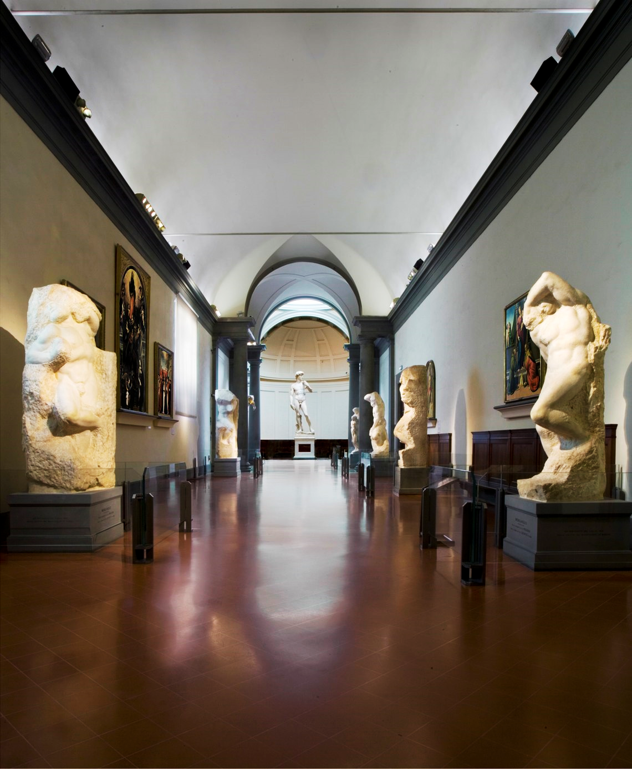

Slide 3
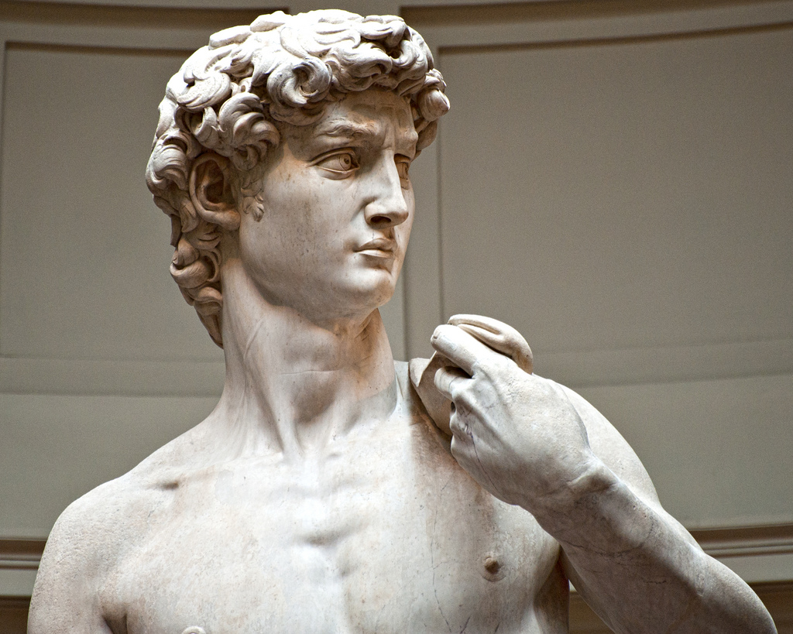

Slide 4
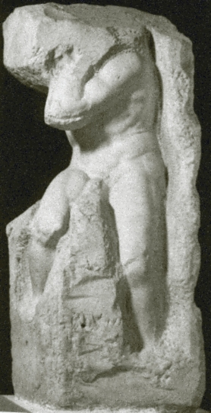

Slide 5
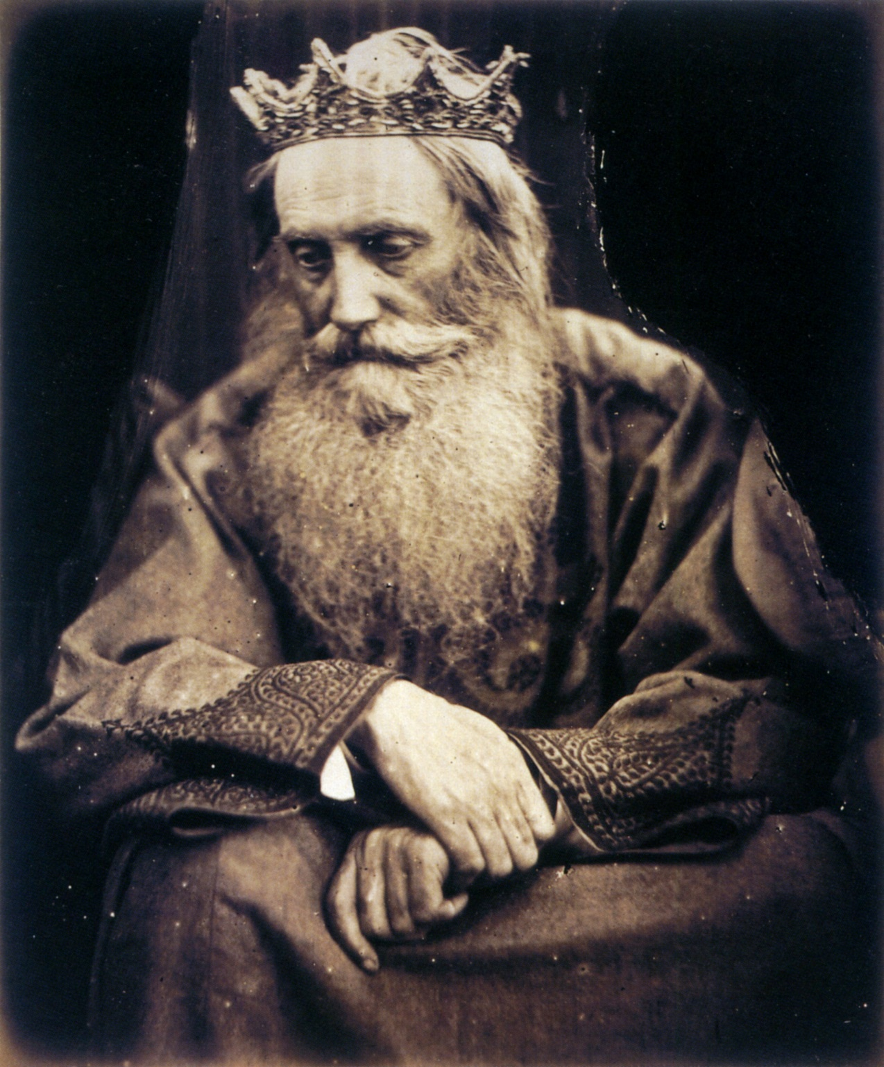

Slide 6
2 Samuel 24 (CEB)
² So the king said to Joab and the military commanders who were with him, “Go...and take a census of the people so I know how many people there are.”
³ Joab said to the king, “...But why does my master the king want to do this?”
⁴ But the king’s word overruled Joab and the military commanders....

Slide 7
2 Samuel 24 (CEB)
⁹ Joab reported to the king the number of the people who had been counted: in Israel there were 800,000 strong men who could handle a sword; in Judah the total was 500,000 men.
¹⁰ But after this David felt terrible that he had counted the people. David said to the Lord, “I have sinned greatly in what I have done. Now, Lord, please take away the guilt of your servant because I have done something very foolish.”

Slide 8
The End of an Era
A Heart after God’s Own Heart
Putting yourself under God’s chisel
Putting yourself before God’s presence

Slide 9
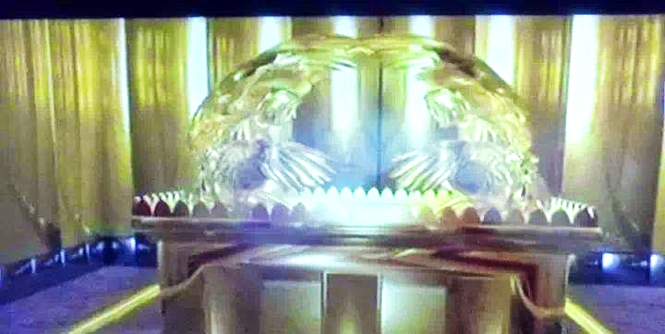

Slide 10
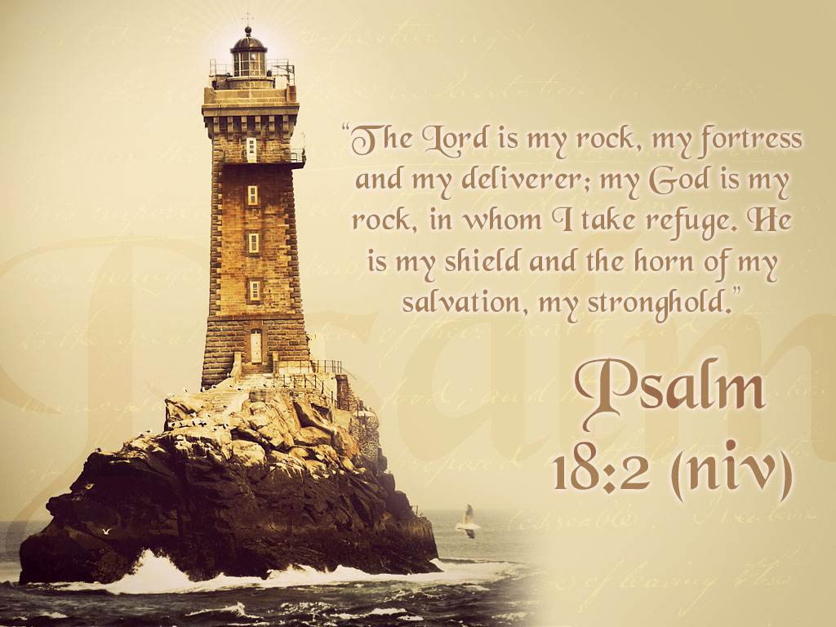
2 Samuel 22 and Psalm 18 (CEB)
¹ David spoke the words of this song to the Lord after the
Lord delivered
him from the
power of all his
enemies and
from Saul.

Slide 11
2 Samuel 22:2-3 (CEB)
Left: David said: The Lord is my solid rock, my fortress, my rescuer.
Right: My God is my rock—I take refuge
in Him!—He’s my shield and my salvation’s strength,
Left: My place of safety and my shelter.
Right: My savior! Save me from violence!

Slide 12
2 Samuel 22:4-7 (CEB)
Left: Because He is praiseworthy, I cried out to the Lord, and I was saved from my enemies.
Right: Death’s waves were all around me; rivers of wickedness terrified me.
Left: The cords of the grave surrounded me; death’s traps held me tight.
Right: In my distress I cried out to the Lord; I cried out to my God.
Left: God heard my voice from his temple; my cry for help reached his ears.

Slide 13
2 Samuel 22:10-11(CEB)
Right: God parted the skies and came down; thick darkness was beneath his feet.
Left: God mounted the heavenly creatures and flew; He was seen on the wind’s wings.
Right: From on high God reached down and grabbed me; He took me out of deep waters.

Slide 14
2 Samuel 22:17-20(CEB)
Left: God saved me from my powerful enemy, saved me from my foes, who were too much for me.
Right: They came at me on the very day of my distress, but the Lord was my support.
Left: He brought me out to wide open spaces; He pulled me out, because He delights
in me.

Slide 15
The End of an Era
Putting yourself before God’s presence
and under God’s chisel:
1. When times are tough, the Lord is our Security
“He pulled me out, because He delights in me”
-2 Samuel 22:20

Slide 16
2 Samuel 22:25,
28-31 (CEB)
Right: And so the Lord restored me for my righteousness, because I am clean in His eyes.
Left: You are the one who saves people who suffer, but your eyes are against the proud. You bring them down!
Right: You are my lamp, Lord; the Lord illumines my darkness.
Left: With you I can charge into battle; with my God I can leap over a wall.
Right: God! His way is perfect; the Lord’s word is tried and true.
Left: He is a shield for all who take refuge in Him.

Slide 17
The End of an Era
Putting yourself before God’s presence
and under God’s chisel:
1. When times are tough, the Lord is our Security
2. When days are dark, the Lord is our Light
“You are my lamp, Lord; the Lord illumines
my darkness.” -2 Samuel 22:29

Slide 18
2 Samuel 22:32-36(CEB)
Right: Now really, who is divine except the Lord? And who is a rock except our God?
Left: Only God! My mighty fortress, who makes my way perfect,
Right: Who makes my step as sure as the deer’s, who lets me stand securely on the heights,
Left: Who trains my hands for war so my arms can bend a bronze bow.

Slide 19
The End of an Era
Putting yourself before God’s presence
and under God’s chisel:
1. When times are tough, the Lord is our Security
2. When days are dark, the Lord is our Light
3. When our walk is weak, the Lord is our Strength
“Your help has made me great.” -2 Samuel 22:36

Slide 20
2 Samuel 22:47,
50-51 (CEB)
Left: The Lord lives! Bless God, my rock!
Right: Let my God, the rock of my salvation, be lifted high!
Left: That’s why I thank you, Lord, in the presence of the nations.
Right: That’s why I sing praises to your name.
Left: You are the one who gives great victories to your king,
Right: Who shows faithful love to your anointed one–to David and to his descendants forever.

Slide 21
The End of an Era
Putting yourself before God’s presence
and under God’s chisel:
1. When times are tough, the Lord is our Security
2. When days are dark, the Lord is our Light
3. When our walk is weak, the Lord is our Strength
4. When our future is foggy, the Lord is our Hope
“The Lord lives! Bless God, my rock!”
-2 Samuel 22:47

