Slide 1
A MAN OF PASSION & DESTINY
The Shepherd King
“Some time later, David questioned the Lord, ‘Should I go to one of the towns in Judah?’” “Yes, go,” the Lord told him. “Which one should I go to?” David asked.
“To Hebron,” the Lord replied.” ~2 Samuel 2:1

Slide 2
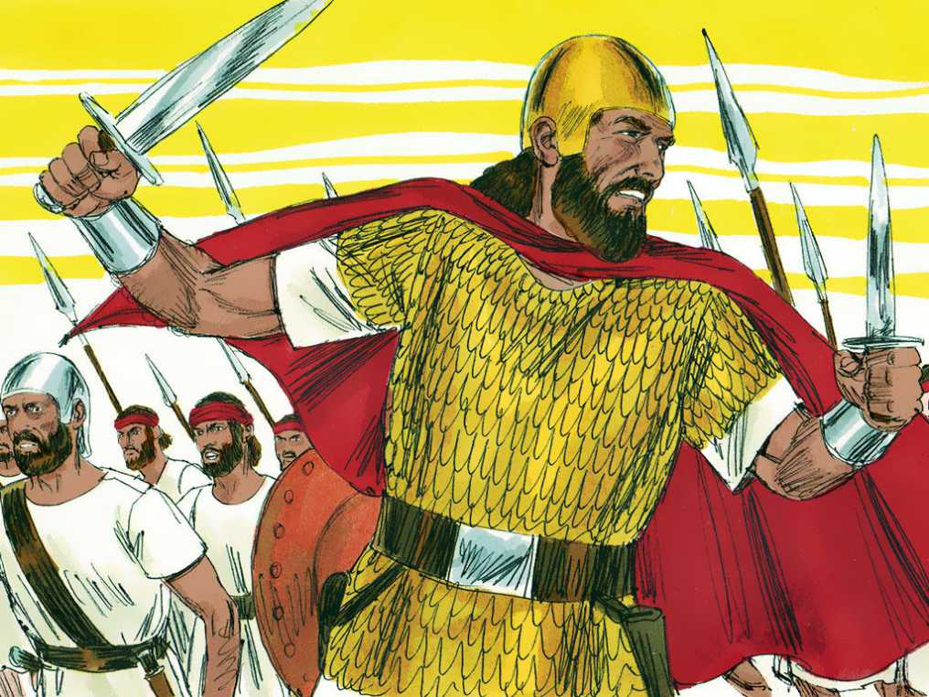
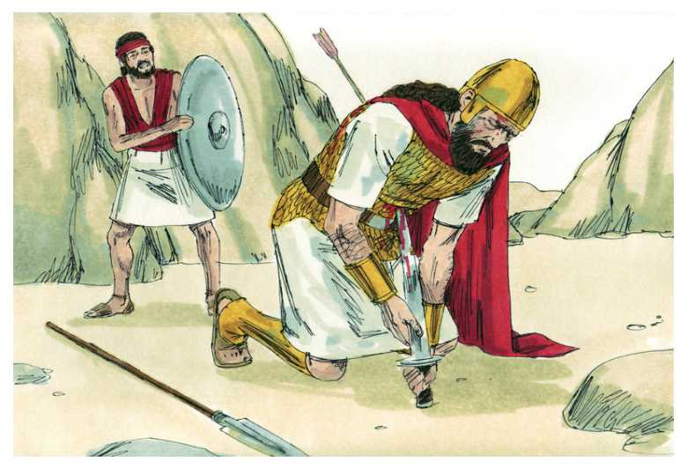

Slide 3
1 Samuel 27:1
David said to himself, “One day I will be destroyed by Saul’s power. The best thing for me to do is to escape to Philistine territory. Then Saul will give up looking for me in Israelite territory, and I will escape his power.”

Slide 4
1 Samuel 30:6-8
⁶ David was in deep trouble because the troops were talking about stoning him. Each of the soldiers was deeply distressed about their sons and daughters. But David found strength in the Lord his God. ⁷ David said to the priest Abiathar, Ahimelech’s son, “Bring the priestly vest to me.” So Abiathar brought it to David.
⁸ Then David asked the Lord, “Should I go after this raiding party? Will I catch them?”
“Yes, go after them!” God answered. “You will definitely catch them and will succeed in the rescue!”

Slide 5
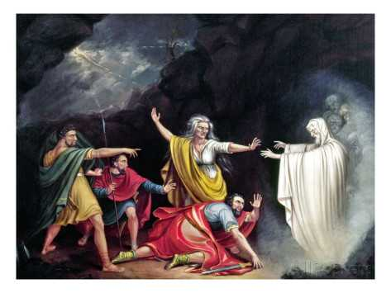

Slide 6
The Shepherd King
Wait upon God for important decisions –
“Pray it through!”
Psalm 37:23 “The Lord orders the steps
of the godly, and delights in them.”

Slide 7
2 Samuel 2
¹ Some time later, David questioned the Lord, “Should I go to one of the towns in Judah?”
“Yes, go,” the Lord told him.
“Which one should I go to?” David asked.
“To Hebron,” the Lord replied.
² So David went there, along with his two wives: Ahinoam from Jezreel and Abigail, Nabal’s widow, from Carmel. ³ David also took the soldiers who were with him, each with his family, and they lived in the towns around Hebron.

Slide 8
2 Samuel
2:4 “Then the people of Judah came to Hebron and anointed David king over the house of Judah.”
2:10-11 “Saul’s son Ishbosheth was 40 years old when he became king over Israel, and he ruled for two years. The house of Judah, however, followed David. ¹¹ The amount of time David ruled in Hebron over the house of Judah totaled seven and a half years.
3:1 The war between Saul’s house and David’s house was long and drawn out. David kept getting stronger, while Saul’s house kept getting weaker.

Slide 9
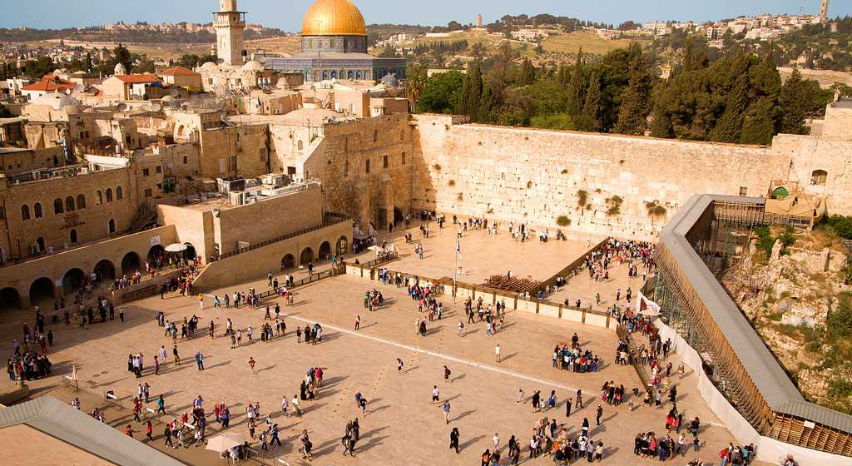
The new capital: The City of Peace (“Jerusalem”)

Slide 10
The Shepherd King
Wait upon God for important decisions –
“Pray it through!”
Commit to lead well your own family
1 Timothy 3:4-5 “He must manage his own household well,
with all dignity keeping his children in line,
for if someone does not know how to manage his own household, how will he care for God's church?”

Slide 11
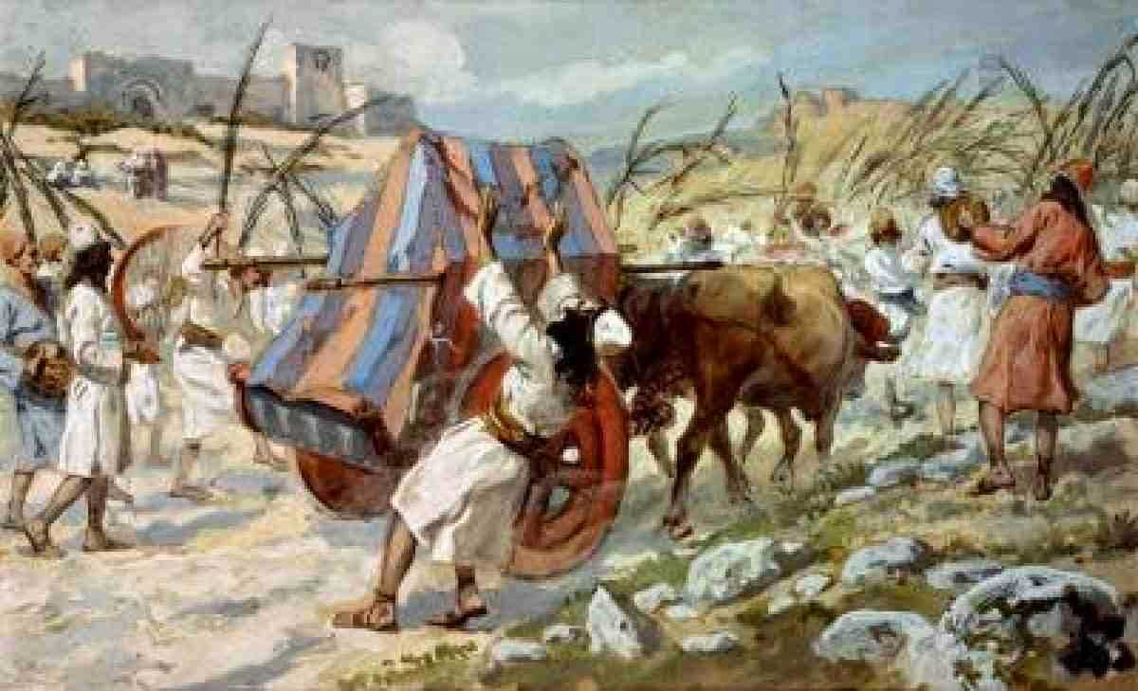

Slide 12
The Shepherd King
Wait upon God for important decisions –
“Pray it through!”
Commit to lead well your own family
Attend to obedience - heartfelt is not enough
John 14:23 “Jesus replied, ‘Anyone who
loves me will obey my teaching.’”

Slide 13
2 Chronicles 6:7-9
[Solomon said,] ⁷ “My father David wanted to build a temple for the name of the Lord, Israel’s God. ⁸ But the Lord said to my father David: ‘It is very good that you had it in your heart to build a temple for my name. Nevertheless, ⁹ you yourself won’t build that temple. Instead, your very own son will build the temple for my name.’”

Slide 14
The Shepherd King
Wait upon God for important decisions –
“Pray it through!”
Commit to lead well your own family
Attend to obedience - heartfelt is not enough
Let God do things God’s way
1 Chronicles 22:5 “David thought...the Lord’s temple must be great beyond compare...so I myself will prepare things for him. So David made extensive preparations before his death.”

