Slide 1
A MAN OF PASSION & DESTINY
The End of an Era
“I will celebrate before the Lord.”
~2 Samuel 6:21

Slide 2
What is “worship”?
A verb?
A noun?
A service?

Slide 3
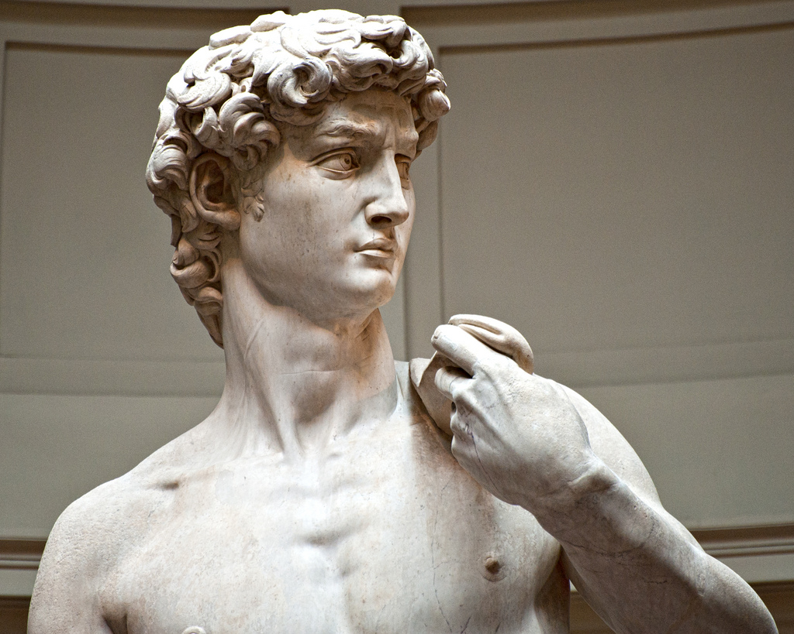

Slide 4
2 Samuel 6:2
He and all his men went to Baalah in Judah to bring up from there the ark of God, which is called by the Name, the name of the LORD Almighty, who is enthroned between the cherubim on the ark.

Slide 5
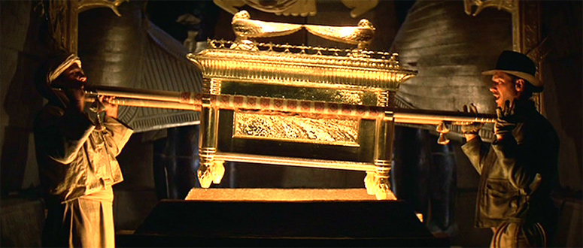

Slide 6
2 Samuel 6:5
David and all Israel were celebrating with all their might before the LORD, with castanets, harps, lyres, tambourines, sistrums and cymbals.

Slide 7
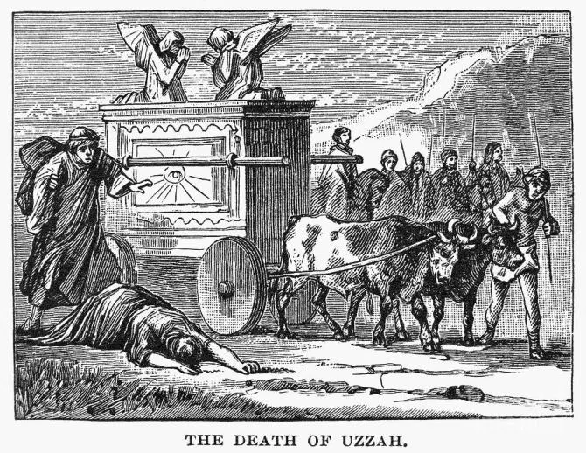

Slide 8
Worship is…
Work!

Slide 9
Worship is…
Work!
(Heart work is hard work)

Slide 10
2 Samuel 6:13
When those who were carrying the ark of the LORD had taken six steps, he sacrificed a bull and a fattened calf.

Slide 11
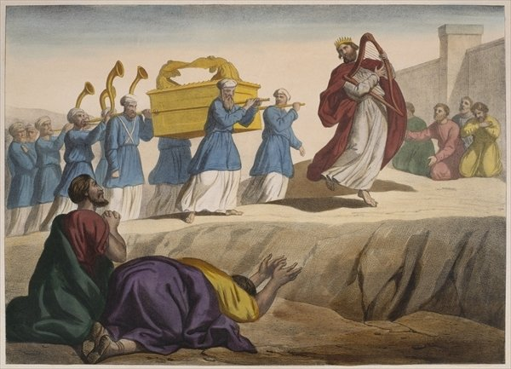

Slide 12
Worship is…
Work!
(Heart work is hard work)
Sacrificial
(Moving outside of comfort)

Slide 13
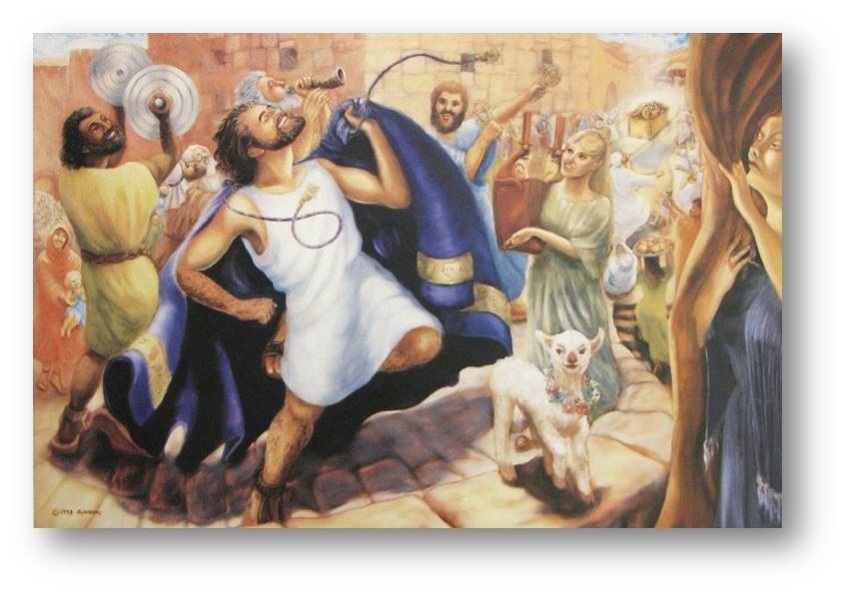

Slide 14
Worship is…
Work!
(Heart work is hard work)
Sacrificial
(Moving outside of comfort)
Celebratory

Slide 15
Worship is…
Work!
(Heart work is hard work)
Sacrificial
(Moving outside of comfort)
Celebratory
(Are we grateful?)

Slide 16
2 Samuel 6:20-22
When David returned home to bless his household, Michal daughter of Saul came out to meet him and said, "How the king of Israel has distinguished himself today, going around half-naked in full view of the slave girls of his servants as any vulgar fellow would!"
David said to Michal, "It was before the LORD, who chose me rather than your father or anyone from his house when he appointed me ruler over the LORD's people Israel--I will celebrate before the LORD. I will become even more undignified than this, and I will be humiliated in my own eyes. But by these slave girls you spoke of, I will be held in honor."

Slide 17
Worship is…
Work!
(Heart work is hard work)
Sacrificial
(Moving outside of comfort)
Celebratory
(Are we grateful?)

