Slide 1
It’s a
Seussical Life!
Discovering Creative Ways to Live as God’s Kids
Eat them! Eat them! Here they are!”
“Taste and see how good the Lord is! The one who takes
refuge in Him is truly happy!” Psalm 34:8

Slide 2
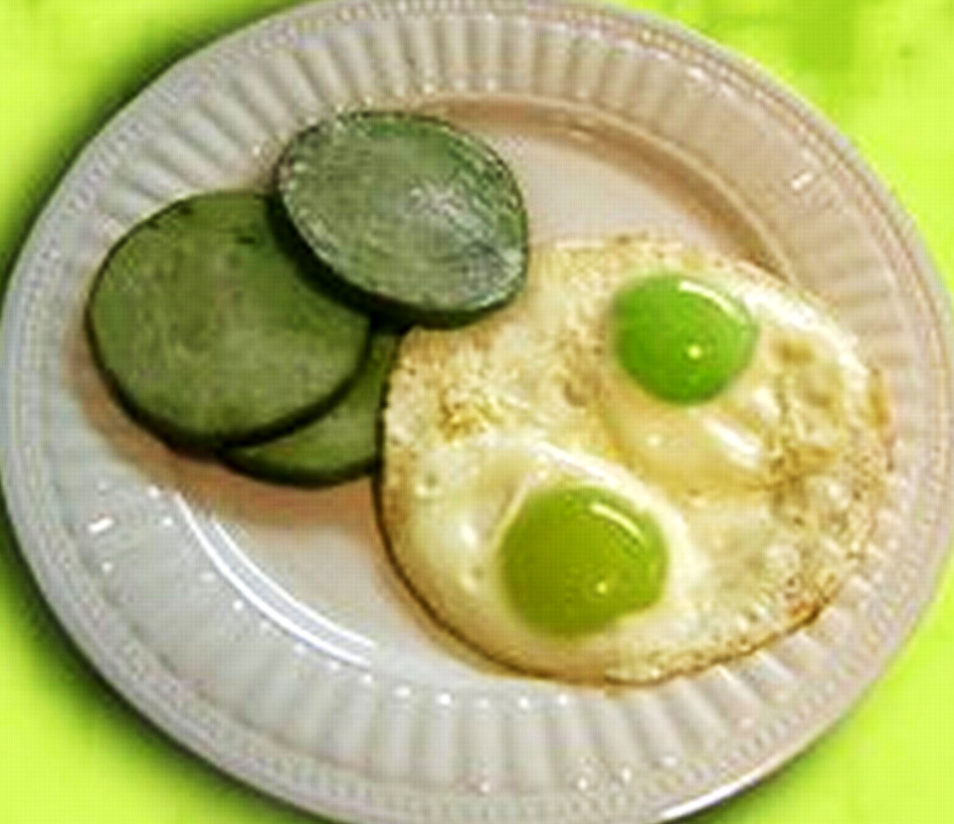

Slide 3
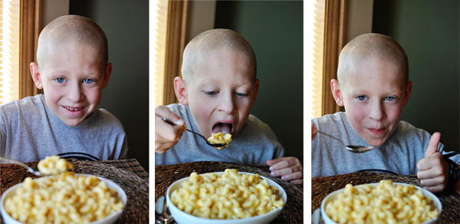

Slide 4
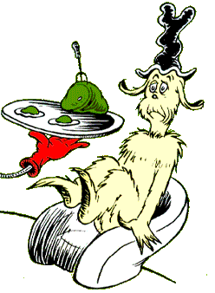

Slide 9
“Taste and see how good the Lord is! The one who takes refuge in Him is truly happy!”
Psalm 34:8

Slide 10
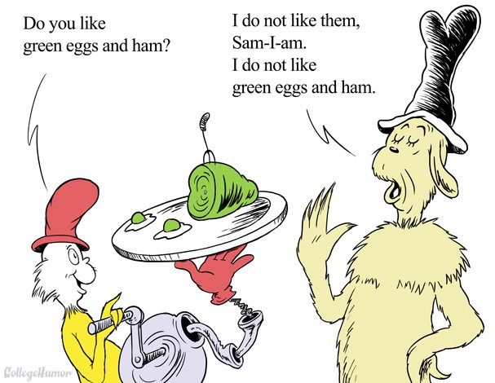

Slide 12
2 Corinthians 5:14-20 (CEV)
¹⁴ The love of Christ controls us, because we have concluded this: one died for the sake of all; therefore, all died. ¹⁵ He died for the sake of all so that those who are alive should live not for themselves but for the one who died for them and was raised.
¹⁶ So then, from this point on we won’t recognize people by human standards. Even though we used to know Christ by human standards, that isn’t how we know Him now.
¹⁷ So then, if anyone is in Christ, that person is part of the new creation. The old things have gone away, and look, new things have arrived!

Slide 14
2 Corinthians 5:14-20 (CEV)
¹⁸ All of these new things are from God, who reconciled us to Himself through Christ and who gave us the ministry of reconciliation. ¹⁹ In other words, God was reconciling the world to Himself through Christ, by not counting people’s sins against them. He has trusted us with this message of reconciliation.
²⁰ So we are ambassadors who represent Christ. God is negotiating with you through us. We beg you as Christ’s representatives, “Be reconciled to God!”

Slide 15
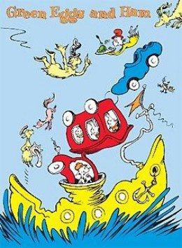

Slide 16
“Eat them! Eat them! Here they are!”
Urgency to share Jesus
“We beg you as Christ’s representatives, ‘Be reconciled to God!’”
2 Corinthians 5:20b

Slide 17
“Eat them! Eat them! Here they are!”
Urgency to share Jesus
Persistency and creativity
“Let’s not get tired of doing good, because in time we’ll have a harvest if we don’t give up.” Galatians 6:9

Slide 18
“Eat them! Eat them! Here they are!”
Urgency to share Jesus
Persistency and creativity
Jesus sells Himself
“Taste and see how good the Lord is! The one who takes refuge in Him is truly happy!”
Psalm 34:8

Slide 20
