Slide 1
It’s a
Seussical Life!
Discovering Creative Ways to Live as God’s Kids
Buttering an Upside Down World”
“You have heard that it was said, An eye for an eye and a tooth for a tooth. But I say to you that you must not oppose those who want to
hurt you. If people slap you on your right cheek, you must turn
the left cheek to them as well.” Matthew 5:38-39

Slide 3
What is your initial reaction:
Is different,
beautiful, or weird?

Slide 4
“‘Fear not!’” declares the Lord, ‘for I am with you.’”
Isaiah 41:10

Slide 5
“Vengeance is mine, declares the Lord!”
Deuteronomy 32:35

Slide 7
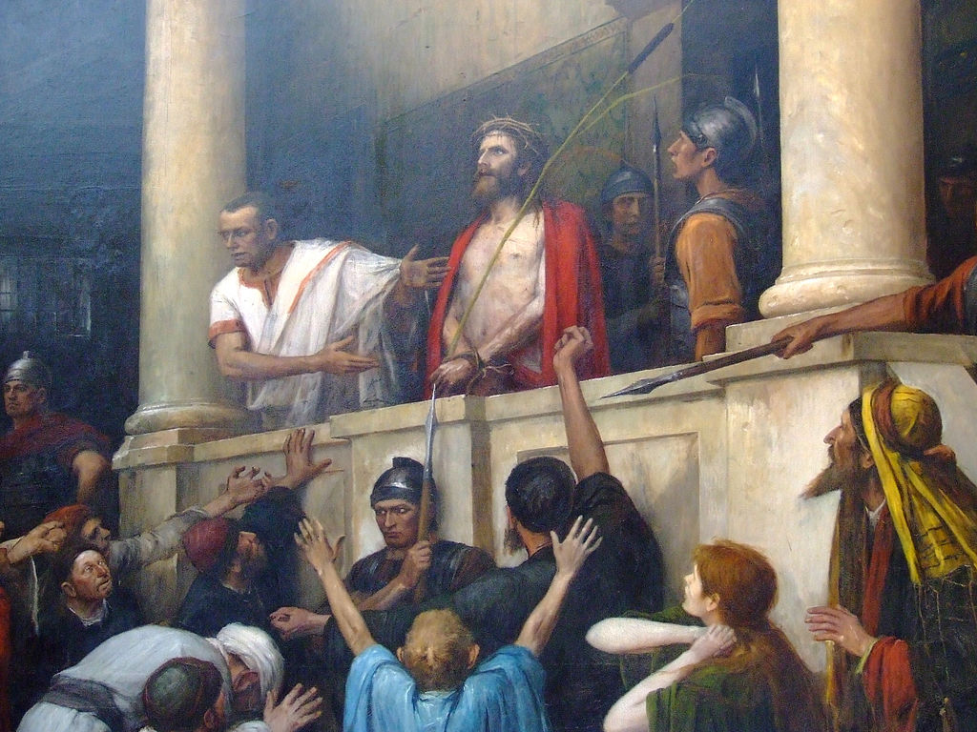

Slide 8
Matthew 5
Jesus said, ³⁸ “You have heard that it was said, ‘Eye for eye, and tooth for tooth.’ ³⁹ But I tell you, do not resist an evil person. If anyone slaps you on the right cheek, turn to them the other cheek also. ⁴⁰ And if anyone wants to sue you and take your shirt, hand over your coat as well. ... ⁴³ “You have heard that it was said, ‘Love your neighbor and hate your enemy.’ ⁴⁴ But I tell you, love your enemies and pray for those who persecute you, ⁴⁵ that you may be children of your Father in heaven....’”

Slide 9
1 Corinthians 13:4-7
⁴ Love is patient, love is kind. It does not envy, it does not boast, it is not proud. ⁵ It does not dishonor others, it is not self seeking, it is not easily angered, it keeps no record of wrongs. ⁶ Love does not delight in evil but rejoices with the truth. ⁷ It always protects, always trusts, always hopes, always perseveres.

Slide 11
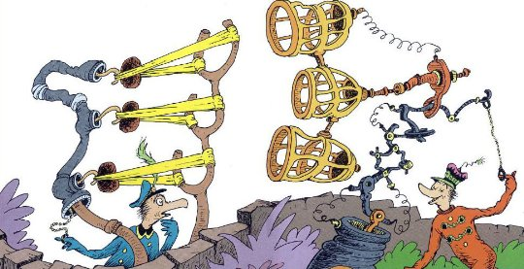

Slide 12
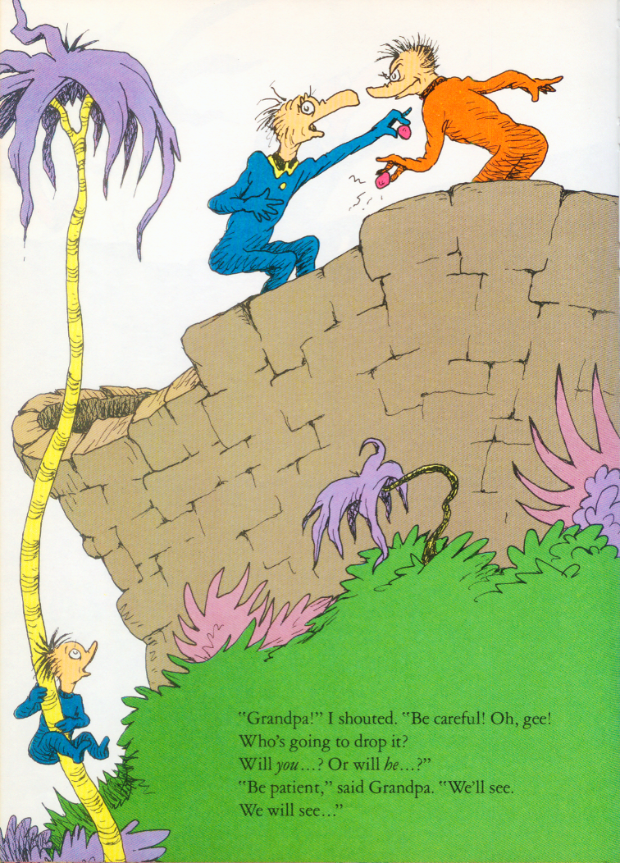

Slide 13
Buttering an Upside Down World
Willfully choosing to see the other first as God’s treasured child

