Slide 1
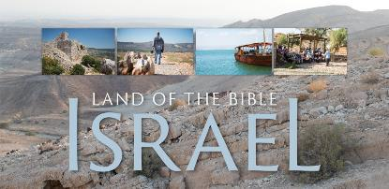
Welcome!
Housekeeping: Creature comforts (Bathrooms, etc.)
Eat lunch during the seminar
Interactive Style: Please feel free to ask questions or make comment as we go

Slide 2
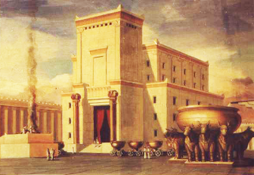
History of the Holy Land
By Rev. David Werner
Sun., Nov. 6, 2016
Session #3: The Earthly Life of Jesus

Slide 3
Sessions: Sundays:
Session #1: From Creation through the First Temple - PowerPoint & handouts online!
Session #2: From the First Temple to the Life of Jesus - PowerPoint & handouts online!
Session #3: The Earthly Life of Jesus - Today!
Session #4: From Jesus to Constantine: The Early Church - Dec. 4
Session #5: From Constantine through WWII - Jan. 8
Session #6: Since WWII - Feb. 12

Slide 4
Purpose
Tour group taking a Church History Study Tour to Israel & Jordan March 2017
Learning the story arc of the Bible and its historical and geographical backdrop
Understanding the geographical history of the biblical story
Contextualization: “The Dirt of Salvation”
Faith is not just ideas and beliefs, it is real history, people, and events
Jesus was a real person who actually lived in a certain place
The Christian faith has no Holy Land, but it does have a historic location
Understanding the history of the current situation of the Middle East

Slide 5
Questions or Comments?

Slide 6
Psalm 147
¹ Praise the Lord! Because it is good to sing praise to our God!
Because it is a pleasure to make beautiful praise!
² The Lord rebuilds Jerusalem, gathering up Israel’s exiles.
³ God heals the brokenhearted and bandages their wounds.
⁴ God counts the stars by number, giving each one a name.
⁵ Our Lord is great and so strong! God’s knowledge can’t be grasped!
⁶ The Lord helps the poor, but throws the wicked down on the dirt!
⁷ Sing to the Lord with thanks; sing praises to our God with a lyre!
¹⁰ God doesn’t prize the strength of a horse; God doesn’t treasure the legs of a runner.
¹¹ No. The Lord treasures the people who honor Him, the people who wait for his faithful love.

Slide 7
Psalm 147
¹² Worship the Lord, Jerusalem! Praise your God, Zion!
¹³ Because God secures the bars on your gates, God blesses the children you have there.
¹⁴ God establishes your borders peacefully. God fills you full with the very best wheat.
¹⁵ God issues His command to the earth–God’s word speeds off fast!
¹⁹ God proclaims his word to Jacob; His statutes and rules to Israel.
²⁰ God hasn’t done that with any other nation; those nations have no knowledge of God’s rules.
Praise the Lord!

Slide 8
Opening prayer

Slide 9
Today
Review: Old Testament Story
The Roman Empire
Israel in the early Roman Empire
Jewish life and religion in the 1st Century AD
The earthly life of Jesus in Judaea

Slide 10
The Old Testament Story, Land, & Backdrop
Empire in Control (Dates) | Date (BCE) | Event
Sumerian Empire in Mesopotamia (?3,000 - 2334) Egypt Old Kingdom (2686-2134) | 4004 3000? | Biblical Creation Flood & Tower of Babel Origin of Sumerian Religion Origin of Egyptian religion
Akkadian Empire in Mesopotamia (2334 - 2083) |  | Origin of Canaanite religion
Sumerian Empire in Mesopotamia (2218 - 1750) Egypt Middle Kingdom (2030 - 1640) | 2000 1880 | Canaan populated by city-states Abraham goes to Canaan Israelites move to Egypt
First Babylonian Dynasty in Mesopotamia (1750 - 1530) Hittite Empire, Turkey (1595 - 1220) Egypt New Kingdom (1550 - 1070) | 1440 1380 | Canaan controlled by Egypt Exodus under Moses; The Law/Torah Israelites invade Canaan Time of the Judges
Assyrian Empire across Middle East (1353 - 612) | 1000 960 722 | King David: Israelites control Canaan Temple in Jerusalem Divided Kingdom Fall of Israel to Assyria

Slide 11
The Old Testament Story, Land, & Backdrop
Empire in Control (Dates) | Date (BCE) | Event
Neo-Babylonian Dynasty across Middle East (612 - 539) | 581 | Fall of Judah to Babylon Exile - Babylonian control Judah
Persia across Middle East (539 - 331) | 538 444 440 | Jews begin return from Exile Persia Jerusalem & Temple rebuilt controls End of Old Testament story Judah
Alexander the Great/Greek conquers the Middle East (339 - 331) | 332 | Judah conquered by Alexander the Great
Greek Divided Kingdom: Ptolomics and Seleucids (329 - 63) | 329 180 160 | Judah controlled by Ptolomic Empire Judah controlled by Selucid Empire Judah self-rule; Hasmodian Dynasty
Romans Conquer the Western World | 63 40 | Judah conquered by Pompey for Rome Rome makes Herod King of Judaea

Slide 12
Religions of the Middle East on the Eve of Rome
Egypt, Mesopotamia, Greece and Roman ancient religions were all a pantheon of local gods with human attributes and powers of/over nature.
Judaism introduced the idea of monotheistic supreme God over all things who was only good.
Zoroastrianism was introduced when the Persian Empire ruled the area (539-331 BCE).

Slide 13
Zoroastrianism
The Religion of Ancient Persia (Iran); introduced to the West through Cyrus and Darius. Zoraster lived in the 7th century, or perhaps the 10th century BCE, and taught the way of truth, or wisdom. He declared that there is only one god among the Persian pantheon: The Supreme Being, the deity of wisdom, Ahura Mazda (Lord who is Wise), who is only good. Leading characteristics include the battle between good (wisdom) and evil (deceit), human free will, truth, an afterlife in either heaven or hell, the coming of a messiah, and the future victory of good. Key sayings include: “Good Thoughts, Good Words, Good Deeds.” “There is only one path and that is the path of Truth.” “Do the right thing because it is the right thing to do, and then all beneficial rewards will come to you also.”

Slide 14
Zoroastrianism
Followers of Zoroastrianism were known as magi, or wise men. (Is this the context for the 3 Magi who came when Jesus was born?) Yet the term also had a more general meaning in the ancient world.
Note: Zoroastrianism was suppressed by the Muslim conquerors of Persia/Iran from the AD 7th century onwards. (Current estimate is 2.6 million followers, mostly living in Iran.)

Slide 15
Backdrop of Religions not directly affecting the Middle East
Confucius (551-479 BCE), Chinese Philosopher. Father of Confucianism.
Buddha (550-480 BCE), India. Father of Buddhism.

Slide 16
Term Definitions
The Hebrews: Ethnic term for the ancient Semitic people tracing their lineage back to Jacob. Etymology of the word ’ibrî probably means “one from the other side (of the river).” This term is used throughout the Old Testament for God’s chosen people.
The Israelites: A term for the people who traced their lineage back to Jacob, also called Israel. This term is used in the Old Testament primarily in two ways: 1) In the earlier part of the Old Testament for God’s chosen people, 2) In the latter part of the Old Testament for the people of the northern kingdom of Israel.
The Jews: Ethnic and religious term for people who trace their heritage back to the people in the southern kingdom of Judah. This term is used only in the very later parts of the Old Testament, but throughout the New Testament. Since the time of the New Testament, it is used as an ethnic term (if a person has a Jewish mother) as well as a religious term (if a person practices Judaism).

Slide 17
The Roman Empire
The Western world is greatly shaped by the ancient Roman Empire. The Roman Empire dated in the West officially from 27 BCE - CE 476, and in the east from 27 BCE - CE 1453. It drew upon Greek values and reinterpreted them in strength, loyalty, and practicality across the Mediterranean world for 500 years in the West and 1,500 years in the East.
At its height (CE 117) the Empire controlled nearly 2 million square miles and included 20% of the world’s population (70 million people). Its capitals were the largest cities in the world: Rome from 100 BCE – CE c.400, and Constantinople (New Rome) after AD 500.

Slide 18
The Roman Empire
Early on the empire brought unprecedented political stability and prosperity known as the Pax Romana, or “Roman Peace.”
The Roman Empire was among the most powerful economic, cultural, political and military forces in the world of its time. The longevity and vast extent of the empire ensured the lasting influence of Latin and Greek language, culture, religion, inventions, architecture, philosophy, law and forms of government on the empire's descendants. By means of European colonialism following the Renaissance, and their descendant states, Greco Roman and Judaeo-Christian culture was exported on a worldwide scale, playing a crucial role in the development of the modern world.

Slide 19
Roman culture and ideals dramatically shaped the Western Culture, even to today.
Latin gave rise to the romantic languages of Europe (even the word “romantic” comes from the word “Rome”), and 60% of English words are Roman in origin.
The “Roman arch” and other innovations revitalized architecture.
Science: Rationalism, observation, objectivity. Medicine, biology, and other disciplines use Latin and Greek names. Seven of our planets are named after Roman gods.
Politics: The Roman ideals of republic, representative government, citizenship, and justice.
Art: Took Greek concepts of perfection and transposed it into real, dynamic life.
Military: The Roman system is still taught at West Point. Rome rid the seas of piracy!
Inventions and innovation: Roman culture borrowed and improved from other cultures; pragmatism brought great success, such as the Roman system of transportation and roads.

Slide 20
The Roman Empire: Early Dates
753 BCE | Legendary founding of Rome
509 | Romans ousted their neighboring Etruscan conquerors and formed a republic
146 | Rome conquers Corinth marking the expansion of the Roman Republic
63 | Roman general Pompey, captures Jerusalem; Palestine becomes tributary to Rome
44 | Julius Caesar killed, March 15
31 | Battle of Actium: Octavian (the later Emperor Augustus) defeats Cleopatra of Egypt
27 | Roman Senate proclaims Octavian as Caesar Augustus, first Roman emperor
14 CE | Augustus dies, Tiberius becomes Emperor
26 | Tiberius withdraws to the island of Capri until his death in 37. Sejanus, Prefect of the Praetorian Guard, is left as de facto ruler of Rome.

Slide 21
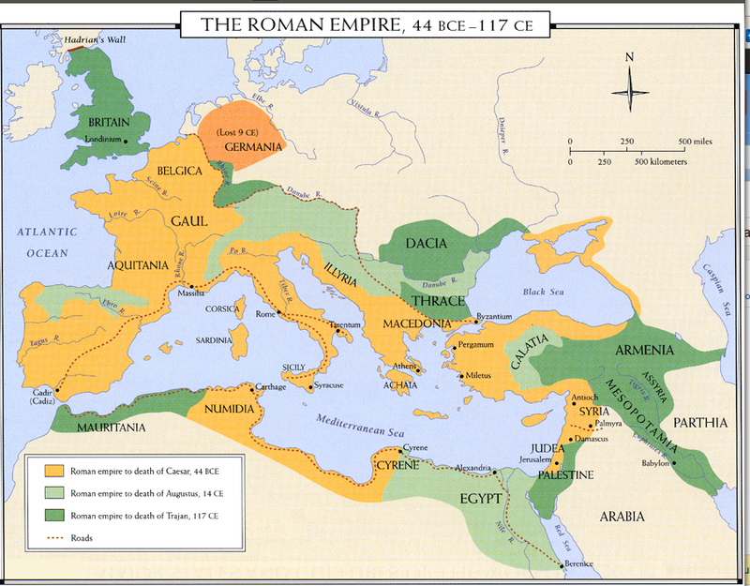

Slide 22
Israel / Judaea in the early Roman Empire
170 | Maccabean Revolt by the Jews in Judah against Seleucid Empire
160 | Hasmonean Dynasty rules Judah as vassals of the declining Seleucid Empire
110 | Hasmonean Dynasty secures autonomous rule and expands to include Samaria, Galilee, Iturea, Perea, and Idumea.
63 | Roman general Pompey defeats the Seleucids in Syria. He also captures Jerusalem and conquers Judah (Roman: Judaea). Judaea becomes tributary to the Roman Republic. The Hasmonean kings serve as client kings to the Roman Republic.
49 | Roman civil war between Pompeii and Julius Caesar. Pompeii defeated.
170 | Maccabean Revolt by the Jews in Judah against Seleucid Empire
160 | Hasmonean Dynasty rules Judah as vassals of the declining Seleucid Empire
110 | Hasmonean Dynasty secures autonomous rule and expands to include Samaria, Galilee, Iturea, Perea, and Idumea.
63 | Roman general Pompey defeats the Seleucids in Syria. He also captures Jerusalem and conquers Judah (Roman: Judaea). Judaea becomes tributary to the Roman Republic. The Hasmonean kings serve as client kings to the Roman Republic.

Slide 23
Herodian Dynasty
134-104 | Hasmonean ruler John Hyrcanus conquered Edom (Idumea) and forced the Edomites to convert to Judaism. Edomite leader Antipas I converts.
90? | Antipas I (“the Edomite”) appointed governor of Edom.
67 | Antipater I (“the Idumean” or “the Edomite”), son of Antipas I, serves as chief advisor to Hasmonean king Hyrcanus II.
49 | Roman Civil war between Pompeii and Julius Caesar. Antipater I sides with Caesar.
47 | As an expression of gratitude, Julius Caesar appoints Antipater I to be procurator of Judaea, Antipater I’s son Phasael Governor of Jerusalem, and Antipater I’s son Herod Governor of Galilee.
44 | Julius Caesar is assassinated on March 15th (“the Ides of March”).
134-104 | Hasmonean ruler John Hyrcanus conquered Edom (Idumea) and forced the Edomites to convert to Judaism. Edomite leader Antipas I converts.
90? | Antipas I (“the Edomite”) appointed governor of Edom.
67 | Antipater I (“the Idumean” or “the Edomite”), son of Antipas I, serves as chief advisor to Hasmonean king Hyrcanus II.

Slide 24
Herodian Dynasty
43 | Antipater I is murdered by poison.
42 | Mark Antony comes to Judaea and becomes friends with Herod
41 | Mark Antony elevates Herod to the rank of tetrarch of Jerusalem and Galilee.
40 | Parthians attack eastern Roman provinces. Herod and his mother Cypros (a Nabataean) escape to Rome, where Herod appeals to the Roman Senate. The Senate proclaims Herod as “King of the Jews,” giving him the whole of Judaea as a vassal kingdom. Herod returns to Judaea and uses Roman soldiers against Antigonus II Mattathias, the last Hasmonean king.
37 | Herod besieges Jerusalem; defeats Antigonus II Mattathias, the last Hasmonean king.

Slide 25
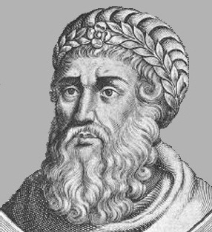
Herod the Great
King of Judaea (the Roman name for the county) 40/37 - 4 BCE.
Roman Senate appointed him “King of the Jews” in 40 BCE.
Friend of the Romans, Mark Antony in particular.
Was of Edomite dissent (a Semitic Arab), but a practicing Jew.
His grandfather converted to Judaism under threat of losing land holdings. Yet the Jews didn’t count conversion to Judaism under duress to be a legitimate conversion. Herod was raised in a Jewish home and was a practicing Jew.

Slide 26
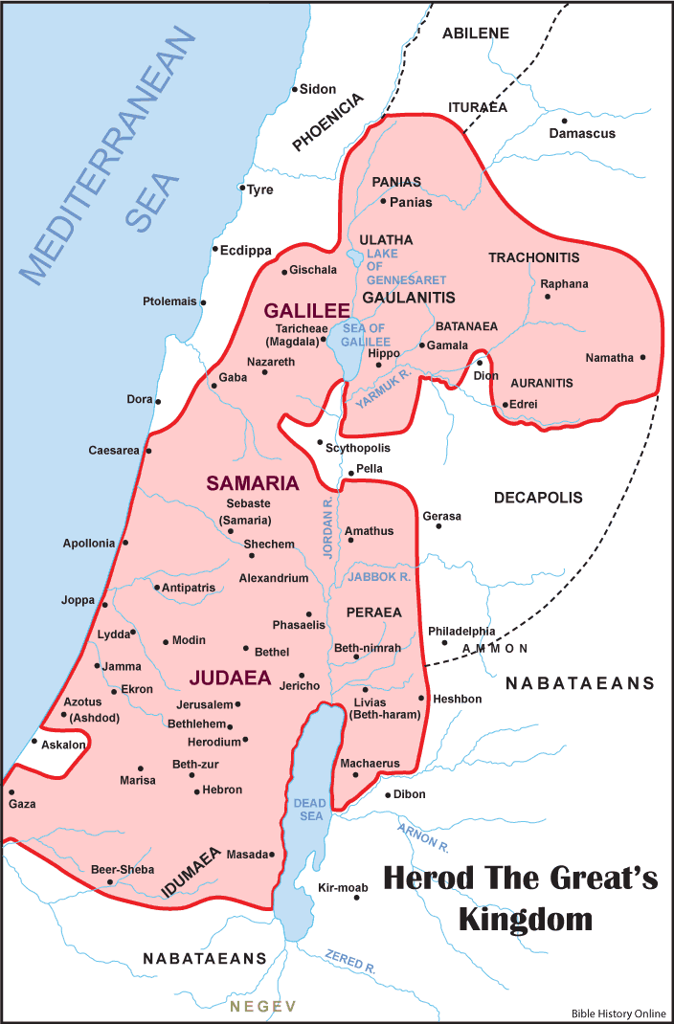
Herod the Great
Was not popular with the Jewish people. His authority came from Rome, not the Jews.
Ruthless and despotic, but his control brought stability.
Terrified of threats to his reign. Ruthlessly crushed any opposition.
Had 10 wives (including a Hasmonean princess (whom he later executed), a daughter of a Jewish High Priest, and a Samaritan)
Had at least 9 sons and 4 daughters.
Had 1 wife and 3 sons executed for treason.

Slide 27
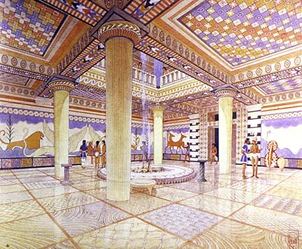
Herod the Great
Although Herod was not liked by his people, Herod is called “The Great” for bringing stability to a land that had been convulsing in turmoil for over 100 years. He generally raised the prosperity of his land and people. His organization of resources propelled a vast building campaign, building many fortresses, aqueducts,
theaters, and other public
buildings. His projects included
Jerusalem, a palace at Jericho
(where he died), Herodium (a
town built for his tomb), and
Masada (fortress palace).

Slide 28
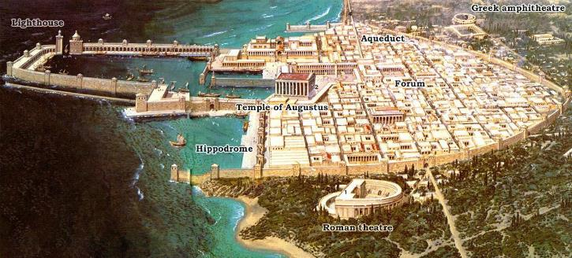
Caesarea Maritima
One of his most impressive feats was building an artificial harbor on the Mediterranean coast so massive that it was able to host the entire Roman fleet. Israel has no natural harbor, so this had to be created by transferring massive tons of stone. Herod did this to appease Rome while at the same time remind his people that the power of Rome backing Herod could come quickly. Remains of this harbor are still visible today.

Slide 29
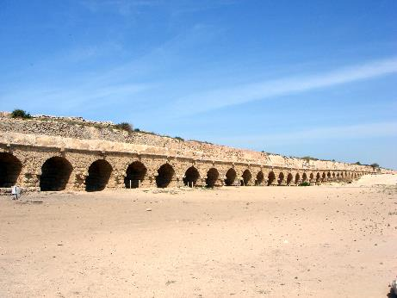
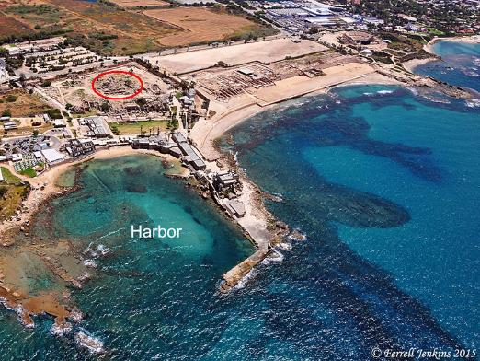
Caesarea Maritima Today

Slide 30
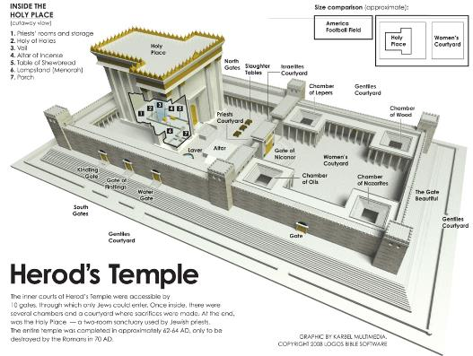
Temple in Jerusalem
Yet Herod’s most impressive building project was to rebuild the Temple in Jerusalem.
Doing this earned cooperation from the Jewish leadership and people.
He started it in 20 BCE, but it wasn’t finished until 60 CE.
It was under construction all during the life of Jesus! (Mark 13:1-2)

Slide 31
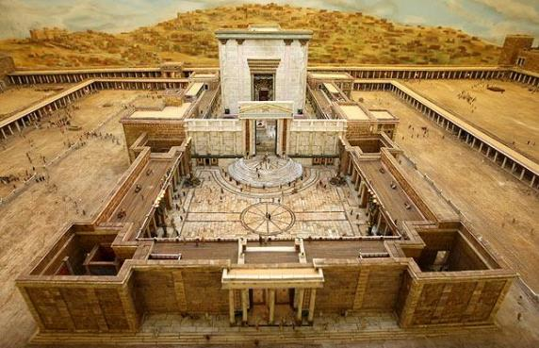
Temple in Jerusalem
Herod expanded the Temple Mount, adding a third more (for a total of 34 acres!)
Expanded/Replaced Zerubbabel’s temple. It is called the Second Temple (some call it the third, counting Zerubbabel’s as the second).
It was one of the largest building campaigns of the 1st century world!
The priests built the
actual temple itself.
Was a glorious building
that won Herod fame
throughout the Roman
Empire.

Slide 32
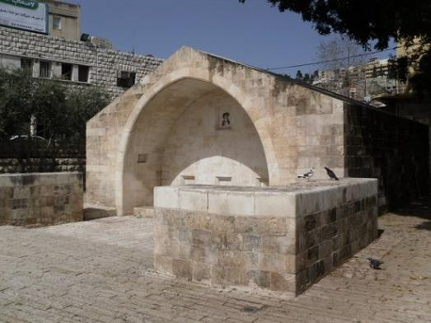
Jesus’ birth
Joseph and Mary lived in Nazareth.
In Nazareth there is a shrine marking the well where, according to tradition, the angel Gabriel appeared to Mary telling her she was going to bear the Christ child.

Slide 33
Jesus’ birth
Emperor Augustus Caesar called for censuses to be conducted in order to collect taxes. Since Jewish property was tied to the father, men and their families were required to go to their father’s estates. Joseph’s family was from Bethlehem, a little village 6 miles south of Jerusalem. Bethlehem’s claim to fame was that it was also the home town of King David.
Herod was still king, and he died in 4 BCE. Therefore Jesus must have been born shortly before then.
David was a shepherd in the nearby hills of Bethlehem. 1000 years later, when Jesus was born, there were still shepherds on the hills, and the angels called them to come see Jesus.

Slide 34
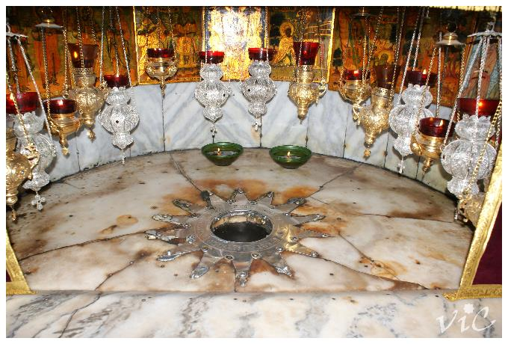
The Church of the Nativity
Today in Bethlehem (which is in the West Bank territory) the Church of the Nativity sits over the place believed to be where Jesus was born.

Slide 35
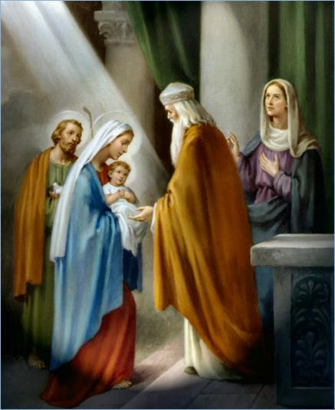
Jesus’ First Trip to the Temple
Jesus’ parents brought Him to be dedicated at the Temple in Jerusalem (6 miles from Jerusalem) and offer the sacrifices to “redeem” Him as their first born male (Luke 2:22ff).

Slide 36
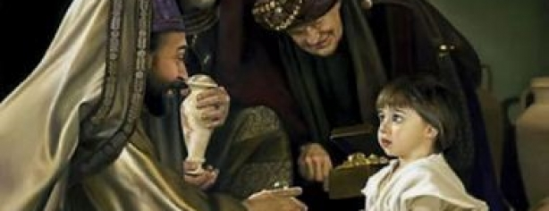
The Magi
Probably Joseph moved in with a relative in Bethlehem and stayed on to do carpentry for a while.
Magi came from the East. Most likely these were Zoroastrians, perhaps from Babylon or Persia.
They first traveled to Jerusalem to speak with King Herod. Herod sent them to Bethlehem.
The magi arrive when Jesus is a toddler, and Joseph and Mary have moved into a home. They had been in Bethlehem perhaps a year.

Slide 37
Herod the Great slaying of the babies in Bethlehem
Herod, likely old and sick, is still terrified of usurpers to his throne. He calls for all male babies 2 years old and younger to be killed in Bethlehem. There is no reference to this terrible tragedy anywhere else but in the Bible. Yet Herod did many cruel things, and Bethlehem was a small, insignificant village.
Joseph and Mary flee down to Egypt until Herod dies.
After he dies, they return to their home in Nazareth.

Slide 38
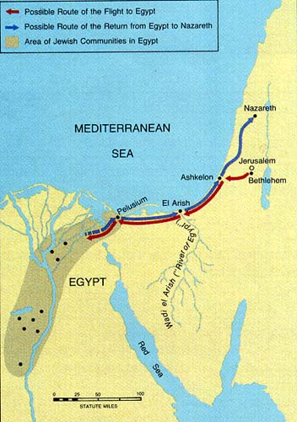

Slide 39
Herodian Dynasty in Judaea
When Herod the Great died in 4 BCE, his kingdom was divided among his three sons. Rome granted them each the title of “Tetrarch.”
Herod Archelaus, son of Herod and Malthace the Samaritan, was given half the kingdom: Judaea proper, Edom and Samaria. He governed the Jews ruthlessly, until he was banished to Gaul in AD 6. Rome took over direct rule, making it the Roman province of Judaea.
Herod Philip I, son of Herod and his fifth wife Cleopatra of Jerusalem, was given jurisdiction over the northeast part of his father’s kingdom; he ruled there until his death in 34 CE. His area for three years was put under the province of Syria.
Herod Antipas, another son of Herod and Malthace the Samaritan, was made ruler of the Galilee and Perea; he ruled there until he was also exiled to Gaul by Emperor Caligula in 39 CE. This is the Antipas in the New Testament Gospels who beheaded John the Baptist and was part of the trial of Jesus.

Slide 40
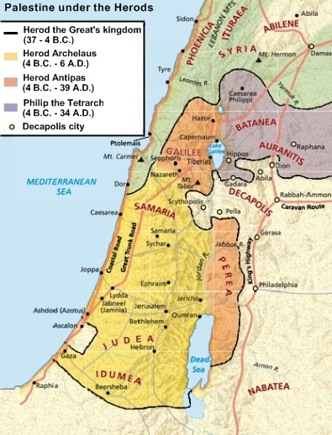
Kingdoms of Herod’s Sons

Slide 41
During the adult life and ministry of Jesus, the rulers of Judaea were:
Judaea proper, Edom and Samaria was governed by Roman prefects or governors.
There were four prefects after Herod Archelaus was banished in 6 CE, and before 26 CE, when Pontius Pilate served as the fifth prefect (from 26–36 CE).
Herod Philip I tetrarch of the northeast part of his father’s kingdom (until his death in 34 CE, when it was governed by Syria for 3 years).
Herod Antipas tetrarch of the Galilee and Perea (until exiled in 39 CE).

Slide 42
The End of the Herodian Dynasty
Agrippa I, grandson of Herod (son of executed Aristobulus IV), was friends with Emperor Caligula, who appointed him ruler with the title of king over the territories of Herod Philip I in 37 CE. In 39 CE he was given the territories of Herod Antipas. Then, in 41 CE, Emperor Claudius added Judaea province, that previously belonged to Herod Archelaus. Thus Agrippa I reunited his grandfather’s kingdom under his rule for three years before he died.
When Agrippa died in 44 CE, his son, Agrippa II was appointed King and ruler of the norther part of his father’s kingdom.
The southern part, the Roman province of Judaea, was ruled by a prefect. In 92 CE, Agrippa II died and all of the Province of Judaea was ruled directly by a Roman prefect.

Slide 43
Jesus at the Temple at the Age of 12
Jesus’ parents were devout Jews, as evidenced by their dedication of Jesus at the Temple and that they returned to Jerusalem to celebrate important holidays: “Every year Jesus’ parents went to Jerusalem for the Festival of the Passover” (Luke 2:41).
The only legitimate story of Jesus’ childhood is the story from Luke 2:41-52. At the age of 12, Jesus was in the Temple courtyard talking (for 1-3 days!) with the priests and scribes: “After three days they found Him in the temple courts, sitting among the teachers, listening to them and asking them questions. Everyone who heard Him was amazed at His understanding and His answers.” (Luke 2:46-47)

Slide 44
Understanding Jesus’ Adult Ministry:
Roman Palestine
Palestine was the Roman name of the region that includes modern day Israel, Lebanon, and parts of Jordan, Syria and Egypt.
Rome was unusually generous with the Jews in Judaea, allowing them to practice their own religion (something they didn’t allow in other regions) and be governed by their own kings. They also allowed the Sanhedrin, the Jewish religious council, to govern all matters of religion and culture.
Yet, as the unrest again erupted after Herod the Great’s death, Rome had to slowly take over ruling the area directly.
Judaea was considered the “armpit of the Empire,” due to its location at the edge of the empire, and its stubborn Jews. Pontius Pilate did NOT want to go there!
The area was of little importance for taxes to the Roman treasury, but it controlled the land and coastal sea routes to the bread basket Egypt and was a border province against the Parthian Empire because of the Jewish connections to Babylonia (since the Babylonian exile).
The Roman capital was at Caesarea Maritima (not Jerusalem).

Slide 45
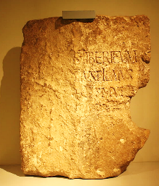
Archeology - Pontius Pilate
Until recently, the only record of Pontius Pilate was in Christian literature. Many claimed he never existed. Then in 1961, a stone fragment was discovered (“The Pilate Stone”) at Caesarea Maritima with the following inscription:
[DIS AUGUSTI]S TIBERIÉUM To the Divine Augusti [this] Tiberieum
[...PO]NTIUS PILATUS ...Pontius Pilate
[...PRAEF]ECTUS IUDA[EA]E ...prefect of Judea
[...FECIT D]E[DICAVIT] ...has dedicated [this]
It is the only non-Christian reference to
Pilate contemporary with his life.

Slide 46
Rulers of First Century Judaea
The Roman Emperor & Senate had ultimate jurisdiction over the entire empire.
Judaea was a satellite of Syria, and of its Governor of Syria (Quirinius at Jesus’ birth) was located at the capital of Damascus.

Slide 47
Roman authority was exercised locally through either the tetrarchs (Herod’s sons) or the prefect (Pilate), who answered directly to the Governor of Syria.
The prefect of Judaea was seated at Caesarea Maritima, the Roman capital.
Judaea was theocracy in that Jewish laws were enforced among Jews.
The Sanhedrin was the Jewish religious governing body, made up of 30 leaders.
The Sanhedrin was centered in the Temple in Jerusalem.
The Sanhedrin was allowed autonomous enforcement of all their rules except capital punishment, which was reserved for the Roman tetrarch or prefect.
The High Priest was in charge of the Sanhedrin, elected annually and appointed by the tetrarch or prefect. The Governor of Syria could (and did!) depose the High Priest.

Slide 48
Antonia Fortress: Housed some of the Roman soldiers stationed in Jerusalem. Also stored the Jewish High Priest’s vestments.
Herod’s Palace: Where the prefect would have stayed while in Jerusalem. Probably along the East wall of Jerusalem.
Pilate’s Praetorium (where he tried Jesus) was traditionally located in the Antonia Fortress. Recent archeology suggest it was located near Herod’s Palace, on the Western Hill on the opposite site of the city.

Slide 49
Understanding Jesus’ Adult Ministry:
Religious Map of 1st Century Israel Background
The Assyrian takeover of Israel and the Babylonian Exile of Judah radically changed the socio-political setting of Israel.
Shortly after Solomon’s death, King Jeroboam of Israel established a royal sanctuary for the northern kingdom of Israel in the city of Dan to compete with the Jerusalem Temple. (1 Kings 12) Thus Dan became the center of worship for Israel. Later, a temple was built at Mt. Gerizim for sacrificial worship. Yet, Israel did not maintain pure Yahweh worship and began incorporating other religious practices almost immediately.

Slide 50
Understanding Jesus’ Adult Ministry:
Religious Map of 1st Century Israel Background
When Assyria conquered the northern Kingdom of Israel in 722 BCE, it removed the leaders and influential people and transported them throughout the wider empire. They assimilated and intermarried with local people, and their unique ethnic identity was lost.
Those who were left in the country were the lower classes of people, kept mainly to do the hard labor of the land and services. Assyria brought in leaders and owners from other areas. Over time, they assimilated and intermarried with the local Israelites. Again the ethnic purity of the Israelites was lost. (The 10 Lost Tribes of Israel.)
The northern people also adopted the religious practices of the neighboring and immigrant peoples. The holy site of Dan continued, but it was religious practices varied from place to place.

Slide 51
Understanding Jesus’ Adult Ministry:
Religious Map of 1st Century Israel Background
When Babylon conquered the southern Kingdom of Judah, they slowly removed leaders and influential people and transported them to a place near Babylon. They kept the Jews together in one location. The Jews in exile and the Jew who remained in Judea maintained ethnic purity.
At the end of the Exile, the Jews were able to return back to Judah and restore Jewish religion and culture.

Slide 52
Understanding Jesus’ Adult Ministry:
Religious Map of 1st Century Israel Background
During the time of the Maccabees
The area around Jerusalem and Jericho, called Judah, staunchly held to Yahweh worship.
The area south of Judah, called Idumaea (including Hebron and Beersheba), had a population of Arab dissent. These people were forcibly converted to Judaism.
The middle part of the kingdom was called Samaria (including Samaria and Beth-shean) and it failed to conform to strict Yahweh worship. This led to a great resentment between the Jews and Samaritans.
The northern part of the kingdom, called Galilee (including Nazareth and Capernaum), largely returned to authentic Yahweh worship.

Slide 53
Understanding Jesus’ Adult Ministry:
Religious Map of 1st Century Israel Background
During the time of King Herod
All the areas were united. Yet Samaria continued its own religious practices, and Jews traveling between Galilee and Judah began the custom of walking around Samaria.
The area east of Samaria was directly controlled by Rome, a region called The Decapolis (or 10 cities).
Note: Jews traveling between Galilee and Judah traveled through pagan Decapolis rather than through apostate Samaria!

Slide 54
Understanding Jesus’ Adult Ministry:
Religious Map of 1st Century Israel Background
During the time of Jesus’ ministry
Galilee and Judaea (including Idumaea) held strict Yahweh worship.
Samaria maintained their own religion, a blend of Jewish and pagan worship.
The Decapolis followed Roman worship.

Slide 55
Understanding Jesus’ Adult Ministry:
Jewish Scriptures & Worship
The Jewish Scriptures were completed in the form we know today as the Old Testament during the time of the Exile.
Most of the older books had been passed down through oral tradition. It was not until the time of the divided kingdom that the inspired Word of God was written down by the priests in the Temple. Some were not finished until the time of the Exile and return.
Torah / Books of Moses / Pentateuch / Books of Law
History - 12 books from Joshua through Ezra
Scrolls / Poetry - 5 books from different periods (Job being the earliest, Solomon’s books the most recent)
5 Major Prophets - “Major” refers to longer length
12 Minor Prophets - “Minor” refers to shorter length

Slide 56
Understanding Jesus’ Adult Ministry:
Jewish Scriptures & Worship
During 1st century Palestine there were two versions of the Hebrew texts.
One was the Greek translation, called the Septuagint (39 books that are in the Christian Old Testament), which was translated in stages during the Hasmonean Dynasty (3rd-2nd century BCE).
The other, the Masoretic Text (the 24 books that are the official Hebrew version) was not finalized until at least the Herodian dynasty, perhaps even after the life of Jesus.

Slide 57
Understanding Jesus’ Adult Ministry:
Jewish Scriptures & Worship
Synagogue
During the time of the Exile, faithful Jews far from the Temple gathered together to maintain Jewish worship. This centered around reading, learning, and discussing the Torah and other Holy Scriptures.
Worship evolved into weekly gathering, on the Sabbath, to read, pray, and discuss the Scriptures.
Requirements to form a synagogue was to have 10 Jewish adult men.
Each Synagogue had a board of elders that governed the Synagogue
Elders would elect a Ruler of the Synagogue to organize and lead the services.

Slide 58
Understanding Jesus’ Adult Ministry:
Jewish Scriptures & Worship
Rabbis
When a Jew went through extra training to become an expert in the Scriptures, they were given the title of Rabbi, or “Teacher of the Law.”
It became customary to have at least one Rabbi connected to each Synagogue.
Other Rabbis wandered from place to place teaching in local Synagogues. Learners, or disciples, would follow the Rabbi around learning from him as they traveled.
Today the title Rabbi is reserved for Jewish clergy who lead and conduct worship.

Slide 59
Understanding Jesus’ Adult Ministry:
Jewish sects during Jesus’ ministry
Levites: Descendants of the tribe of Levi. They were originally charged with assisting the priests in the worship system of Israel. They had no land in Israel but lived among the rest of the tribes. They received 48 cities, however, some in each tribe’s land. Levites received the tithe from the population, and they, in turn, turned over a tenth of what they received to the priests. The Levites took turns serving at the Temple, perhaps a few weeks out of the year.
Priests: Descendants of Aaron. They were the official ministers or worship leaders in Israel. Priests were charged with the sacrificial rights of the Tabernacle and Temple. During Jesus’ day priests took turns serving at the temple (Zechariah, in Luke 1, for example). They had distinctive and symbolic clothes. They also went through special training and education in the Scriptures.

Slide 60
Understanding Jesus’ Adult Ministry:
Jewish sects during Jesus’ ministry
Chief Priests: During Jesus’ life, because the number of priests had grown so large, the main duties of Temple worship were reserved for a group designated “chief priests.” Other priests did more academic work, translating and teaching the Scriptures. Leaders of the Sanhedrin were chief priests. Chief Priests were usually Sadducees.
Members of the Sanhedrin: The Sanhedrin was the highest ruling body on matters of religion and daily life and the court of justice among the Jewish people. It was comprised of 70 members and the High Priest. Members included chief priests, Pharisees, and scribes.

Slide 61
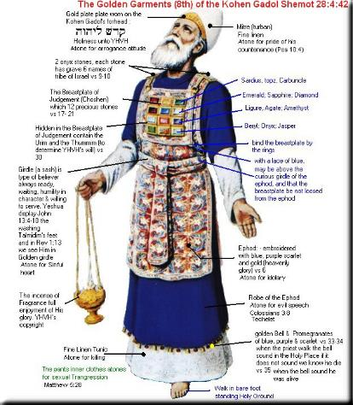
Understanding Jesus’ Adult Ministry:
Jewish sects during Jesus’ ministry
High Priest: Elected chief of the priests, ruler of the Temple. He was also President of the Sanhedrin. His position was as mediator between God and the people. He had special vestments passed down since the time of the Exodus (Exodus 28). Included was the breastplate of the 12 stones representing the 12 Tribes of Israel, and the Urim and Thummim which were used to divine God’s will. He was the only person allowed to ever enter the Holy of Holies, and only once a year, on the Day of Atonement.

Slide 62
Understanding Jesus’ Adult Ministry:
Jewish sects during Jesus’ ministry
Pharisees: Members of a religious and political party that insisted on a legalistic observance of the Jewish law as interpreted by the scribes (the “tradition of the elders”). They loathed the presence of “pagan” Rome and insisted on keeping separate from them as much as possible. Jesus seems most closely aligned with Pharisees. Paul was also a Pharisee. Many Pharisees were ordinary people.
Sadducees: Influential Jewish people usually made up of leading families of rich landowners, aristocrats, merchants and powerful priests. The high priest and the most powerful members of the priesthood were mainly Sadducees (Acts 5:17). Theologically they denied the “tradition of the elders,” the handed-down interpretations and commentary on the Scriptures. They only held the Torah (the first five books) as Scripture, and denied the bodily resurrection. Politically they aligned themselves with the Romans, often trying to manipulate their position for political benefit.

Slide 63
Understanding Jesus’ Adult Ministry:
Jewish sects during Jesus’ ministry
Herodians: Influential Jews who encouraged the adopting of Greek customs and Roman law. They sided with the Sadducees against the Pharisees with their pro-Roman sympathies. Herodians are only mentioned a few times in the New Testament.
Elders: Leaders responsible for governing the Jewish communities. They were usually from the upper class who drew heavily from experts of the Law, such as the priests, scribes, Rabbis, and Pharisees. It also refers to the authors of the commentary and passed-down interpretations on the Scriptures (The Talmud and Mishnah, and later the Gemara).

Slide 64
Understanding Jesus’ Adult Ministry:
Jewish sects during Jesus’ ministry
Scribes: Highly educated people who studied the Scriptures and served as copyists, editors, and teachers. The Scribes were the “keepers of the Torah.” Their interpretation of the Law became legally binding. May priests served as scribes. Sometimes the Gospels refer to Scribes as lawyers or Teachers of the Law. Scribes could not be paid for their services and had to work in other ways for income. This led to many scribes being from wealthy families.
Samaritans: Racially mixed people from the area of Roman Judaea called Samaria. They had their own religious practices that where somewhat based on Jewish religious practices. Jews considered Samaritans worse than pagans because the Samaritans “should know better!”

Slide 65
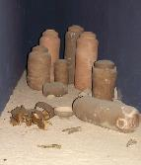
Understanding Jesus’ Adult Ministry:
Jewish sects during Jesus’ ministry
Essenes: A monastic Jewish sect, the largest group of whom had a monastery at Qumran. They collected ancient writings–Jewish and others–and tried to live in a way that honored them all. They stored their older manuscripts in clay jars in the adjacent hillside. They were wiped out when the Romans put down the Jewish Rebellion in CE 66-70. The texts in the jars were discovered in the 10 years following WWII and became known as “The Dead Sea Scrolls.”
Zealots: Fanatical group devoted to the Jewish Law and tradition and to the removal of the Romans from Judea. They considered it treason against God to pay Roman taxes since God alone was their King. As they became more radical, many were known as Sicarii (Latin meaning daggermen) who made it their mission to kill any Roman or supporter of Rome. Their fanaticism was one factor that provoked Roman retaliation in the Roman-Jewish war CE 66-70.

Slide 66
Understanding Jesus’ Adult Ministry:
Jewish sects during Jesus’ ministry
High Priests of the Jews in First Century Judah
Simon ben Boethus, 23-5 BCE (his daughter Mariamne was third wife of Herod the Great)
Matthias ben Theophilus, 5-4
Joazar ben Boethus, 4
Eleazar ben Boethus, 4-3
Joshua ben Sie, 3 ?
Joazar ben Boethus (restored), ? CE 6
Ananus ben Seth, 6-15
Ishmael ben Fabus, 15-16
Eleazar ben Ananus, 16-17
Simon ben Camithus, 17-18
Joseph Caiaphas, 18-36 (son in law of high priest Ananus ben Seth)

Slide 67
Understanding Jesus’ Adult Ministry:
Messianic Expectations
The Jewish Scriptures prophesied of a coming Messiah. Main passages include Genesis 3:15, Genesis 12:3, Isaiah 7:14, Isaiah 9 and 11, Isaiah 52:13-53:12, Micah 5:2, etc.
Many of the prophesies could be interpreted in “layers,” applying to 1) The current situation, 2) The coming of the Messiah, and 3) The end times.
For example, the prophesy that God would raise up a “shoot from the stump of Jesse” (Isaiah 11:1) meant 1) To the Jews in Exile that God would restore the kingdom of Judah, 2) That the Messiah would be a King in the royal line of David, and 3) The Messiah would be a King that would reign in eternity.

Slide 68
Understanding Jesus’ Adult Ministry:
Messianic Expectations
The current political climate of 1st century Judaea, and that the Jews were chafing under the political rule of the Romans, provided a context for the Teacher of the Law to interpret the messianic passages to mean that God would bring a military warrior who would “throw off the yolk of oppression” [Rome] and set up an autonomous rule Kingdom of the Jews.
This political climate made Judaea a “tinderbox” of turmoil almost always ready to boil over.
There were many people who claimed to be the messiah and tried to lead the people into revolt against the Romans.
Many of Jesus’ followers considered Him to be a military messiah (see John 6:15). This was the official charge the Jewish leaders brought against Jesus at His trial before Pilate (John 19:15). This also may have been Judas’ expectation as well.

Slide 69
Understanding Jesus’ Adult Ministry:
Messianic Expectations
Yet, this militaristic interpretation of the Messiah neglects the main purpose of the Messiah, which is to serve as the Answer God brings to the problem of sin. Further, it does not fit with the overall mission of God’s people (whom God called for a purpose) to serve as a blessing, a light, to all the people of earth. For example:
Isaiah 42:6-7 “I, the Lord, have called you in righteousness; I will take hold of your hand. I will keep you and will make you to be a covenant for the people and a light for the Gentiles, ⁷ to open eyes that are blind, to free captives from prison and to release from the dungeon those who sit in darkness.”

Slide 70
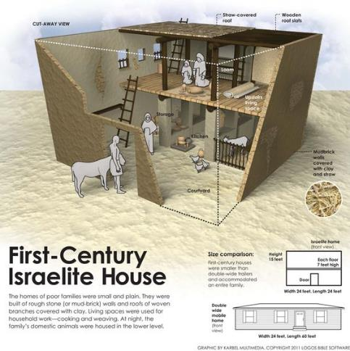
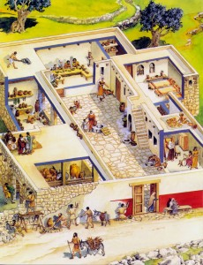
Understanding Jesus’ Adult Ministry: Common Life
Typical 1st Century Jewish home

Slide 71
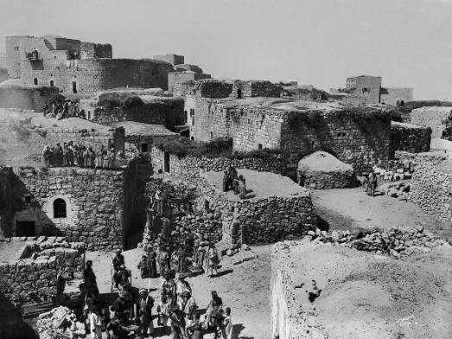
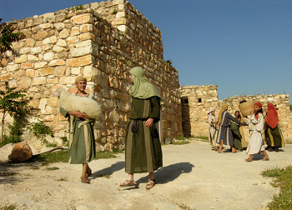
Understanding Jesus’ Adult Ministry: Common Life
Typical 1st Century Jewish village

Slide 72
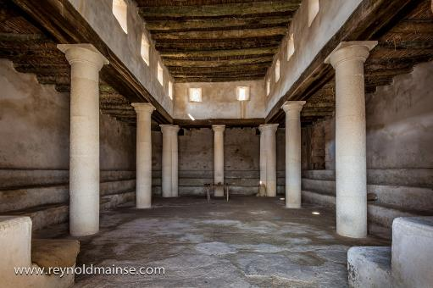
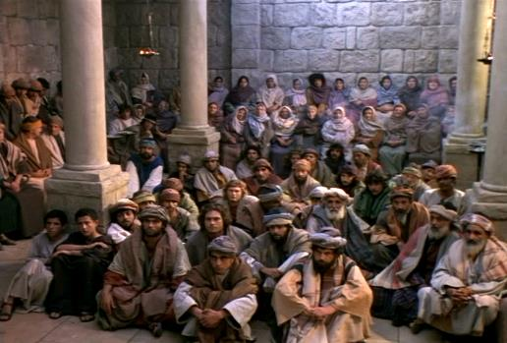
Understanding Jesus’ Adult Ministry: Common Life
Typical 1st Century Jewish synagogue

Slide 73
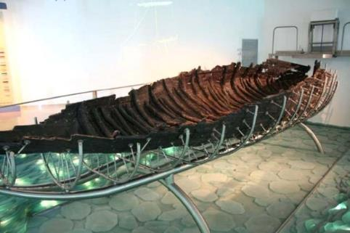
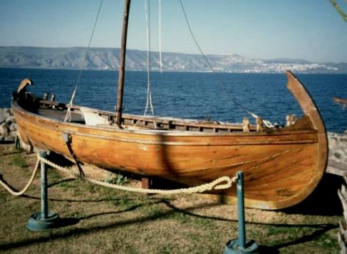
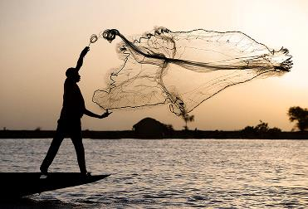
Understanding Jesus’ Adult Ministry: Common Life
Typical 1st Century Jewish fishing boat

Slide 74
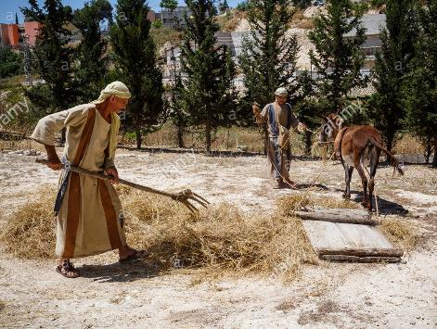
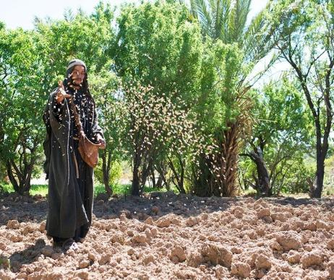
Understanding Jesus’ Adult Ministry: Common Life
Typical 1st Century Jewish farmer

Slide 75
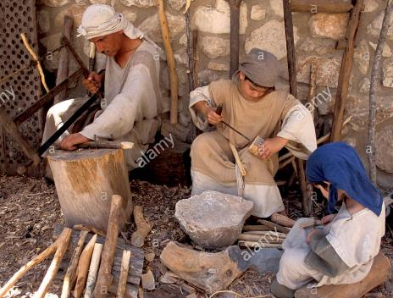
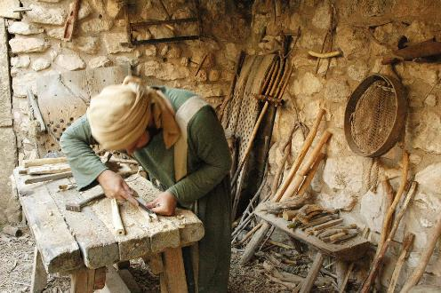
Understanding Jesus’ Adult Ministry: Common Life
Typical 1st Century Jewish carpenter

Slide 76
Questions, Observations, Thoughts, Insights
We are next going to look at Jesus’ three years of adult ministry.

Slide 77
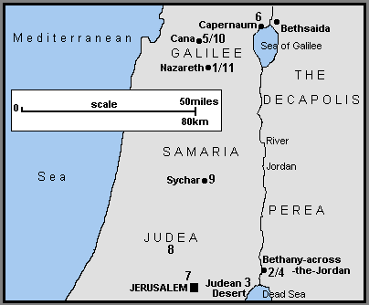
Jesus’ Earthly Ministry: Year 1: Opening Events
[1] Jesus, now about 30 years old (Lk 3:23) travels from His home town of Nazareth in Galilee.
[2] At the River Jordan, possibly near Bethany across the Jordan, He is baptized by John the Baptist (Mt 3:13; Mk 1:9).
[3] He goes in to the Judean Desert or wilderness to face the devil’s temptation (Mt 4:1; Mk 1:12; Lk 4:1).

Slide 78
Year 1: Opening Events
[4] At the River Jordan near Bethany across the Jordan, or Bethabara (Jn 1:28), and according to John’s Gospel, Jesus calls His first five disciples (Jn 1:35). These include Philip, Andrew, and Simon Peter all from Bethsaida in Galilee (Jn 1:44). According to Matt. 4, Jesus called them in Capernaum. Perhaps they were from Bethsaida but were living and working now in Capernaum.

Slide 79
Year 1: Opening Events
[5] Jesus returns north to Galilee with His disciples (Jn 1:43), and at a wedding in Cana, changes the water into wine his first recorded miracle (Jn 2:1).
[6] He continues on to Capernaum, on the northern shore of the Sea of Galilee with his mother, brothers and disciples, and stays there a short time (Jn 2:12).

Slide 80
Year 1: Early Ministry in Judea, Samaria & Galilee
[7] He travels south to Jerusalem for the Passover the first one mentioned in the Gospels (Jn 2:13). There He drives the money changers from the Temple for the first time (Jn 2:14). He also meets the Pharisee, Nicodemus (Jn 3:1).
[8] Jesus leaves for the countryside of Judea where His disciples baptize believers (Jn 3:22).

Slide 81
Year 1: Early Ministry in Judea,Samaria &Galilee
[9] Jesus and His disciples continue northwards from Judea (Jn 4:3), passing through the territory of Samaria (Jn 4:4). Near Sychar, Jesus meets the Samaritan woman at the well (Jn 4:5). Many Samaritans believe in Him (Jn 4:39), after which He continues on to Galilee (Jn 4:43).
[10] He reaches Galilee (Mt 4:12; Mk 1:14; Lk 4:14; Jn 4:45), and back in Cana heals the official’s son who lays sick in Capernaum (Jn 4:46).
[11] Jesus returns to His home town of Nazareth, and preaches in the synagogue (Lk 4:16). He is rejected for the first time (Lk 4:28).

Slide 82
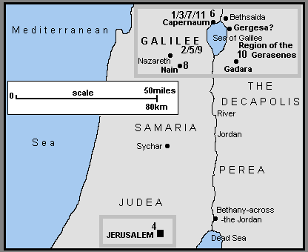
Year 2: Year of Popularity - 1st Preaching Tour of Galilee
[1] Jesus moves to Capernaum (Mt 4:13; Mk 1:21; Lk 4:31). According to the Synoptic Gospels, Jesus call his first disciples perhaps only now to full time service (Mt 4:18; Mk 1:16; Lk 5:1). In Capernaum He heals the madman in the synagogue (Mk 1:23; Lk 4:33) and Peter’s mother in law of her fever (Mt 8:14; Mk 1:29; Lk 4:38).
[2] Jesus travels throughout Galilee, preaching and healing (Mt 4:23; Mk 1:39), including the leper (Mt 8:2; Mk 1:40; Lk 5:12).

Slide 83
Year 2: Year of Popularity - 1st Preaching Tour of Galilee
[3] Returning to Capernaum (Mk 2:1) a paralyzed man is healed (Mt 9:2; Mk 2:3; Lk 5:18) and Jesus calls Matthew (or Levi) the tax collector to be a disciple (Mt 9:9; Mk 2:14; Lk 5:27).
[4] Jesus travels from Galilee south to Jerusalem for a Jewish festival possibly the Second Passover identified in the Gospels (Jn 5:1). At the Pool of Bethesda He heals the crippled man (Jn 5:2).

Slide 84
Year 2: Year of Popularity - 1st Preaching Tour of Galilee
[5] Returning north to Galilee, Jesus heals the man with the shriveled hand (Mt 12:9; Mk 3:1; Lk 6:6) and many others (Mt 12:15; Mk 3:7).
[6] On a hillside in Galilee, probably near Capernaum, Jesus selects His twelve apostles (Mt 10:1; Mk 3:13; Lk 6:12) and delivers the Sermon on the Mount (Mt 5:1). In Luke’s report Jesus comes down from a hillside to give the Sermon (Lk 6:20).
[7] Back in Capernaum, (Mt 8:5; Lk 7:1) Jesus heals the Roman centurion’s servant (Mt 8:5; Lk 7:2).

Slide 85
Year 2: Year of Popularity– 2nd Preaching Tour of Galilee
[8] Jesus continues preaching and healing in Galilee, and in Nain brings the widow’s son back to life (Lk 7:11).
[9] Accompanied by the twelve apostles and some of His women helpers, Jesus continues His second Galilee tour (Lk 8:1).

Slide 86
Year 2: Year of Popularity– 2nd Preaching Tour of Galilee
[10] He sails across the Sea of Galilee (Mt 8:18; Mk 4:35; Lk 8:22) and calms a storm (Mt 8:24; Mk 4:37; Lk 8:23). Landing in the region of the Gerasenes (Mk 5:1; Lk 8:26) or Gadarenes (Mt 8:28) in Gentile Decapolis the Ten Towns or Cities, Jesus heals the madman in the story of the Gadarene Swine (Mt 8:28; Mk 5:2; Lk 8:27).
[11] Sailing back across the Sea of Galilee (Mk 5:21) Jesus lands at “his own town” of Capernaum (Mt 9:1). Here he raises Jairus’ daughter from the dead.

Slide 87
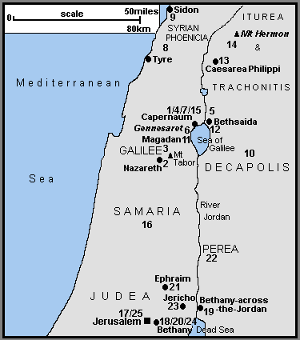
Year 3: Year of Opposition - 3rd Preaching Tour of Galilee
[1] Jesus travels from Capernaum to “His own native town” of Nazareth (Mk 6:1).
[2] In Nazareth, He is rejected for a second time (Mt 13:54; Mk 6:1).
[3] He continues through Galilee (Mt 13:58; Mk 6:6) and sends out the twelve apostles to preach the Gospel (Mt 10:5; Mk 6:7; Lk 9:1).
[4] The Twelve return to Capernaum from their mission (Mk 6:30, Luke 9:10).

Slide 88
Year 3: Year of Opposition - 3rd Preaching Tour of Galilee
[5] From Capernaum, they go off by boat with Jesus to a quiet place (Mk 6:32) near Bethsaida (Lk 9:10). Here he feeds the 5,000 (Mt 14:14; Mk 6:33; Lk 9:11; Jn 6:5).
[6] The disciples return across the Sea of Galilee (Mt 14:22; Mk 6:45), Jesus walking on the water to join them (Mt 14:25; Mk 6:48; Jn 6:19). They land near the Plain of Gennesaret and Jesus heals many people there (Mt 14:34; Mk 6:53).
[7] From Gennesaret they make their way back to Capernaum (Jn 6:24) and Jesus teaches about the Bread of Life (Jn 6:26).

Slide 89
Year 3: Year of Opposition –
Preaching Tour of Syrian-Phoenicia, Ituraea and the Decapolis
[8] Jesus retires from Galilee to the region of Tyre and Sidon in Syrian Phoenicia (Mt 15:21; Mk 7:24) where He heals the daughter of the Gentile Syrophoenician woman (Mt 15:22; Mk 7:25).
[9] He leaves Syrian Phoenicia via Sidon for Galilee (Mt 15:29) but travels through the Decapolis (Mk 7:31).
[10] In the Decapolis He heals the deaf and mute man (Mk 7:32) and feeds the 4,000 (Mt 15:32; Mk 8:1).

Slide 90
Year 3: Year of Opposition –
Preaching Tour of Syrian-Phoenicia, Ituraea and the Decapolis
[11] Reaching the Sea of Galilee, He crosses by boat to the Magadan/ Dalmanutha region (Mt 15:39; Mk 8:10). There the Pharisees and Sadducees ask for a sign from
heaven (Mt 16:1; Mk 8:11).
[12] Continuing on to Bethsaida, a blind man is healed (Mk 8:22).
[13] Jesus now travels from Galilee, north to Caesarea Philippi in Ituraea and Trachonitis, where Peter confesses that Jesus is the Christ (Mt 16:13; Mk 8:27)

Slide 91
Year 3: Year of Opposition –
Preaching Tour of Syrian-Phoenicia, Ituraea and the Decapolis
[14] Continuing on from Caesarea Philippi possibly further north towards Mount Hermon, three of the disciples see Jesus Transfigured in the presence of Elijah and Moses (Mt 17:1; Mk 9:2; Lk 9:28). On His return, Jesus heals the boy with epilepsy (Mt 17:14; Mk 9:14; Lk 9:37). [Other traditions place the Transfiguration to the south, on Mount Tabor. The epileptic boy would then have been healed in the Galilee area.]
[15] In Galilee (Mt 17:22; Mk 9:30), in Capernaum (Mk 9:33), Jesus pays the Temple Tax with a fish. (Mt 17:24). Then to avoid the dangers in Judea, He remains in Galilee (Jn 7:1).

Slide 92
Year 3: Year of Opposition – Later Ministry in Judea
[16] Jesus leaves Capernaum and Galilee for the last earthly time (Mt 19:1; Mk 10:1) and heads for Jerusalem (Lk 9:51; Jn 7:10). Travelling by Samaria, He heals the ten lepers (Lk 17:11) but is rejected in a Samaritan village (Lk 9:52)

Slide 93
Year 3: Year of Opposition – Later Ministry in Judea
[17] Arriving in Jerusalem for the Feast of the Tabernacles in the Autumn of c AD29 (Jn 7:10), Jesus forgives the woman caught in adultery (Jn 8:2) and heals the blind man who is taken before the Sanhedrin (Jn 9:1)
[18] During His travels in Judea, Jesus visits Martha and Mary in Bethany (Lk 10:38), returning to Jerusalem for “Hanukkah”, the Feast of Dedication in December (Jn 10:22).

Slide 94
Year 3: Year of Opposition – The Last Few Months
[19] Jesus withdraws to Bethany across the Jordan (or Bethabara), and into the province of Perea, and stays for a while (Jn 10:40)
[20] Following the death of Lazarus, Jesus returns to Bethany near Jerusalem, and raises him (Lazarus) from the dead (Jn 11:1).
[21] Because of threats to His life, Jesus withdraws to Ephraim to the north of Jerusalem (Jn 11:54).

Slide 95
Year 3: Year of Opposition –
Ministry in Perea (Modern Jordan)
[22] He then crosses the River Jordan and works in Perea (Mt 19:1; Mk 10:1). There He blesses the little children (Mt 19:13, Mk 10:13; Lk 18:15) and speaks to the rich young man (Mt 19:16; Mk 10:17; Lk 18:18).

Slide 96
Year 3: Year of Opposition – Final Journey to Jerusalem
[23] Jesus now travels towards Jerusalem for the last time (Mt 20:17; Mk 10:32; Lk 18:31). Passing through Jericho He heals one (or two) blind men (Mt 20:29; Mk 10:46; Lk 18:35) and converts Zacchaeus the tax collector (Lk 19:1).

Slide 97
Year 3: Year of Opposition – Final Journey to Jerusalem
[24] Reaching Bethany (Jn 12:1) the home of Lazarus, Mary and Martha, Jesus is anointed by Mary either now (Jn 12:2), or later (Mt 26:6; Mk 14:3) after His triumphal entry into Jerusalem (Mt 21:1; Mk 11:1; Lk 19:29; Jn 12:12).
[25] During the Easter week, Jesus returns to Jerusalem each day after staying overnight in Bethany (perhaps staying with Lazarus, Mary and Martha) on the Mount of Olives (Mt 21:17 18; Mk 11:11 12;19; Lk 21:37).

Slide 98
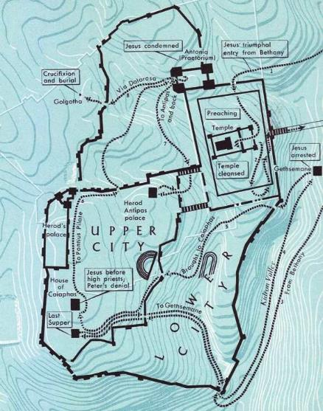
Last Week: “Jesus’ Passion” - In Jerusalem
Gospel references: Matthew 21 27, Mark 11-15, Luke 19:28-23, John 12-19
[1] “Palm Sunday:” Jesus rode into Jerusalem on the back of a colt of a donkey found at a village opposite Bethphage (map: top right). He was received by the people with cries of “Hosanna,” meaning “Save now.” They spread their cloaks on the road and waved palm branches in blessing.
[2] The synoptic Gospels report a second cleansing of the Temple courts during this visit. After teaching in the Temple He returned to Bethany.

Slide 99
Last Week: “Jesus’ Passion” - In Jerusalem
[3] Maundy Thursday: On Thursday Jesus and His disciples celebrated the Seder meal of the Passover (The Last Supper) at a house, the large upper room of which was “furnished and ready” (Mark l4: l5 and Luke 22:12). Traditionally this is located in the rich Upper City of Jerusalem at the home of one of Jesus’ followers.
[4] After the Supper, Jesus and the disciples walked through the Kidron valley, to Gethsemane (the ‘Oil Press’) at the Mount of Olives. There He prayed earnestly with the Father. Then He was arrested by a crowd armed with swords and clubs, led by Judas Iscariot.

Slide 100
Last Week: “Jesus’ Passion” - In Jerusalem
[5] Jesus was led to the house of the high priest Caiaphas. There He was interrogated first by the former high priest Annas and then by an informal tribunal presided over by Caiaphas. During these events Peter, who was waiting outside in the courtyard of the palace, denied knowing Jesus three times.

Slide 101
Last Week: “Jesus’ Passion” - In Jerusalem
[6] Jesus was convicted of claiming He was God, and so they invoked the death penalty. Yet, since this could only be carried out by the Romans, they brought Jesus to the prefect Pontius Pilate, who was in town to keep order during the Passover. The Jews brought the charge to Pilate against Jesus that He claimed to be “King of the Jews,” which was treason if Caesar was king.

Slide 102
Last Week: “Jesus’ Passion” - In Jerusalem
[7] When Pilate heard that Jesus was from Galilee, he sent Jesus to Herod Antipas, tetrarch of Galilee, who was also in Jerusalem for the Passover. Antipas sent Jesus back to Pilate.
Antipas probably stayed at his father’s palace while visiting. Pilate may have stayed there, too. Pilate also could have stayed at the fortress of Antonia north of the Temple. Pilate held trial at the praetorium, which could have been either at the palace or at the Antonia. Pilate had Jesus flogged, hoping that he could then set Him free. This most likely was done at the Antonia.

Slide 103
Last Week: “Jesus’ Passion” - In Jerusalem
[8] When the crown still demanded that Jesus be crucified and instead asked for Barabbas to be set free, Jesus was led by Roman soldiers to Golgotha, traditionally a place outside the Second Wall of Jerusalem. Here he was executed according to Roman practice, by crucifixion.
According to tradition, Jesus was buried nearby, in a tomb belonging to Joseph of Arimathea.

Slide 104
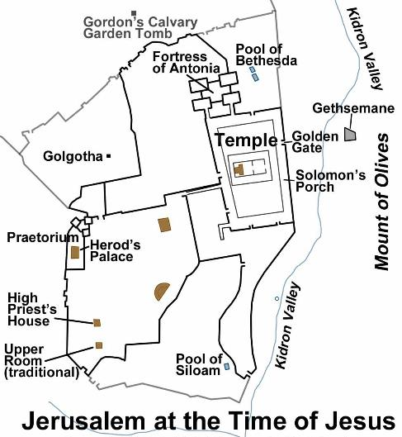
The Church of the Holy Sepulcher
According to Hebrews 13:12, Jesus was crucified outside the city walls. Today the Church of the Holy Sepulcher (marking the traditional site of the crucifixion and burial) lies within the city walls of Jerusalem. It has been suggested that in Jesus’ day, the city wall went between the crucifixion site and the Temple, and that the city walls were expanded at a later time. Yet there is no archeological evidence for a wall between the Church and the Temple mount.

Slide 105
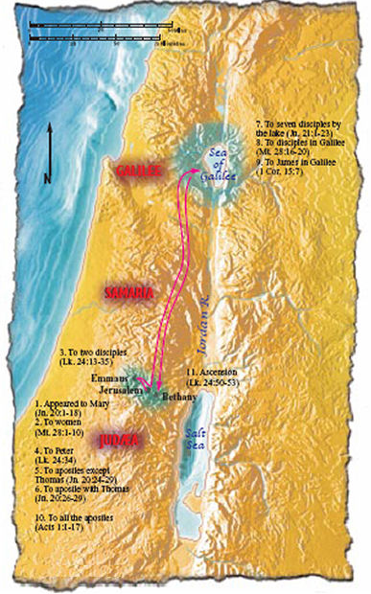
Jesus’ Resurrection, Appearances, and Ascension

Slide 106
Timeline of the Life of Jesus
World History | Date | Biblical & Church Events
Augustus emperor of Rome | 27 BCE - CE 14
Jesus Christ born | 4 BCE | Jesus Christ born
 | 4 | Herod the Great Dies.
Herod Archelaus, tetrarch of Judea | 4 | Herod Antipas, tetrarch of Galilee
 | 2 ? | Birth of Paul
Herod Archelaus exiled, prefects govern Judea | 6
 | 8 CE | Jesus teaches in temple at age 12
Tiberius emperor of Rome | 14-37
 | 27 | Jesus Baptized by John. Jesus’ public ministry.
 | 30 | Jesus Christ crucified, raised, ascended to heaven

Slide 107
Questions, Observations, Thoughts, Insights

Slide 108
Closing Blessing: Psalm 147
¹ Praise the Lord! Because it is good to sing praise to our God!
Because it is a pleasure to make beautiful praise!
² The Lord rebuilds Jerusalem, gathering up Israel’s exiles.
³ God heals the brokenhearted and bandages their wounds.
⁴ God counts the stars by number, giving each one a name.
⁵ Our Lord is great and so strong! God’s knowledge can’t be grasped!
⁶ The Lord helps the poor, but throws the wicked down on the dirt!
⁷ Sing to the Lord with thanks; sing praises to our God with a lyre!
¹⁰ God doesn’t prize the strength of a horse; God doesn’t treasure the legs of a runner.
¹¹ No. The Lord treasures the people who honor Him, the people who wait for his faithful love.

Slide 109
Closing Blessing: Psalm 147
¹² Worship the Lord, Jerusalem! Praise your God, Zion!
¹³ Because God secures the bars on your gates, God blesses the children you have there.
¹⁴ God establishes your borders peacefully. God fills you full with the very best wheat.
¹⁵ God issues His command to the earth–God’s word speeds off fast!
¹⁹ God proclaims his word to Jacob; His statutes and rules to Israel.
²⁰ God hasn’t done that with any other nation; those nations have no knowledge of God’s rules.
Praise the Lord!

Slide 110
Next sessions!
Nov. 6 - NT: Israel during the Life of Jesus
Dec. _______?? - NT: From Jesus to Constantine: The Early Church
Jan. 8 - Israel from Constantine through WWII
Feb. 12 - Israel since WWII

