Slide 1
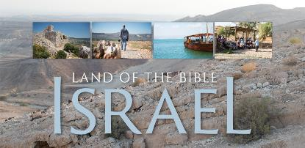
Welcome!
Housekeeping: Creature comforts (Bathrooms, etc.)
Eat lunch during the seminar
Interactive Style: Please feel free to ask questions or make comment as we go

Slide 2
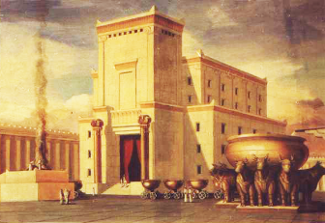
History of the Holy Land
By Rev. David Werner
Sun., Oct. 2, 2016
Session #1: Creation until the First Jerusalem Temple

Slide 3
Overview:
“History of the Holy Land” Seminar
Join Pastor David on a learning journey tracing the history of the lands of the Bible from creation through today. We’ll use maps, time lines, and archeological findings to trace the events, people and stories of the Bible, as well as unpack the historical account after the Bible.

Slide 4
Six-Session Seminar
At Forest Hills UMC
Bring a sack lunch
Sunday Afternoons
12:00 - 2:00 p.m. History of the Holy Land
2:00 - 3:30 p.m. Pilgrims of the Holy Land
(Study Tour group sessions)
Everyone welcome!

Slide 5
Sessions: Sundays:
Oct. 2 - OT: From Creation through the First Temple
Oct. 23 - OT: From the First Temple through the eve of Jesus’ birth
Nov. 6 - NT: The Life of Jesus
Dec. 4 - NT: From Jesus to Constantine: The Early Church
Jan. 8 - From Constantine through WWII
Feb. 12 - Since WWII

Slide 6
Purpose:
Tour group taking a Church History Study Tour to Israel and Jordan March 2017
Learning the story arc of the Bible and its historical and geographical backdrop
Understanding the geographical history of the biblical story
Contextualization: “The Dirt of Salvation”
Faith is not just ideas and beliefs, it is real history, people, and events
Jesus was a real person who actually lived in a certain place
The Christian faith has no Holy Land, but it does have a historic location
Understanding the history of the current situation of the Middle East

Slide 7
Questions or Comments?

Slide 8
Hymn: “We’re Marching to Zion” (UMH #733)
Text: Isaac Watts; refrain by Robert Lowry; Music: Robert Lowry
Verse 1
Come, we that love the Lord, and let our joys be known; join in a song with sweet accord, join in a song with sweet accord and thus surround the throne, and thus surround the throne.
Refrain
We're marching to Zion, beautiful, beautiful Zion; we're marching upward to Zion, the beautiful city of God.

Slide 9
Hymn: “We’re Marching to Zion” (UMH #733)
Text: Isaac Watts; refrain by Robert Lowry; Music: Robert Lowry
Verse 3
The hill of Zion yields a thousand sacred sweets
before we reach the heavenly fields, before we reach the heavenly fields, or walk the golden streets, or walk the golden streets.
(Refrain)
Verse 4
Then let our songs abound, and every tear be dry;
we're marching through Emmanuel's ground, we're marching through Emmanuel's ground, to fairer worlds on high, to fairer worlds on high.
(Refrain)

Slide 10
Psalm 122 A pilgrimage song. Of David
¹ I rejoiced with those who said to me, | “Let’s go to the Lord’s house!”
² Now our feet are standing | in your gates, Jerusalem!
³ Jerusalem is built like a city | joined together in unity.
⁴ That is where the tribes go up— | the Lord’s tribes!
It is the law for Israel | to give thanks there to the Lord’s name,

Slide 11
Psalm 122 A pilgrimage song. Of David
⁵ because the thrones of justice are there | the thrones of the house of David!
⁶ Pray that Jerusalem has peace: | “Let those who love you have rest.
⁷ Let there be peace on your walls; | let there be rest on your
fortifications.”
⁸ For the sake of my family and friends, | I say, “Peace be with you, Jerusalem.”
⁹ For the sake of the Lord our God’s house | I will pray for your good.

Slide 12
Prayer:
O Lord, we gather together because we desire to know more of you. You have given us your Word in the Scriptures. We thank you for it. Send to us now your Holy Spirit to help us put places, names and dates to the great story of Your salvific work. We pray that by doing so, it might become real to us in new and different ways. In Christ’s Name we pray, Amen.

Slide 13
Session #1: Creation until the First Jerusalem Temple
BACKGROUND
Introduction to the area:
Where in the world is this place?
Sharing: What images, words, ideas come to mind as you think about the Holy Land

Slide 14
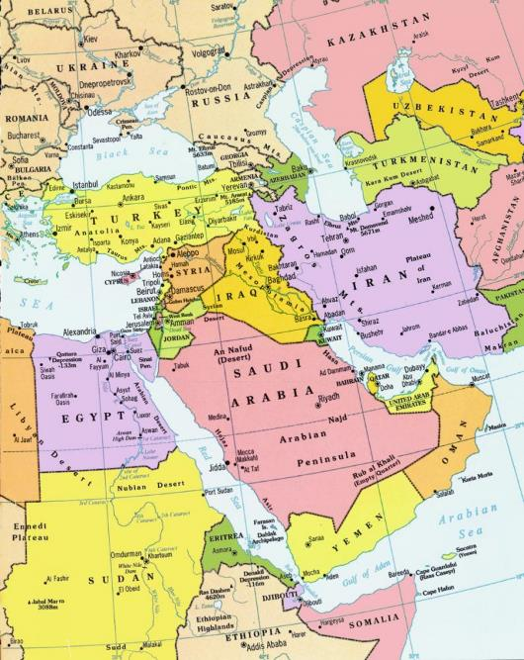

Slide 15
Definitions:
Middle East - Modern term that includes the area from Turkey, Egypt, Saudi Arabia, Iraq and Iran. It replaced the Eurocentric term “Near East,” which was used to divide the land mass of Europe through Asia. “West” referred to Europe. “Near East” meant the lands of the east closest to Europe. “Far East” referred to eastern Asia, such as China and Japan. The logical term “East” is not used as a geographic term, but rather Asia.

Slide 16
Definitions:
Canaan - The Semitic land of the Ancient Near East. It is used in the Bible to refer to the area of the Promised Land before the Hebrews got there. The Hebrews won the land from the people there (“Canaanites”) in war.

Slide 17
Definitions:
Promised Land - The land promised by God to Abraham for his descendants to live forever (Genesis 15:18 21 “That day the Lord cut a covenant with Abram: ‘To your descendants I give this land, from Egypt’s river to the great Euphrates, 19 together with the Kenites, the Kenizzites, the Kadmonites, 20 the Hittites, the Perizzites, the Rephaim, 21 the Amorites, the Canaanites, the Girgashites, and the Jebusites.’”)

Slide 18
Definitions:
Israel - Another name for the Patriarch Jacob (Genesis 32:28). His descendants, called “The Tribes of Israel,” or “Israelites,” were often called simply “Israel.” When these people became a nation, the name of their country became “Israel.” It was retained by the northern kingdom during the time of the divided kingdom.

Slide 19
Definitions:
Palestine - Term, likely based on the Philistine people, used by Greeks and Romans to refer to the region of the Holy Land. Since then, the word has always been used to refer to a region or province (never a state) under political control of another authority. The “Palestinian Territories” refers to the areas within the state of Israel not part of the nation of Israel.

Slide 20
Definitions:
Holy Land - The lands considered holy by Jews, Christians and Muslims as the lands of the events of the Bible. Generally it refers to the land on both sides of the Jordan river, between historic Syria and Egypt.

Slide 21
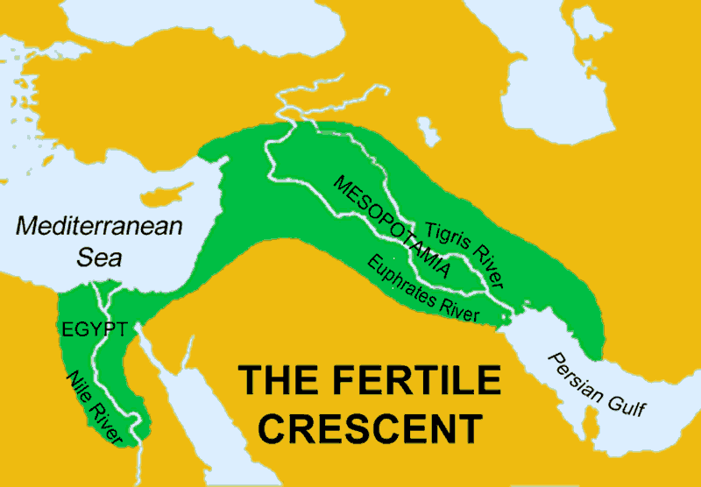
PREHISTORY: The Emergence of People
Origins of humanity, anthropologically and archeologically are traced back to Africa. Origins of society and civilizations are traced back to what is often called the “Fertile Crescent.” It’s the land in the Middle East that shows the first emergence of sustained social communities. Developed along the fertile land supported by water: Nile River, the eastern Mediterranean Sea, the Tigris & Euphrates River, and the western Persian Gulf.

Slide 22
Biblical Creation: 4,004 BCE
(“Before Common Era”)
Genesis 2: ⁸ The Lord God planted a garden in Eden in the east and put there the human he had formed. ⁹ In the fertile land, the Lord God grew every beautiful tree with edible fruit, and also he grew the tree of life in the middle of the garden and the tree of the knowledge of good and evil.
¹⁰ A river flows from Eden to water the garden, and from there it divides into four headwaters.

Slide 23
Biblical Creation: 4,004 BCE
(“Before Common Era”)
Genesis 2: ¹¹ The name of the first river is the Pishon. It flows around the entire land of Havilah, where there is gold. ¹² That land’s gold is pure, and the land also has sweet smelling resins and gemstones. ¹³ The name of the second river is the Gihon. It flows around the entire land of Cush.
¹⁴ The name of the third river is the Tigris, flowing east of Assyria; and the name of the fourth river is the Euphrates.
¹⁵ The Lord God took the human and settled him in the garden of Eden to farm it and to take care of it.

Slide 24
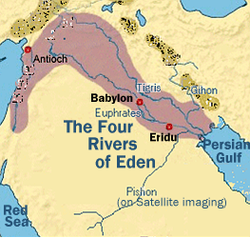

Slide 25
Biblical Creation: 4,004 BCE
(“Before Common Era”)
Interestingly, the origin account in the Bible (Genesis 1-3) locates the earliest activity of people in Mesopotamia! The “one river” seems to suggest a common source watering the whole area. The four rivers, geographically, all flow from different places. The “one river” may be “the dome of water above” that brings rain.

Slide 26
Biblical Creation: 4,004 BCE
(“Before Common Era”)
According to Genesis 5, there are 1,656 years between Creation and the flood of Noah. Almost nothing geographic is mentioned about this time in the Bible. But, if we use the biblical beginning date of creation as 4,004 B.C., then the flood, biblically, might be 2,348 B.C.

Slide 27
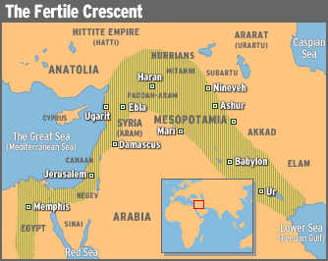
There are archeological records of beginning civilizations dating back to 3,000 B.C.

Slide 28
After the flood, the three sons of Noah settled in different areas of the Middle East.
Genesis 9:18-19
¹⁸ “The sons of Noah who came out of the ark were Shem, Ham and Japheth. (Ham was the father of Canaan.) ¹⁹ These were the sons of Noah, and from them came the people who were scattered over the earth.”
Shem: Arabian Peninsula, Ham: Egypt, and Japeth: Greece, Turkey, Syria, Iraq, Iran.

Slide 29
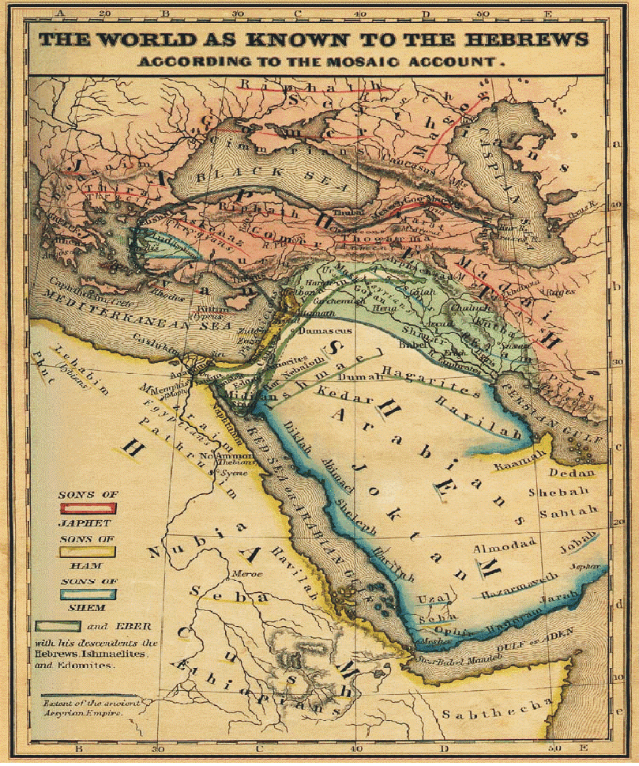

Slide 30
The Cursing of Canaan:
Genesis 9:20-27
Strange story of how Noah becomes drunk and passes out naked in his tent. Ham (his youngest son) enters the tent, sees his father naked, does nothing, but goes and tells his two brothers. His two brothers, Shem and Japeth, go in and respectfully cover Noah. When Noah awakes, he curses Ham’s youngest son, Canaan, prophesying that Canaan’s descendant will be slaves to the descendants of Shem and Japeth.
This is a strange curse, because Noah seems to arbitrarily curse the youngest son of his youngest son. It seems almost to be a pre-justification for the way the Hebrews later treated the Canaanites.

Slide 31
Table of Nations: Genesis 10
10:1-5 Descendants of Japeth (to the north: From Greece to Iran)
Genesis 10:5 (From these the maritime peoples
spread out into their territories by their clans within their nations, each with its own language.)”
Were the sailors of the Mediterranean, the rivers of Mesopotamia, and the Persian Gulf.

Slide 32
Table of Nations: Genesis 10
10:21-31 Descendants of Shem (to the east, the Arabian Peninsula)
10:30-31 “The region where they lived stretched
from Mesha toward Sephar, to the eastern hill country. These are the sons of Shem by their clans and languages, in their territories and nations.”

Slide 33
Table of Nations: Genesis 10
10:6-20 Descendants of Ham (Egypt, and other areas!)
10:6 “The sons of Ham: Cush, Mizraim, Put and Canaan.”
Cush is identified as north-east Africa, sometimes referring to Egypt, sometimes to Ethiopia, sometimes to Lybia. In ancient times, it referred to the Nubians. Some also suggest Cush to refer to the inhabitants of the Arabian Peninsula.

Slide 34
Genesis 10:6-20 Descendants of Ham
(Egypt, and other areas!)
10:7 “The sons of Raamah: Sheba and Dedan.”
Sheba is often located in Ethiopia, although some consider it in Arabia.
The queen of Sheba comes to visit Solomon in @960 BCE. There is no archeological evidence for Sheba, the British Museum identifies her kingdom was Saba, "the oldest and most important of the South Arabian kingdoms," with dates perhaps 1200 BCE until 275 CE with its capital, Ma'rib.

Slide 35
Genesis 10:6-20 Descendants of Ham
(Egypt, and other areas!)
⁸ “Cush fathered Nimrod, the first great warrior on earth. ⁹ The Lord saw him as a great hunter, and so it is said, “Like Nimrod, whom the Lord saw as a great hunter.” ¹⁰ The most important cities in his kingdom were Babel [or Babylon], Erech, Akkad, and Calneh in the land of Shinar. ¹¹ From that land he went to Assyria and built Nineveh, Rehoboth City, Calah, ¹² and Resen, the great city between Nineveh and Calah.”

Slide 36
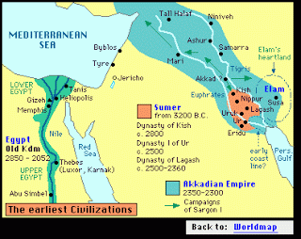
Here we see the beginnings of some of the known
earliest civilizations, including Egypt/Cush, Babylon, Akkadia, and the Assyrians in Nineveh.

Slide 37
Genesis 10:6-20 Descendants of Ham
(Egypt, and other areas!)
¹³ “Mizraim [Egypt] fathered Ludim, Anamim, Lehabim, Naphtuhim, ¹⁴ Pathrusim, Casluhim, and Caphtorim, from which the Philistines came.
“¹⁵ Canaan fathered Sidon his oldest son, and Heth [the Hittites], ¹⁶ the Jebusites, the Amorites, the Girgashites, ¹⁷ the Hivites, the Arkites, the Sinites,
¹⁸ the Arvadites, the Zemarites, and the Hamathites....”

Slide 38
Genesis 10:6-20 Descendants of Ham
(Egypt, and other areas!)
¹⁸ “... After this the Canaanite clans were dispersed. ¹⁹ The Canaanite boundary extends from Sidon by way of Gerar to Gaza and by way of Sodom, Gomorrah, Admah, and Zeboiim to Lasha.
²⁰ These are Ham’s sons according to their clans, their languages, their lands, and their nations.”
Note: Here are recorded the ancestors of the
ancient Canaanites of the Promised Land.

Slide 39
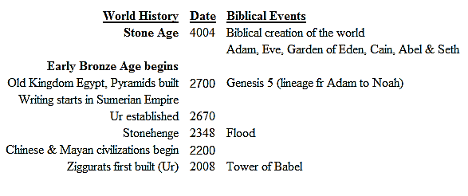
Time Line of the Bible
(All Dates BCE, many dates approximate)

Slide 40
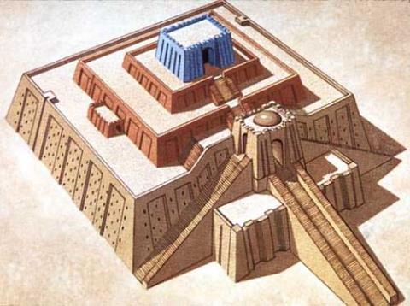
Tower of Babel (Genesis 11)
Ziggurat: Sumerian/Akkadian/Early Babylonian stepped-pyramidic structure
Biblical story seems to be told to explain the dispersion of people from one central area to being scattered throughout the known world: the rise of different civilizations and languages. Biblically this is placed not long after Noah.

Slide 41
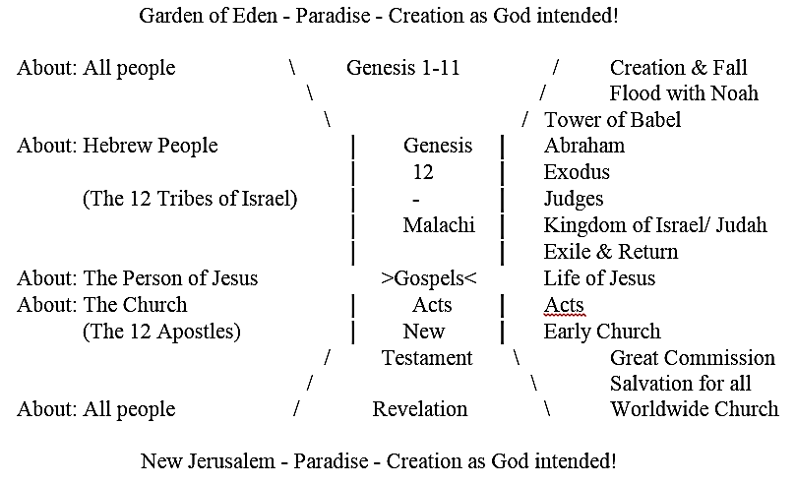
Storyline of the People of the Bible:
Hour-glass shape

Slide 42
PATRIARCHS (C.2000 BCE)
The storyline of Bible goes from “macro-history” (about all people) to “micro-history” (about a certain people group.
Turn in the story driven by God solving the problem of human sin (separation from God)
Starts with the selection of single couple: Abram and Sarai of Ur.
Abraham’s life (c.2166-1991 BCE)

Slide 43
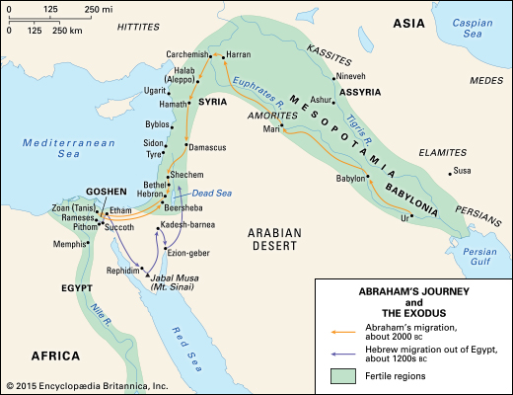
Abram’s and Sarai’s Journey
(c.2000 BCE)

Slide 44
Genesis 11
²⁷ These are Terah’s descendants. Terah became the father of Abram, Nahor, and Haran. Haran became the father of Lot. ²⁸ Haran died while with his father Terah in his native land, in Ur of the Chaldeans. ... Now Sarai was barren; she had no children. ³¹ Terah took his son Abram, his grandson Lot (son of Haran), and his son Abram’s wife, Sarai, his daughter-in-law. They left Ur of the Chaldeans for the land of Canaan, and arriving at Haran, they settled there. ³² Terah lived 205 years, and he died in Haran.

Slide 45
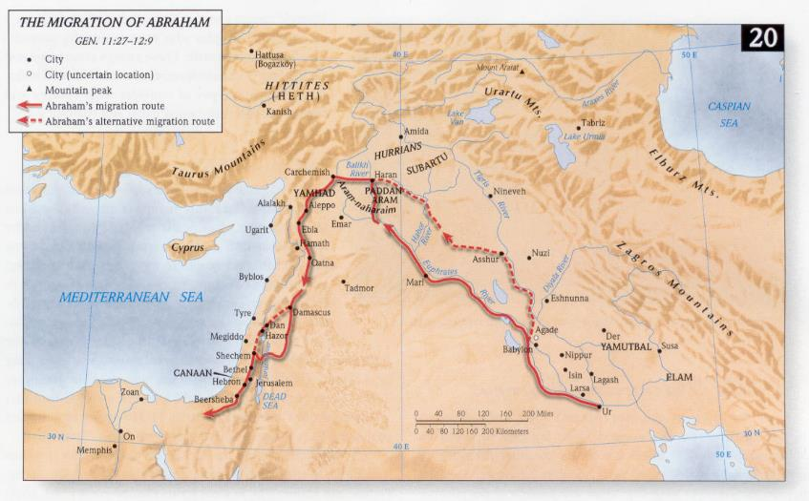
Journey of Terah, Abram, Sarai,
and Lot from Ur to Haran.

Slide 46
God’s Covenant with Abram:
Genesis 12
Land:
People:
Name:
Blessing:
1 The Lord said to Abram, “Leave your land, your family, and your father’s household for the land that I will show you.
2 I will make of you a great nation and will bless you.
I will make your name respected,
And you will be a blessing. 3 I will bless those who bless you, those who curse you I will curse; all the families of the earth will be blessed because of you.”

Slide 47
Genesis 12
⁴ Abram left just as the Lord told him, and Lot went with him. Now Abram was 75 years old when he left Haran. ⁵ Abram took his wife Sarai, his nephew Lot, all of their possessions, and those who became members of their household in Haran; and they set out for the land of Canaan. When they arrived in Canaan, ⁶ Abram traveled through the land as far as the sacred place at Shechem, at the oak of Moreh. The Canaanites lived in the land at that time. ⁷ The Lord appeared to Abram and said, “I give this land to your descendants,” so Abram built an altar there to the Lord who appeared to him.

Slide 48
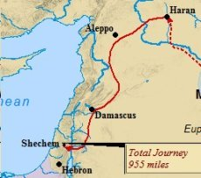
Abram & Sarai’s Journey from
Haran to Shechem

Slide 49
Genesis 12
⁸ From there he traveled toward the mountains east of Bethel, and pitched his tent with Bethel on the west and Ai on the east. There he built an altar to the Lord and worshiped in the Lord’s name. ⁹ Then Abram set out toward the arid southern plain [the Negev], making and breaking camp as he went.

Slide 50
Covenant with Abraham:
Genesis 15:18-21
¹⁸ That day the Lord cut a covenant with Abram: “To your descendants I give this land, from Egypt’s river to the great Euphrates, ¹⁹ together with the Kenites, the Kenizzites, the Kadmonites, ²⁰ the Hittites, the Perizzites, the Rephaim, ²¹ the Amorites, the Canaanites, the Girgashites, and the Jebusites.”

Slide 51
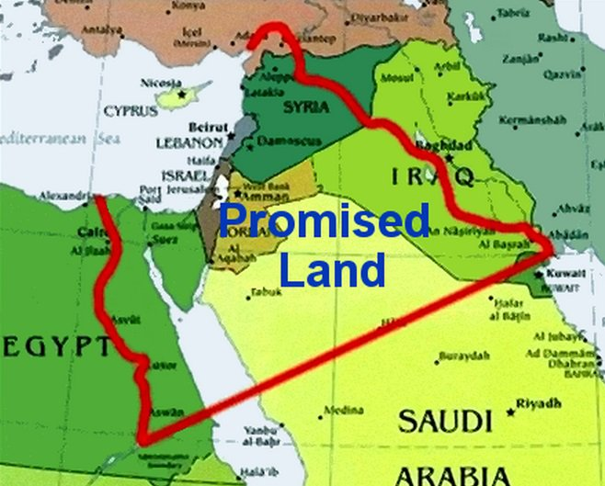
Land Promised to Abram’s Descendants

Slide 52
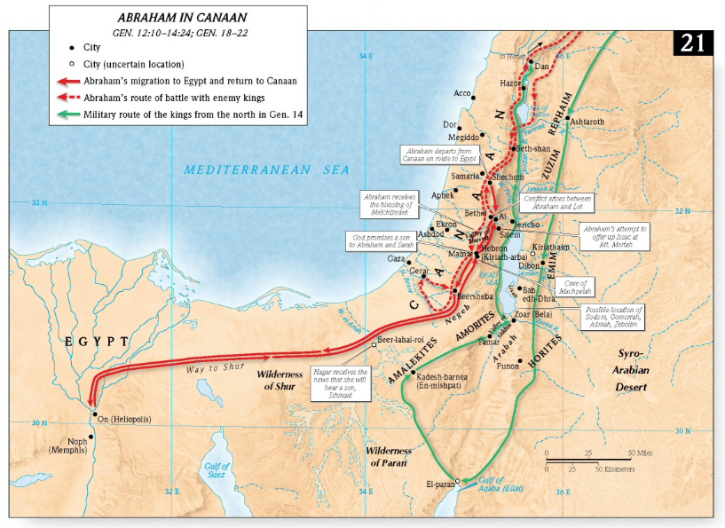
Abraham & Sara in Canaan

Slide 53
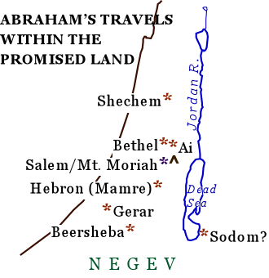
Abraham’s Locations in Israel

Slide 54
Abraham in the Holy Land

Slide 55
Ishmael (c.2080-1943 BCE) –
“Father” of the Arabs
Genesis 21: ²⁰ God remained with the boy [Ishmael]; he grew up, lived in the desert, and became an expert archer. ²¹ He lived in the Paran desert [Hejaz], and his mother found him an Egyptian wife.
Arabic Muslims trace their ancestry to
Abraham through Ishmael.

Slide 56
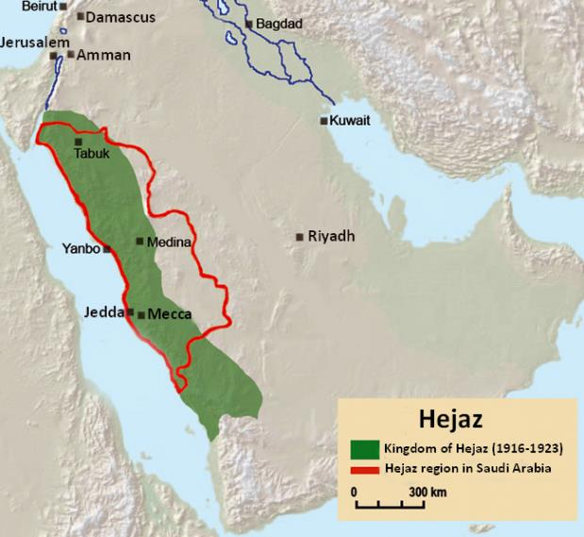
Map of Paran (Hejaz)

Slide 57
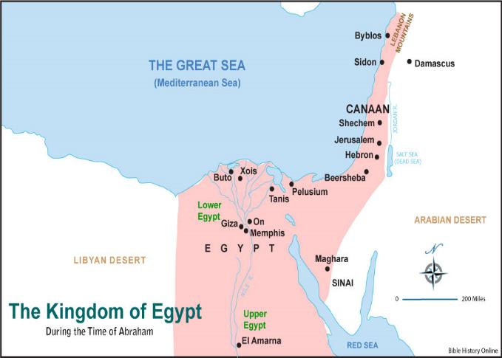
During the Time of the Patriarchs, Canaan was part of Egypt
(beginning of the Middle Kingdom)

Slide 58
Isaac (c. 2066 - 1886 BCE)
Beersheba
- Isaac makes pledge with Abimelech Gen. 26:23-33
- God appeared to Isaac Gen. 26:23-25
Hebron
- Isaac lived here Gen. 35:27
-Isaac & Rebekah buried here

Slide 59
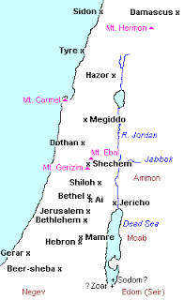
Map of Canaan during the
Time of the Patriarchs

Slide 60
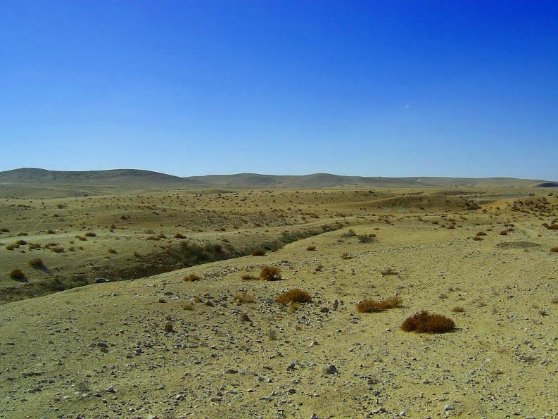
Picture of Be’er Sheva (Beersheba)

Slide 61
Jacob/Israel (c. 2005-1859 BCE)
Beersheba
- God appears to Jacob Gen. 46:1-7
- Jacob flees Esau Gen. 28:10
Bethlehem
- Rachel dies delivering Benjamin Gen. 35:16-20
Hebron
- Jacob lived here Gen. 37:1
- Jacob, Rachel & Leah buried here
Shechem Gen. 33:18-20
- Jacob returned here after 20 years in exile and purchased this plot of the Promised Land from the sons of Hamor
-Dinah, Jacob’s daughter, was raped here Gen. 34

Slide 62
Joseph (c. 1914-1805 BCE)
Shechem Gen. 37:12-14
- Joseph comes here in search of his brothers
Hebron Gen. 37:14-17
- Joseph left here to search for his brothers
Jacob and Joseph’s 11 brothers all move to Egypt

Slide 63
Time Line of the Bible
(All Dates BCE, many dates approximate)

Slide 64
Years between Joseph and Moses
(c. 1800 to either 1450 or 1250 BCE)
The descendants of Jacob/Israel grow into a large nation (about 3 million!)
Hammurabi (d. 1750 BCE) reigns in Babylon - Hammurabi’s Code
Hittites sack Babylon (1595 BCE)
Shang Dynasty in China (c. 1450-1027 BCE)
King Tutankhamen (“King Tut”) Pharaoh in Egypt (1360- 1350 BCE)
19th Dynasty begins in Egypt (1318 BCE)

Slide 65
Dating the Exodus Account
Difficult to determine.
Two major theories:
“High Date” c.1446
-300 years between Joseph’s death and Moses’ birth
-Era of the Judges c. 1350 - 1050 BCE (300 years)
-Pharaoh of the Exodus is Amenhotep II (1453-1426)
“Low Date” c.1290
-450 years between Joseph’s death and Moses’ birth
-Era of the Judges c. 1200 - 1050 BCE (150 years)
-Pharaoh of the Exodus is Rameses II (1304 - 1237)

Slide 66
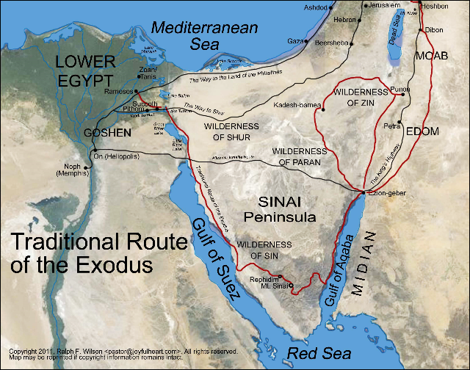
The Traditional (Southern)
Route of the Exodus

Slide 67
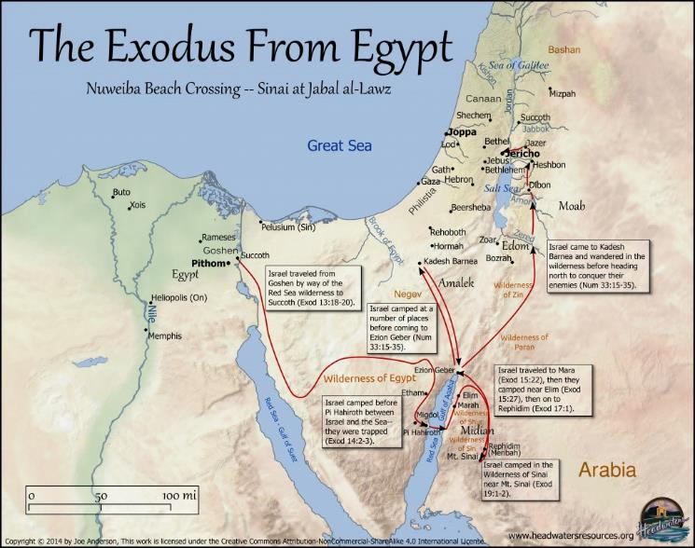
An Alternate Route of the Exodus

Slide 68
Holy Land Locations of Moses
Hebron Numbers 13:17-25
- Moses sent spies here to check out the Promised Land
Jericho
- Moses saw it before he died Deut. 34:1-3

Slide 69
Archeologically Significant
Events from the Exodus
Ten Commandments
Ark of the Covenant
Construction of the Tabernacle

Slide 70
Time Line of the Bible
(All Dates BCE, many dates approximate)

Slide 71
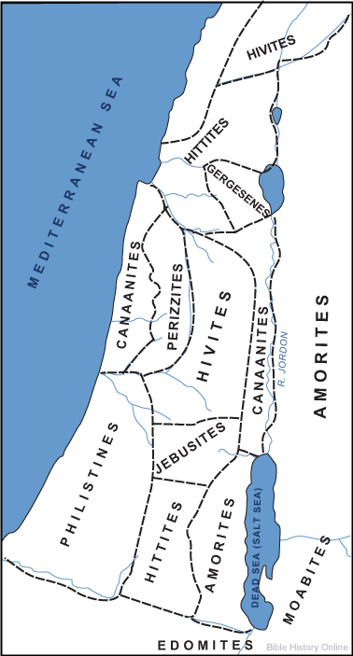
Canaanite Nations before the
Hebrew Conquest

Slide 72
Listing of the 12 Tribes of Israel
(Genesis 35:22–26)
Mother Sons:
Leah: 1. Reuben, 2. Simeon, 3. Levi, 4. Judah, 9. Issachar, 10. Zebulun
Bilhah (Rachel's maid): 5. Dan, 6. Naphtali
Zilpah (Leah's maid): 7. Gad, 8. Asher
Rachel: 11. Joseph, 12. Benjamin

Slide 73
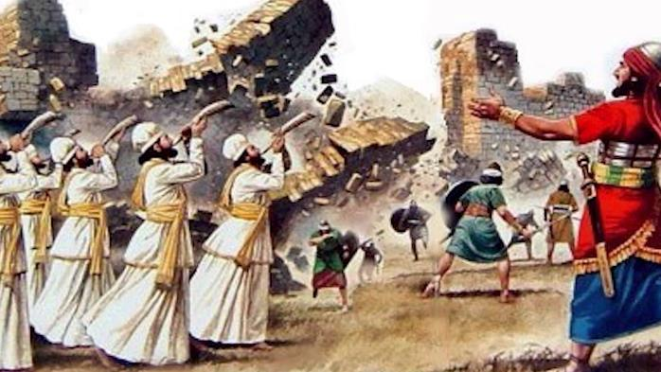
The Conquering of Canaan
Battle of Jericho “High Date” c.1380 BCE
Battle of Jericho “Low Date” c.1230 BCE

Slide 74
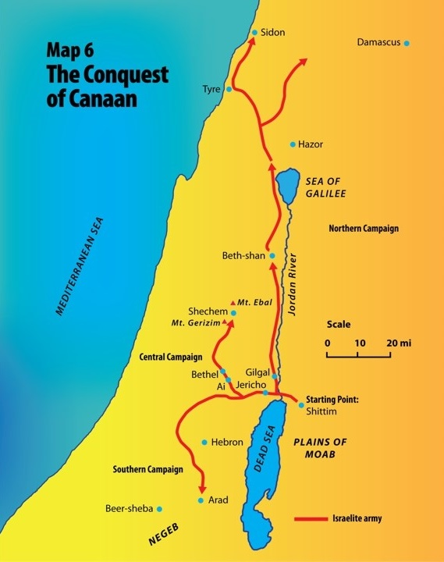
Map of the Conquest of Canaan

Slide 75
No Land for Levi!
Levi’s descendants were designated as Aaron’s successor as the priests of Israel.
Levi’s tribe was not to inherit land in the Promised Land.
Instead, they were to be allowed to settle on land within each of the other tribes.
This ensured that each tribe would have priests within their areas.
The priests took rotations (usually a few weeks a year) serving at the sacrificial altar, first in the Tabernacle, then in the Temple

Slide 76
12 Tribes Reconfigured
When Joseph presented his two sons to Jacob/Israel,
Jacob/Israel adopted them as his own (Gen. 48:1-7)
Joseph’s portion of the Promised Land was divided between his 2 sons
Therefore, even though Levi got no land,
there was still 12 portions in the Promised Land

Slide 77
Land Allotments for the
12 Tribes of Israel
Mother Sons:
Leah: Reuben, Simeon, Levi, Judah, Issachar, Zebulun
Bilhah (Rachel's maid): Dan, Naphtali
Zilpah (Leah's maid): Gad, Asher
Rachel: Joseph (Ephriam & Menasseh), Benjamin

Slide 78
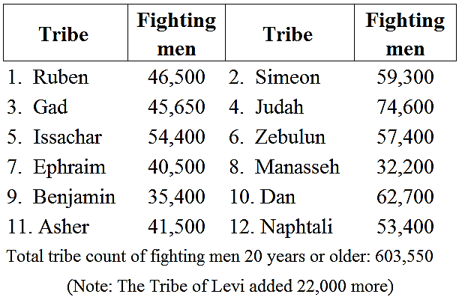
Census in Numbers of the
12 Tribes of Israel

Slide 79
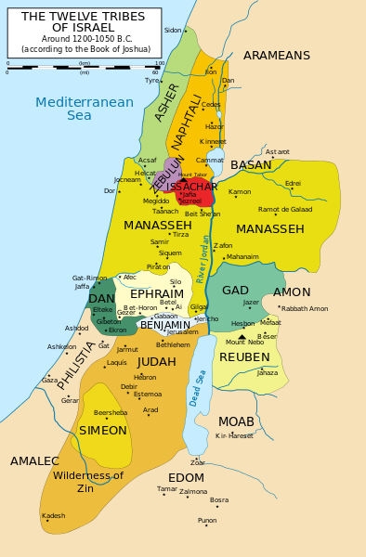
Land Allotments for the
Promised Land under Joshua

Slide 80
Reuben, Gad and Manasseh get
land east of the Jordan River
The tribes of Reuben and Gad had lots of herds and flocks, and the land east of the Jordan was seen as very suitable for herds and flocks. Therefore, they requested this land. (Numbers 32:1) Moses only assented after these tribes still vowed to cross the Jordan and fight the Canaanites alongside the other tribes.
The tribe of Manasseh complained that their land could not support their tribe, as they were too big. Joshua then told them to take land east of the Jordan as well, provided they fought for it and cleared it. (Numbers 32:33)

Slide 81
The Time of the Judges
From the time Joshua and the Israelites conquer Jericho (1380 or 1230 BCE) until the crowing of Saul King (1051 BCE), the Israelites had no kings. They were ruled by “judges,” which were military leaders who helped subdue their enemies. The 12 Tribes failed to successfully conquer fully the indigenous Canaanites, as God had commanded, and thus they had ongoing strife within their lands.

Slide 82
List of the Judges
Joshua, successor of Moses
Othniel from the Tribe of Judah
Ehud from the Tribe of Benjamin
Shamgar, a Levite
Deborah the prophetess, from Ephraim
Barak from the Tribe of Naphtali
Gideon from the Tribe of Menasseh
Abimelech from the Tribe of Menasseh
Tola from the Tribe of Issachar
Jair Hagiladi, from the Tribe of Menasseh
Jephtah from the Tribe of Menasseh
Ibzan* of Bethlehem, from the Tribe of Judah
Elon from the Tribe of Zebulun
Abdon from the Tribe of Ephraim
Samson from the Tribe of Dan
Eli, the High Priest of Shilo
Samuel, the Prophet, a Levite
*Also identified with Boaz, husband of Ruth

Slide 83
Important Locations during
the time of the Judges:
Beersheba
- Established as the southern limit to the Promised Land Judges 18
Bethlehem
- Burial place of Izban, 10th Judge Judges 12:8-10
- Book of Ruth staged here Ruth
Beth Shean
- Tribe of Manasseh unable to expel Canaanites from here Judges 1:27;17:16
Dan (the city)
- Established as the northern limit of the Promised Land Judges 18
Hebron
- Captured by Joshua Joshua 10
- City of Refuge Joshua 20:7
Jericho
- Joshua and the Israelites conquer Joshua 2-6
-Joshua pronounced curse to anyone who rebuilds Jericho Joshua 6:26

Slide 84
Important Locations during
the time of the Judges:
Jordan River
- Israelites cross on dry ground into the Promised Land Joshua 3-4
Megiddo
- Conquered under Joshua Joshua 12:21
- Battle of Deborah Judges 5:19
Mount Tabor
- Deborah and Barak meet here before defeating Sisera Judges 4:6-17
Plain of Esdraelon
- Gideon & 300 men victorious Judges 7
Shechem
- Israelites carry Joseph’s bones to be buried here Gen. 50:25; Joshua 24:32
- City of Refuge Joshua 20:7; 21:21
- Site of Joshua’s farewell address Joshua 24:15
-Abimelich, son of Gideon, tried to establish himself as king Judges 9

Slide 85
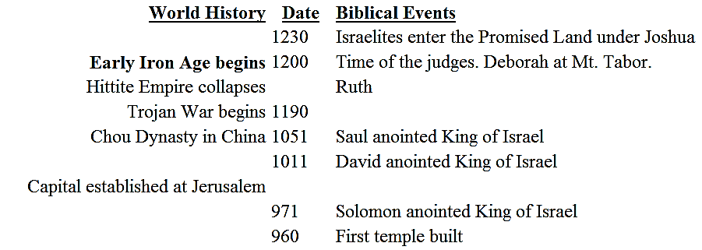
Time Line of the Bible
(All Dates BCE, many dates approximate)

Slide 86
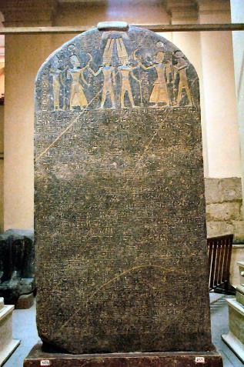
Pharaoh Merneptah’s (1213-1203 BCE)
victory stele mentions Israel for the
first time in non-biblical history

Slide 87
The Birth of a Nation:
Kingdom of Israel
In 1051 BCE the Tribes of Israel ask for a king, and Samuel anoints Saul, from the tribe of Benjamin, king. This makes Israel, for the first time, a centralized state. His kingdom was significantly smaller than the lands allotted to the 12 tribes, as their occupation had been less than successful. Saul’s reign was plagued by wars, often with the Philistines to the west.

Slide 88
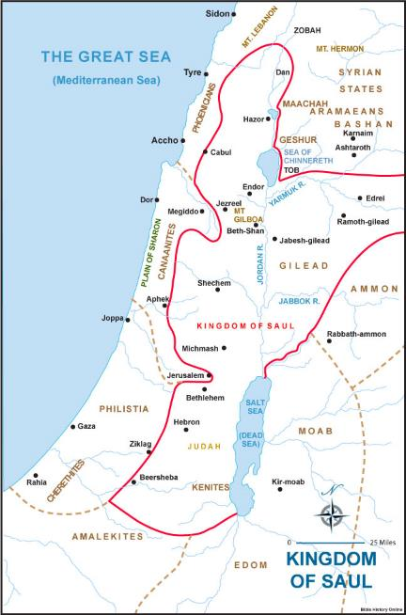
Map of Saul’s Kingdom

Slide 89
Important Locations during
the Reign of Saul
Gibea (10 miles NE of Bethlehem) - Saul born
Gilgal - Samuel commissions Saul as king
Ark of the Covenant at Kiriath-jearim (NW of Jerusalem)
Tent of Meeting at Nob (Near Jerusalem)
Mt. Gilboa, near Beth Shean
- Saul kills himself 1 Samuel 31:3-13

Slide 90
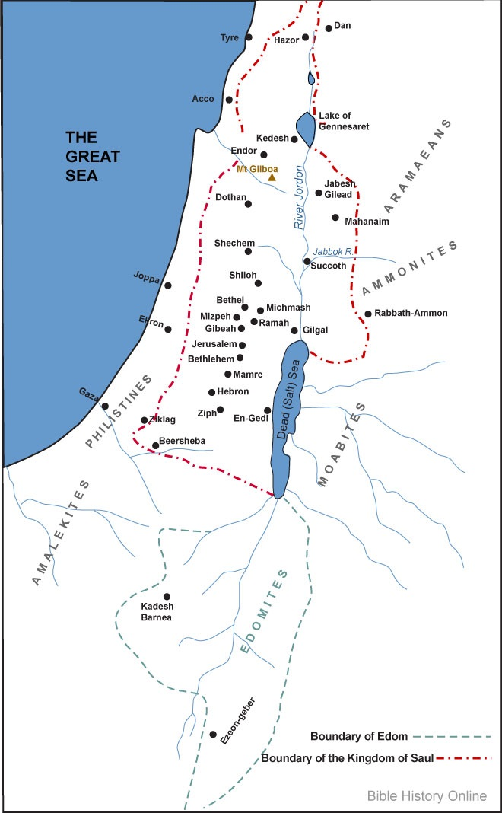
Map of Saul’s Kingdom
with important locations

Slide 91
Capitols of the
United Kingdom of Israel
United Kingdom under Saul: Gibeah, 10 miles NE of Bethlehem
Northern Kingdom Israel under Ish-Bosheth: Mahanaim, east of Jordan River
Southern Kingdom Judah under David: Hebron: 6 miles south of Bethlehem
United Kingdom Israel under David: Jerusalem (established in 1000 BCE)

Slide 92
David:
The Great King of Israel
BCE: Event: Age:
1040 Born 0
1030? Anointed by Samuel to be king 10?
1025? Fights Goliath 15?
1020? Saul’s court & Army 20?
1015? Fugitive of Saul 25?
1010 King of Judah in Hebron 30
1003 King of all Israel 37

Slide 93
David:
The Great King of Israel
BCE: Event: Age:
1000 Makes Jerusalem the capital 40
998? Brings Ark of Covenant to Jerusalem 42?
993 Peace! David’s kingdom established 47
993? David sins with Bethsheba 47?
980? Absolom rebels, becomes king in
Hebron for 1 year; David in exile 60?
977? Sheba’s Rebellion 63?
970 David dies 70

Slide 94
David:
The Great King of Israel
Establishes Jerusalem as the capital of Israel.
David chooses a little Jebusite (a Canaanite tribe) village called Salem, with its fortress on the hill of Zion, to be his new capital. It was on the boarder between Judah and Israel, and by moving his capital from Hebron, he helped unify the whole nation (2 Samuel 5). According to the earliest Jewish traditions Jerusalem is directly identified with the ancient Salem that the biblical Melchizedek, king of righteousness, dwelt in and the whom Abraham paid his tithe to (Gen 14; Heb 7).
David called the new city “The City of David” and renamed it Jerusalem, in Hebrew meaning “City of Peace,” sending a signal to both Israel and Judah that he was putting an end to the civil war between Israel and Judah, and ushering in a new era of peace among the tribes of Israel.

Slide 95
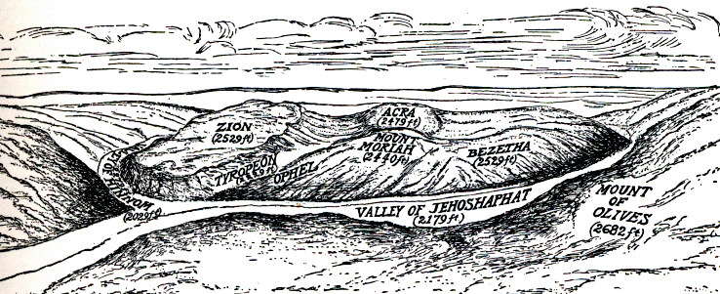
Jerusalem before David

Slide 96
Jerusalem of David
After capturing Salem, David fortified the new capital, expanding the fortress of Zion. This is what today is called the City of David part of Jerusalem.

Slide 97
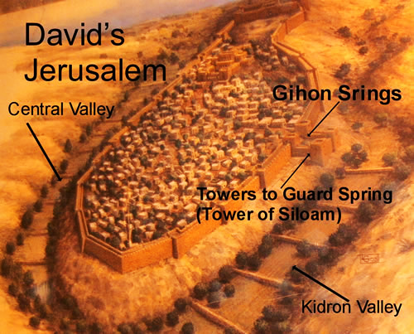
Jerusalem of David

Slide 98
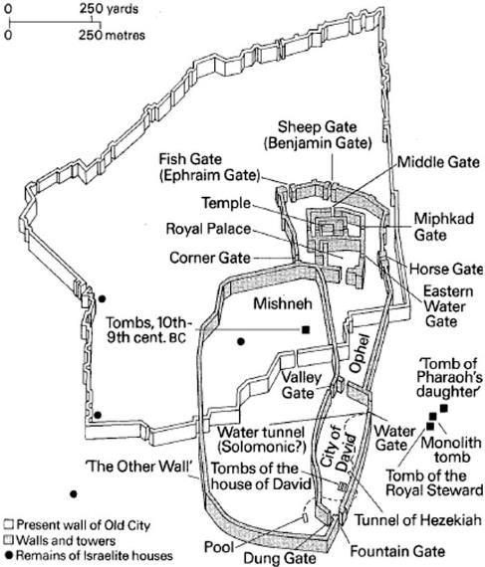
Jerusalem of David

Slide 99
David:
The Great King of Israel
Under David, the Kingdom of Israel grew to its largest size and influence. It was a political entity and force in the Middle East. Also, the kingdom’s boarders fulfilled God’s pledge to Abraham, from Rivers of Egypt to Euphrates!

Slide 100
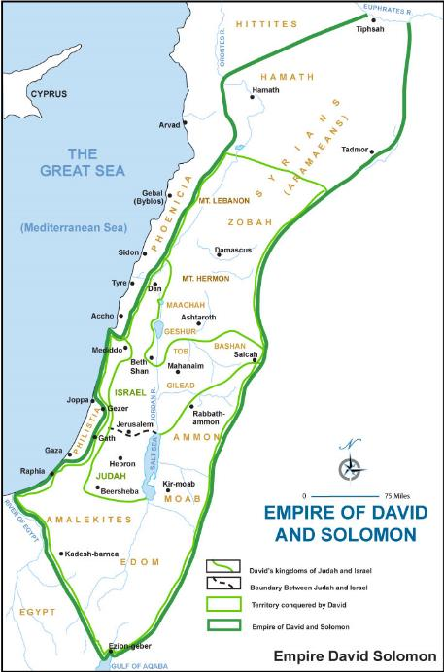

Slide 101
Important Locations during
the Reign of David
Bethlehem
- Samuel came to find David here 1 Samuel 16:34,11-13
- David shepherd here 1 Samuel 17:15
- David from here 1 Samuel 16:1,4,18; 17:12,15,58;20:6
- David desired a drink from the well here when in exile
2 Samuel 23:14-17
1 Chronicles 11:16-19
Desert of Judah - David hid here from Saul 1 Samuel 23ff
Gath of the Philistines - Goliath from here,
David lived here 1 Samuel 17, 21, 27

Slide 102
Important Locations during
the Reign of David
Hebron
- David’s first capital city 2 Samuel 2:1-4,10,11;
5:1-5; 1 Kings 2:11
-Joab killed Abner 2 Samuel 4:5-12
-Absalom organized a revolt against his father David
2 Samuel 15:7-12
Jerusalem - David made this the country’s capital 2 Samuel 5
Mount Moriah (Temple Mount)
- Purchased by David
- Built an altar, offered burnt offerings,
staying off a great plague 2 Sam. 24:15-25
- Here David gathered supplies for the Temple of God which Solomon built 1 Chr. 21:18-22:5, 2 Chr. 3:1-7,11
Ziklag - David lived here until Saul’s death 1 Samuel 27-30

Slide 103
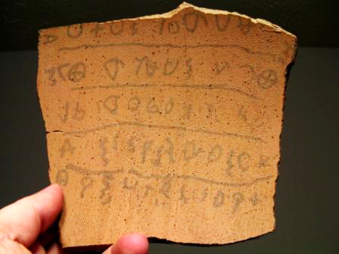
Archeology: The Hebrew Language
In 2012 Archaeologists discovered in Israel a pottery shard of the earliest known Hebrew writing, a 10th century BCE inscription dating from the reign of King David. The finding could mean the Hebrew Bible was written centuries earlier than scientists thought. Scholars have pinned the writing of the Hebrew Bible to the sixth century B.C. This ancient text puts the origin four centuries earlier than that.

Slide 104
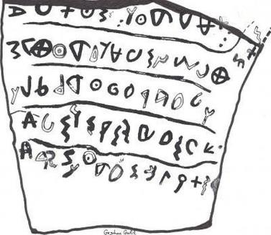
Archeology: The Hebrew Language
The ancient inscription reads (in English):
1' you shall not do [it], but worship the [Lord].
2' Judge the sla[ve] and the wid[ow] / Judge the orph[an]
3' [and] the stranger. [Pl]ead for the infant / plead for the po[or and]
4' the widow. Rehabilitate [the poor] at the hands of the king.
5' Protect the po[or and] the slave / [supp]ort the stranger.

Slide 105
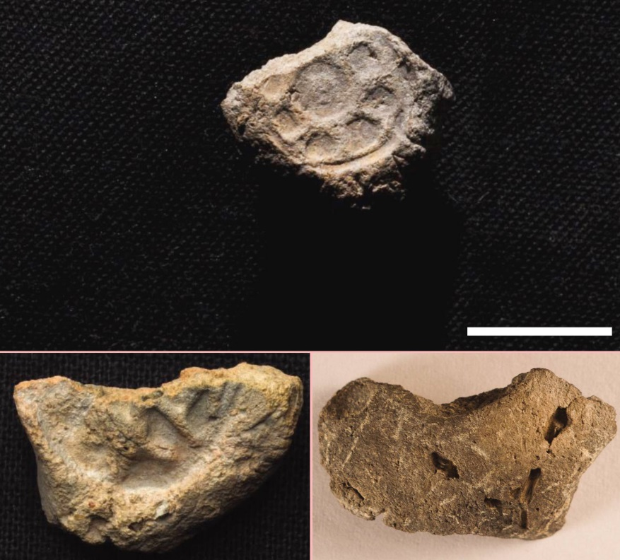
Archeology: Civilization in
Israel during Iron Age
Some historians argue that there was no organized civilization in Israel during the Iron Age (Judges through King Solomon)
Six official clay seals (or bullae) were discovered near Gaza in 2014 and provide evidence that there was an organized government in existence.

Slide 106
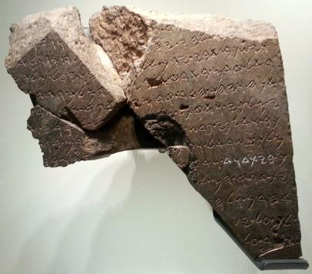
Archeology: David
Earliest mention of David outside the Bible comes in a stele found in Tel Dan in 1992. Dated to the 9th century BCE (800s BCE), the broken fragment tells, in Aramaic, of a king boasting of his victories over the king of Israel and his ally the king of the "House of David" (bytdwd) [highlighted].

Slide 107
King Solomon, according to the Bible
Wealthiest of the kings of Israel - tribute came in from neighboring kingdoms
Famous throughout the Middle East for wisdom
Reign of peace
Political genius
700 wives (most were political marriages) and 300 concubines (1 Kings 11:3)
Extensive building campaign, including expanding Jerusalem, the temple, Solomon’s stables, palaces, and expanding and fortifying many cities.
His reign ended with the country in heavily taxed and beginning to fracture, along with pagan worship flourishing due to the religions of his many foreign wives!

Slide 108
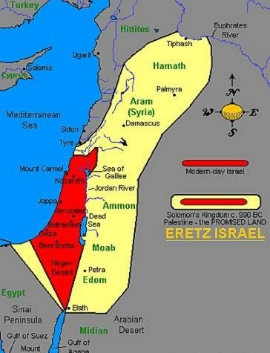
Kingdom of Israel during Solomon

Slide 109
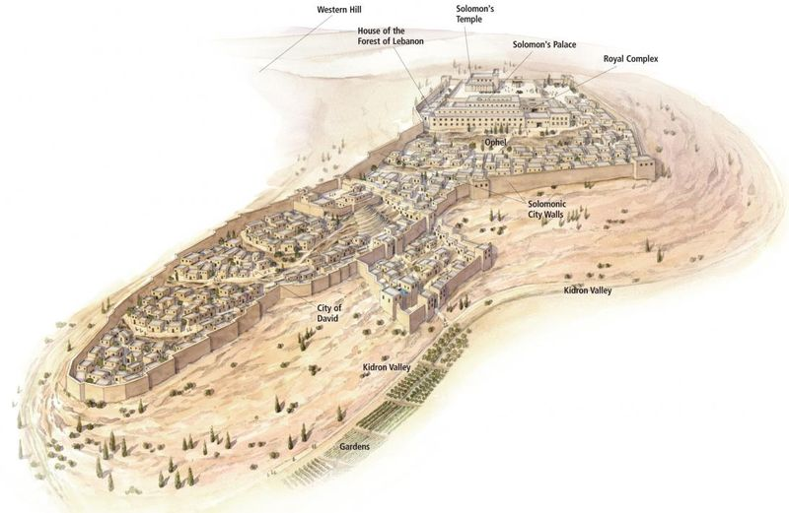
Jerusalem during King Solomon

Slide 110
Jerusalem during King Solomon

Slide 111
Solomon’s Temple
Solomon chose the site of Mt. Moriah for the temple (the place where Abraham attempted to sacrifice Isaac). He built a huge platform elevating the temple mount higher than Mt. Zion, making it the highest in the area. (This temple mount still survives today in Jerusalem!) The temple platform was nearly 15 acres! The temple took 10 years to build, and used resources provided by his father, David.

Slide 112
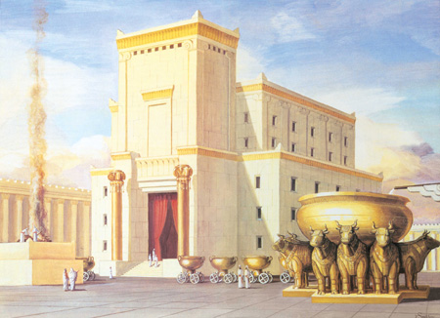
Solomon’s Temple

Slide 113
Important Locations during
the Reign of Solomon
Jerusalem and the Temple
Megiddo
- Key city in Solomon’s day I Kings 4:12; 9:15
Mount of Olives
- Where King Solomon erected the high places for the strange gods of his foreign wives I Kings 11:1

Slide 114
Questions, Observations, Thoughts, Insights

Slide 115
Next sessions!
Oct. 23 - OT: From the First Temple through the eve of Jesus’ birth
Nov. 6 - NT: The Life of Jesus
Dec. 4 - NT: From Jesus to Constantine: The Early Church
Jan. 8 - From Constantine through WWII
Feb. 12 - Since WWII

Slide 116
Closing Blessing (Responsively)
Psalm 122 A pilgrimage song. Of David.
¹ I rejoiced with those who said to me, “Let’s go to the Lord’s house!”
² Now our feet are standing in your gates, Jerusalem!
³ Jerusalem is built like a city joined together in unity.
⁴ That is where the tribes go up— the Lord’s tribes! It is the law for Israel to give thanks there to the Lord’s name,

Slide 117
Closing Blessing (Responsively)
Psalm 122 A pilgrimage song. Of David.
⁶ Pray that Jerusalem has peace: “Let those who love you have rest.
⁷ Let there be peace on your walls; let there be rest on your fortifications.”
⁸ For the sake of my family and friends, I say, “Peace be with you, Jerusalem.”
⁹ For the sake of the Lord our God’s house I will pray for your good.

Slide 118
pilgrims
2:30 p.m. Welcome to the First Orientation

Slide 119
Introductions
Why do you want to go to Israel?

Slide 120
25 Travelers who have said “Yes!”
David, Reese, Rebekah & Nathan Werner, Forest Lake, MN
Bergie & Kay Bergerson, Forest Lake, MN
Ryan Bonngard, Menomonie, WI
Mike & Pat Botzek, Willmar, MN
Duane & Judy Dittberner, Forest Lake, MN
Lynn Ersbo, Minneapolis, MN
Rozanne Foster, Forest Lake, MN
Chris & Teresa Gruber, Forest Lake, MN
Dan & Gloria Hair, Princeton, MN
Andrea Hendrickson, Forest Lake, MN
Sandra Hochstetler, Perry IA
Lauralee Johnson, Forest Lake, MN
Paulette Johnson, Forest Lake, MN
Thomas and Gail Meister, Saint Croix Falls, WI
Sherry Robinson, Plymouth, MN
Dori Vaughn, Forest Lake, MN

Slide 121
Anyone not sure they will actually go?
Anyone know of anyone else who may be interested?
There is room for 33 travelers so far.
Anyone currently looking for a roommate?

Slide 122
Cost: $3,500 for 25 travelers
$700 deposits pp due the end of October
Refund: 100% until Nov. 30
50% between Dec. 1 and Jan. 31
0% after Jan. 31 (Travel insurance important here!)
Balance due Jan. 31, 2017 (non refundable!)

Slide 123
Dates: Sat., March 11 - Wed., March 22
Flight: Air Canada: Minneapolis to Toronto, from Toronto to Tel Aviv.
Flight changes! Reserved flight was departing 11 a.m. on March 11.
That flight canceled!
Now need to depart 6 a.m. on March 11! (7 hour overlay in Toronto!)
Options: Change travel dates?
Could leave one day earlier with little impact in itinerary or cost increase.

Slide 124
Dates: Sat., March 11 - Wed., March 22
Flight: Air Canada: Minneapolis to Toronto, from Toronto to Tel Aviv.
Flight changes! Reserved flight was departing 11 a.m. on March 11.
That flight canceled!
Now need to depart 6 a.m. on March 11! (7 hour overlay in Toronto!)
Options: Change travel dates?
Could leave one day earlier with little impact in itinerary or cost increase.

Slide 125
Advanced Preparations for Travel
Everyone will need a valid, up-to-date passport. Without this, you will not be allowed on the airplane. Valid through Oct. 2017 (precaution against extended medical recovery!)
Travel insurance is your own responsibility (highly recommended!)
Transportation to and from Minneapolis is your own responsibility

Slide 126
Financial Concerns
Budget for spending money
Breakfast and dinner daily, some lunches
Most major credit cards accepted
Call your credit and debit card bank and tell them you will be traveling in Israel & Jordan
Currency: Shekels (Israel), Jordan (dinar). We will be securing Shekels in advance, and you can buy some from us. Let us know how much! We’ll talk more about this later. We are only in Jordan for a half day, so dinars not important.

Slide 127
Medical Concerns
Contact your medical insurance to see if you will be covered during your trip. You may need to purchase trip medical insurance if you are not covered.
Secure eyeglasses/contact prescriptions and lists of medications you are taking.
Talk to your doctor about prescriptions for motion sickness while on the trip.
Be sure to take along a sufficient supply of prescribed medications. They should be kept in the original container you received them in from your pharmacy.

Slide 128
CDC Recommendations for shots
Must: Make sure you are up-to-date on routine vaccines: measles-mumps-rubella (MMR) vaccine, diphtheria-tetanus-pertussis vaccine, varicella (chickenpox) vaccine, polio vaccine, and your yearly flu shot.
Recommended:
Hepatitis A: CDC recommends this vaccine because you can get hepatitis A through contaminated food or water in Jordan, regardless of where you are eating or staying.
Typhoid: You can get typhoid through contaminated food or water in Jordan (Israel has no threat, but information is lacking in Gaza and West Bank of Israel). CDC recommends this vaccine for most travelers, especially if you are visiting smaller cities or rural areas, or if you are an adventurous eater.

Slide 129
CDC Recommendations for shots
Consider:
Hepatitis B: You can get hepatitis B through contaminated needles and blood products, so CDC recommends this vaccine if you might have any medical procedures.
Rabies: Although rabies can be found in dogs, bats, and other mammals in Jordan and Israel, including the West Bank and Gaza, it is not a major risk to most travelers. CDC recommends this vaccine only for people spending time in remote areas that put them at risk for animal bites (such as adventure travel and caving).
Note:
Yellow Fever: There is no risk of yellow fever in Jordan. The government of Jordan requires proof of yellow fever vaccination only if you are arriving from a country with risk of yellow fever. This does not include the US or Israel.

Slide 130
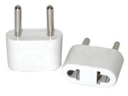
Pre-Packing
Plan to pack less than you think! Then, take even less!
Good walking shoes/boots - Do not skimp on this, and have them fully broken in before we leave
Electronics: Israel requires a special plug AND power converter! (Israel runs on 220v! - Some devices can run on both 110v and 220v)
Weather: Highs 70, Lows 50
Sun hat, sunglasses, rain gear (light rain possible)

Slide 131
Go through itinerary...
including changes

Slide 132
Resources: Maps, books, movies, etc.
This PowerPoint will be available on the church website.
I will provide paper copies to those who prefer that.
We will be providing a text we will begin reading together by next meeting.
Other resources will be coming, too.
Other suggestions?

Slide 133
Questions, Observations, Thoughts, Insights

Slide 134
Next sessions!
Oct. 23 - OT: From the First Temple through the eve of Jesus’ birth
Nov. 6 - NT: The Life of Jesus
Dec. 4 - NT: From Jesus to Constantine: The Early Church
Jan. 8 - From Constantine through WWII
Feb. 12 - Since WWII

Slide 135
3:30 p.m. Closing:
Hebrew Blessing
“The Lord bless you and keep you; the Lord make his face shine upon you and be gracious to you; the Lord turn his face toward you and give you peace.”
(Numbers 6:24-26)

Slide 136
Thank you!

