Slide 1
It’s a
Seussical Life!
Discovering Creative Ways to Live as God’s Kids
Can You Hear?”
“Religion that God our Father accepts as pure and faultless is this: to look after orphans and widows in their distress and to keep oneself from being polluted by the world.” James 1:27

Slide 2
Mark 4 (CEV)
“²¹ He said to them, ‘Do you bring in a lamp to put it under a bowl or a bed? Instead, don’t you put it on its stand? ²² For what-ever is hidden is meant to be disclosed, and whatever is con-cealed is meant to be brought out into the open. ²³ If anyone has ears to hear, let them hear.’”

Slide 3
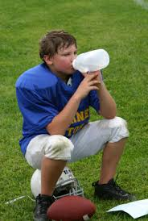

Slide 4
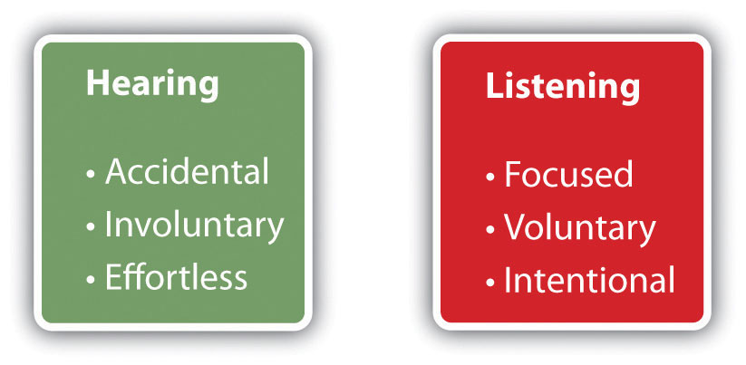

Slide 5
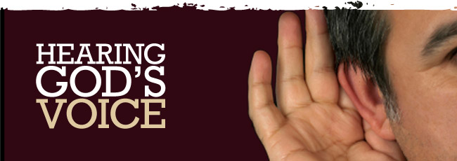

Slide 6
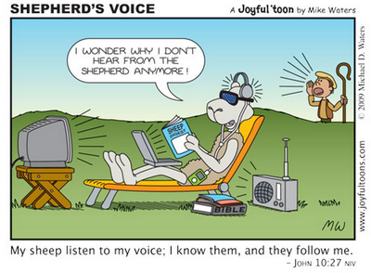

Slide 7
Can you hear?
Hearing God’s voice takes practice
“Those who have ears, let them hear!”
~Jesus

Slide 9
Luke 4 (CEV)
¹⁴ Jesus returned in the power of the Spirit to Galilee, and news about Him spread throughout the whole countryside. ¹⁵ He taught in their synagogues and was praised by everyone.
¹⁶ Jesus went to Nazareth, where He had been raised. On the Sabbath He went to the synagogue as He normally did and stood up to read. ¹⁷ The synagogue assistant gave Him the scroll from the prophet Isaiah. He unrolled the scroll and found the place where it was written:
¹⁸ The Spirit of the Lord is upon me, because the Lord has anointed me.

Slide 10
Luke 4 (CEV)
He has sent me to preach good news to the poor,
to proclaim release to the prisoners and recovery of sight to the blind,
to liberate the oppressed, ¹⁹ and to proclaim the year of the Lord’s favor.
²⁰ He rolled up the scroll, gave it back to the synagogue assistant, and sat down. Every eye in the synagogue was fixed on Him. ²¹ He began to explain to them, “Today, this scripture has been fulfilled just as you heard it.”

Slide 11
Can you hear?
Hearing God’s voice takes practice
Hearing the voice of the ignored
“Religion that God our Father accepts as pure and faultless is this: to look after orphans and widows in their distress and to keep oneself from being polluted by the world.” James 1:27

Slide 12
Can you hear?
Hearing God’s voice takes practice
Hearing the voice of the ignored
Ignoring the voices of the heard
“Religion that God our Father accepts as pure and faultless is this: to look after orphans and widows in their distress and to keep oneself from being polluted by the world.” James 1:27

Slide 13
Can you hear?
Hearing God’s voice takes practice
Hearing the voice of the ignored
Ignoring the voices of the heard
Hearing because they are important
“You are precious and honored in my sight, and I love you”
Isaiah 43:4

Slide 14
Can you hear?
Hearing God’s voice takes practice
Hearing the voice of the ignored
Ignoring the voices of the heard
Hearing because they are important
Being heard because you are important
“And the King will answer them, ‘Truly, I say to you, as you did it to one of the least of these my brothers, you did it to me.’”
Matthew 25:40

Slide 15
