Slide 1
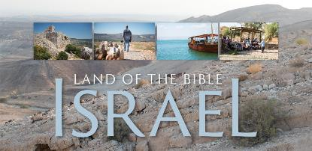
Welcome!
Housekeeping: Creature comforts (Bathrooms, etc.)
Eat lunch during the seminar
Interactive Style: Please feel free to ask questions or make comment as we go

Slide 2
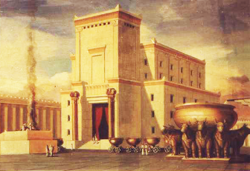
History of the Holy Land
By Rev. David Werner
Sun., Oct. 23, 2016
Session #2: The First Jerusalem Temple until the Time of Jesus

Slide 3
Overview:
“History of the Holy Land” Seminar
Join Pastor David on a learning journey tracing the history of the lands of the Bible from creation through today. We’ll use maps, time lines, and archeological findings to trace the events, people and stories of the Bible, as well as unpack the historical account after the Bible.

Slide 4
Six-Session Seminar
At Forest Hills UMC
Bring a sack lunch
Sunday Afternoons
12:00 - 2:00 p.m. History of the Holy Land
2:00 - 3:30 p.m. Pilgrims of the Holy Land
(Study Tour group sessions)
Everyone welcome!

Slide 5
Sessions: Sundays:
Oct. 2 - OT: From Creation through the First Temple
Oct. 23 - OT: From the First Temple through the eve of Jesus’ birth
Nov. 6 - NT: The Life of Jesus
Dec. 4 - NT: From Jesus to Constantine: The Early Church
Jan. 8 - From Constantine through WWII
Feb. 12 - Since WWII

Slide 6
Purpose:
Tour group taking a Church History Study Tour to Israel and Jordan March 2017
Learning the story arc of the Bible and its historical and geographical backdrop
Understanding the geographical history of the biblical story
Contextualization: “The Dirt of Salvation”
Faith is not just ideas and beliefs, it is real history, people, and events
Jesus was a real person who actually lived in a certain place
The Christian faith has no Holy Land, but it does have a historic location
Understanding the history of the current situation of the Middle East

Slide 7
Questions or Comments?

Slide 8
Hymn: “Jerusalem”
(Unofficial national anthem of England)
Text: William Blake, 1804. Music: Sir Hubert Parry, 1916
And did those feet in ancient time,
Walk upon England’s mountains green:
And was the holy Lamb of God,
On England’s pleasant pastures seen!
And did the Countenance Divine,
Shine forth upon our clouded hills?
And was Jerusalem builded here,
Among these dark Satanic Mills?

Slide 9
Hymn: “Jerusalem”
(Unofficial national anthem of England)
Text: William Blake, 1804. Music: Sir Hubert Parry, 1916
Bring me my Bow of burning gold;
Bring me my Arrows of desire:
Bring me my Spear: O clouds unfold!
Bring me my Chariot of fire!
I will not cease from Mental Fight,
Nor shall my Sword sleep in my hand:
Till we have built Jerusalem,
In Englands green & pleasant Land

Slide 10
Hymn: “Jerusalem”
(Unofficial national anthem of England)
Text: William Blake, 1804. Music: Sir Hubert Parry, 1916

Slide 11
Psalm 125 A song of worship.
¹ Everyone who trusts the Lord is like Mount Zion
that cannot be shaken and will stand forever.
² Just as Jerusalem is protected by mountains on every side,
the Lord protects his people by holding them in his arms now and forever.
³ He won’t let the wicked rule His people or lead them to do wrong.
⁴ Let’s ask the Lord to be kind to everyone who is good and completely obeys Him.
⁵ When the Lord punishes the wicked, He will punish everyone else who lives a crooked life.
Pray for peace in Israel!

Slide 12
Opening prayer

Slide 13
Today:
Review
Canaanite lands, culture and religion
Archeology
Israel: Exile, Possessing Canaan, Time of the Judges,
United Monarchy
Empires of the Ancient Middle East
Divided Kingdoms: Israel and Judah, The Prophets,
Fall of Israel, Fall of Judah
Exile, Return, Greek Possession, Hasmodean
Kingdom, Romans
King Herod and the Temple

Slide 14
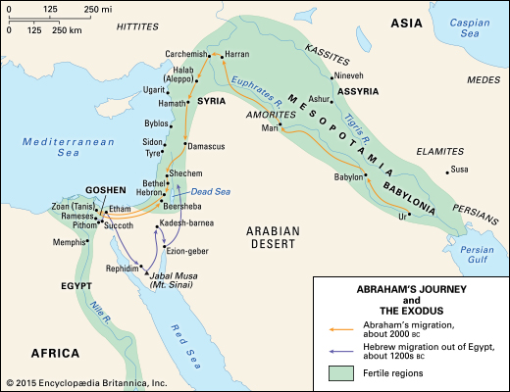
Abraham’s story is set in ancient
Sumer & Egypt (c.2000 BCE)

Slide 15
God’s Covenant with Abram:
Genesis 12
Land:
People:
Name:
Blessing:
¹ The Lord said to Abram, “Leave your land, your family, and your father’s household for the land that I will show you.
² I will make of you a great nation and will bless you.
I will make your name respected,
And you will be a blessing. ³ I will bless those who bless you, those who curse you I will curse; all the families of the earth will be blessed because of you.”

Slide 16
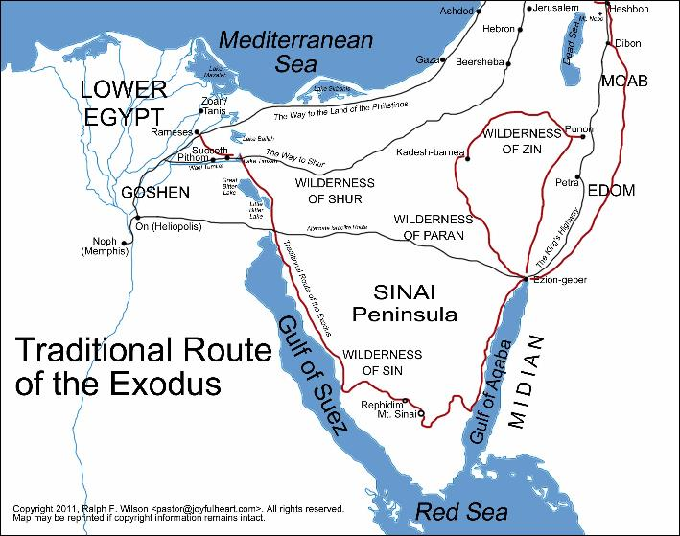
Exodus 1446 BCE (Early date)

Slide 17
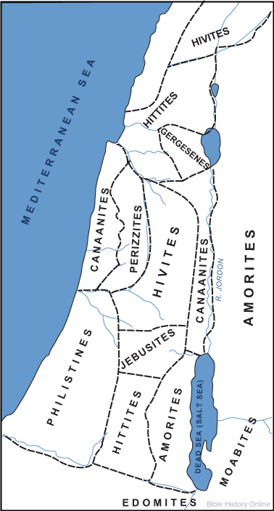
Canaanite Nations before the Hebrew Conquest

Slide 18
Canaan
The Bronze Age civilization comprising what is today Jordan, Israel, Lebanon and Syria. The ancient people there referred to the land as “ca-na-na-um.” They were never really centrally organized but clustered into various city-states.

Slide 19
Canaan
The Greeks called the Canaanites the Phoenikes or “Phoenicians.” The Romans transcribed it to “poenus,” thus calling the descendants of the Canaanite settlers in Carthage “Punic.”
“Phoenician” and “Canaanite” refer to the same culture. Archaeologists and historians commonly refer to them as Canaanites during the Bronze Age, pre 1200 BCE, and Phoenicians as their Iron Age descendants, particularly those living on the coast.

Slide 20
Canaan, 1400 BCE
Canaan culture was fairly advanced.
Cities were well laid out, and houses showed good design and construction.
Floors of buildings, were often paved, or plastered.
Drainage systems had been developed.
Workers were skilled in the use of copper, lead, and gold.
Pottery was among the finest anywhere in the world.
Extensive trade was conducted with foreign countries, including Egypt, Northern Mesopotamia, and Cyprus.

Slide 21
The ancient Canaanite religion:
In addition to the Bible, the greatest source of the religion of these people is the Ugaritic tablets, from the Syrian port city Ugarit. The city was destroyed in the 12th century BCE, during the time of the Judges. The city lay buried until it was discovered in 1928 and excavated. A large collection of clay tablets was uncovered, including the Ba’al Cycle, which describes of the Ba’al religious cult.

Slide 23
The ancient Canaanite religion:
The Canaanite religion was a loosely defined pantheon of gods that shared much in common with the antecedent Akkadian and Egyptian religions. It arose during the Early Bronze Age, and continued (at times flourished!) even after the Israelite invasion. The Israelites failed to completely destroy all the Canaanite people as God commanded when they entered, and they even absorbed some of their religious practices over time. There are places and times when the Canaanite religious practices were more prominent. Traces probably continued until the destruction of Israel by the Romans in 70 A.D.

Slide 24
The ancient Canaanite religion:
The religion adapted and morphed over time and places. It was similar to what we know as Greek and Roman mythology in that the gods were very human in many ways: they loved, fought, coupled, sometimes meddled in human affairs, controlled nature and fertility, and had natural attributes or powers associated with each of them. Like other ancient religions, these gods were localized and believed to reside with the land and its peoples.

Slide 25
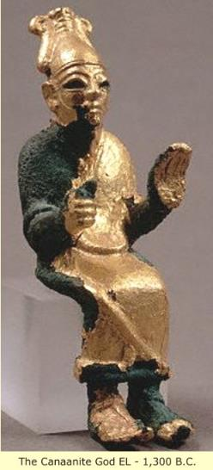
The ancient Canaanite religion:
There were a great number of deities, and scholars have not compiled an exhaustive list. Some of the more prevalent include:
El, also called ‘Il or Elyon (“Most High”), Father of the pantheon. In places he was replaced by his son, Ba’al Hadad, as the main god of worship. In places El was simply called Ba’al.

Slide 26
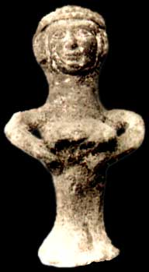
The ancient Canaanite religion:
There were a great number of deities, and scholars have not compiled an exhaustive list. Some of the more prevalent include:
Athirat, “walker of the sea.” Also called Astarte or Ashtart, Queen of Heaven. Also Asherar yam, “our lady of the sea.” Great goddess of the ancient Near East. Mother goddess, heavenly mother. When El is identified as Ba’al, his wife is sometimes called Baalat, “our dear lady.” Also known as Elat. After the Bronze Age (and in the Bible), called Asherah.

Slide 27
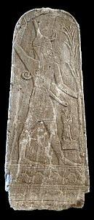
The ancient Canaanite religion:
There were a great number of deities, and scholars have not compiled an exhaustive list. Some of the more prevalent include:
Ba’al Hadad (literally “master of thunder”). Also referred to as Baalshamin, and in some places Melqart. Storm god. Son of El. Sometimes synonymous with El. Becomes the main god of Canaanite worship.
[Note, Although it is often spelled “Baal,” the spelling “Ba’al” identifies a hard break in pronunciation, so it is pronounced “BA - all.”]

Slide 28
The ancient Canaanite religion:
There were a great number of deities, and scholars have not compiled an exhaustive list. Some of the more prevalent include:
Anat (also Anath), virgin goddess of love, war and strife. Sister and wife of Ba’al Hadad. Sometimes a sister of Athirat. Often designated “the Virgin” in ancient texts. Probably one of the best known of the Canaanite deities, she was famous for her youthful vigor and ferocity in battle; in that respect she was adopted as a special favorite by the Egyptian king Ramses II (reigned 1279 13 BC).

Slide 29
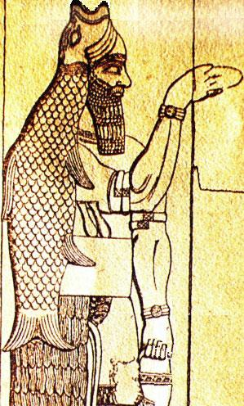
The ancient Canaanite religion:
There were a great number of deities, and scholars have not compiled an exhaustive list. Some of the more prevalent include:
Ba’al Hammon, god of fertility and renewer of all energies. In the worship of Tanit and Ba’al Hammon, children, probably firstborn, were sacrificed.
Dagon, god of crop fertility and grain. Often represented as a fish god of people living by water. In the Bible this god is one of the primary gods of the Philistines.

Slide 30
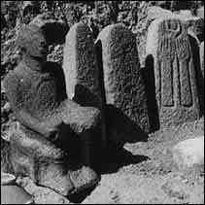
The ancient Canaanite religion:
There were a great number of deities, and scholars have not compiled an exhaustive list. Some of the more prevalent include:
Moloch, putative god of fire.
The Bible describes that it was a religious practice to sacrifice your child (especially first born) to Moloch, sometimes terming it having them “pass through the fire.”
God’s law sternly forbids the practice of human sacrifice.
Leviticus 20:2 “The Lord told Moses to say to the community of Israel: Death by stoning is the penalty for any citizens or foreigners in the country who sacrifice their children to the god Molech. They have disgraced both the place where I am worshiped and my holy name, and so I will turn against them and no longer let them belong to my people.”

Slide 31
The ancient Canaanite religion:
There were a great number of deities, and scholars have not compiled an exhaustive list. Some of the more prevalent include:
Mot or Mawat, god of death. Not worshiped or given offerings. Was cut up by Anat.
The afterlife belief was much like the Egyptians. Following physical death, the npš (usually translated as “soul”) departed from the body to the land of Mot (Death). Bodies were buried with grave goods, and offerings of food and drink were made to the dead to ensure that they would not trouble the living. Dead relatives were venerated and sometimes asked for help.

Slide 32
Mythology
In the Ugaritic Ba’al Cycle, Ba’al Hadad challenges Mot. Mot swallows Ba’al, sending him to the Underworld. With no one to give rain, there is a terrible drought in Ba’al’s absence. Anat goes to the Underworld, kills Mot and returns Ba’al to refresh the Earth with rain.

Slide 33
Mythology
Early on, El was the high god, and he and Athirat are the father and mother of the pantheon. In later traditions, Ba’al eclipses El and becomes the dominant (and high) god to be worshiped. Ba’al takes on El’s power and position, and even his wife (Athirat).

Slide 34
Elohim
El was the proper name for the high god, and among ancient Semitic languages (like Hebrew) it also became the generic word for god. In Ugarit “children” was “ilhm.” The children of El were called “Elohim.”
Among Jews, there are seven names of God in the Scriptures that, once written, cannot be erased because of their holiness: YHWH (“I Am”), El (“God”), Elohim (“Gods”), Eloah (“God”), El Shaddai (“God Almighty”), and Tzevaot or Sabaoth (“Of Hosts”). They seem to be Semitic words that were adapted from the Canaanite religion.

Slide 35
Elohim
The word is the most common word for God used in the Bible. It is used as singular, “God” (Exodus 3:4 “... Elohim called to Moses out of the [burning] bush ....”) and gods (plural: Exodus 20:3 “You shall have no other elohim before me.”).
Interestingly, as a noun, elohim is plural. Christians see that when used in its singular sense as a word for God, it allows room for the one/singular God to be Trinity. (Also, Genesis 1:26 “Then Elohim said, “Let us make mankind in our own image.”)

Slide 36
Adoni
Adon or Adonis was a lesser god. He was known to be handsome and young. He was worshiped at a country shrine of Aphka at the source of the river Nahr Ibrahim. In mythology, Ashtarte and he had a love affair, but another jealous god took the form of a wild boar and killed him. The death of Adon(is) was marked by annual rites of mourning when the river became red with the god’s blood. However, as Ashtarte weeps for his loss, she promises to bring him back to life every spring. The legend of Adonis carries over to Greek mythology, where both Aphrodite and Persephone fell in love with him.

Slide 37
Adonai
The plural form of “adon” meaning “lord.” In the Hebrew Bible, it is only used to refer to God (“The Lord”). The singular form, “adon” or “adoni” (“my lord”) is a royal title used for people.
Example: Deuteronomy 10:17 (“For the LORD your God is God of gods, and Lord of lords.”) uses the proper name YHWY alongside the superlative constructions “god of gods” (elohê ha elohîm) and “lord of lords” (adonê ha adonîm).

Slide 38
Adonai
The Jews, out of respect, did not speak God’s proper name (“Yehweh”), although it was written (as YHWH). (When “Yehweh” is used in the Old Testament, it is denoted in our English Bibles as lower capital “LORD”). When Jews speak about or to God, they use the word “Adonai” (the plural form of Adonis, and again Christians see the Trinity suggested). Further, when reading the Bible, when the name “Yehweh” (“YHWH”) is printed, Jews speak the name “Adonai.”

Slide 39
Trivia:
Elion (another way of saying El or Elohim) was described in Greek sources as married to Beruth (as in the city of Beirut, the capital of Lebanon).
The Hebrew name for God Almighty (“El Shaddai”), some scholars suggest, may be a derivative of the Canaanite god El and shaddû`a (“mountain dweller”) to mean “God of the Mountain(s).”

Slide 40
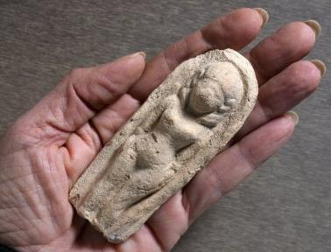
Cult of Astarte
It was very common religious practice to leave little cult statues of Astarte (which were produced in many different forms) as votive offerings in shrines and sanctuaries as
prayers for good harvest,
for children, and for
protection and tranquility
in the home.

Slide 41
Ashtoreth
Hebrew scholars think that the goddess “Ashtoreth” mentioned in the Bible is a deliberate compilation of the Greek name “Astarte” and the Hebrew word “boshet” (meaning “shame”), indicating the Hebrew contempt for her cult. Ashtaroth, the plural form of the goddess’s name in Hebrew, became a general term denoting goddesses and paganism.
Example: 2 Kings 23:13 “The king then defiled the shrines facing Jerusalem, south of the Mountain of Destruction. Solomon the king of Israel had built these for Ashtoreth, the monstrous Sidonian god, for Chemosh, the monstrous Moabite god, and for Milcom, the detestable Ammonite god.”

Slide 42
Ba’al
Or Ba’al Hadad (literally “master of thunder” - compare to Zeus in Greek mythology, god of the thunderbolts).
Early on he was the son of El. By the time of the Ugaritic texts, however, he eclipsed El as the main god who was worshiped and feared. The text uses the titles “Rider of the Clouds,” “Almighty,” and “Lord of the Earth” for him. He is the most vigorous and aggressive of the gods, the one on whom mortals most immediately depend. He is also often designated “the son of Dagan,” although Dagan (biblical Dagon of the Philistines) does not appear as an actor in the mythological texts.

Slide 43
Ba’al
The Ugarit tablets make him chief of the Canaanite pantheon. He is the source of life and fertility, the mightiest hero, and the lord of war. There were many temples of Ba’al in Canaan, and the name Ba’al was often added to that of a locality, e.g., Baal-peor, Baal-hazor, Baal-hermon.

Slide 44
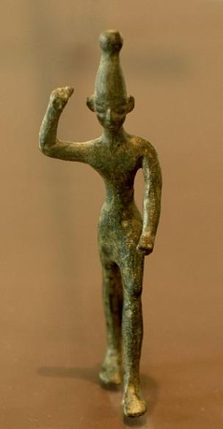
High Places
Canaanite deities such as Ba’al were represented by figures which were placed in shrines often on hilltops, or ‘high places’ surrounded by groves of trees.

Slide 45
Asherah Poles
The idols of the goddess Astarte, or Asherah, included small terra cotta figures that emphasized her as a fertility goddess. These figures, left as offerings at shrines, took on many shapes and forms, sometimes being very plain, and sometimes even being uncarved.
Worship of Astarte is usually associated with what is called “an Asherah pole,” a sacred tree or pole that stood near Canaanite temples to Astarte/ Asherah.

Slide 46
Asherah Poles
For example:
2 Chronicles 33:3 “[King Manasseh of Judah] rebuilt the local shrines that his father Hezekiah had torn down. He built altars for the god Baal and set up sacred poles for worshiping the goddess Asherah. And he faithfully worshiped the stars in the sky.”
Jeremiah 17:1-2 “Judah’s sin is engraved ... on the tablets of their hearts ... Even their children remember their altars and Asherah poles beside the spreading trees and on the high hills.”
Hosea 4:13a “You offer sacrifices on mountaintops and hills, under oak trees, and wherever good shade is found.”

Slide 47
The practice of Child Sacrifice
(in the Bible, also “pass through the fire”)
There is no direct Canaanite texts referencing or describing human or child sacrifice. It seems it may have been more of an occasional and/or folk practice.
There are many references to it in the Old Testament, particularly because it was a sin that so greatly provoked the Lord.
There are also references by surrounding peoples attesting that Canaanite practices included child sacrifice.

Slide 48
The practice of Child Sacrifice
(in the Bible, also “pass through the fire”)
After the 10th plague on Egypt, God claims that the first born belongs to Him. Rather than sacrificing them, however, the Israelites are to redeem them.
Exodus 13
¹ The Lord said to Moses, ² “Dedicate to me the first born son of every family and the first born males of your flocks and herds. These belong to me.” ….¹¹ The Lord will give you the land of the Canaanites, just as he promised you and your ancestors. ¹² From then on, you must give him every first born son from your families and every first born male from your animals, because these belong to him. ... You must redeem every first born son.”

Slide 49
The practice of Child Sacrifice
(in the Bible, also “pass through the fire”)
God strongly forbids human and child sacrifice.
Leviticus 20:2-5
² “Say to the Israelites: ‘Any Israelite or any foreigner residing in Israel who sacrifices any of his children to Molek is to be put to death. The members of the community are to stone him. ³ I myself will set my face against him and will cut him off from his people; for by sacrificing his children to Molek, he has defiled my sanctuary and profaned my holy name. ⁴ If the members of the community close their eyes when that man sacrifices one of his children to Molek and if they fail to put him to death, ⁵ I myself will set my face against him and his family and will cut them off from their people together with all who follow him in prostituting themselves to Molek.’”

Slide 50
The practice of Child Sacrifice
(in the Bible, also “pass through the fire”)
Even so, some Israelites, it seemed, practiced child sacrifice when they got to Canaan.
Psalm 106:35-38
But they mingled with the nations And learned their practices, And served their idols, Which became a snare to them. They even sacrificed their sons and their daughters to the demons, and shed innocent blood, The blood of their sons and their daughters, Whom they sacrificed to the idols of Canaan; And the land was polluted with the blood.

Slide 51
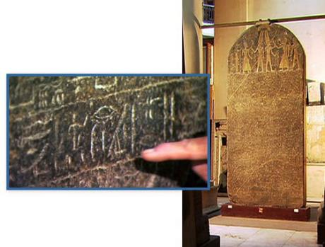
There is no archeological evidence, or Egyptian record, of the Hebrew people ever living within Egypt. The earliest historical reference of a people called Israel is The Merneptah Stele (the victory stele of Pharaoh Merneptah, the son of Ramesses II), dated to about 1206 BCE and now housed at the Cairo Museum. It mentions a list of peoples and city states in Canaan, and among them are the Israelites. The other ethnic groups are
described as states, but the
Israelites are described as “a
people.” It seems they were
aware that the Israelites had
not yet reached a level of
state organization.

Slide 52
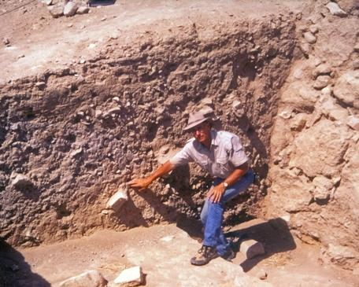
Jericho
Archaeologists have found that Jericho was destroyed around 1400 B.C.E. (the time of Joshua, early Exodus dating). (Based on Bryant G. Wood’s correction of Kathleen Kenyon’s dating.) The first major excavation of Jericho was carried out by a German team
between 1907 and 1909. They
found piles of mud bricks at
the base of the mound the
city was built on.

Slide 53
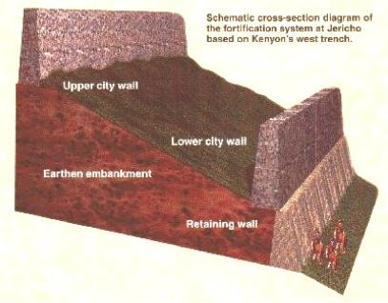
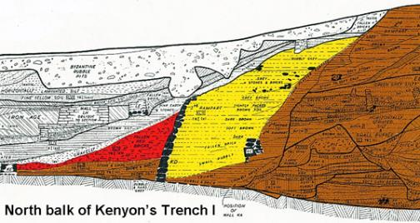
Jericho
British archaeologist Kathleen Kenyon excavated the site in the 1950s and determined that they were from the city wall, which had collapsed when the city was destroyed. (Although she claimed that they collapsed before 1400 BCE based on lack of imported pottery.)

Slide 54
Jericho
Evidence of a terrible fire marks the artifacts.
Kenyon wrote in her excavation report:
“The destruction was complete. Walls and floors were blackened or reddened by fire, and every room was filled with fallen bricks, timbers, and household utensils; in most rooms the fallen debris was heavily burnt.”
The biblical story says that when the Israelites invaded the city, they set it on fire.

Slide 55
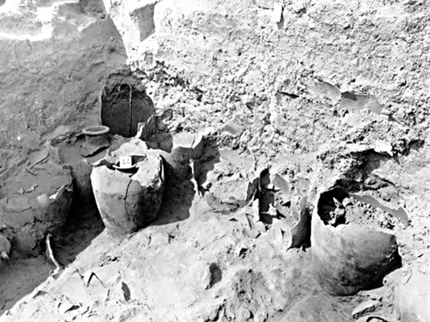
Jericho
Both Garstang and Kenyon found dozens of store jars full of grain from the Canaanite city of Jericho. This seems to suggest that the city was burned, not looted. Further, the biblical account says
that the Israelites
invaded right after the
harvest. Most scholars
speculate that an earth-
quake caused the
collapse.

Slide 56
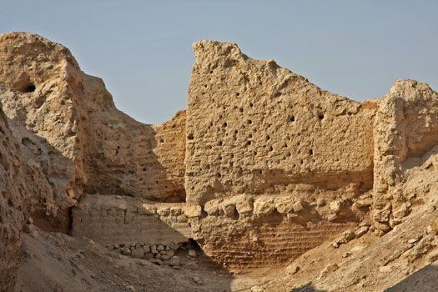
Jericho
Interestingly, a portion of the city wall, only on the north side of the site, remained standing. The Bible states that Rahab’s house was built against the city wall. Archeologists have documented that the preserved city wall on the north side of the city had houses built against it.

Slide 57
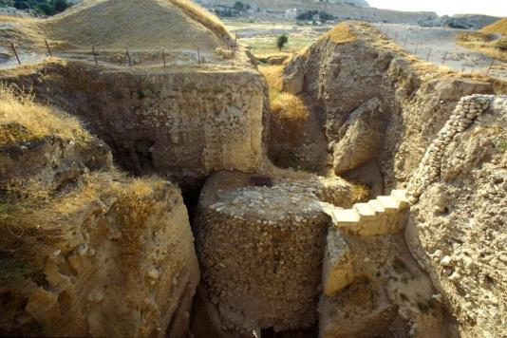
Jericho
Both Jericho and Damascus claim to be the oldest, continually inhabited cities in the world. 1Kings 16:34 says that Hiel of Bethel rebuilt Jericho during the reign of King Ahab. All of Hiel’s children died, fulfilling the prophecy of Joshua 6:26. Today Jericho is a Palestinian city in the West Bank. Here is the remains
of a tower at Jericho, one
of the earliest known
stone structures made
by man.

Slide 58
Divine Justification?
The claim the Israelites had on the land of Canaan was one of oral tradition of a promise God made to their ancestor Abraham. Their ownership of it, however, came by military conquest and invasion. They got the land because they took it by force.
For the locals it may have been seen as a contest between gods - whose was mightier.
Many others, however, have claimed that the Israelites “made up” the promise of their God giving them this land as a means to justify their conquest as divine right. This seems like a “might makes right” with a divine justification. And such claims, remember, have been made by invaders throughout history, including the European Americans’ seizure of American Indian lands in our country.
Seeing this complexity may help provide some background to understanding the current Israel-Palestine conflict.

Slide 59
Many of the places that the Hebrew people settled in Canaan lack archeological evidence of military conquest or being founded on ruins of destroyed Canaanite towns. Rather, they are founded on bedrock or on virgin soil. Archeologists also have discovered that many of the large Canaanite towns “conquered” by invading Israelites were either not really destroyed, or were destroyed by “Sea People” (such as the Philistines) during the time of the Hebrew conquest.

Slide 60
Although a cursory reading of Joshua and Judges may suggest that the Israelites invaded quickly in a wave of destruction, a closer reading suggests that it was not quite so. Many of the places they “conquered” were not really destroyed, but rather the Israelites took over control, moved in, and lived alongside the Canaanites. In fact, Joshua 17 bluntly stated that each of the tribes of Israel did not “utterly destroy” the Canaanites or their cities, as God had commanded. Archeological evidence, then, could agree with a gradual takeover, in which the invading Israelites didn’t destroy the cities but rather took them over.

Slide 61
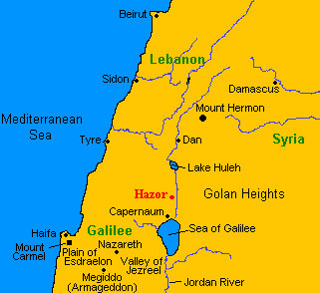
Hazor in Galilee, however, does show archeological evidence of being destroyed by fire by invading Hebrew people, as the Bible clearly says happened in Joshua 11. Hazor was termed the principle city of Canaan, and a key victory for the Israelites. The Israelite kings would later reestablish the city, only to be destroyed again by the Assyrians.

Slide 62
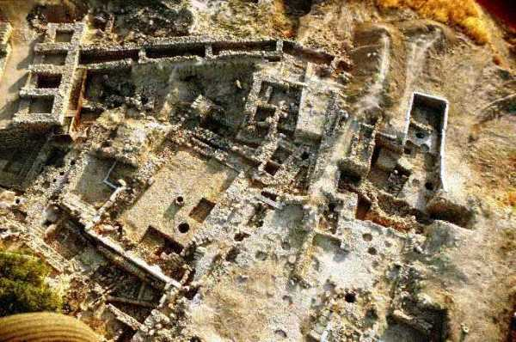
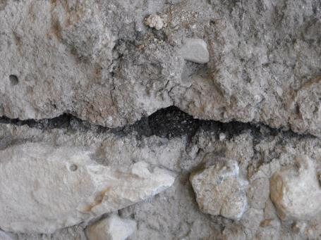
Hazor
Burn layer found across the excavations at Hazor, showing the city was burned down about the time of the invading Hebrews.

Slide 63
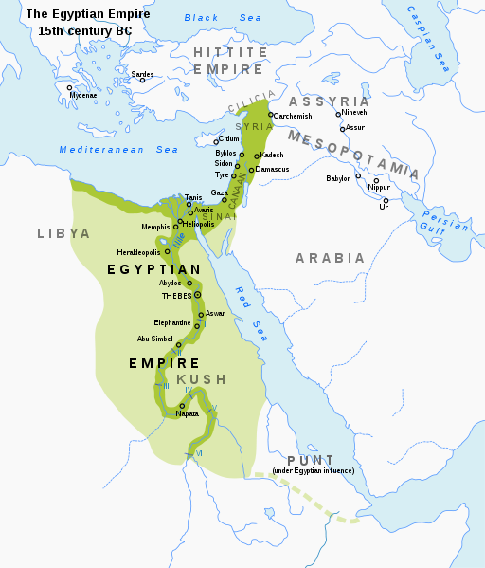
Out of Egypt, but not out from under Egypt!
Egypt New Kingdom (16th - 11th centuries BCE)
At the time of the Israelites invaded Canaan, the region was (nominally) under the control of Egypt.

Slide 64
Canaan and the Egyptian New Kingdom:
Pharaoh Thutmose III (1504 1450 BCE) had added the region to Egypt’s domain (c. 1570).
His son, Amenho-tep II (1450 1424), Pharaoh of the Exodus (early date), continued control.
His son, Thutmose IV (1424 1414), Pharaoh while Israel was in the wilderness. More interested in foreign alliances than military dominance; did not maintain a strong presence in Canaan.
His son, Amenhotep III (1414 1378), Not interested in maintaining an empire. He was more concerned with domestic interests. He only maintained nominal interest in Canaan.

Slide 65
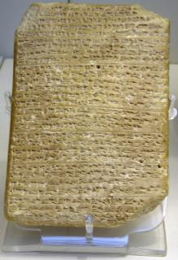
Canaan and the Egyptian New Kingdom:
A library of nearly 400 clay letters found at Tel el-Amarna, upper Egypt, account the diplomatic correspondence between the Egyptian administration and its representatives in Canaan and Amurru during the New Kingdom (14th century BCE). The Amarna letters are unusual because they are mostly written in Akkadian cuneiform, the writing system of ancient
Mesopotamia. They help modern readers
understand better the culture and language
of the Canaanite peoples in pre biblical
times.

Slide 66
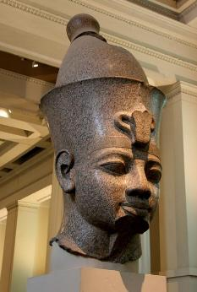
Canaan and the Egyptian New Kingdom:
Of particular interest is the correspondence by officials from towns in Canaan seeking help amid an attacking people called “Hapiru.” Some scholars suggest this may be a reference to the Hebrew people, due to the similarity of words and the fact the Hebrews were attacking Canaanite towns during this time.
Pharaoh Amenhotep III (1414 1378),
it seems, simply ignored the Canaanite pleas
for help against the Hapiru, leaving the cities to defend themselves. (“High Date” for fall of Jericho
is c. 1380 BCE)

Slide 67
Canaan and the Egyptian New Kingdom:
One of the Amarna letters, dating from the reign of his son, Amenhotep IV (1378-1367 BCE), came from a man named Abdi Hiba, Governor of Jerusalem. It is an exasperated requested aid from Pharaoh Amenhotep IV.
The letter states the following:
“Why do you not hear my plea? All the governors are lost; the king, my lord, does not have a single governor left! Let my lord, the king, send troops of archers, or the king will have no lands left. All the lands of the king are being plundered by the Habiru. If archers are here by the end of the year, then the lands of my lord, the king, will continue to exist; but if the archers are not sent, then the lands of the king, my lord, will be surrendered.”

Slide 68
Canaan and the Egyptian New Kingdom:
Another letter is from a man named Shuwardata, governor of Gath (of the Philistines):
“May the king, my lord, know that the chief of the Hapiru has besieged the lands which your god has given me; but I have attacked him. Also let the king, my lord, know that none of my allies have come to my aid, it is only I and Abdu Heba who fight against the Hapiru chief. I plead with the king my lord, if you agree, send Yanhamu, and let us quickly go to war, so that the lands of the king, my lord, might be restored to their original boundaries!”

Slide 69
Canaan and the Egyptian New Kingdom:
Shuwardata, the governor of Gath, is also mentioned in the following letter from a man named Milkilu, a prince of Gezer, with whom he was allied:
“Let it be known to the king that there is great hostility against me and against Shuwardata. I ask the king, my lord, protect his land from the approaching Hapiru.”

Slide 70
Canaan and the Egyptian New Kingdom:
These two governors, it seems, ended up offering an alliance with the Hapiru, as Abdi Heba, governor of Jerusalem, complains:
“Let it be known what Milkilu and Shuwardata did to the land of the king, my lord! They sent troops of Gezer, troops of Gath, they took the land of Rubutu; the land of the king went over to the Hapiru. But now even a town near Jerusalem, Bit Lahmi [Bethlehem] by name, a village which once belonged to the king, has fallen to the enemy. Let the king hear the words of your servant Abdi Heba, and send archers to restore the imperial lands of the king! But if no archers are sent, the lands of the king will be taken by the Hapiru people. This act was done by the hand of Milkilu and Shuwardata.”

Slide 71
Ancient Empires of the Middle East
until the Kingdom of Israel (BCE)
Sumerian Empire (Mesopotamia) 3000? - 2334, 2218 - 1750
Egypt Old Kingdom (NE Africa) 2686 - 2134
Akkadian Empire (Mesopotamia) 2334 - 2083
Egypt Middle Kingdom (NE Africa): 2030 - 1640
First Babylonian Dynasty (Mesopotamia): 1750 - 1530
Hittite Empire (Turkey): 1595 - 1220
Egypt New Kingdom (NE Africa): 1550 - 1070
Assyrian Empire (Mesopotamia): 1353 - 612

Slide 72
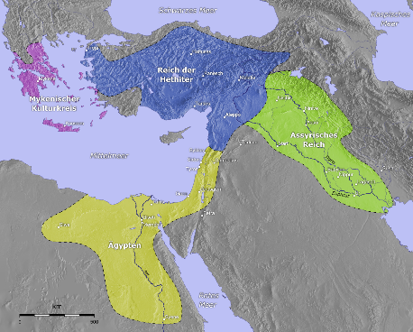
Israelites: Minor players amid giant empires
When the Israelites moved from Egypt and into the Promised Land, Egypt New Kingdom controlled the area. Yet Egypt was much more concerned with the Hittite and the Assyrian empires to the north. Palestine was a “buffer zone” between the empires.

Slide 73
The Hittite Empire spread across north central Anatolia (Turkey) from 1595 - 1220 BCE
The Hittites were a very present threat during the time of the Israelite Judges.
There was a lack of archeological evidence of the Hittite empire until the early 1800s, and many scholars doubted the existence of the Hittite empire as mentioned in the Bible. Then, when Egyptian hieroglyphs were first able to be translated in 1822, coupled with archeological discoveries beginning in the 1830s, a wealth of information and evidence of the Hittites began to be revealed.

Slide 74
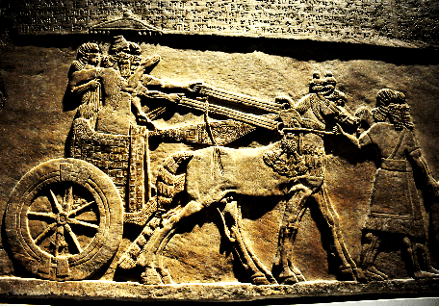
The Hittite Empire
The Hittite military made successful (terrifying) use of chariots, and although belonging to the Bronze Age, the Hittites were the forerunners of the Iron Age, developing the manufacture of iron artifacts. Chariots and iron gave them the military advantage to expand as a kingdom, being (sometimes fierce) rivals of Egypt. The Israelites in Canaan were between two strong
military powers: The Egyptian
New Kingdom and the Hittites
both of whom used chariots
and new iron weapons.

Slide 75
Religions of the Ancient World
Sumerian Empire (Mesopotamia) 3000? - 2334, 2218 - 1750 BCE
Ancient mythology of a pantheon of gods as personalities of nature
The Gilgamesh Epic (flood account)
Humans are created from a slain god in order to serve the gods
Afterlife was a dark, scary place of servitude
Egypt Old and Middle Kingdoms (NE Africa) 2686 - 2134, 2030 - 1640 BCE
Pantheon of gods, under the leadership of Ra who direct order (“ma-at”) on earth.
Ancient mythology of gods each with a function or attribute
Centered on the fertility of the Nile River
Akkadian Empire (Mesopotamia) 2334 - 2083 BCE
Ancient mythology of a pantheon of gods each with a function or attribute
Kings were high priests
Main gods were gods of fertility, war, son and the afterlife

Slide 76
Religions of the Ancient World
First Babylonian Dynasty (Mesopotamia): 1750 - 1530
Modified slightly the Akkadian/Sumerian religion
Introduced Marduk as the high god
The Enuma Elish (creation story)
Astrology a major part of the religion
Hittite Empire (Turkey): 1595 - 1220
“Thousand gods,” but mythology largely lost
Localized gods for each town
Egypt New Kingdom (NE Africa): 1550 - 1070
Old pantheon and mythologies were streamlined and reduced. Occasional episodes of monotheism centered under a pharaoh.
Assyrian Empire (Mesopotamia): 1353 - 612
The king was the high priest, was chosen by the gods as their earthly representative
Assyr was the high god among a pantheon of gods

Slide 77
The Promised Land
God commanded the Hebrew people under Joshua to destroy all the people of the land of Canaan as they entered. One of the reasons for this was that they were supposed to be God’s punishment against the Canaanites for their pagan worship. When God promised the land to Abraham, God said that they were first going to live in Egypt. The reason, says God, is that the sin of the local people is not yet deserving of utter destruction. In Genesis 15:16, God says to Abraham, “Four generations later, your descendants will return here and take this land, because only then will the people who live here be so sinful that they deserve to be punished.

Slide 78
The Promised Land
When the Israelites occupied the land, however, they did not follow God’s command to destroy all the people there. Judges 1:27-35 relays how each of the tribes failed to conquer their land completely.
“1:29 The Ephraim tribe did not get rid of the Canaanites ... The Zebulun tribe did not get rid of the Canaanites ...
The Asher tribe did not get rid of the Canaanites ...” (etc.)

Slide 79
The Promised Land
God forecasted that because of this failure, the Canaanites would continue to cause them trouble, lead them astray in their worship, and ultimately cause their undoing.
Judges 2 “¹ I promised your ancestors that I would give this land to their families, and I brought your people here from Egypt. We made an agreement that I promised never to break, ² and you promised not to make any peace treaties with the other nations that live in the land. Besides that, you agreed to tear down the altars where they sacrifice to their idols. But you didn’t keep your promise. ³ And so, I’ll stop helping you defeat your enemies. Instead, they will be there to trap you into worshiping their idols.”

Slide 80
The Promised Land
It came quickly. As soon as Joshua and his generation died, the people started to adopt some of the pagan religious practices of the Canaanites.
Judges 2 “¹⁰ After a while the people of Joshua’s generation died, and the next generation did not know the Lord or any of the things he had done for Israel. ¹¹⁻¹³ The Lord had brought their ancestors out of Egypt, and they had worshiped him. But now the Israelites stopped worshiping the Lord and worshiped the idols of Baal and Astarte, as well as the idols of other gods from nearby nations.”

Slide 81
The Promised Land
During the time of the Judges, the Israelites struggled with the Canaanite people and their pagan religious practices.
Judges 10:6 “Then the Israelites again did things that the Lord saw as evil. They served the Baals and the Astartes, as well as the gods of Aram, Sidon, Moab, the Ammonites, and the Philistines. They went away from the Lord and didn’t serve Him.”
Judges 16:23 [When Samson was in captivity] “The Philistine rulers threw a big party and sacrificed a lot of animals to their god Dagon. The rulers said: Samson was our enemy, but our god Dagon helped us capture him!” [Samson destroys the temple to Dagon as he dies.]

Slide 82
The Promised Land
Story of Samuel and the Ark of the Covenant in the Philistine Temple of Dagon
1 Samuel 5 “¹ The Philistines took the sacred chest from near Ebenezer to the town of Ashdod. ² They brought it into the temple of their god Dagon and put it next to the statue of Dagon, which they worshiped. ³ When the people of Ashdod got up early the next morning, they found the statue lying facedown on the floor in front of the sacred chest. They put the statue back where it belonged. ⁴ But early the next morning, it had fallen over again and was lying facedown on the floor in front of the chest. The body of the statue was still in one piece, but its head and both hands had broken off and were lying on the stone floor in the doorway.”

Slide 83
The Promised Land
Samuel leads the Israelites to stop worshiping pagan gods
1 Samuel 7:3-4 “Then Samuel said to the whole house of Israel, ‘If you are turning to the Lord with all your heart, then get rid of all the foreign gods and the Astartes you have. Set your heart on the Lord! Worship Him only! Then He will deliver you from the Philistines’ power.’ So the Israelites got rid of the Baals and the Astartes and worshipped the Lord only.”

Slide 84
The Promised Land
The reading of the rest of the Old Testament history of the Israelites in the Promised Land accounts the continued cycle of the people struggling to remain faithful to the Lord God. The cycle occurs over and over again:
1. The Israelites fall away from worshiping only God and being incorporating worship of the Canaanite gods.
2. God withdraws His favor and protection from them. They experience hardship.
3. The people (usually through a courageous leader) cry out to God, repent of their sin, uproot the centers of pagan worship, destroy the idols, and make a commitment to worship only the one true God.
4. Whenever the people worship authentically, they are blessed and protected by God.
Yet, the Israelites don’t! The cycle occurs over and over again!

Slide 85
The United Kingdom
The rise of the Kingdom of Israel, and the United Kingdom under Saul, David and Solomon, although a focal of Biblical history, was rather an unimportant development amid the giant empires that were rising and falling in the Middle East. It rose during a rare time of when there was no major empires dominating the area. Further, it’s presence on the time line of history is quite brief (only 120 years). This is one of the main reasons why there are so few extra-biblical references to the Kingdom of Israel. To the world powers of history, it didn’t much matter!

Slide 86
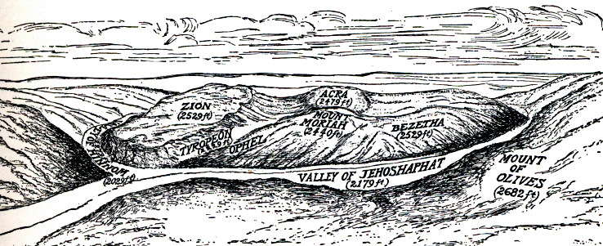
The United Kingdom
A key development, however, was David’s establishing Jerusalem as the capital of the Kingdom of Israel. He chose Mount Zion for its natural defenses.

Slide 87
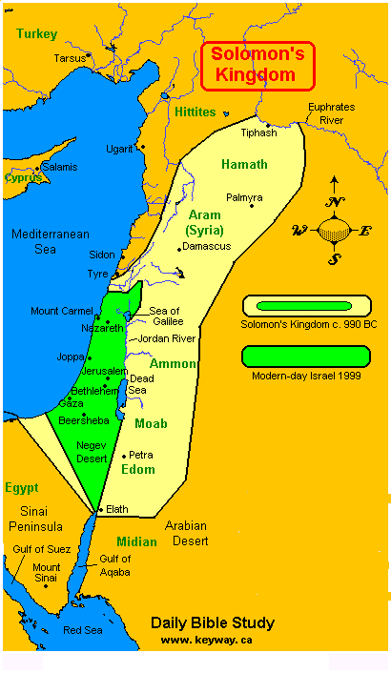
The United Kingdom
Under King Solomon (980-940 BCE) the Kingdom of Israel reached the height of its power.

Slide 88
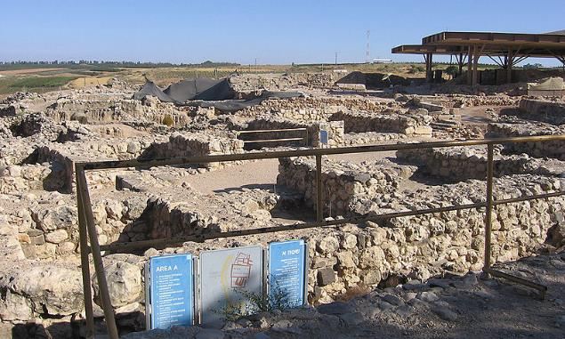
The United Kingdom
There are some archeological remains of the United Kingdom in Israel. Most mainstream archeologists date a series of monumental royal constructions to the 10th century: the famous gates at Hazor and Megiddo and Gezer. This confirms in 1 Kings 9:15 17 the famous description of Solomon's
construction of
gates of
Jerusalem, Hazor,
Megiddo, and
Gezer.

Slide 89
The United Kingdom
During the time of the united kingdom (Saul, David, Solomon) the kings fought against the Canaanite people (such as Saul and David against the Philistines). Saul turned away from God, but David remained faithful.
1 Chronicles 10:10 [When Saul was defeated] “The Philistines put Saul’s armor in the temple of their gods and hung his head in the temple of their god Dagon.”
1 Samuel 31:10 “They put Saul’s armor in the temple of Astarte, and hung his body on the wall of Beth-shan.”

Slide 90
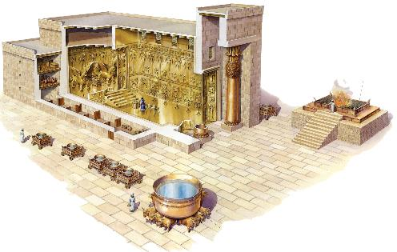
The United Kingdom
The Temple to the Lord God of the Israelites stood as a gleaming proclamation of the (sometimes stalwart) commitment to worship only the one true God as prescribed in the Law. The Temple replaced the Tabernacle and housed the Ark of the Covenant. Solomon built the temple on Mount Moriah, the next hill north of Mount Zion. Solomon covered the top of the mountain
with a broad platform on
which he built the Temple.

Slide 91
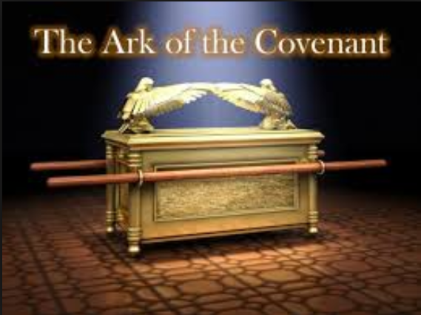
The United Kingdom
The Ark was to represent the location of God’s real presence: between the wings of the angels on the Ark’s cover, called “The Mercy Seat.” Priests from the Tribe of Levi were to attend the Temple, perform all the prescribed sacrifices and cultic duties, and lead the people in proper and worship and teaching.

Slide 92
The United Kingdom
King Solomon, over time, was lured into worshiping the gods of his many wives.
1 Kings 11 “⁴ As Solomon grew old, his wives turned his heart after other gods, and his heart was not fully devoted to the Lord his God, as the heart of David his father had been. ⁵ He followed Ashtoreth [Astarte] the goddess of the Sidonians, and Molek the detestable god of the Ammonites.
⁶ So Solomon did evil in the eyes of the Lord; he did not follow the Lord completely, as David his father had done.
⁷ On a hill east of Jerusalem, Solomon built a high place for Chemosh the detestable god of Moab, and for Molek the detestable god of the Ammonites. ⁸ He did the same for all his foreign wives, who burned incense and offered sacrifices to their gods.”

Slide 93
The Divided Kingdom
Solomon’s Kingdom Divided upon His Death
1 Kings 11:9 “The Lord became angry with Solomon because his heart had turned away from the Lord, the God of Israel, who had appeared to him twice. ¹⁰ Although he had forbidden Solomon to follow other gods, Solomon did not keep the Lord’s command. ¹¹ So the Lord said to Solomon, “Since this is your attitude and you have not kept my covenant and my decrees, which I commanded you, I will most certainly tear the kingdom away from you and give it to one of your subordinates.” ... ³³ I am doing this because they have abandoned me and worshipped the Sidonian goddess Astarte, the Moabite god Chemosh, and the Ammonite god Milcom. They haven’t walked in my ways by doing what is right in my eyes—keeping my laws and judgments—as Solomon’s father David did.

Slide 94
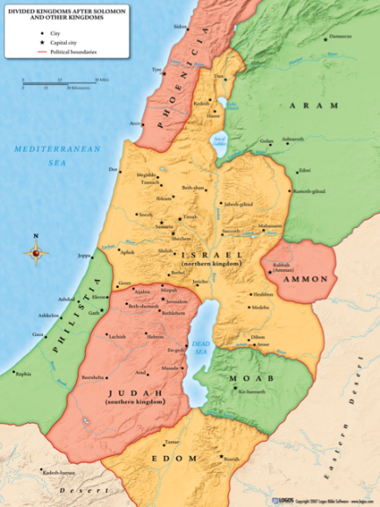
The Divided Kingdom
Civil War!
There was civil war for the 60 years after Solomon’s death and the succession of the northern kingdom, as Rehoboam and the country of Judah tried unsuccessfully to reestablish a united kingdom.

Slide 95
The Divided Kingdoms of Israel
Northern Kingdom
Name: Israel
Tribes: “The 10 Northern Tribes”
First King: Jeroboam
Capital: First Shechem (1 Kings 12:25), then Tirza
(1 Kings 14:17), then Samaria (1 Kings 16:24)
Conquered: 722 BCE by the Assyrians
Southern Kingdom
Name: Judah
Tribes: Judah and Benjamin
First King: Rehoboam (Solomon’s son)
Capital: Jerusalem
Conquered: 581 BCE by the Babylonians

Slide 96
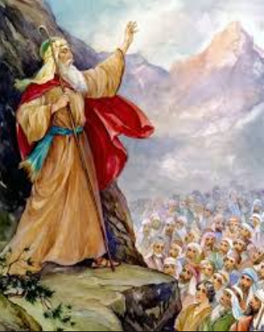
The Prophets
The role of the prophets of the Old Testament were to speak God’s words to God’s people. The Holy Spirit came upon only certain individuals to reveal God’s message. The first official prophet was Moses. Joshua and the judges also served in a prophetic role. Yet the prophet as a distinct office came into fullness with the establishment of the Israelite monarchy. Prophets and kings go together. Israel was a theocracy. The king was to lead the people
politically (justice), militarily (protection), and
in true worship of God. God raised up prophets
to instruct the kings in how God wanted them to
be God’s leader to the people. Also, when the
monarch and the priests failed in leading the
people correctly, God had prophets address the
people directly.

Slide 97
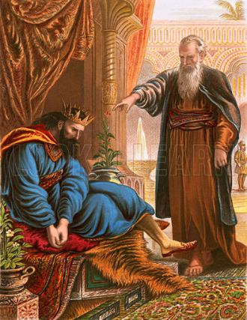
The Prophets
Prophets revealed God’s words in two ways.
Prophecy can be revealing what is true. In this role, prophets urged people to follow God correctly and pronounced condemnation for the ways that people didn’t.
Prophecy can also be revealing what will be true. In a very simple way, leaders inquired of God what they
should do in certain situations. God was
still the leader of the people and would tell
leaders what to do in difficult and unclear
situations. If the leaders were faithful to
God, God blessed them, told them what to
do, and revealed what was going to
happen. If they were not, God was silent
to them or gave a judgement against them.

Slide 98
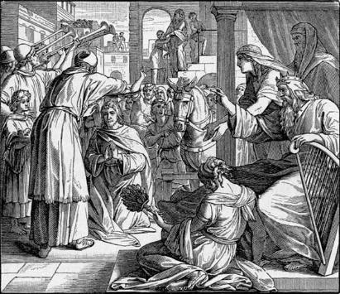
The Prophets
Prophets were personally called by God. God’s Spirit came upon them and they were given insights and messages for others. The others, however, had the difficult duty of distinguishing between true and false prophets. People, especially kings, wanted prophets to say what they wanted them to say! Since kings often sponsored and rewarded prophets, it became lucrative
to claim to be a prophet and say what
was wanted.
The test for distinguishing a
real prophet, the Bible says, was to
look and see if his prophesies came
true.

Slide 99
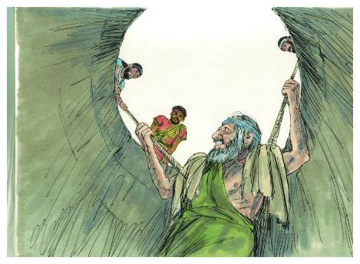
The Prophets
Most of the true prophets refused sponsorship and often spoke judgement against the people and leaders. Thus it was often a dangerous calling to be a prophet, as most of the time the people didn’t want to hear the message! This speaking of correction carries on into English today as “speaking prophetically,” which can mean pronouncing judgement.
The prophetic role declined when the monarchy was lost. It was replaced by the Holy Spirit, who was given into each believer, at the end of the time of Jesus. The Holy Spirit leads, guides, and directs each Christian, although there is still the spiritual gift of prophesy.
Jeremiah imprisoned in a cistern

Slide 100
Refer to Handout!
United Kingdom
Dates
Prophets: Kings (yrs ruled): BCE:
Eli (c. 1100 - 1060)
Samuel (c. 1050-20) Saul (40) 1050
Nathan (c. 990-60) David (40) 1010
1000 David makes Jerusalem the capital
Solomon (40) 970
960 Solomon completes the Temple
Note: Bold indicates a king described as “good” in God’s eyes.

Slide 101
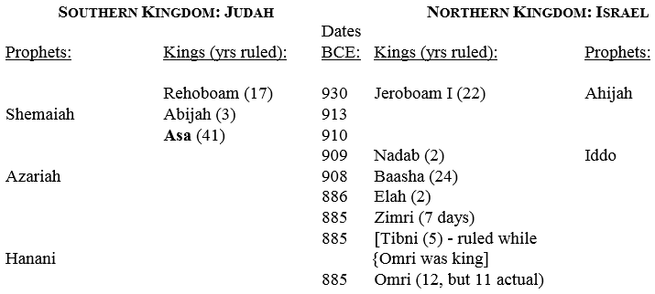
Divided Kingdom
Note: Bold indicates a king described as “good” in God’s eyes.

Slide 102
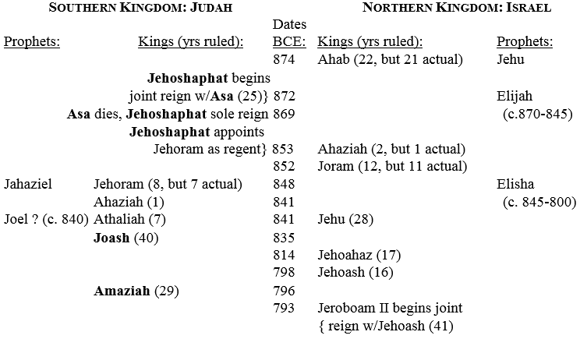
Divided Kingdom
Note: Bold indicates a king described as “good” in God’s eyes.

Slide 103
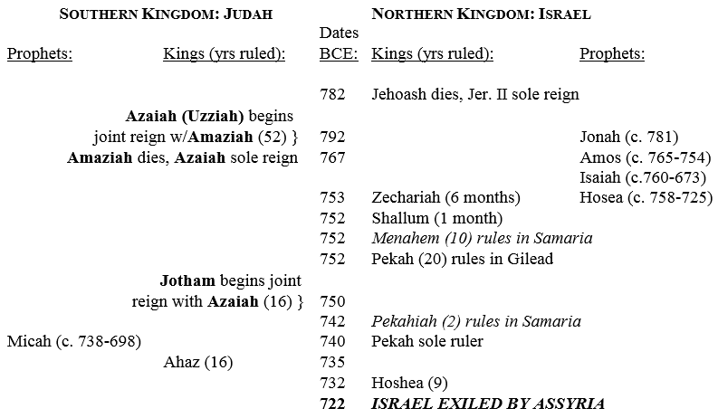
Divided Kingdom
Note: Bold indicates a king described as “good” in God’s eyes.

Slide 104
Divided Kingdom
The northern kingdom continued as a nation, but its line of kings (which were no longer a part of the royal line of David), are recorded to all “did evil in the sight of the Lord.” They did not follow their faith strictly, partly due to the fact that they no longer had access to Jerusalem and its temple.
Hosea 4:13a “You offer sacrifices on mountain-tops and hills, under oak trees, and wherever good shade is found.”

Slide 105
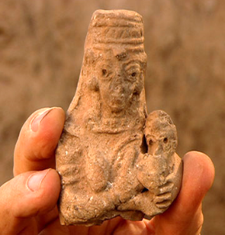
Divided Kingdom
Archeologists have found thousands of little terracotta female figurines in tombs, in households, just everywhere throughout Israel, dating from the 10th to the 6th century BCE. They show a nude female glorifying fertility. Although not certain, archeologists suggest they
represent Asherah. It does
suggest, however, that the
Israelites struggled to maintain
a pure allegiance to Yehweh!

Slide 106
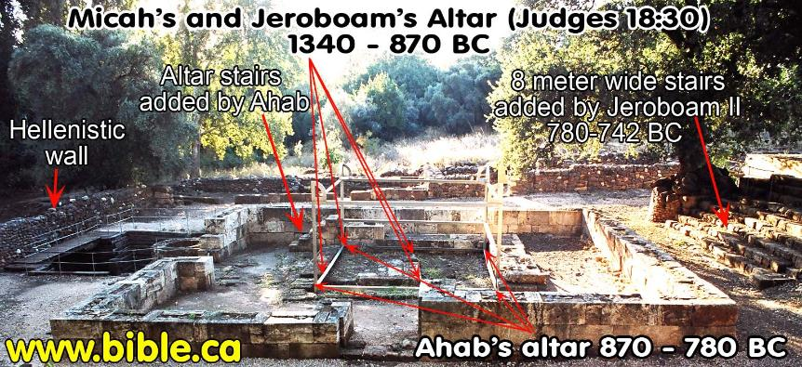
Divided Kingdom
Pagan Altar at Tel Dan
Jeroboam set up a golden calf here in 931 BCE.

Slide 107
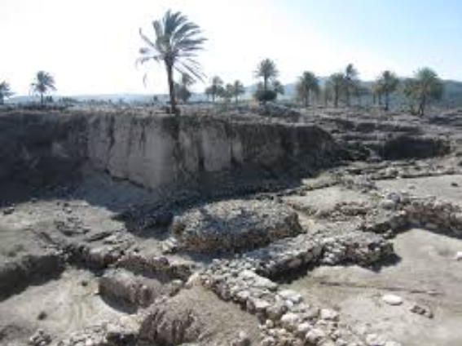
Divided Kingdom
Megiddo, built up by King Solomon.
Round pagan altar at Megiddo, among many other pagan altars dating from different times.

Slide 108
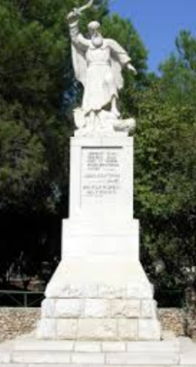
Divided Kingdom
Elijah at Mt. Carmel (near present day Haifa) against King Ahab and Queen Jezebeel’s 45 prophets of Baal and 400 prophets of Asherah. 1 Kings 18:16-45
¹⁸ “I have not made trouble for Israel,” Elijah replied. “But you and your father’s family have. You have abandoned the Lord’s commands and have followed the Baals. ¹⁹ Now summon the people from all over Israel to meet me on Mount Carmel. And bring the four hundred and fifty prophets of Baal and the four hundred prophets of Asherah, who eat at Jezebel’s table.” (1 Kings 18:18-19)

Slide 109
Divided Kingdom
Rise of a Giant: Assyria
As Israel and Judah were dealing with their internal affairs, a sleeping giant to the northeast was reawakening. Assyria again began expanding under the conquests of Shalmaneser V and Sargon II in the 8th century BCE. They conquered Israel and attacked Jerusalem.
During the three year siege of Samaria by the Assyrians, Shalmaneser V died and was succeeded by Sargon II of Assyria, who himself records the capture of that city thus: “Samaria I looked at, I captured; 27,280 men who dwelt in it I carried away” into Assyria. Thus, around 720, after two centuries, the kingdom of the ten tribes came to an end.

Slide 110
Divided Kingdom
According to Scripture, however, Israel was conquered because God stopped defending it.
2 Kings 17 “¹⁶ The people of Israel disobeyed all the commands of the Lord their God. They made two gold statues of calves and set up a sacred pole for Asherah; they also worshiped the stars and the god Baal. ¹⁷ They used magic and witchcraft and even sacrificed their own children. The Israelites were determined to do whatever the Lord hated. ¹⁸ The Lord became so furious with the people of Israel that He allowed them to be carried away as prisoners. Only the people living in Judah were left, ¹⁹ but they also disobeyed the Lord’s commands and acted like the Israelites. ²⁰ So the Lord turned his back on everyone in Israel and Judah and let them be punished and defeated until no one was left.”

Slide 111
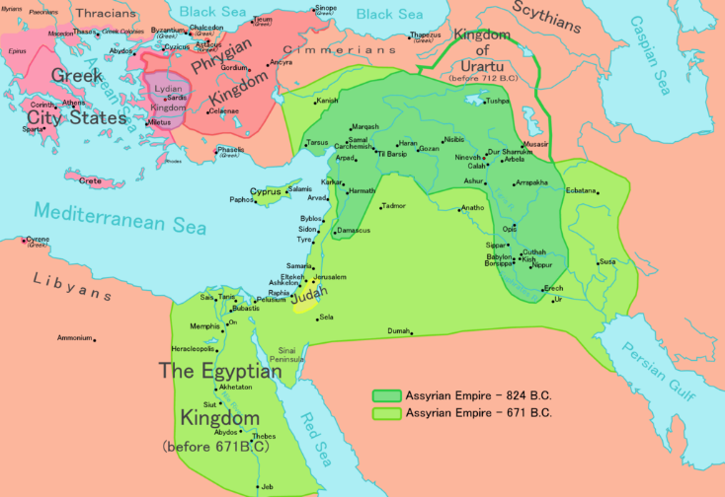
Divided Kingdom
Judah and Jerusalem were spared, but made a vassal kingdom paying annual tribute to Assyria.

Slide 112
Divided Kingdom
Assyria exported the upper classes of the Israelites, scattered all over the Assyrian empire. Likewise, they imported Assyrians into Israel, controlling the country and the lower classes.
For this exile, think “Event” (happened “all of a sudden”). The Israelites intermarried and were assimilated into their local areas, never to again return to their homeland.
These are what have been called “The Ten lost tribes of Israel.”

Slide 113
Timeline of the Middle East

Slide 114
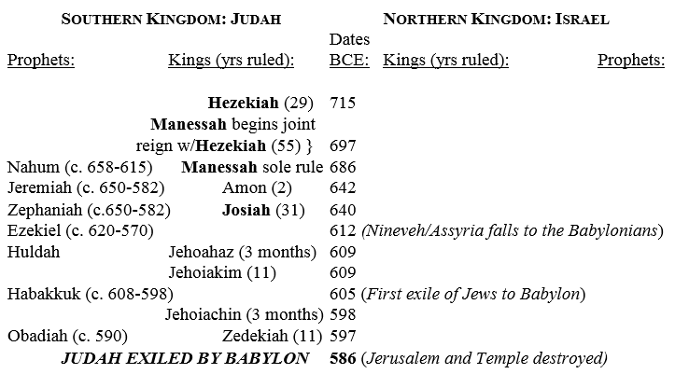
The Divided Kingdom
Note: Bold indicates a king described as “good” in God’s eyes.

Slide 115
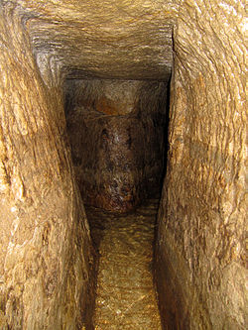
Southern Kingdom: Judah
Siege of Jerusalem, 701 BCE
As the two superpowers of Assyria and Egypt fought, King Hezekiah initiated religious reform in Judah. He aligned Judah with Egypt, and then refused to pay tribute to Assyria. Hezekiah made preparations for a siege by blocking the water springs outside of Jerusalem and digging a 1,750 foot tunnel to the Spring of Gihon
to provide Jerusalem with fresh water. He
also fortified the city and called on the
people to pray to Yehweh.

Slide 116
Southern Kingdom: Judah
Sennacherib attacked Judah, conquering some cities and laying siege to Jerusalem.
The siege is told in the books of 2 Chronicles, 2 Kings and Isaiah (who was the active prophet at the time).
Further, 2 Kings 18 says that Hezekiah paid a tribute in exchange for Assyrian withdrawal. He paid three hundred talents of silver and thirty talents of gold to Assyria, so vast that he was forced to empty the temple and royal treasury of silver and strip the gold from the doorposts of Solomon’s temple. Nevertheless, Sennacherib marched on Jerusalem with a large army.

Slide 117
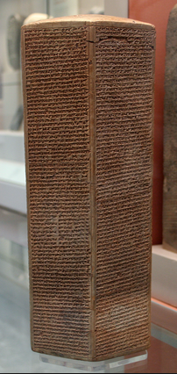
Southern Kingdom: Judah
According to the biblical account, God came to the rescue of Jerusalem. 180,000 Assyrian soldiers mysteriously died. (Some scholars suggest an outbreak of disease, such as cholera, due to the lack of
good water supply.)
Sennacherib’s prism, discovered in
Nineveh 1830, tells of Sennacherib’s conquest
of Judah. It brags that he conquered many
Judean towns and besieged Jerusalem, locking
up King Hezekiah “like a caged bird.” It then
says that Judah paid a huge tribute. Notice,
however, that it did NOT say that they were
able to conquer Jerusalem!

Slide 118
Southern Kingdom: Judah
Jerusalem, and Judah, was spared, because of the faithfulness of Hezekah and the people.
Judah was able to survive longer than Israel, according to the Bible, because Judah (unlike Israel) had periods of reform back to true worship, and had some godly kings.
For example, 2 Kings 23:10 says, “Josiah sent some men to Hinnom Valley just outside Jerusalem with orders to make the altar there unfit for worship. That way, people could no longer use it for sacrificing their children to the god Molech.”
Even so, the people and kings adopted more and more pagan worship. This led, the prophets say, to Jerusalem also being destroyed.

Slide 119
Southern Kingdom: Judah
Ezekiel 23:37 “For they have committed adultery, and blood is on their hands. Thus they have committed adultery with their idols and even caused their sons, whom they bore to Me, to pass through the fire to them as food.”
Jeremiah 17:1-2 “Judah’s sin is engraved ... on the tablets of their hearts ... Even their children remember their altars and Asherah poles beside the spreading trees and on the high hills.”

Slide 120
Southern Kingdom: Judah
Jeremiah 32:35 “And they led Judah into sin by building places to worship Baal in Hinnom Valley, where they also sacrificed their sons and daughters to the god Molech. I have never even thought of telling them to commit such disgusting sins.”
2 Chronicles 28:1-4 “¹ Ahaz was twenty years old when he became king of Judah, and he ruled from Jerusalem for sixteen years. Ahaz was nothing like his ancestor David. Ahaz disobeyed the Lord ² and was as sinful as the kings of Israel. He made idols of the god Ba’al, ³ and he offered sacrifices in Hinnom Valley. Worst of all, Ahaz sacrificed his own sons, which was a disgusting custom of the nations that the Lord had forced out of Israel. ⁴ Ahaz offered sacrifices at the local shrines, as well as on every hill and in the shade of large trees.”

Slide 121
Southern Kingdom: Judah
2 Kings 21:6 “[King] Manasseh sacrificed his own son in the fire, practiced divination, sought omens, and consulted mediums and spiritists. He did much evil in the eyes of the LORD, arousing his anger.”
2 Chronicles 33:3 “[King Manasseh of Judah] rebuilt the local shrines that his father Hezekiah had torn down. He built altars for the god Ba’al and set up sacred poles for worshiping the goddess Asherah. And he faithfully worshiped the stars in the sky.”

Slide 122
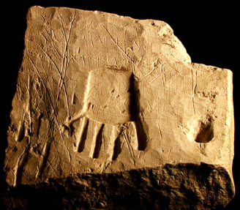
Southern Kingdom: Judah
In 1968, a stone inscription of the 8th century BCE was discovered in a cemetery west of Hebron, at the site of Khirbet el Qí´m. It gives the name of the deceased, and it says “blessed may he be by Yahweh and his Asherah.” Asherah is the name of the old Canaanite Mother Goddess, the consort of El or Ba’al. So it seems that for some, at least, the two were believed to be a pair! The Bible even mentions in 2 Kings 23, which
describes the reforms of King Josiah
in the late 7th century, the purging
the Temple of all the cult
paraphernalia of Asherah. So this
pagan religion even penetrated the
Temple in Jerusalem.

Slide 123
Southern Kingdom: Judah
In 1978, Israeli archaeologists excavating at an 8th century BCE site in the eastern Sinai desert found several Hebrew (?!?!) inscriptions mentioning Ba’al and El (in the form of “Elohim”). Evidently Hebrew people were still worshipping Ba’al and El in the 8th century!
So, the struggle continued with the ancient Canaanite religion!

Slide 124
Southern Kingdom: Judah
The Jew’s official rejection of the Ba’al cult probably explains the change of certain names that incorporated the name “Baal.” Esh-baal was changed to Ish-bosheth, Jerubbaal (a name of Gideon) was changed to Jerubbesheth, and Merib-baal was changed to Mephibosheth.
The link can be again seen in the name Beelzebub (one of Satan’s name), as a form of the Canaanite “Baal-zebub.” 1 Kings 11:4 8 and 2 Kings 1.
Ba’al is cognated in other Semitic languages there as “Bal” and “Bel.” This gives an interesting insight into the persons of Jeze-bel, Hasdru-bal, and Hanni-bal!

Slide 125
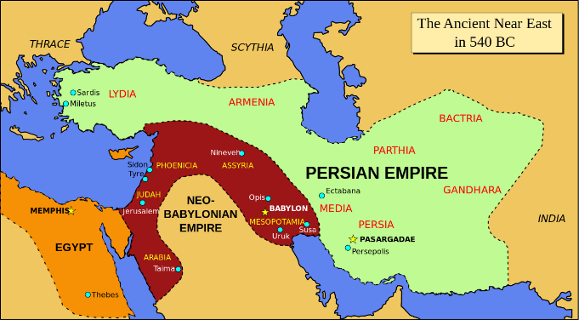
Southern Kingdom: Judah
Clash of Titans!
Assyria had been fighting with Egypt for dominance in the Middle East. Suddenly, almost out of nowhere, a more powerful adversary arose from Assyria’s homeland: Babylon! Under strong kings, most famously Nebuchadnezzar II, the Babylonian empire (called now Neo-Babylon empire) suddenly overtook the Middle East.

Slide 126
Southern Kingdom: Judah
The Fall of Jerusalem and the Destruction of the Temple
In 612 BCE, Babylon conquered and utterly destroyed the Assyrian capital of Ninevah. This brought the 600-year old empire to an end. (Ninevah was abandoned and its ruins weren’t discovered until the 1800s! Present day Mosul of Iraq.)
In 581 Babylon conquered Judah and destroyed Jerusalem. They plundered the Temple and destroyed it. (Interestingly, in the Babylonian records, the Ark of the Covenant was NOT listed among the report of plunder taken from the temple.)

Slide 127
Southern Kingdom: Judah
The Fall of Jerusalem and the Destruction of the Temple
There is little archeological evidence for the destruction of the Temple in Jerusalem in 586 B.C.E. because archeologists have not been able to excavate large areas in Jerusalem. The late Israeli archeologist Yigal Shiloh did find a huge accumulation of debris on the east side of the Temple Mount, cascaded down the hill. This seems to show some evidence. Yet the Temple Mount has never been excavated and never
will be.
This image is ruins of a
house in Jerusalem’s City of David,
dated to 586 BCE, destroyed in the
Babylonian invasion.

Slide 128
Southern Kingdom: Judah
The Exile
The Babylonians, like the Assyrians, removed the leaders and educated people from the Judah. Unlike the Assyrians, however, they put them all in the same place. This enabled the Jews to not intermarry with other people and to remain ethnically pure.
Whereas the Assyrian conquering of Israel is best understood as an “event,” the Babylonian conquering of Judah is best understood as a “process.” The Babylonians removed leaders from Judea slowly over time, and the land of Judah continued its own identity.
“The Exile” began in 581 BCE and continued until Cyrus of Persia decreed that the Jews could return to their home land, in 538.

Slide 129
Southern Kingdom: Judah
The Jews
The term Hebrews or Israelites is used for the people of Israel until the fall of the northern kingdom of Israel.
After that, the people of the southern kingdom of Judah were simply called according to their home country of Judah, or Jews.
From the time of the return of the Babylonian Exile until the present day, the Hebrew people have been called “Jews.”
A current census numbers practicing Jews at 14 million.

Slide 130
Southern Kingdom: Judah
The Return
The Neo-Babylonian Empire did not last very long! It began by conquering Nineveh in 612 BCE, but there was a growing empire to the north, the Persian Empire. The Persian emperor Cyrus the Great conquered Babylon in 539.
One year later, Cyrus the Great decreed that the Jews could return to their home country of Judah.
Israel was governed by the Persians from 539 until Alexander the Great (Greek) defeated Persia in 331.

Slide 132
Southern Kingdom: Judah
Cyrus the Great of Persia decreed that the Jews could return to Judah in 538 BCE.
Again, the return happened slowly, over time, with many Jews remaining elsewhere for a time.
Darius of Persia allowed Zerubbabel, the governor of Judah, to rebuild the temple in Jerusalem in 516. He was given the temple vessels that the Babylonians had taken.
Note: Some call this the “second” temple of Jerusalem. It was similar to Solomon’s temple, but less extravagantly decorated.
Ezra the priest returns to Judah to reinstate worship according to Jewish traditions in 457.
Nehemiah returns to Jerusalem and rebuilds the walls from 444-432.

Slide 133
Timeline of the Middle East

Slide 134
Timeline of the Middle East

Slide 135
Capitals of Israel
United Kingdom under Saul: Gibeah, 10 miles NE of Bethlehem
Northern Kingdom Israel under Ish-Bosheth: Mahanaim, east of Jordan River
Southern Kingdom Judah under David: Hebron: 6 miles south of Bethlehem
United Kingdom Israel under David: Jerusalem (established in 1000 BCE)
Northern Kingdom Israel under Jeroboam’s successors: First Shechem (1 Kings 12:25), then Tirzah (1 Kings 14:17). King Omri built his capital in Samaria (1 Kings 16:24), and it continued there until Israel was conquered by the Assyrians (2 Kings 17:5).
Southern Kingdom Judah under Solomon’s successors: Jerusalem

Slide 136
Map of Israel with Important Locations

Slide 137
Map of Israel with Important Locations

Slide 138
Map of Israel with Important Locations

Slide 139
Map of Israel with Important Locations

Slide 140
Map of Israel with Important Locations

Slide 141
Rise of the Persian Empire
The rising Persian Empire, under Cyrus the Great, conquered Babylon’s brief, 73-year reprisal in 539 BCE. The Persian Empire was the largest empire of the Middle East.

Slide 142
Inter-Testamental Period
The Old Testament story closes with the Jews returning to Judah, which is ruled by Persia. The Temple had been rededicated in 516 BCE, and Ezra reinstates regular worship there in 457. Nehemiah rebuilt the walls of Jerusalem, finishing about 432 BCE.
The story of the Jews continues with the Apocrypha, books written during this time. Most important for the history of the area are 1 and 2 Maccabees. It picks up the story during the time of the Greek Seleucids. During that 100 years, Alexander the Great changes the map!

Slide 143
Rise of the Greek Empire
In 331, Alexander the Great of Greece defeated the Persians, creating his own empire! He brought the western Greek culture throughout the Middle East and Egypt.

Slide 144
The Ptolemaic Empire
Alexander the Great dies suddenly in 323 at the age of 33, and his empire was divided among his generals. Egypt, the Sinai, and Israel was given to Ptolemy I Soter. This Ptolemaic Empire continued until the death of Cleopatra VII (the lover of Roman’s Mark Antony) in 30. The Seleucid and Ptolemaic empires fought several wars, and by 180 the Ptolemy’s were forced to cede Palestine to the Seleucids, who, like the Ptolemy’s before them, held light control over Judea, respected Jewish culture and protected Jewish institutions.

Slide 145
The Divided Greek Empire

Slide 146
The Seleucid Empire
Alexander’s friend Seleucus Nicator (ruled 312–280 BCE) became king and ruled the eastern provinces (from what is today eastern Turkey, Lebanon, Syria, Iraq, Iran and Afghanistan). The huge kingdom had two capitals, which Seleucus founded around 300: Antioch in Syria and Seleucia in Mesopotamia (Iraq). Over the next two centuries the Seleucid Empire declined in size to greater Syria and was finally conquered by the Roman Republic when Pompey entered Antioch in 64.

Slide 147
Antiochus IV
Then, in 175 BCE, the Seleucid emperor Antiochus IV drastically changed the policies in Judea. He deposed the High Priest and appointed a new one who would follow his mandates. He outlawed the Jewish religion and demanded that the Jews follow the Greek god Zeus. He made it punishable by death to practice circumcision, follow kosher food laws, or keep the Sabbath. This caused great upheaval in Judea.

Slide 148
The Books of Maccabees
According to the Books of Maccabees, while Antiochus was busy fighting in Egypt, a rumor spread that he had been killed. In Judea, the deposed High Priest Jason gathered a force of 1,000 soldiers and made a surprise attack on the city of Jerusalem. Menelaus, the High Priest appointed by Antiochus, was forced to flee Jerusalem during a riot. King Antiochus returned from Egypt in 167 BCE, sacked Jerusalem and restored Menelaus. 40,000 Jews were killed, and 40,000 more sold into slavery. Antiochus established a military Greek citadel called the Acra.

Slide 149
Jewish Hanukkah
Most egregious, however, was Antiochus’ defilement of the Temple. As a display of disrespect and subversion, Antiochus sacrificed a pig to the Greek God Zeus on the High Altar in the temple of Jerusalem!
This triggered a full-fledged revolt by the Jewish people. The Maccabee family, led by Judas (or Judah) “The Hammer” waged successful guerilla warfare against the Greek Seleucids authorities They recaptured Jerusalem and the temple and made Jonathan Maccabee the high priest. The Maccabees eventually drove the Seleucids out of Palestine, and Antiochus died in 164 BCE.

Slide 150
Hanukkah
The festival of Hanukkah celebrates the temple’s re-consecration after its defilement by Antiochus IV. Jonathan Maccabee began re-consecrating the temple, but there was only enough undefiled oil for one day. Because of the fighting, the arrival of new holy oil was delayed for eight days. Miraculously, the oil on hand kept
burning for eight days until the new
shipment arrived, and the temple was
restored to its purity.

Slide 151
The Hasmonean Dynasty
With the death of Antiochus IV, the Seleucid Empire began to fracture. The successor was unable to mount sufficient forces to quell the revolt in Judah. Starting in 160 BCE, the Seleucids allowed Judea to be ruled semi-autonomously by descendants of the Maccabean family (which came to be known as The Hasmonean Dynasty). Over time, as the Seleucid Empire crumbled, Judea was allowed full independence.

Slide 152
The Roman Empire
Rome was rising as an empire, conquering Greece in 146 BCE. In 64 Pompey conquered the Seleucid Kingdom. He also traveled south and conquered Judah in 63. Then, in 60, Pompey, Marcus Crassus, and Julius Caesar formed the First Roman Triumvirate and expanded Rome’s boarders by military campaigns. In 43 Antony, Octavian (later Augustus), and Lepidus formed the second Triumvirate. The Roman Republic made Judea a client kingdom, and in 40 BCE elected Herod “The Great” as King of the Jews. Herod, although hated by the Jews, set about a massive building campaign, particularly rebuilding the Temple in Jerusalem. Octavian defeated Mark Antony and Cleopatra in 31, making Rome ruler of Egypt. In 27 Octavian founded the Roman Empire, becoming Caesar Augustus, the first Roman Emperor. Augustus was the emperor and Herod the king when Jesus is born in 4 BCE.

Slide 153
The Roman Empire at Jesus’ Birth

Slide 154
Timeline of the Middle East

Slide 155
Who’s in Charge? (Who had ruled the Israelites?)
2000 BCE Abraham called to go to Canaan
1800 - 1380 Israelites in Egypt
1380-1050 Israelites in Canaan, governed by Judges, Ruled by Egypt
1050 - 722 Israel and the divided kingdoms self-rule
722 Northern kingdom Israel conquered by Assyrian Empire. National identity lost.
722 - 586 Southern kingdom Judah self-rule
586 - 539 Southern kingdom Judah ruled by Babylon Empire
539 - 331 Southern kingdom Judah ruled by Persian Empire
331 - 312 Southern kingdom Judah ruled by Greek Empire
312 - 180 Southern kingdom Judah ruled by Ptolemaic Empire
180 - 160 Southern kingdom Judah ruled by Seleucid Empire
160 - 63 Southern kingdom Judah self-rule under Hasmonean Dynasty
63 BCE - AD 70 Southern kingdom Judah ruled by Roman Empire

Slide 156
Questions, Observations, Thoughts, Insights

Slide 157
Closing Blessing (Responsively)
Psalm 125 A song of worship.
¹ Everyone who trusts the Lord is like Mount Zion
that cannot be shaken and will stand forever.
² Just as Jerusalem is protected by mountains on every side,
the Lord protects his people by holding them in his arms now and forever.
³ He won’t let the wicked rule His people or lead them to do wrong.
⁴ Let’s ask the Lord to be kind to everyone who is good and completely obeys Him.
⁵ When the Lord punishes the wicked, He will punish everyone else who lives a crooked life.
Pray for peace in Israel!

Slide 158
Next sessions!
Nov. 6 - NT: Israel during the Life of Jesus
Dec. 4 - NT: From Jesus to Constantine: The Early Church
Jan. 8 - From Constantine through WWII
Feb. 12 - Since WWII

