Slide 1

Mark 12:13-17 (CEB)
¹³ [The Jewish leaders] sent some of the Pharisees and Herodians to Jesus to catch Him in His words. ¹⁴ They came to Him and said, “Teacher, we know that you are a man of integrity. You aren’t swayed by others, because you pay no attention to who they are;
but you teach the way of God in
accordance with the truth. Is it right to
pay the imperial tax to Caesar or not?
¹⁵ Should we pay or shouldn’t we?”

Slide 2
Mark 12:13-17 (CEB)
¹⁵ But Jesus knew their hypocrisy. “Why are you trying to trap me?” He asked. “Bring me a denarius and let me look at it.” ¹⁶ They brought the coin, and He asked them, “Whose image is this? And whose inscription?”
“Caesar’s,” they replied.
¹⁷ Then Jesus said to them, “Give back to Caesar what is Caesar’s and to God what is God’s.” And they were amazed at him.

Slide 3
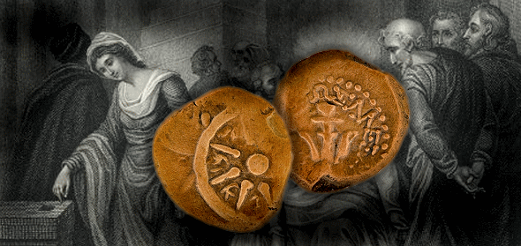


Slide 4
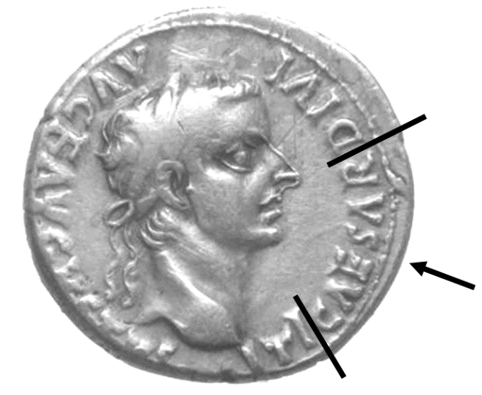

Slide 5
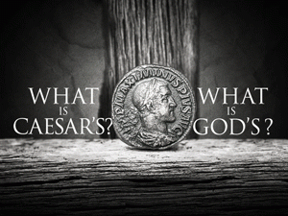

Slide 6
Genesis 1:26-28 (NIV)
“Then God said, “Let us make mankind in our image, in our likeness ... So God created mankind in his own image, in the image of God he created them; male and female he created them. God blessed them ....”

Slide 7
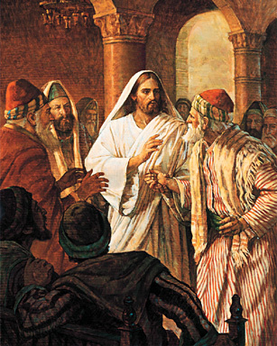

Slide 8


Slide 9

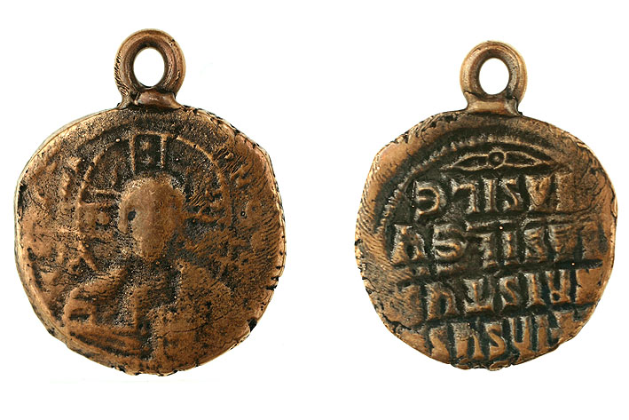
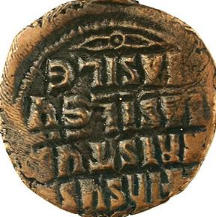

Slide 10

➔ Michael Stanley Karan
Baptism: June 22, 2003 at Grace UMC, Mpls
Confirmation Mentor: Bob Rosenbaum
Favorite Bible Verse: Romans 12:2
  “Do not conform to the pattern of this world, but be transformed by the renewing of your mind. Then you will be able to test and approve what God’s will is - His good, pleasing and perfect will.”
Favorite Christian Song: Joy to the World

Slide 11

➔ Erik Robert Kargel
Baptism: Oct. 20, 2012, Gulf Islands Nat’l Seashore, FL.
Confirmation Mentor: Chuck Yetter
Favorite Bible Verse: Luke 23:39-43
  Then [the criminal] said, “Jesus, remember me when you come into your kingdom.”
  Jesus answered him, “Truly I tell you, today you will be with me in paradise.”
Favorite Christian Song: 10,000 Reasons or
I Got Jesus

Slide 12
➔ Armando Joseph Lorenzi
Baptism: Dec. 1, 2002 at FHUMC
Confirmation Mentor: Louis James
Favorite Bible Verse: Matthew 6:34
  “Do not worry about tomorrow, for tomorrow will worry about itself. Each day has enough trouble of it’s own.”
Favorite Christian Song: Here I am to Worship

Slide 13

➔ Nathan David Werner
Baptism: December 29, 2002 Atwater UMC, Atwater, MN
Confirmation Mentor: Rev. Dan Hair
Favorite Bible Verse: John 14:2-4
  [Jesus said,] “My Father’s house has many rooms; if that were not so, would I have told you that I am going there to prepare a place for you? And if I go and prepare a place for you, I will come back and take you to be with me that you also may be where I am.”
Favorite Christian Song: God’s Not Dead by the Newsboys

Slide 14

The Apostle’s Creed
as understood by Erik Kargel
I believe in the Lord who created us and the universe itself.
I believe in Jesus Christ, who is our Lord and Savior. He was born when the Holy Spirit came to the virgin Mary and gave her a child with God’s awesome power. He was later arrested, nailed to a tree, and killed under Pontius Pilate. He was then buried in a stone tomb. He first descended into hell, and on the third day after his death, He rose and

Slide 15
ascended into Heaven. He now sits at the awesome, great, and powerful God, where at the end of time, Jesus will decide who will live and who will die.
I believe in the Holy Spirt who gave Mary a baby, the places all over the world where Christianity exists, the gathering after death of those who believe and trust that God is real, the power to be forgiven of any bad thing you may do. I believe the resurrection of our bodies after death, and that anyone can go to heaven and become immortal if they chose to follow God. Amen.

Slide 16

& Prayer

Slide 17
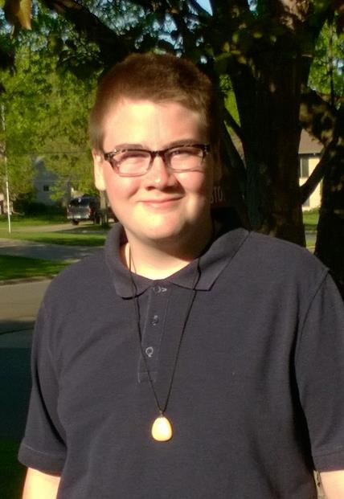


Slide 18
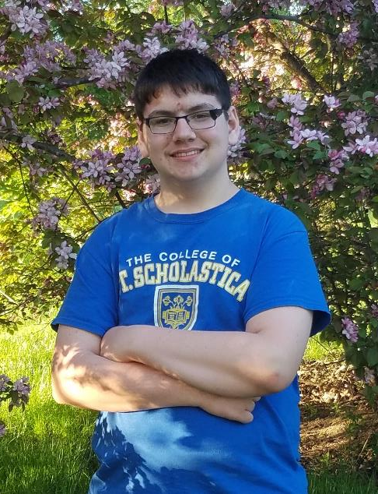


Slide 19
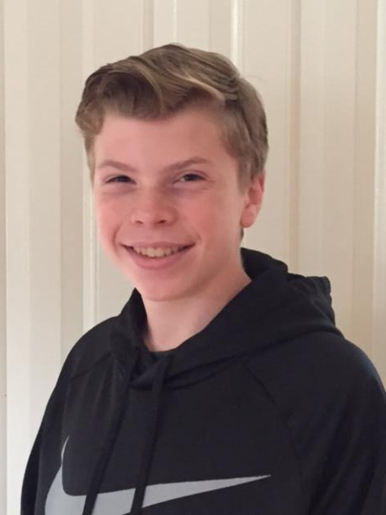


Slide 20
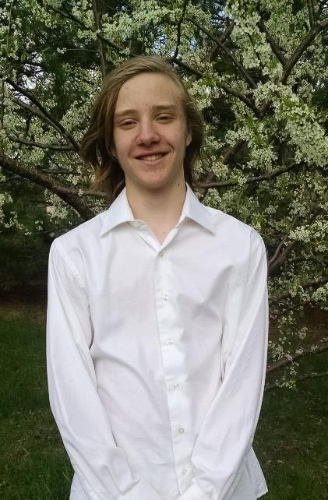


Slide 21

Presentation of the Confirmation Bibles
by the United Methodist Women

Slide 22
Confirmation Verse: Ephesians 4:23-24
“Let the Spirit renew your mind and make you into a new person, for you were created in God’s image in true righteousness and holiness.”

